Slide 1

Smart Library Management System Using PEGA
Bapatla Engineering College Department of Information Technology
Project Review
on
Under The Esteemed Guidance of
Sk.Shareen
Presented By,
Batch – A8.
N.Noble Sujani(Y22AIT486)
M.Aswitha(Y22AIT477)
M.Rajeswari(Y22AIT479)
K.Harsha(L23AIT538)
E.Jashuva(L23AIT534)

Slide 2
Contents
Abstract
Problem Statement
Literature Review
Domain Knowledge
Architecture and Methodology
Implementation
Result
Conclusion
Future Scope

Slide 3
Abstract
The Smart Library Management System using Pega is an advanced low-code application designed to automate and optimize the daily operations of a library. Traditional library systems rely heavily on manual processes, which are time-consuming, error-prone, and inefficient.
This system leverages Pega’s powerful case management and workflow automation capabilities to digitize core library functions such as book search, issue, return, fine calculation, and user management. Each operation is treated as a case, ensuring proper tracking, transparency, and faster processing.
The system also provides role-based access for students and administrators, ensuring secure and organized handling of library resources. By integrating business rules and automated decision-making, the system enhances operational efficiency and improves the overall user experience.

Slide 4
Problem Statement
Libraries that rely on manual or semi-automated systems face multiple challenges:
Difficulty in maintaining accurate records of books and users
Time-consuming book issue and return processes
Lack of real-time availability status of books
Errors in fine calculation and due date tracking
Limited accessibility for users
To address these issues, there is a need for an automated, intelligent, and scalable system. The proposed solution uses Pega to build a smart, workflow-driven library management system that ensures accuracy, speed, and ease of use.

Slide 5
Literature Review
Several existing systems have attempted to digitize library operations:
1. Traditional Library Management Systems
Use basic database systems for storing records
Provide limited automation features
Depend on manual intervention
Limitation: Lack of intelligent workflow and decision-making
2. Web-Based Library Systems
Allow users to search and reserve books online
Improve accessibility
Limitation: Do not provide end-to-end automation or process tracking

Slide 6
3. Automated Systems with Basic AI
Introduce recommendation systems
Enhance user experience
Limitation: Complex implementation and limited integration
Proposed System Advantage: The Pega-based system overcomes these limitations by integrating workflow automation, real-time case tracking, and business rule management into a single platform

Slide 7
Domain Knowledge
The system is built using key concepts of Pega:
Low-Code Development: Enables rapid application development with minimal coding using visual tools
Case Management: Every library activity (book issue, return, fine payment) is treated as a case with a lifecycle
Data Objects: Used to store structured information such as Book Details, Member Information, and Transactions
User Interface (UI): Built using Pega sections and portals to provide an interactive experience
Business Rules: Used for automation such as due date calculation, fine computation, and validations
Integration Capabilities: Allows future integration with external systems like digital libraries or payment gateways

Slide 8
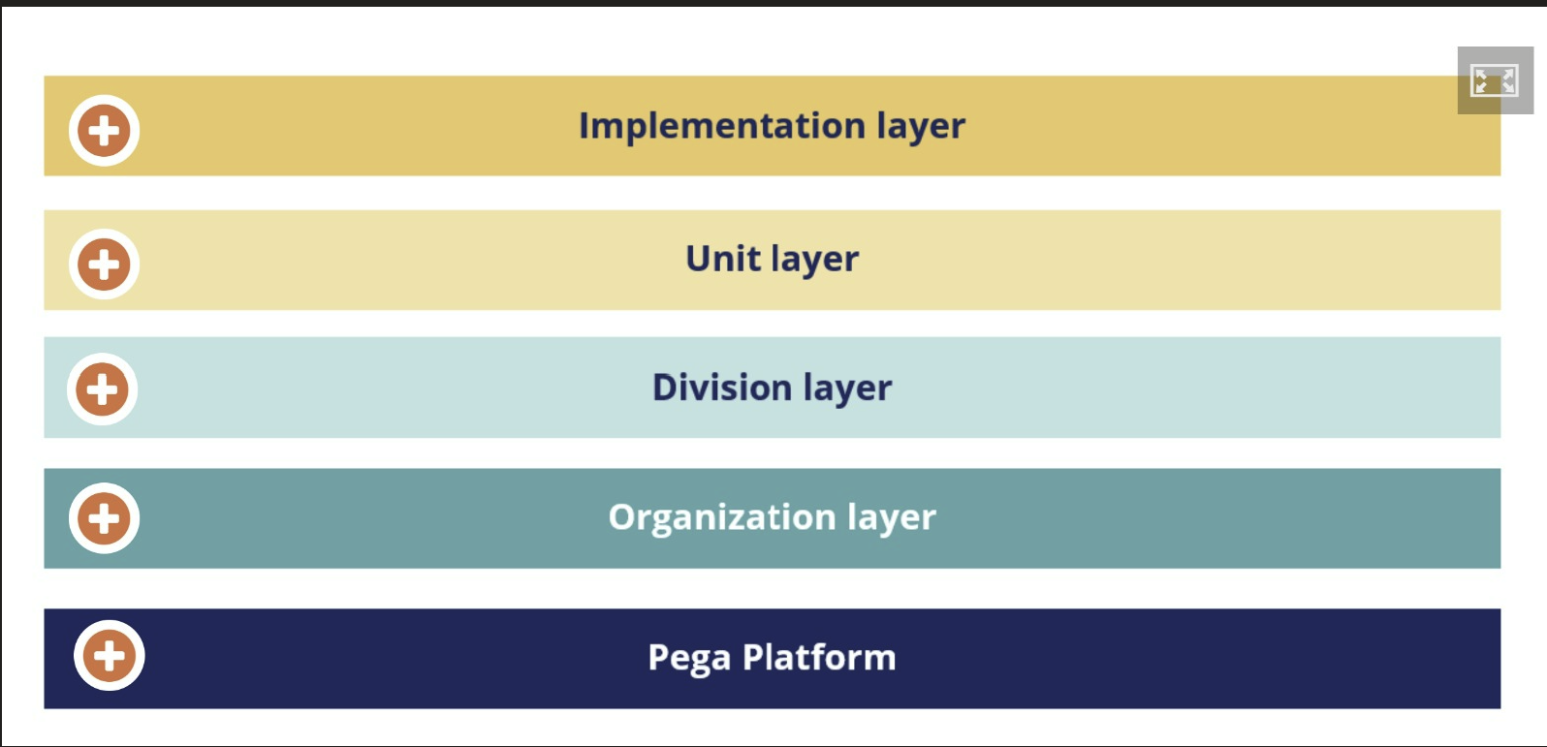
Architecture

Slide 9
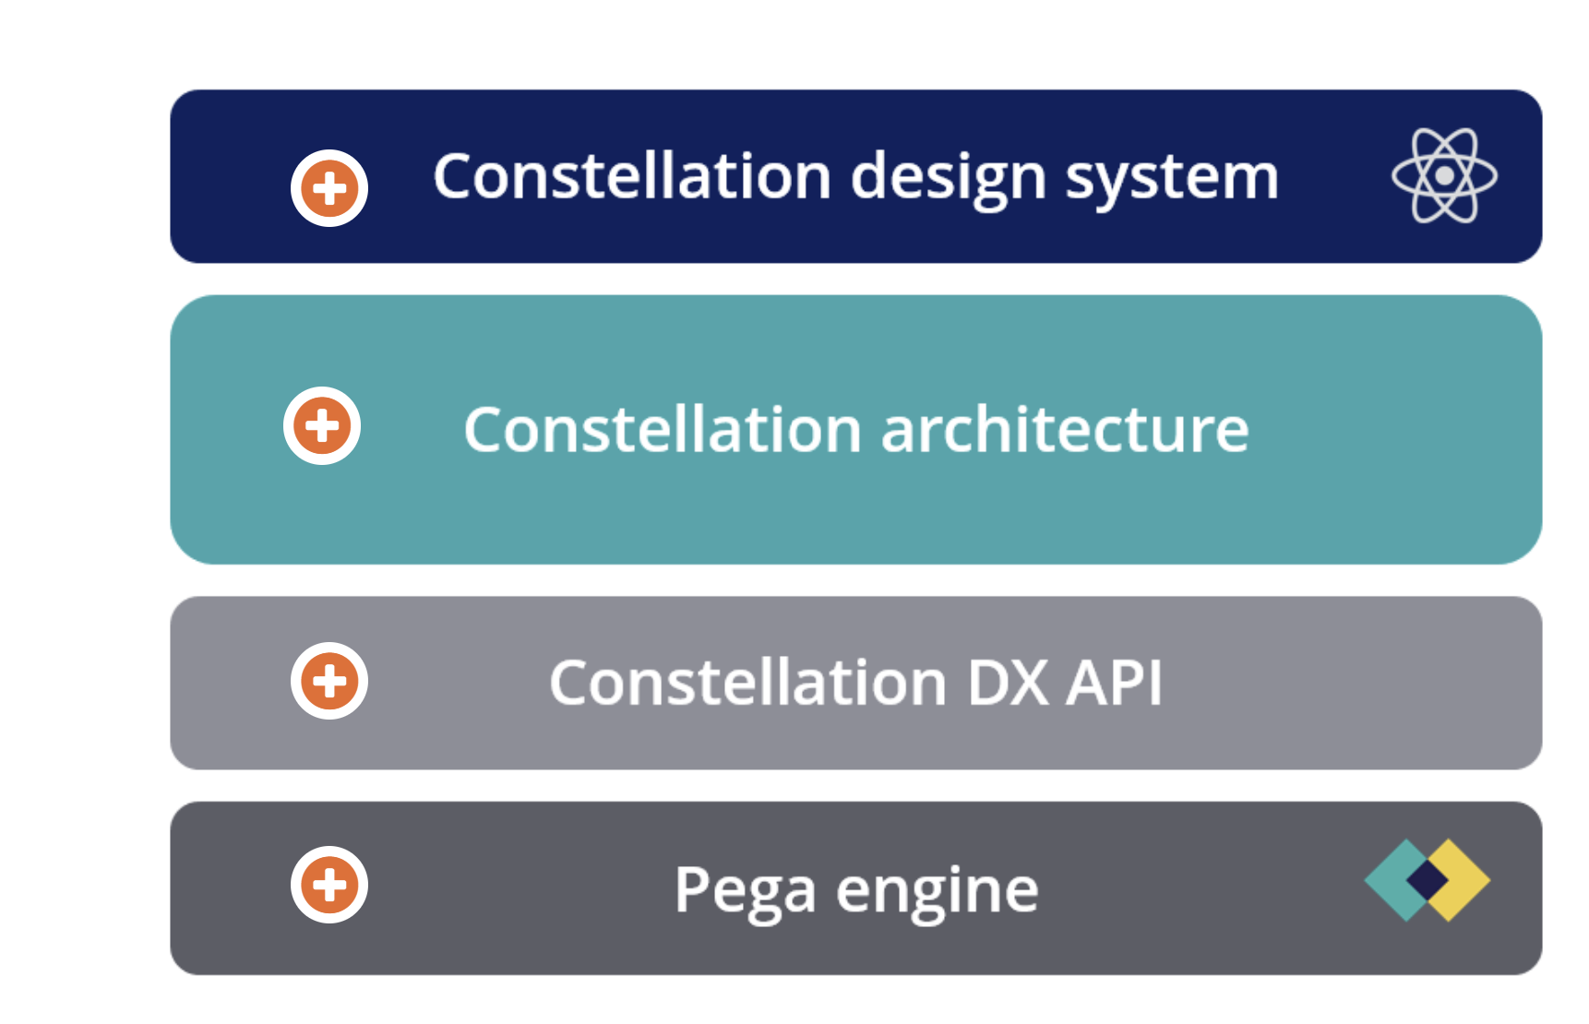

Slide 10
Methodology
The system is developed using the following steps:
Requirement Analysis: Identify features like book issue, return, and fine calculation
Case Design: Define case types such as “Book Issue Case” and “Book Return Case”
Data Modeling: Create data objects for storing library information
Workflow Design: Design stages such as Request, Approval, Processing, and Completion
UI Design: Develop user-friendly forms and dashboards
Rule Implementation: Configure business rules for automation
Testing: Perform unit and system testing
Deployment: Deploy application for users

Slide 11
System Requirements
1. Hardware Requirements
Processor: Intel i3 / i5 or higher
RAM: Minimum 4 GB (8 GB recommended for smooth Pega performance)
Storage: Minimum 256 GB SSD
Network: Stable internet connection
Input Devices: Keyboard and Mouse
2.Software Requirements
Pega-Specific Requirements
Pega App Studio: For building application
Pega Dev Studio: For advanced configuration
Case Designer: To design workflows
Data Designer: To manage data objects
UI Designer: For creating user interface

Slide 12
Implementation
Steps
Application developed using Pega App Studio (Low-Code Platform)
Created Case Types: Book Issue Case
Book Return Case
Designed Workflows (Stages & Steps):
Request → Validation → Approval → Completion
Developed Data Objects: Book Details
Member Details
Transaction Records
Built User Interface: Admin Portal (manage books/users)
User Portal (search, issue, return books)
Implemented Business Rules: Book availability check
Due date & fine calculation
Performed Testing: Unit Testing
System Testing
Deployed on Pega Server (Tomcat) for real-time access

Slide 13
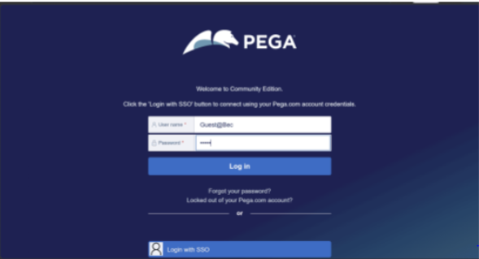
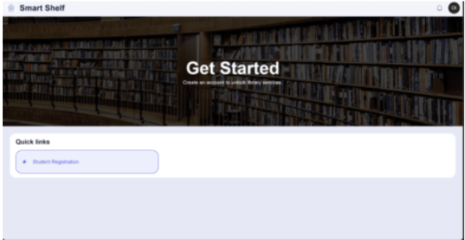
Result

Slide 14
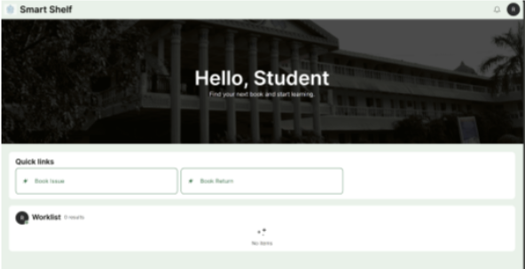
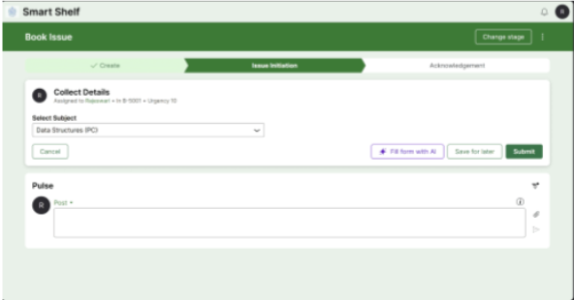

Slide 15
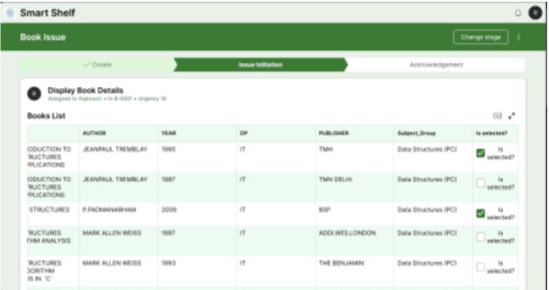
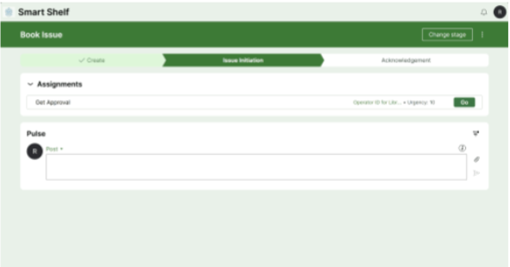

Slide 16
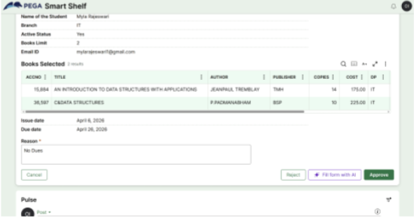
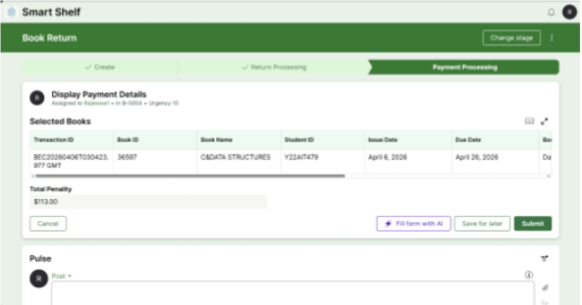

Slide 17
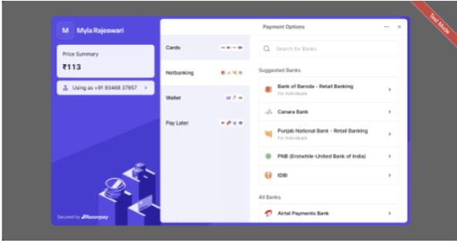
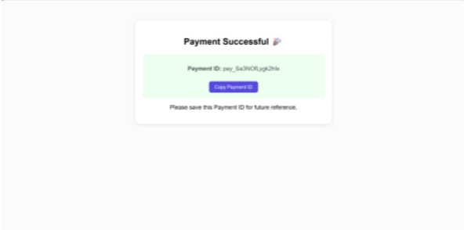

Slide 18
Conclusion
The Smart Library Management System using Pega successfully automates library operations and eliminates inefficiencies present in traditional systems.
By leveraging Pega’s low-code platform and case management capabilities, the system ensures better performance, scalability, and maintainability. It provides a reliable and user-friendly solution for modern libraries.

Slide 19
Future Scope
The system can be further enhanced by:
Developing a mobile application for remote access
Integrating barcode/QR code scanning for faster processing
Adding AI-based book recommendation systems
Implementing online payment gateways
Generating advanced analytics and reports

Slide 20
ANY QUERIES..?

Slide 21
THANK YOU

