Slide 1

Predicting STEM SALARIES
Noboru Hayashi, May 2022

Slide 2
Agenda
1. ASK – Motivation & Goal
2. GET - ETL
3. EXPLORE - EDA
4. MODEL – Model Building
5. REPORT – Result & Prediction
ASK
GET
EXPLORE
MODEL
REPORT
Data Science Process

Slide 3

1. ASK – Motivation & Goal
Personal curiosity about the salary of STEM workers from companies such as FAANG, as a Data Science major student
Want to know more about the factors that possibly bring higher pay
Knowledge of the market could help STEM specialists to understand his/her market value for making better career decisions
Study Design: a linear regression model to predict salaries

Slide 4
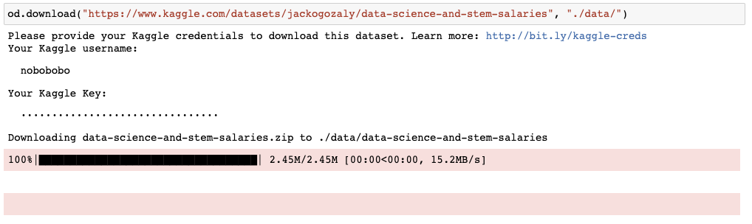
2. GET – ETL
Data source: Data Science and STEM Salaries, Kaggle 2021
Contains 62,000+ STEM salary records from scraped from levels.fyi, a website provides compensation package information of top companies
The source file is in .csv format, can be systematically downloaded by using Kaggle API (Personal Kaggle credentials are required)
The notebook file get_data.ipynb contains the codes to download the csv file.
Once the csv file is download to local, it can be read as Pandas dataframe to facilitate analysis

Slide 5
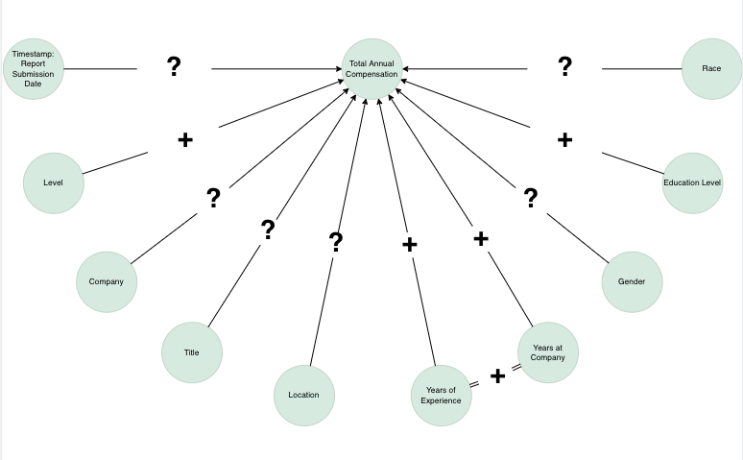
3. EXPLORE - EDA
Most features are categorical features
Low-cardinality features, such as Gender, Race, Education level, are one-hot encoded. While high-cardinality ones are not
Numerical features are Timestamp, Years of Experience, Years at Company
Relationship examples:
Compensation vs. Years of Experience
Compensation from Common Companies vs. Uncommon Companies
Compensation in Common Locations vs. Uncommon Locations

Slide 6
3. EXPLORE – EDA (Cont’d)
Before EDA, the source file contains 62642 records with 29 columns
Missing Values: No missing value in the target variable, Total Yearly Compensation. But 19540 records (31.19%) are missing gender value.
Outliers: Removed about 1000 records (1.5%) with outlying total compensations
High Cardinality String Fields: Some fields such as tag and other detail are text fields with high cardinality. These fields would require NLP to be used as regressors
Since the target variable is numerical and most regressors are categorical, our pairwise comparisons mainly involved multiple histograms
In EDA, created some grouping variables to group high cardinality features such as common companies vs. uncommon companies
The distributions of yearly compensations across these groups are both right skewed but the ‘peaks’ are slightly different
Based on EDA, high cardinality fields require preprocessing before one-hot encoding, or other encoding method
After EDA: 61718 rows, 60+ regressors

Slide 7
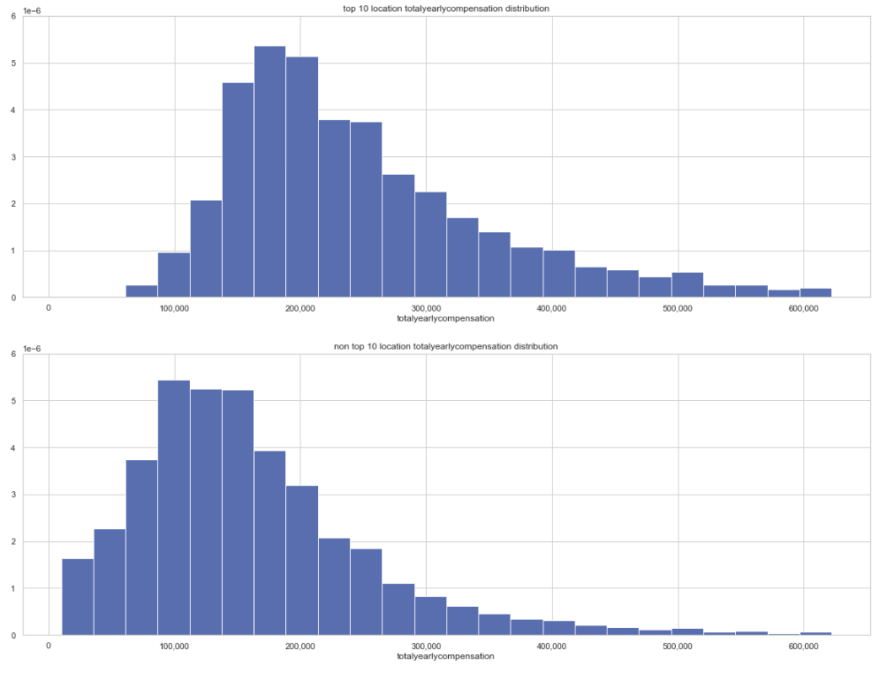
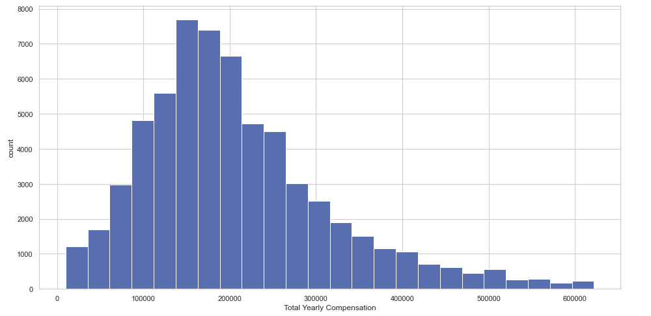
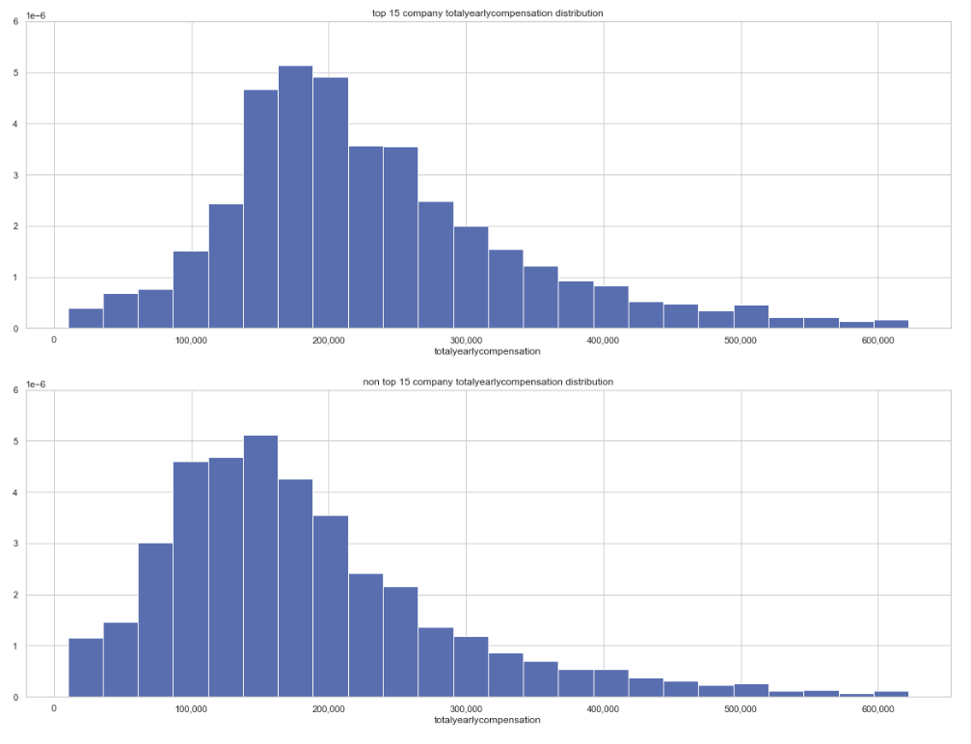
3. EXPLORE – EDA (Cont’d)
Total Year Compensation of 15 common companies vs. uncommon companies
Histogram: Total Yearly Compensation
Total Year Compensation of 10 common locations vs. uncommon locations

Slide 8
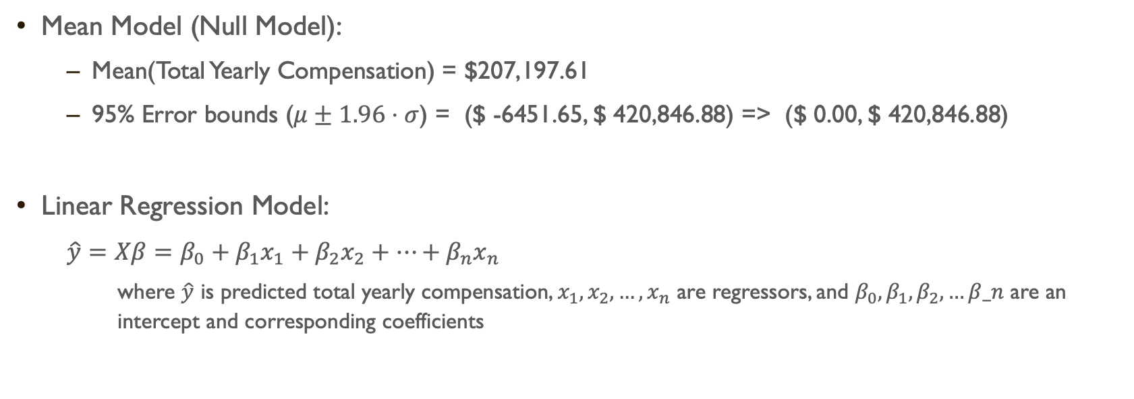
4. MODEL – Model BUILDING
Mean Model (Null Model):
Mean(Total Yearly Compensation) = $207,197.61
95% Error bounds ($μ±1.96⋅σ$) = ($ -6451.65, $ 420,846.88) => ($ 0.00, $ 420,846.88)
Linear Regression Model:
$\hat{y}=Xβ=β_{0}+β_{1}x_{1}+β_{2}x_{2}+…+β_{n}x_{n}$
where $\hat{y}$ is predicted total yearly compensation, $x_{1}, x_{2},…,x_{n}$ are regressors, and $β_{0}, β_{1},β_{2}, …β_n$ are an intercept and corresponding coefficients

Slide 9
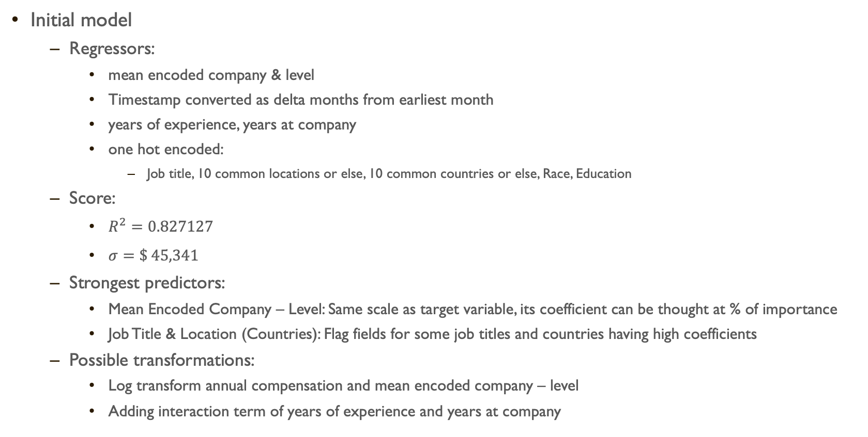
4. MODEL – Model BUILDING
Initial model
Regressors:
mean encoded company & level
Timestamp converted as delta months from earliest month
years of experience, years at company
one hot encoded:
Job title, 10 common locations or else, 10 common countries or else, Race, Education
Score:
$R^{2}=0.827127$
$σ=\$ 45,341$
Strongest predictors:
Mean Encoded Company – Level: Same scale as target variable, its coefficient can be thought at % of importance
Job Title & Location (Countries): Flag fields for some job titles and countries having high coefficients
Possible transformations:
Log transform annual compensation and mean encoded company – level
Adding interaction term of years of experience and years at company

Slide 10
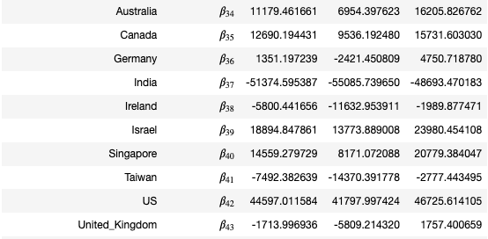
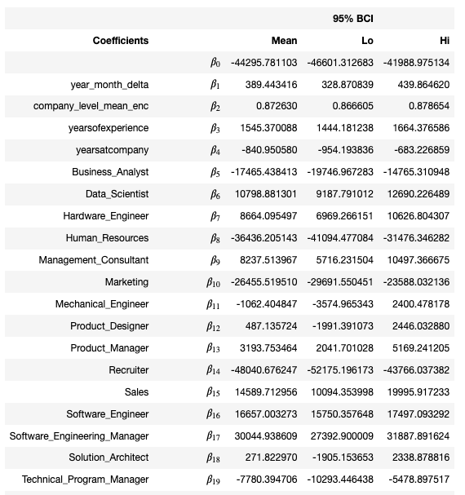
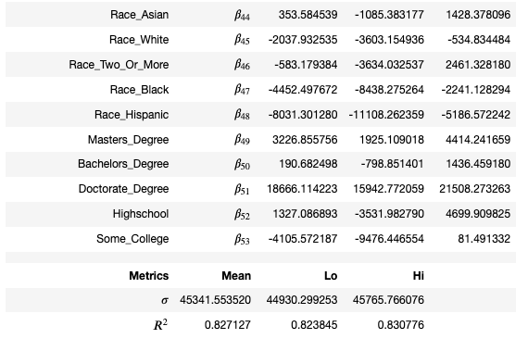
4. MODEL – Model BUILDING (CONT’D)

Slide 11
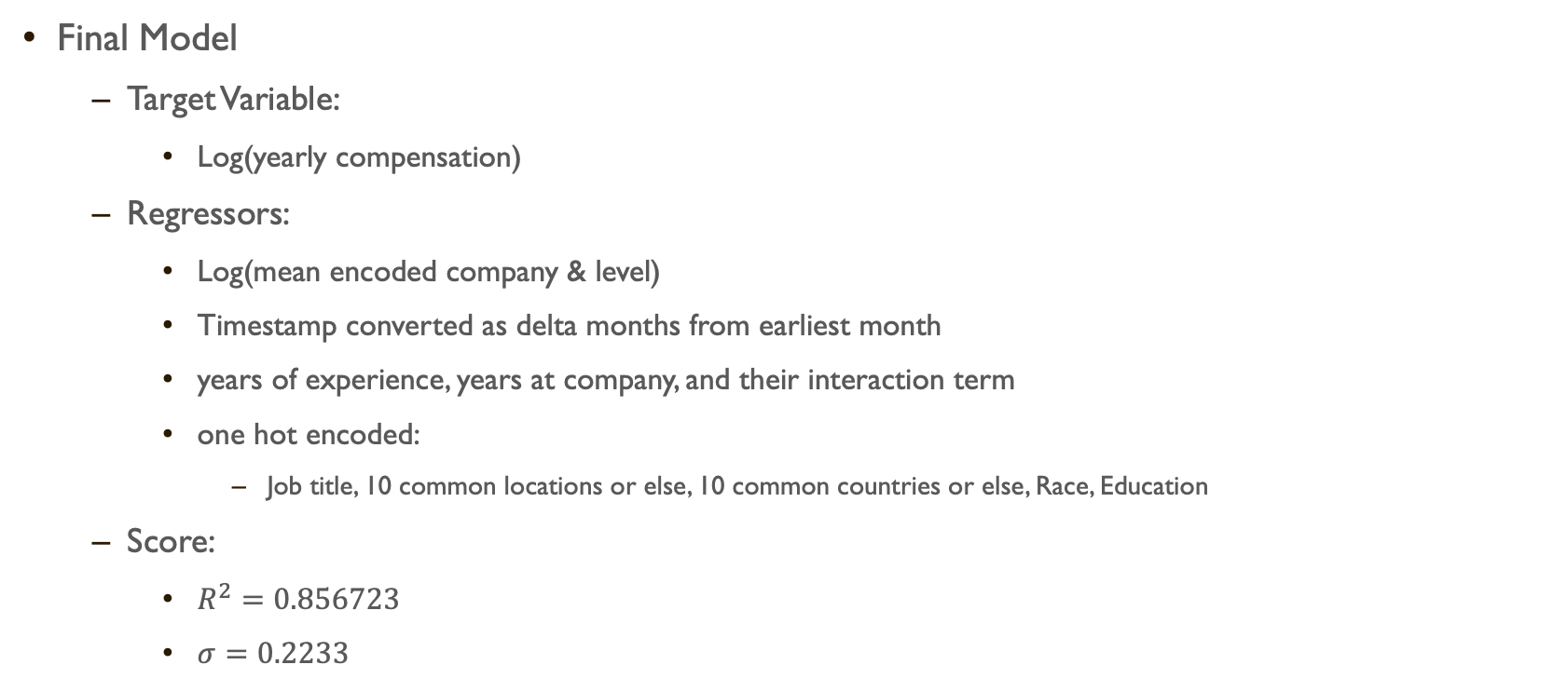
4. MODEL – Model BUILDING (CONT’D)
Final Model
Target Variable:
Log(yearly compensation)
Regressors:
Log(mean encoded company & level)
Timestamp converted as delta months from earliest month
years of experience, years at company, and their interaction term
one hot encoded:
Job title, 10 common locations or else, 10 common countries or else, Race, Education
Score:
$R^{2}=0.856723$
$σ=0.2233$

Slide 12
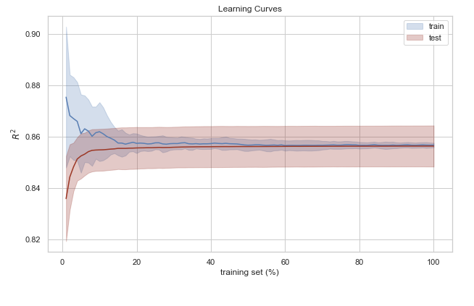
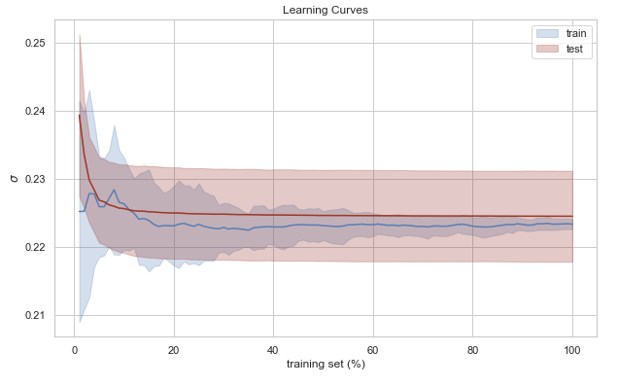
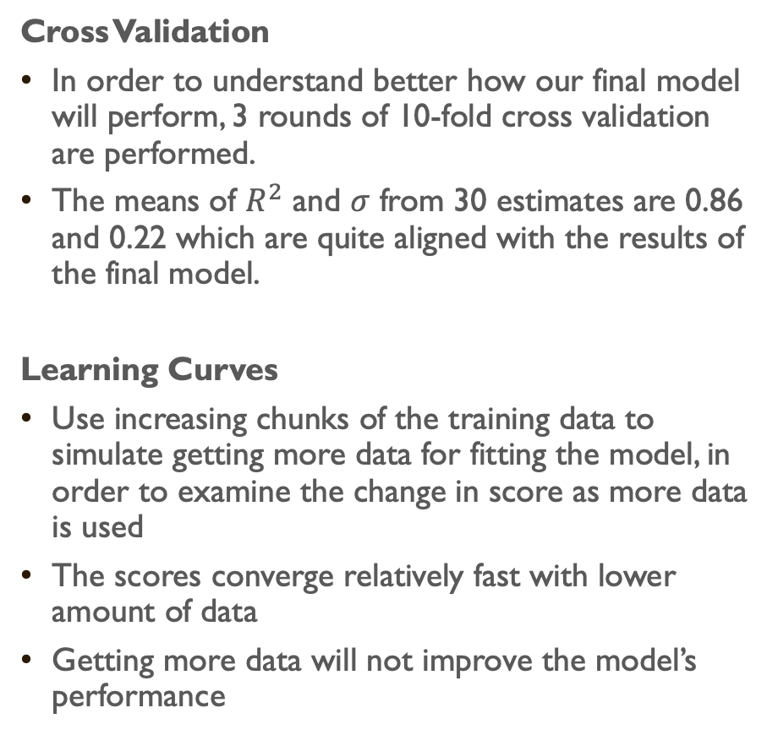
5. REPORT – Result & Prediction
Cross Validation
In order to understand better how our final model will perform, 3 rounds of 10-fold cross validation are performed.
The means of $R^{2}$ and $σ$ from 30 estimates are 0.86 and 0.22 which are quite aligned with the results of the final model.
Learning Curves
Use increasing chunks of the training data to simulate getting more data for fitting the model, in order to examine the change in score as more data is used
The scores converge relatively fast with lower amount of data
Getting more data will not improve the model’s performance

Slide 13
5. REPORT – Result & Prediction (Cont’d)
Prediction
Sample #1: a random person (data point) from the dataset
A Winston Salem, NC based White Male Human Resources person, working in Collins Aerospace as P6, graduated with MA degree, year of experience = 8, year at company = 8, the salary is submitted on April 17, 2021. His true total compensation is 164K.
Model Result:
Prediction: $ 130,933.23
95% Error bounds: $ 84,514.25 ~ $ 202,838.27.

Slide 14
5. REPORT – Result & Prediction (Cont’d)
Prediction
Sample #2: an ‘imaginary’ person with following info:
A Seattle based Asian Male Data Scientist, working in Amazon as L4, graduated with MA degree, year of experience = 1, year at company = 5, the salary is submitted on May 1st, 2022. His true total compensation for 2022 is 169K.
Model Result:
Prediction: $ 164,911.90
95% Error bounds: $ 106,449.10 ~ $ 255,482.97.

Slide 15
Thank you ☺

