Slide 1





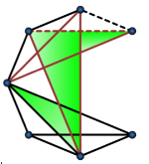
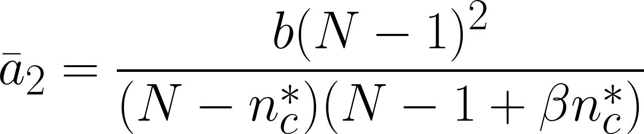

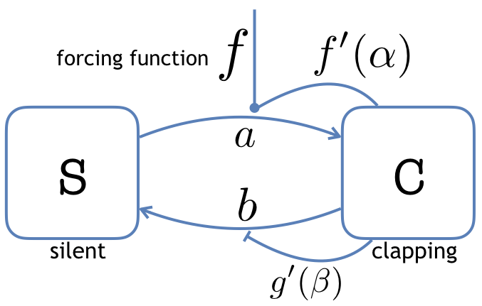
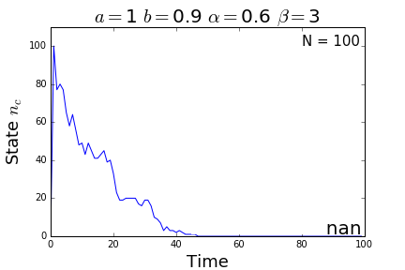
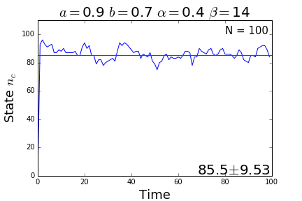
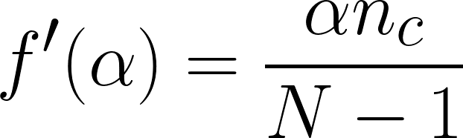

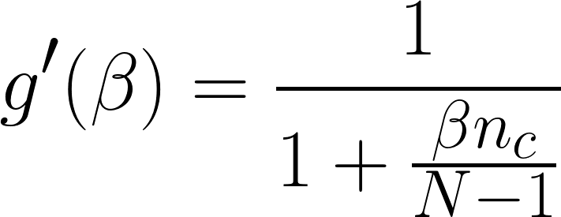

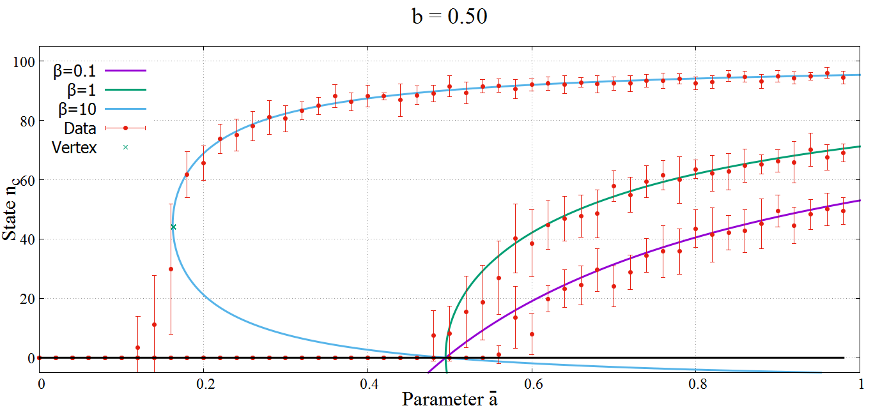
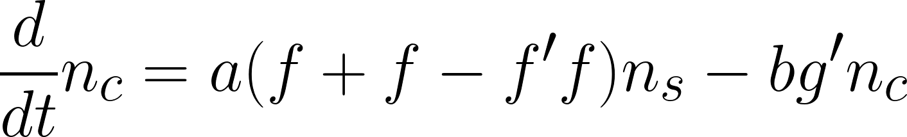

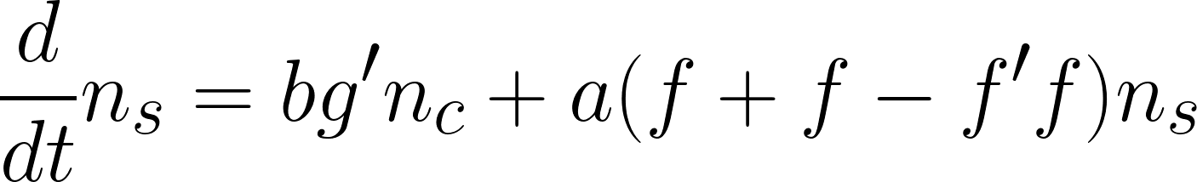


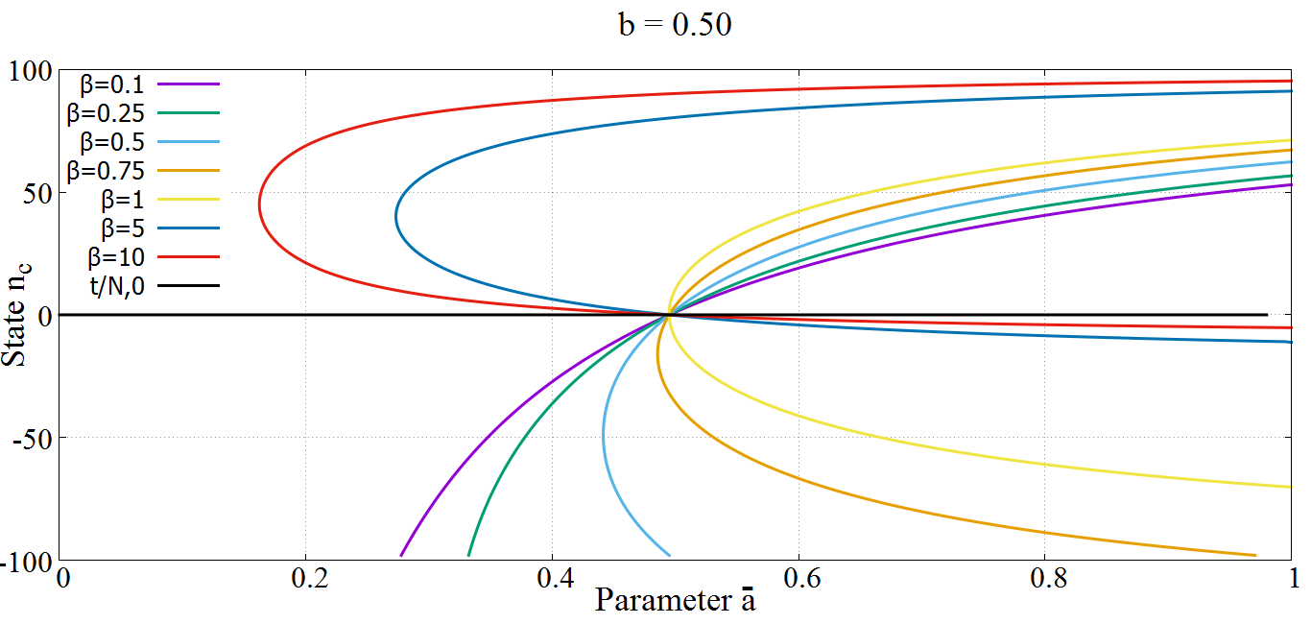
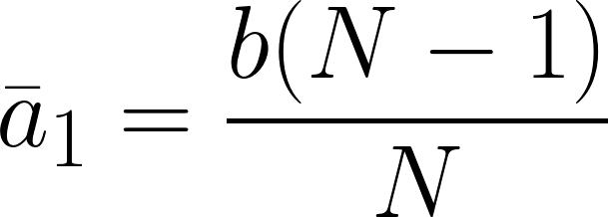

Steady-state dynamics of an audience applause model
Antonio Miguel V. Cruz* and Johnrob Y. Bantang
Complexity Science Group, Instrumentation Physics Laboratory, National Institute of Physics, University of the Philippines Diliman, Quezon City, Philippines
*acruz@nip.upd.edu.ph
We propose a compartmental model for the dynamics of audience applause consisting of agents that are either silent (S) or clapping (C). The model includes two mechanisms. The first is a feedback mechanism that is parameterized by α which enhances the probability a that agents in state C influence those in state S to transition to C. Parameters α and a are simplified to ᾱ where ᾱ = aα. The second is a modulating mechanism that is parameterized by β which limits the probability b that those in state C transition to S. The steady-state dynamics of the resulting equations show that three possible solutions can exist, which includes a trivial case when all agents rest at S. Since negative steady-state values are extraneous solutions, only two of these solutions exist for ᾱ greater than a critical parameter value ᾱ₁ For β > 1, we find a second critical parameter value ᾱ₂ such that a second non-trivial non-extraneous but unstable solution exists. We confirm our results by agent-based Monte Carlo simulations.
Compartmental Model of Audience Applause
For curves with β > 1, two n_{c} solutions exist for ᾱ between a new critical point, ᾱ₂ and ᾱ₁.
We propose an SCS model based on the standard SIS model[1] where each agent in the system is either in state S (“silent”) or in state C (“clapping”). The state of the system is given by the number of agents in each corresponding state, n = (n_{c},n_{s}). n will be fully specified by n_{c} alone.
where n*_{c} = [1+(β -1)N]/2β. The lower branch is an unstable steady state.
Simulation Experiments
We confirm our analytical results by simulating the model using an agent-based Monte Carlo method. Below are sample simulations with trivial(left) and non-trivial(right) steady-states, each with its own unique parameters.
Figure 1. Proposed SCS model of audience applause. It contains a fixed number of agents transitioning between two states. The behavior of the model by the parameters a, b, α, and β.
Parameters a and b are transitional probabilities from S to C and from C to S respectively. f is a forcing function that allows transition. f’(α) and g’(β) are the feedback and modulation functions parameterized by α and β respectively.
Figure 3. Sample simulations given a population of 100 agents with 100 iterations.(Left) Simulation with parameters a = 1, b = 0.9, α = 0.6, β = 3, showing a trivial steady-state of 0. (Right) Simulation with parameters a =0.9, b = 0.7, α = 0.4, β = 14, showing a steady-state of 85.
Since the simulations settle to a certain n_{c} at t > 50, we assume that the value of n_{c} at t = 100 is the same as the value of n_{c} as t approaches infinity. The mean of the final n_{c} of ten simulations was plotted against the parametric plot of the steady-state equation of the same parameters.
(1) models spontaneous transition based on the number of people already clapping while (2) is taken from the Michaelis-Menten equation, which aims to model enzyme kinetics [2]. The differential equations below describe the reactions of the system.
Steady-state solutions
Figure 4. The simulated steady-states values (red, with error bars) plotted against the analytical steady-state values for b = 0.5. ᾱ₂ is denoted by the vertex(cross).
Steady-state occurs when the state n is fixed and when the forcing function expires. (3) and (4) are simplified to the steady-state equation for n_{c.} :
Simulations with β < 1 are trivial until ᾱ = ᾱ₁, in which they bifurcate to the non-trivial curve. However, simulations with β > 1 bifurcate to the non-trivial, upper branch of the curve for some ᾱ < ᾱ₂.
where ᾱ = aα. The parametric plot of (5) is shown below for b = 0.5.
Conclusion
Simulations successfully emulate the compartmental model in accordance to the differential equation for the steady-state of the given system. The feedback mechanism parameter β is an agent character related to how they are affected by already-applauding audience. Agents with higher β values tend to generate very high steady-state values and create a critical number required to approach this steady-state value.
Figure 2. The analytical steady-state solutions for a fixed b = 0.5 and varying β. Included is the trivial steady-state n_{c} = 0. Values below 0 are extraneous.
References
All curves intersect at around ᾱ = b. Setting n_{c} to 0 gives us the equation for the critical point, ᾱ₁
[1] P. Dodds and D. Watts, A generalized model of social and biological contagion, J. Theoret. Biol. 232, 587 (2005).
[2] L. Johnson and R. Goody, The original michaelis constant: Translation of the 1913 michaelismenten paper, Biochemistry 50, 8264 (2011).

