Slide 1





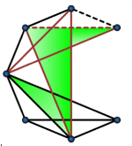
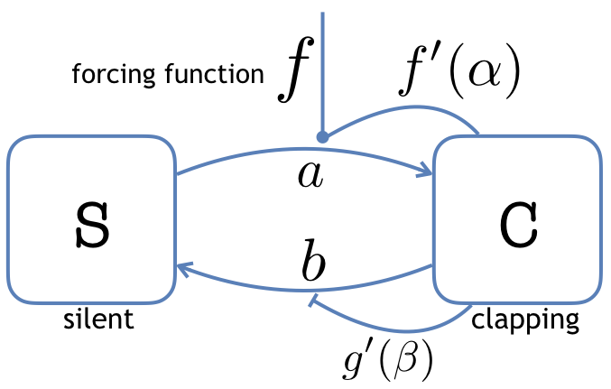
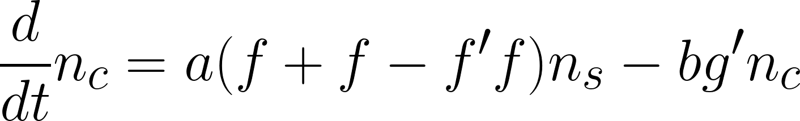
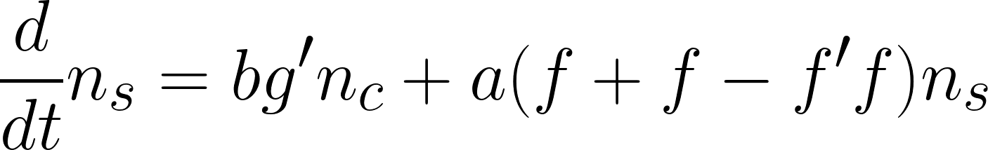
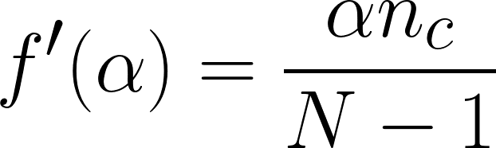
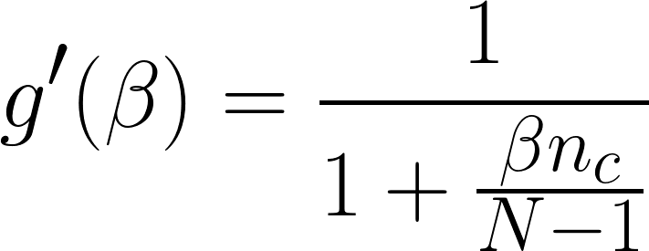
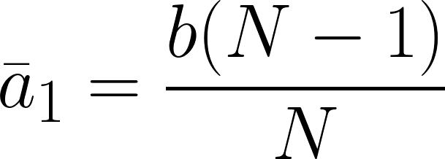
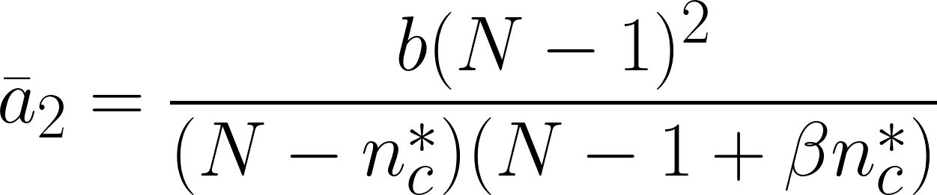
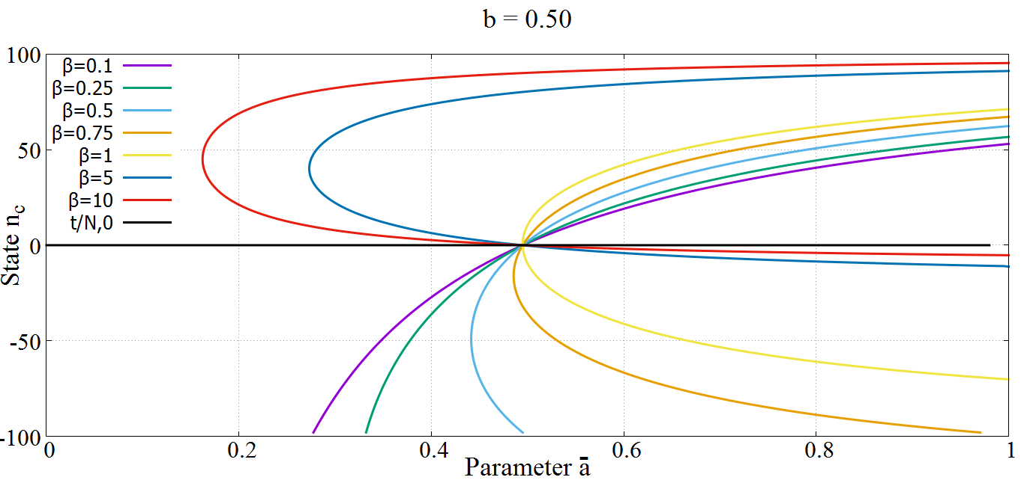
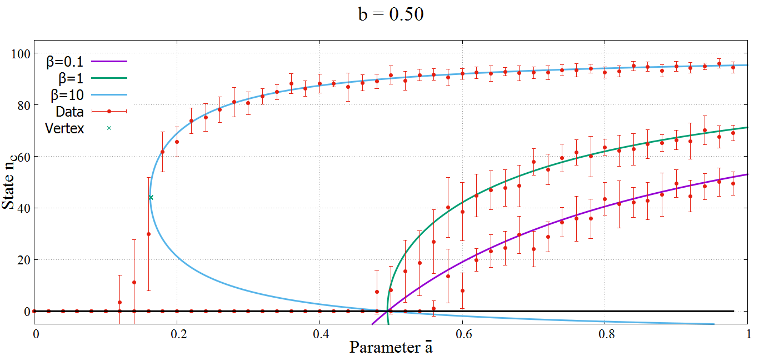
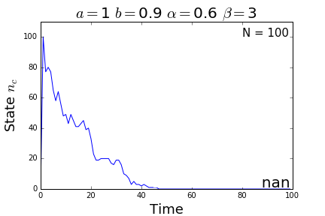
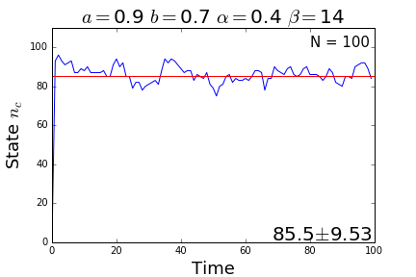
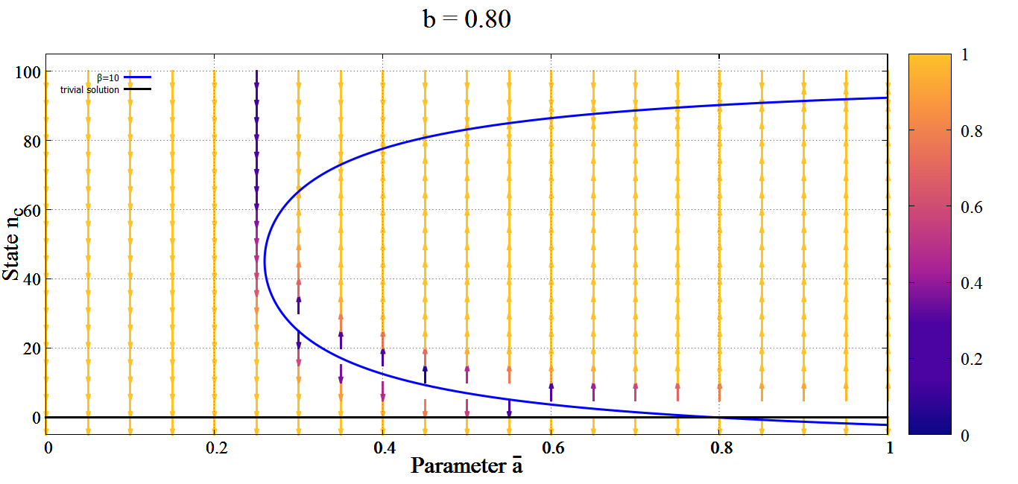
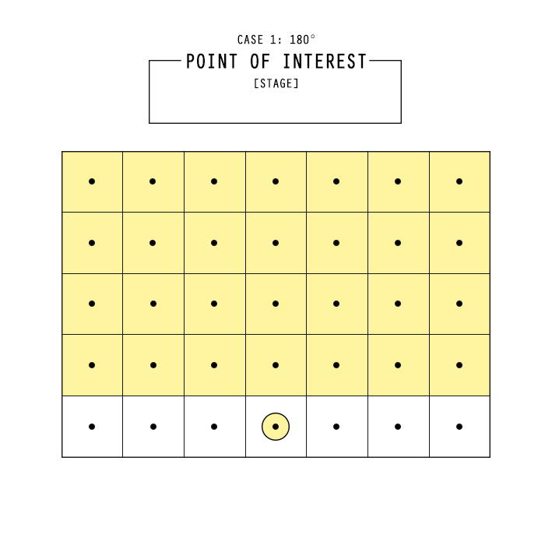
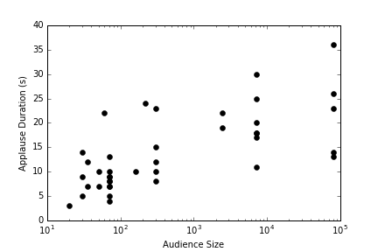
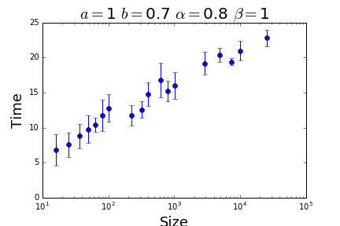
Dynamics of an SIS-like audience applause model
Antonio Miguel V. Cruz
Instrumentation Physics Laboratory
Adviser: Dr. Johnrob Bantang
Objectives
Proposed Compartmental Model*
Create a model that simulates an audience applause
Study the underlying dynamics of the system
Find a correlation between the applause duration and audience size
Differential equations of the system
Steady-state solutions
*based on the standard SIS-model [1]. g’ is taken from the Michaelis-Menten equation[2].
N → audience size
n_{c} → number of agents in state C
ā = aα
n*_{c} = [1+(β -1)N]/2β
Steady-state equation
Critical Points
The phase space plot of the steady-state solutions with a set b = 0.5 and varying β. Included is the trivial steady-state n_{c} = 0. Values below 0 are extraneous.
Analytical solutions are confirmed using an agent based Monte-Carlo method. Shown below are sample simulations with a trivial (left) and non-trivial (right) steady-state.
The phase space plot of the steady-state equation for a set b value and various β values.
Bifurcation from the trivial to non-trivial solution occurs before the critical point ā₂, for β > 1, and at ā₁, for β < 1. Steady-state does not occur at lower branches of β > 1 solutions
Incorporating Spatial Effects
Limiting the agents that can influence the reference agent allows simulations to have a finite applause time. This configuration was used to find parameter sets the best emulated that of real-life applause.
Removing the forcing function allows the system to act freely. The vectors point to the steady-state of the coordinate point (ā, n_{c}). The heat map represents the probability, 1 being 100% and 0 being 50%. Coordinate points on the lower branch are unstable and may settle to either trivial or non-trivial steady-states.
References
[1] P. Dodds and D. Watts, A generalized model of social and biological contagion, J. Theoret. Biol. 232, 587 (2005).
[2] L. Johnson and R. Goody, The original michaelis constant: Translation of the 1913 michaelismenten paper, Biochemistry 50, 8264 (2011).

