Slide 1
Gen AI
Day 1

Slide 2
Topics
Evolution of AI
Gen AI without bells and whistles
Market leader, companies and products
What are these tools capable of?
Custom GPTs
API Availability
Next evolution
References

Slide 3
Evolution of AI
Rule based code
ML - Machine learning the field of study that gives computers the ability to learn without being explicitly programmed.
Prediction based system (supervised)
Anamoly Detection (unsupervised)
Recommendations (Think Youtube / Instagram)
Deep Learning
Image classification
Self-Driving cars
https://claude.ai/share/175110f6-a0b3-45d3-83f4-9405b93d63db

Slide 4
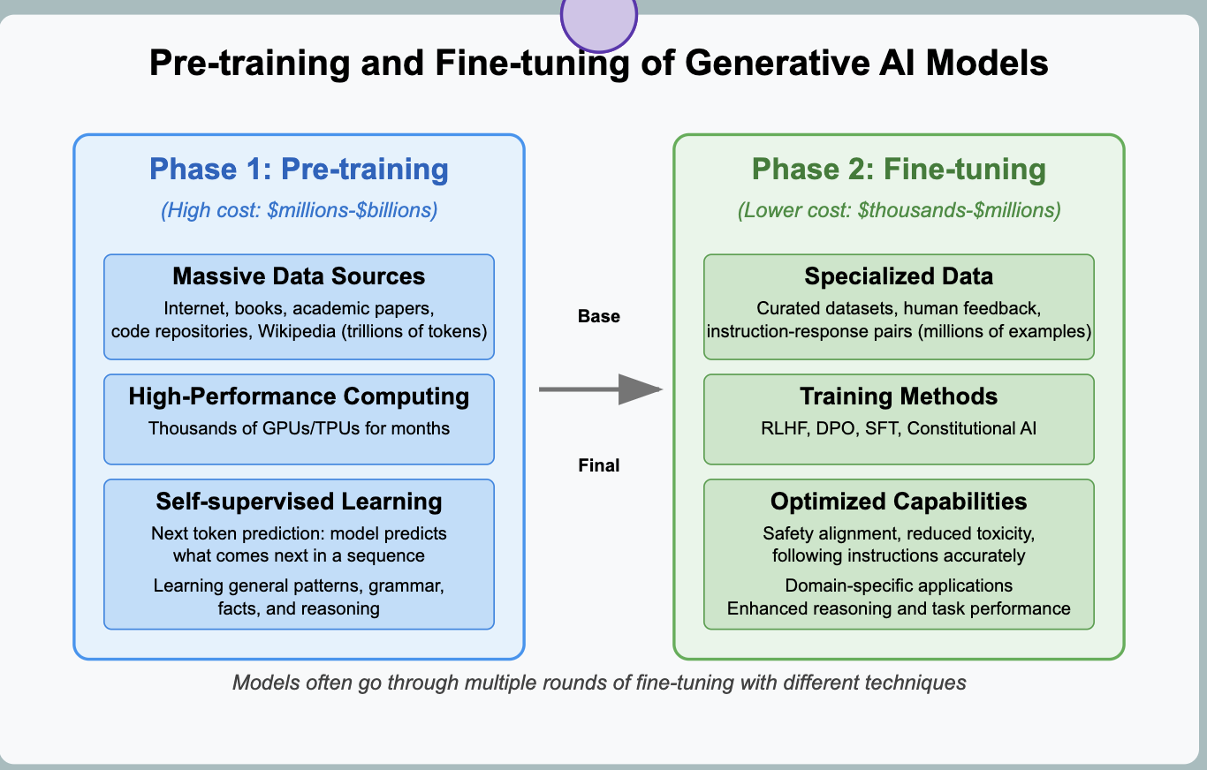
Gen AI at its simplest form

Slide 5
Market leader, companies and products
Open AI
ChatGPT
Sora
Anthropic
Claude
Google
Gemini
NotebookLM
Perplexity

Slide 6
Open-source alternatives
Facebook
Llama
Deepseek
Alibaba
Gwen

Slide 7
Types of models
General
Text only
Multimodals
Pre-training with more data, made the model better
Reasoning
Similar, reasoning models can also be text only or support multimodals, but most reasoning models now days are multimodal

Slide 8
What these products can do on its own?
Answer questions with trained data as text
Can listen and respond in audio as well
Surf the web
Deep research

Slide 9
Custom GPTs
Cover letter crafter
Another example -> Interview preparation helper

Slide 10
APIs availability
Makes way for building custom application as well
What do clients typically come up with?
Frameworks
Langchain
Semantic Kernal
Agentic Framework
LangGraph
Crew AI
AutoGen

Slide 11
Next evolution
Smaller, faster and cost inexpensive models (smaller versions already run on mobile)
Increasing context window of models
Physical AI leading to Robots helpers

Slide 12
References
https://chatgpt.com/
https://partyrock.aws/apps (create custom apps for free)
https://gemini.google.com/app?hl=en-IN
https://sora.com/explore
https://notebooklm.google.com/
https://youtu.be/zjkBMFhNj_g?si=rxfYw4Urp8SElkVg (Andrej karpathy video series)
https://platform.openai.com/docs/guides/prompt-generation (meta prompt)

Slide 13
References
https://platform.openai.com/docs/models
https://docs.anthropic.com/en/docs/about-claude/models/all-models
https://www.perplexity.ai/
https://v0.dev/

