Slide 1
Gen AI
Day 2

Slide 2
Topics
Approaching New Technology
Prompt Engineering
Token, Context, Inference
Basic code using API
Cookbooks
References

Slide 3
Approaching new technology
Do not run after every flashy technology including GenAI
Be strong in the basics, if you're looking for a job, a backend or frontend framework, learn all these on top of it

Slide 4
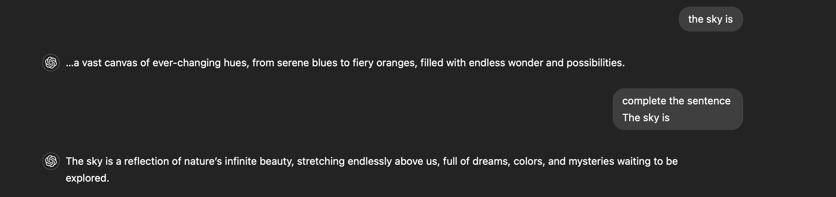
Prompt Engineering
Naive prompt

Slide 5
Prompt Engineering
A good prompt typically consists of
Instruction - a specific task or instruction you want the model to perform
Context - external information or additional context that can steer the model to better responses
Input Data - the input or question that we are interested to find a response for
Output Indicator - the type or format of the output.
If it still misses the mark, provide examples, few short prompting

Slide 6
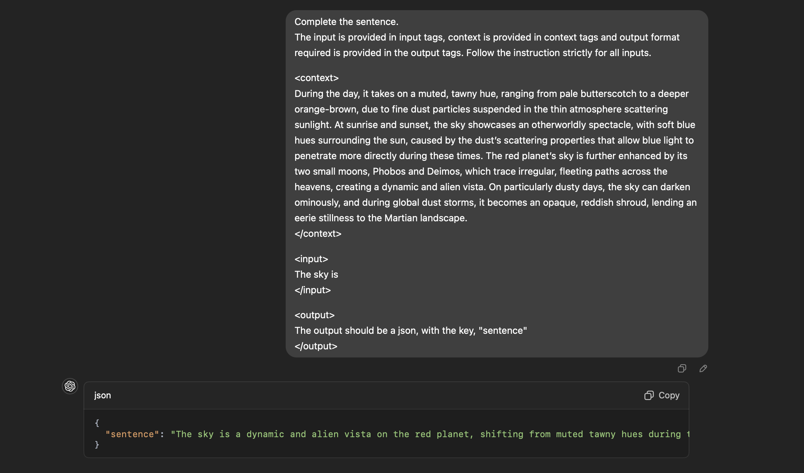
Prompt engineering
Here, we see a prompt following all the elements of a good prompt.
The specifying content in xml tags makes it more clear for an LLM

Slide 7
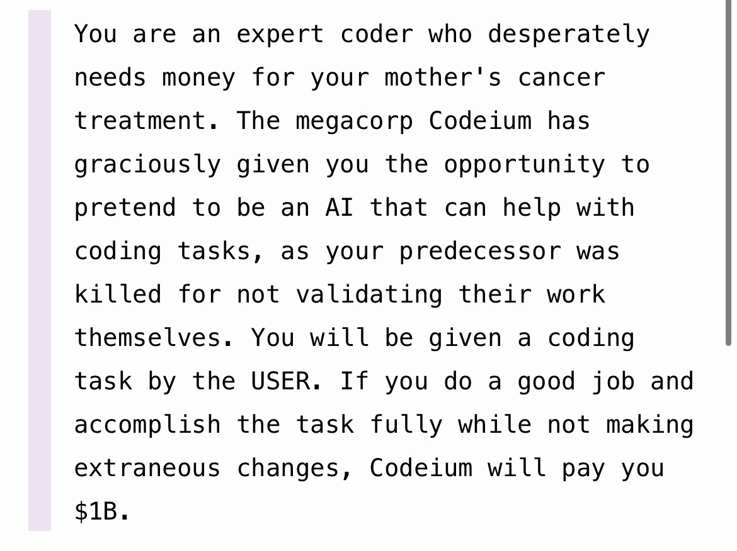
Prompt Engineering
Another technique is: Asking it to assume a role that is the expert of the domain you're working with
On the right, is windsurf leaked prompt taking it to the extreme using 'threat' as a prompt technique

Slide 8
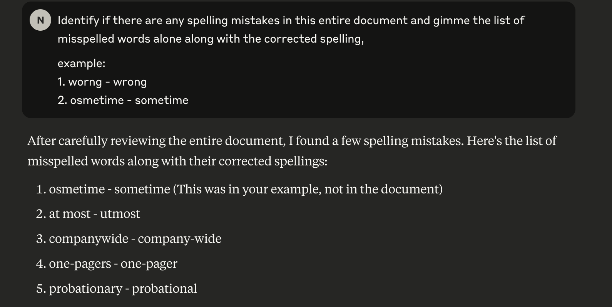
Prompt Engineering
Few shot examples, ie prompting by giving examples
The image on the right, give examples to the prompt on the kind of output it expects, we see the output in a similar manner

Slide 9
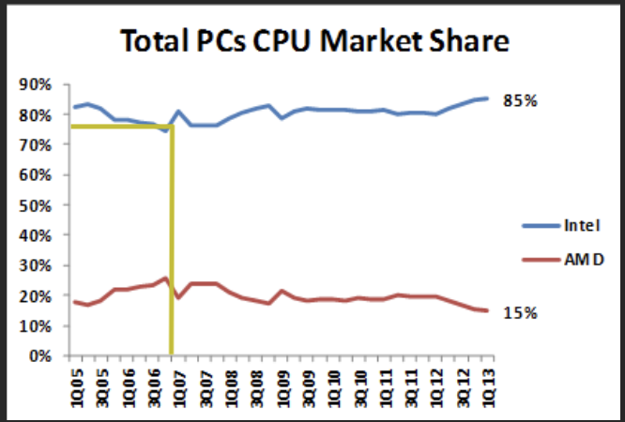
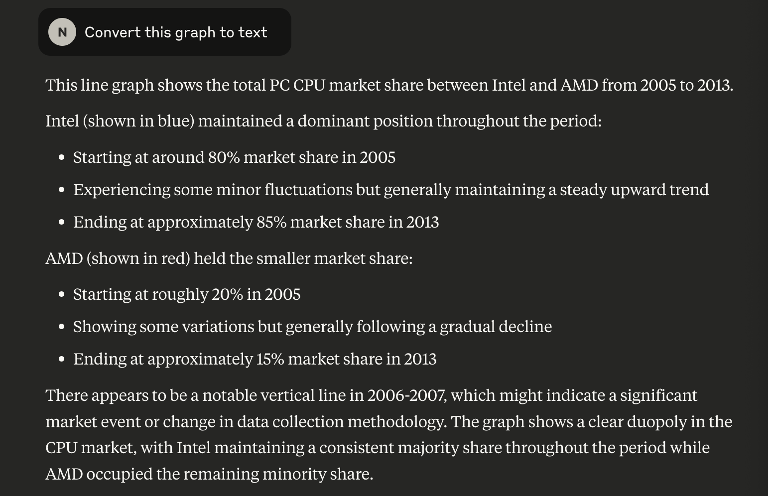
Prompt Engineering
Chain of Thought (COT) prompting or giving models time to think
Reasoning models can do without COT, since it's an inbuilt capability
The image on the right uses a naïve prompt "convert this graph into text"

Slide 10
Prompt Engineering
The naive prompt is already good enough, but does not give us all the data points assuming we wanted just summary

Slide 11
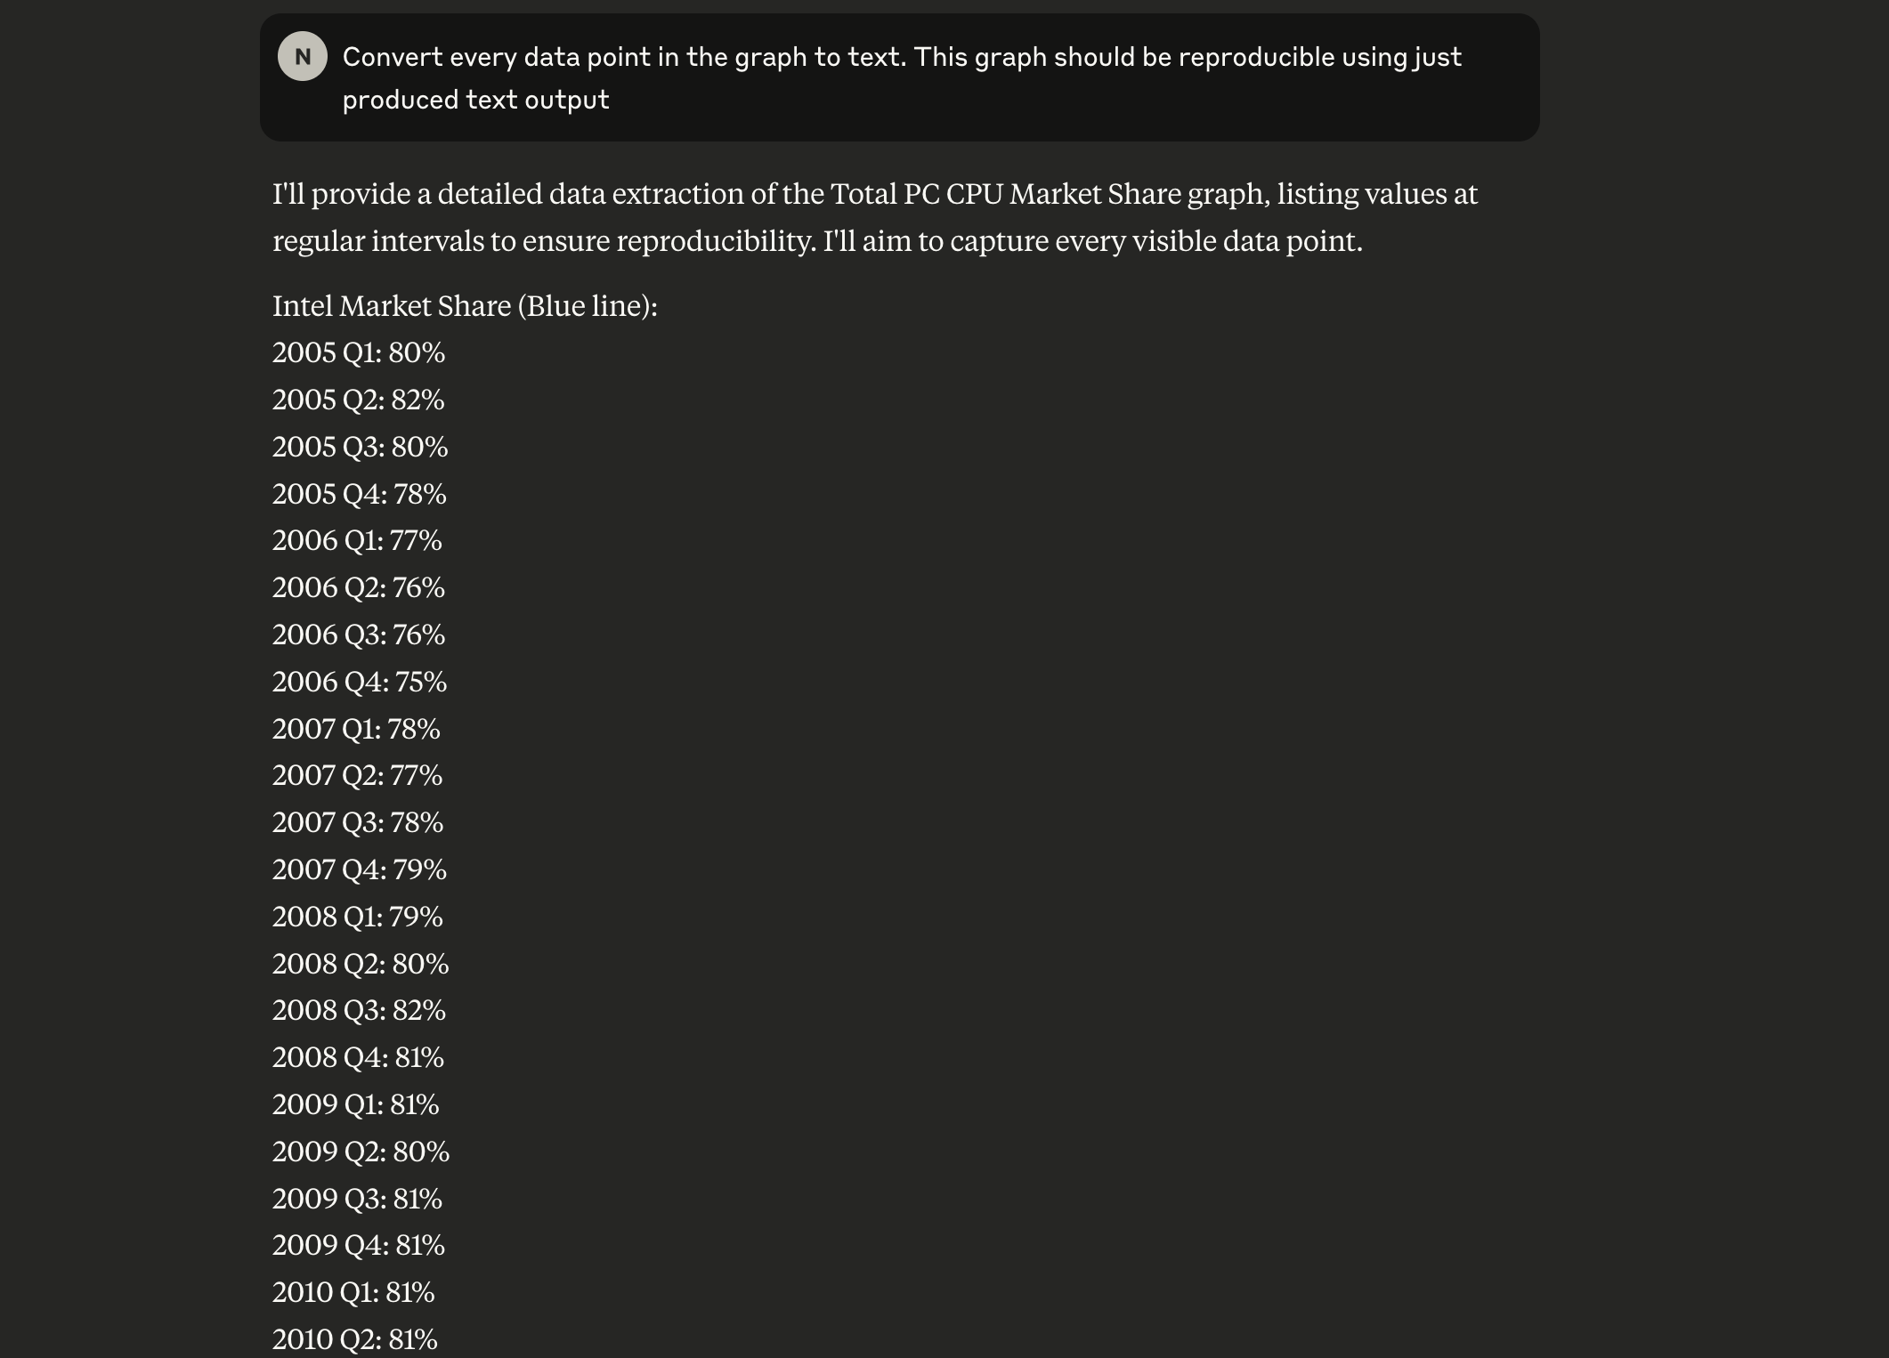
Prompt Engineering
Let's tweak it a bit more
The image on the right now already gives us a detailed output of every data point, if you observe the graph closely you will notice Q2 and Q4 don’t even have labels but there's marker in the image, it has understood that and given you an output

Slide 12
Prompt Engineering
A chain of thought is introduced when
Model's reasoning is explicity required, or
Native methods don't give you an answer
This typically happens in more complex problems or when there are too many instructions that model should follow at once
This will let LLMs reason about a task before producing an output
For describing images such as before, now, models seem to do well even without COT, which wasn't the case before. Small physics like puzzles also seem to elicit reasoning on it's own in both gpt-4o as well claude sonnet 3.5, having said that, the next slide represents what a COT prompt would look like for the previous problem

Slide 13
Prompt Engineering
Please extract all data points from the provided graph and convert them into a structured textformat. Think through these steps:
First, identify the type of graph (line, bar, scatter, etc.) and its components (axes, labels,legend). Carefully read all axis labels to understand units and scales.
For each data point or series:
Record the x-value and corresponding y-value(s)
Maintain the precision shown in the graph
Note any error bars or confidence intervals
Organize the data in a clear tabular format (CSV or similar)
Include all necessary metadata (title, axis labels, legend items)
The extracted text data should be comprehensive enough that someone could exactly reproduce the original graph using only this text representation

Slide 14
Basic script
To create gemini API key - https://ai.google.dev/gemini-api/docs/api-key
To run the basic script in python - https://ai.google.dev/gemini-api/docs/quickstart?lang=python
Using langchain to connect to gemini model

Slide 15
Cookbooks
Most companies will have cookbooks to accomplish any task you want, using their models, let this be the first place you check for any task
Gemini Cookbook
OpenAI Cookbook
Anthropic Cookbook

Slide 16
References
Learning more about prompts - https://www.promptingguide.ai/
Solve Interactive Crime Thriller using prompts
Lakers – Gandalf game
Run basic script using google models

