Slide 1
Python Utility Projects
File Organization & Morse Code Converter

Slide 2

Introduction
This presentation covers two innovative Python projects: a File Organizer that automates file categorization by extensions and a Morse Code Converter that facilitates encoding and decoding of text. Both projects emphasize efficient coding practices and user-friendly interfaces, making them ideal for a variety of users, from technical experts to newcomers in programming.

Slide 3
01
File Organizer

Slide 4
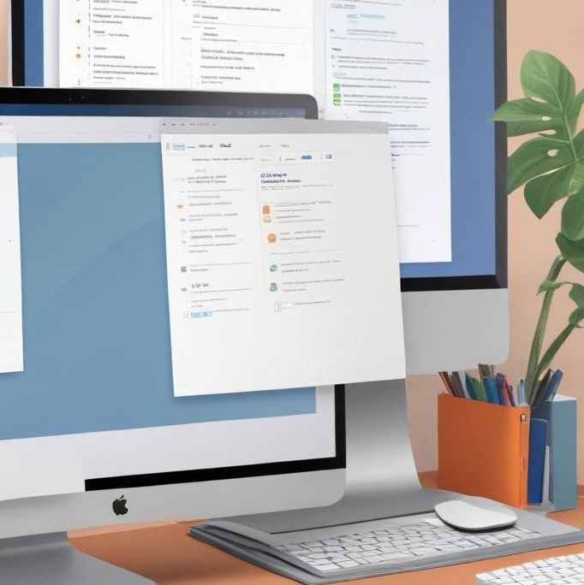
Script functionality and purpose
The File Organizer is designed to simplify file management by automatically sorting files into designated folders based on their extensions. This functionality helps users maintain a clean workspace, ensuring that files are easily accessible and reducing the time spent searching for specific documents.

Slide 5
Key modules used: os and shutil
The script leverages Python's os and shutil modules to interact with the file system. The os module is used for navigating directories and acquiring file information, while shutil is utilized for moving and organizing files. Together, these modules provide the necessary tools to create a functional and efficient file organization system.

Slide 6
Error handling and script limitations
The File Organizer includes robust error handling to manage various issues, such as file access permissions, missing directories, or unsupported file types. It ensures that the main script file is never processed, preventing potential errors. However, limitations exist; for instance, it may not handle files with duplicate names effectively, and it may require manual updates to support additional file types.

Slide 7
02
Morse Code Converter

Slide 8
Functionality and user interaction
The Morse Code Converter offers an interactive command-line interface that allows users to easily convert text into Morse code or decode Morse code back into readable text. Users can input letters, numbers, and special characters, making it versatile for various applications. The design focuses on user experience, ensuring that instructions and results are clear and concise, suitable for both novice and experienced users.

Slide 9

Character support and conversion logic
The converter supports a wide range of characters, including all letters of the alphabet, numbers, and common punctuation marks. It utilizes predefined dictionaries to map each character to its Morse code equivalent, enabling accurate and efficient conversion. The logic also accounts for spaces and unique character sequences to ensure correct output for various input scenarios.

Slide 10
Error handling for invalid inputs
Robust error handling is integral to the Morse Code Converter, designed to manage invalid inputs gracefully. If a user inputs unsupported characters or formats, the program provides clear error messages, guiding the user on how to correct their input. This prevents crashes and ensures a seamless experience, promoting user confidence in the tool's functionality.

Slide 11
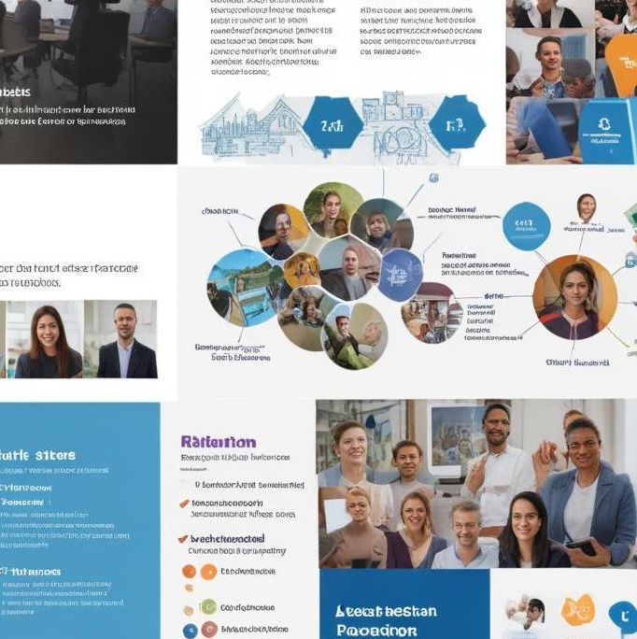
Conclusions
Both Python projects demonstrate not only practical applications of programming but also the importance of user-friendly design and robust error handling. The File Organizer streamlines file management, while the Morse Code Converter bridges communication gaps through technology. Together, these tools showcase the versatility and power of Python in solving everyday problems and enhancing workflows.

Slide 12
Thank you!
Do you have any questions?
+91 620 421 838

