Slide 1

RakshaNet
Your shield against cyber fraud.
AI scam checker, golden-hour emergency guide, tamper-evident evidence vault and an AI complaint drafter, in one offline-first app. Async'26 Hackathon.

Slide 2
THE PROBLEM
Cyber fraud wins at three moments
Before: it looks real
During: panic
After: messy proof
Fake KYC SMS, "digital arrest" calls, task scams and look-alike bank links are convincing, and people have seconds to decide.
Victims freeze. They don't know to call 1930 within the golden hour, when the money can still be frozen.
Screenshots get deleted, complaints are vague, and evidence can be questioned. Cases stall.
India's National Cyber Crime Helpline is 1930; complaints are filed at cybercrime.gov.in. RakshaNet gets victims there faster, with better evidence.

Slide 3
THE SOLUTION
Check it. Act fast. Keep proof. Report.
Scam Check
Golden-hour guide
Evidence Vault
AI complaint
Paste any SMS, WhatsApp, email, link or call script. Instant offline verdict, then a Claude AI analysis: risk, scam type, red flags, next steps.
"Lost money?" flow: call 1930, block bank and UPI, secure accounts, warn contacts, with a checklist that remembers progress.
Messages and screenshots are SHA-256 hashed and chained. Any edit is caught. Sign with a wallet to timestamp.
Claude drafts a ready-to-file cybercrime.gov.in complaint with suspect IDs and evidence hashes.

Slide 4
HOW IT WORKS
Offline-first rules plus Claude where it matters
1. Instant rules
2. Claude analysis
3. Seal
20+ patterns for Indian scams plus link forensics: look-alike bank domains, punycode, shorteners, bare IPs, risky TLDs. Extracts UPI IDs, phones, links and amounts.
Server function calls Claude with a JSON-schema structured output. Pasted text is fenced as untrusted data. It falls back to the rules on any failure.
Each record = canonical JSON {index, time, type, payload, prevHash} hashed with WebCrypto SHA-256. Files are hashed, never uploaded.
4. Verify & anchor
5. Draft
6. Private
Recompute the chain to pinpoint any edit, deletion or reorder. EIP-1193 personal_sign timestamps the vault head.
Claude writes the complaint from the given facts only, leaving <placeholders> for gaps. Offline template fallback.
Installable PWA with no accounts. Data stays on the device, and text is sent to AI only when you press Check or Draft.

Slide 5
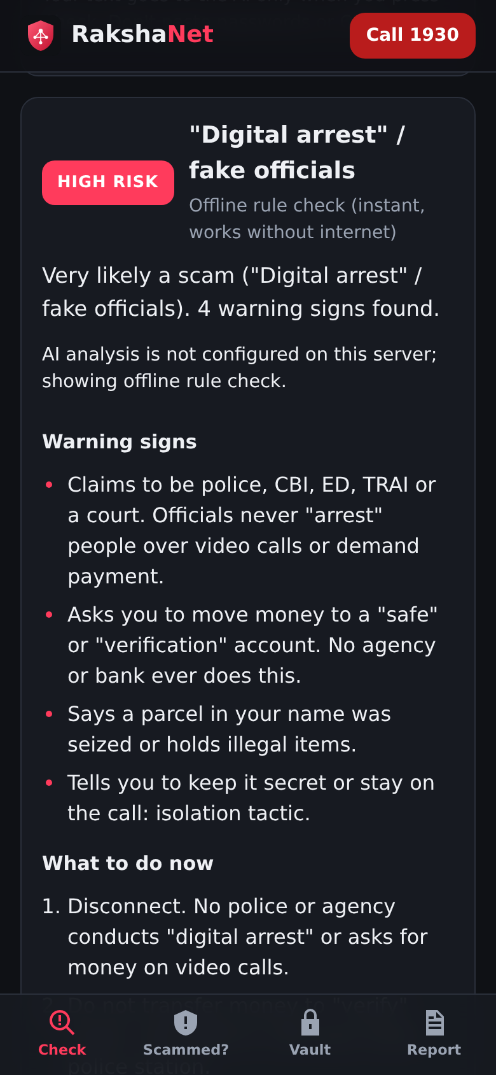
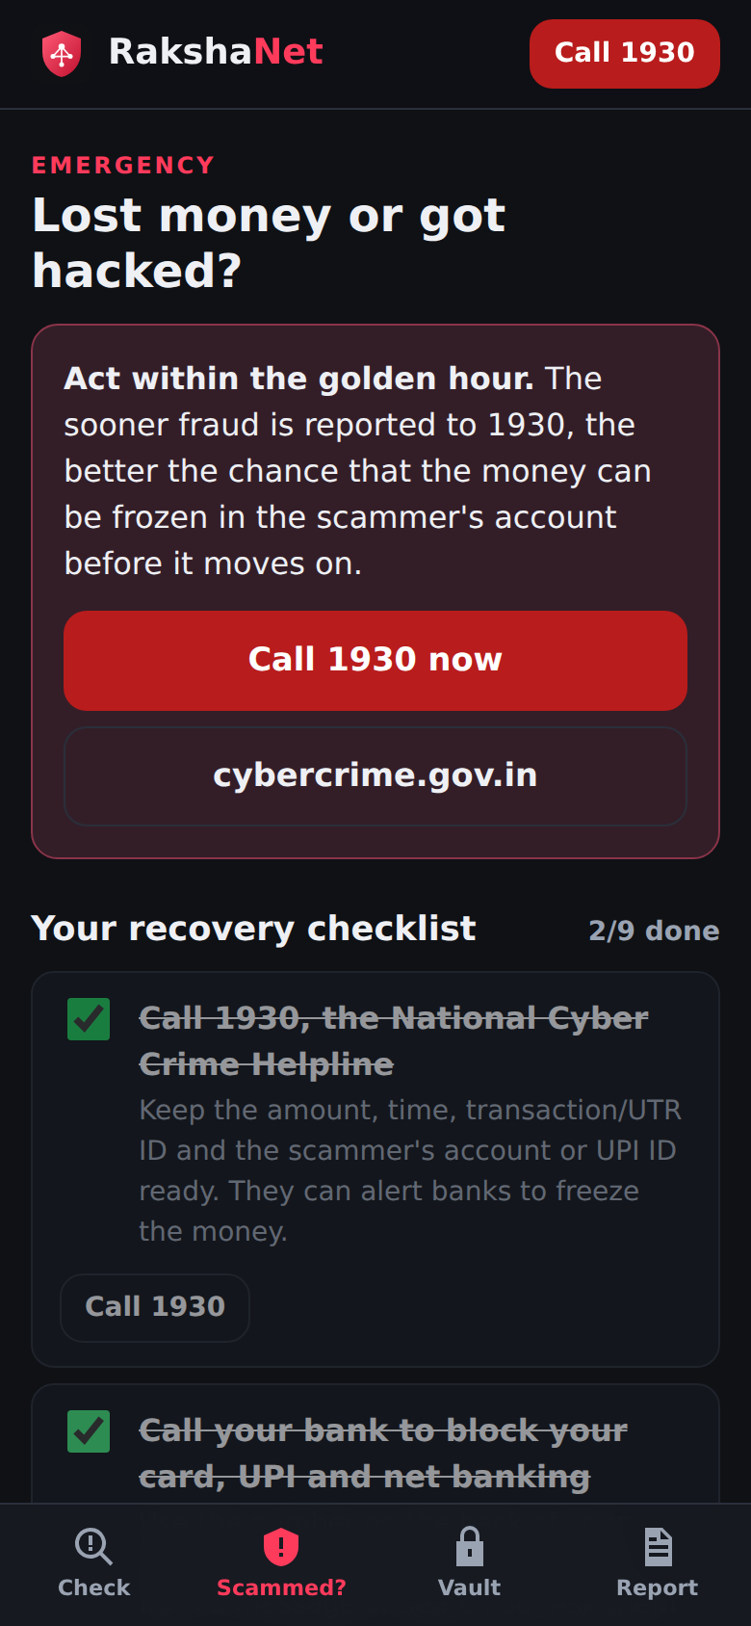
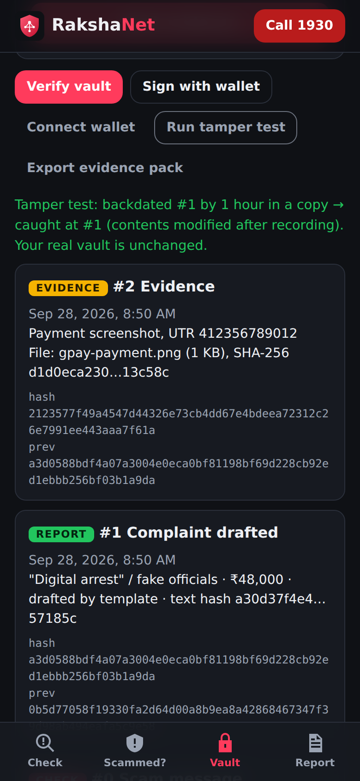
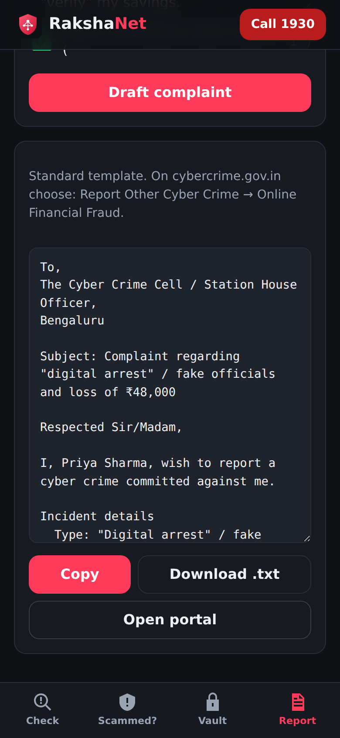
LIVE PROTOTYPE
Built, tested and running today

Slide 6
WHY RAKSHANET
What makes it different
Works with zero signal
Rule engine and vault run offline; AI enhances, never blocks
Built for Indian scams
Digital arrest, UPI collect, KYC, task and loan-app frauds, plus 1930 and NCRP flow
Proof that holds up
Hash-chained vault plus wallet signature: tampering is provable
From panic to complaint in minutes
Checklist, then evidence, then an AI-drafted complaint
Safe AI by design
Structured output, prompt-injection fencing, no invented facts
Private
No sign-up, no database; you choose what is sent

Slide 7
ROADMAP
From prototype to a national scam shield
Now
Next
Later
Offline rules plus Claude scam analysis, golden-hour guide, hash-chained Evidence Vault with wallet signing, AI complaint drafter, PWA.
Screenshot input to Claude, Hindi and regional languages, WhatsApp bot and browser extension, community-reported scam numbers and UPI IDs.
Periodic on-chain anchoring of vault roots, bank and NCRP integrations, live call-scam detection, dashboard for police cyber cells.

Slide 8
Stop the scam. Save the proof. Get help faster.
Try it: <live link> · Code: github.com/nobraindev-pavan/Rakshanet
Helpline 1930 · cybercrime.gov.in

