Slide 1




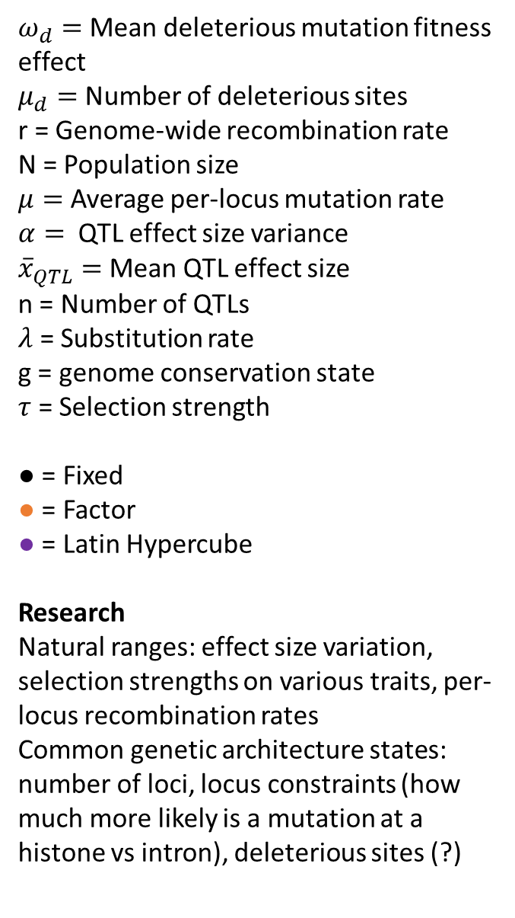



more vs less polymorphic genes with lambda
validate the model: neutral evo of quant gen should lead to pop gen expected results of neutral theory, just added up for each of the loci
$ω_{d}=$ Mean deleterious mutation fitness effect
$μ_{d}=$ Number of deleterious sites
r = Genome-wide recombination rate
N = Population size
$μ=$ Average per-locus mutation rate
$α=$ QTL effect size variance
${\overline{x}}_{QTL}=$ Mean QTL effect size
n = Number of QTLs
$λ$ = Substitution rate
g = genome conservation state
$τ$ = Selection strength
● = Fixed
● = Factor
● = Latin Hypercube
Research
Natural ranges: effect size variation, selection strengths on various traits, per-locus recombination rates
Common genetic architecture states: number of loci, locus constraints (how much more likely is a mutation at a histone vs intron), deleterious sites (?)
N
Population genetics
g
$$μ$$
$$τ$$
$$n_{d}$$
$$ω_{d}$$
r
$$α$$
$${\overline{x}}_{QTL}$$
n
Quantitative genetics
$$λ$$
estimated from the data

