Slide 1
8/8 (Tue)
What is addressed below:
Crictical 2D Ising model, uniform coupling on square lattice ($K_{1}=K_{2};K_{3}=0$)
Volume = 32x128, 48x192, 64x256
Check UV & IR behaviors of spin-spin and energy-energy correlators
Memo:
n_skip=50, n_therm=n_skip*100, n_therm=n_traj*1600. Wolff only
Radial quantization picture, x rescaled to [-pi, pi]

Slide 2
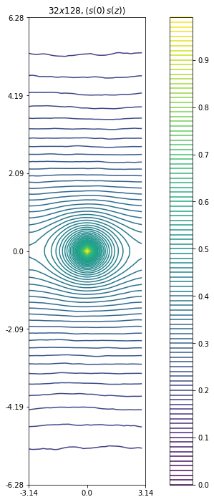
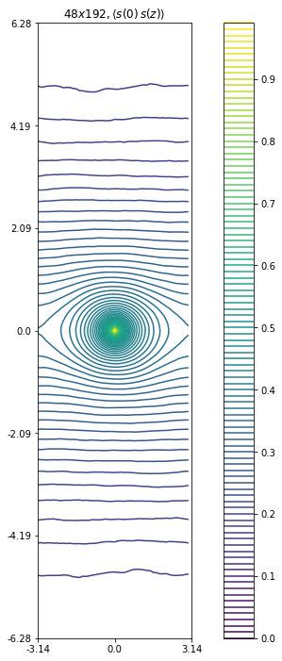
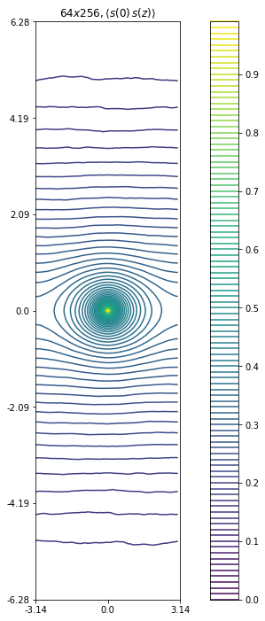
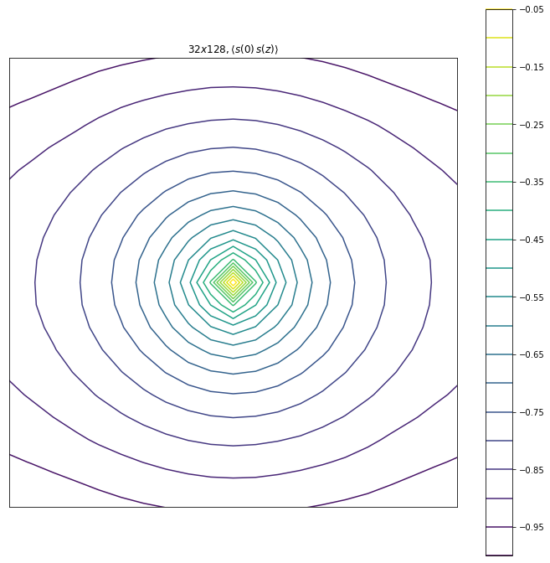
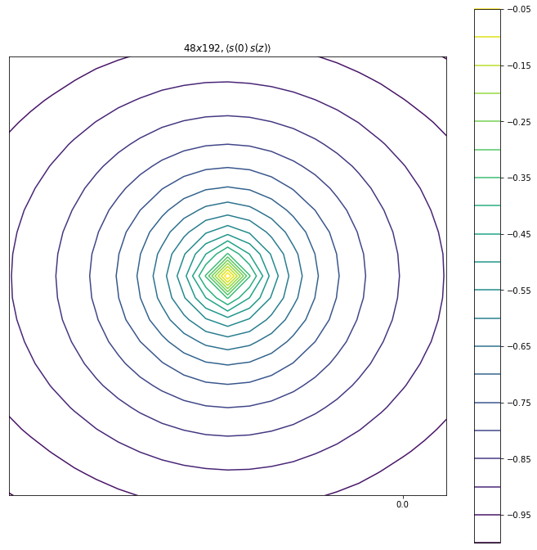
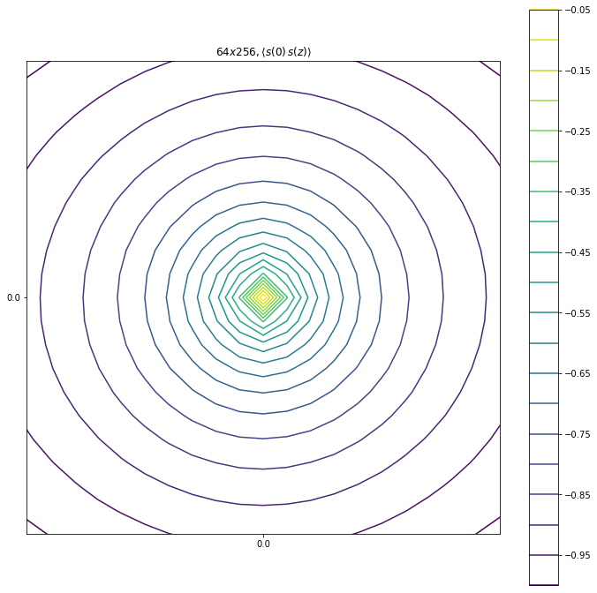
Spin-spin
overview
Circle confirmed
UV not much improved

Slide 3
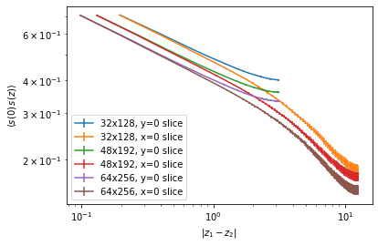

Spin-spin
Exponents seem to agree among three
x=0 and y=0 slices
Reason for the overall factor needs to be understood; IR as well
$→$ compare to exact results of Francesco

Slide 4
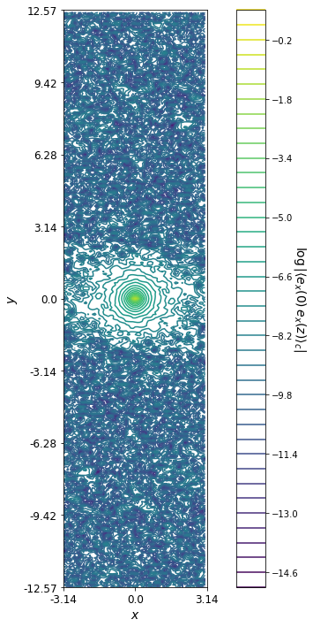
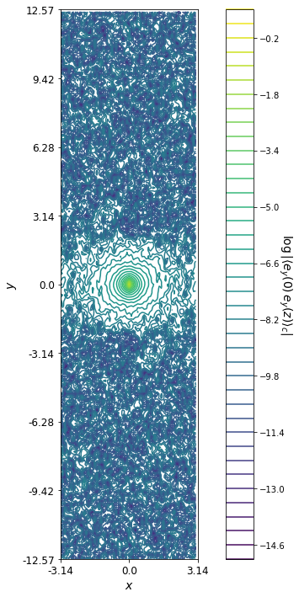
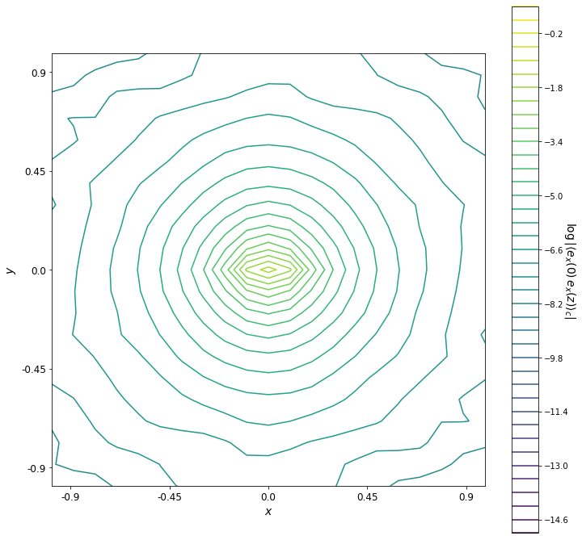
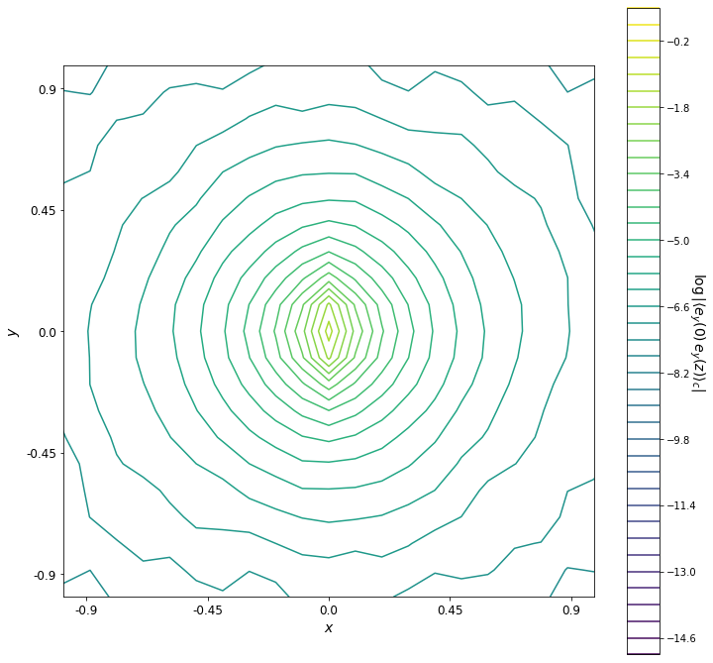
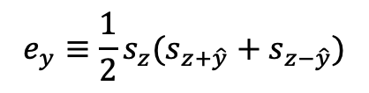
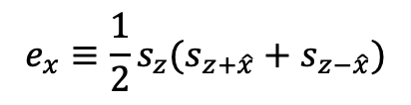
Energy-energy
(64x256)
ex-ex
ey-ey
$$e_{x}≡\frac{1}{2}s_{z}(s_{z+\hat{x}}+s_{z−\hat{x}})$$
$$e_{y}≡\frac{1}{2}s_{z}(s_{z+\hat{y}}+s_{z−\hat{y}})$$
Directional dependence manifest at UV

Slide 5
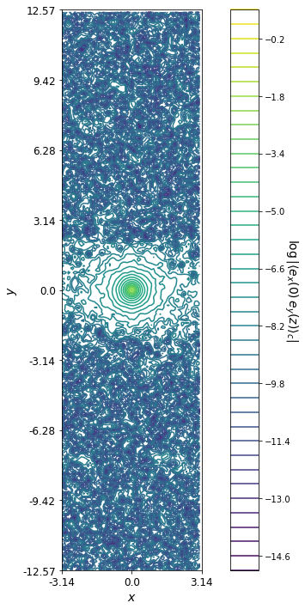
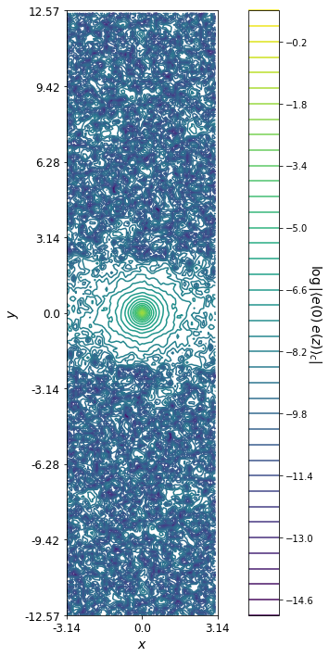
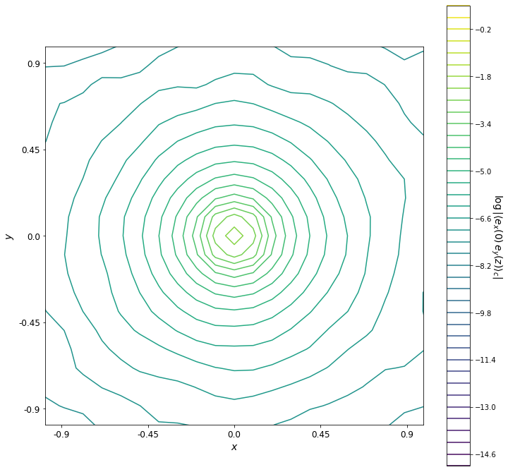
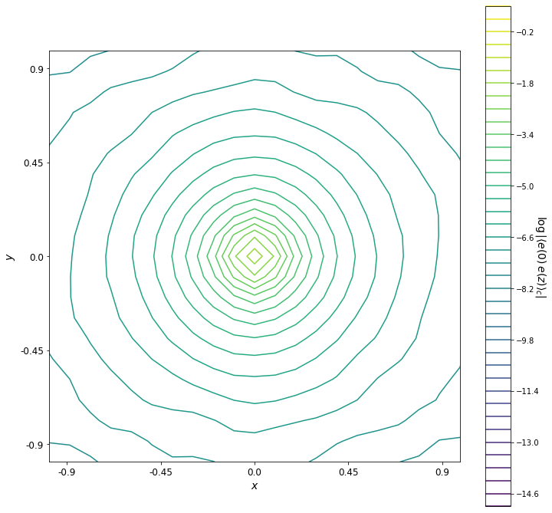
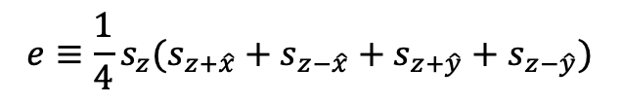
Energy-energy
(64x256)
ex-ey
e-e
$$e≡\frac{1}{4}s_{z}(s_{z+\hat{x}}+s_{z−\hat{x}}+s_{z+\hat{y}}+s_{z−\hat{y}})$$
Directional dependence not much evident (as expected)
Yet differs at UV

Slide 6
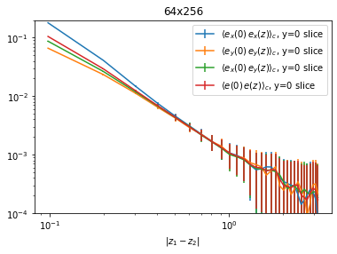
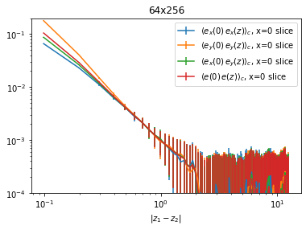

Energy-energy
(64x256)
y=0 slice
x=0 slice
Deviation at small distance (as expected)
Small window but have power-like regions
$→$ exponent needs to be compared to exact results

Slide 7
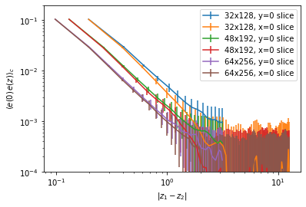
Energy-energy
Reason for the overall factor needs to be understood here as well (large chance of misunderstanding)
x=0 and y=0 slices
Difference in IR not much evident as spin-spin

