Slide 1
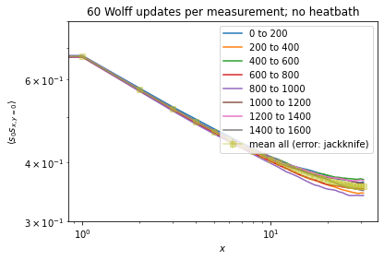
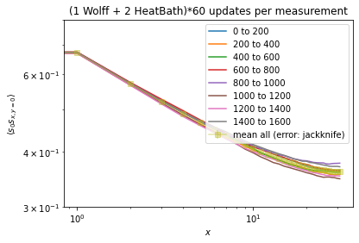
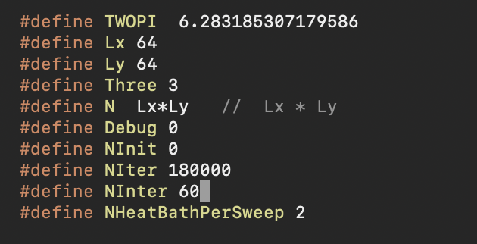
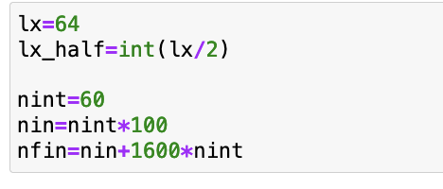


Lattice size = 64*64, $β=β_{crit}$
1 routine = 60 Wolffs
1 routine = (1 Wolff + 2 heatbath) $×$ 60
initialization = 100 routines
initialization = 100 routines
#conf = 1600
#conf = 1600
binsize=200
binsize=200
Calculated on QuantumGeometry codebase:
QuantumGeometry/sandbox/nm/AffineIsing2DclusterNM_v7.cpp
as of Jul 15, 2023

