Slide 1
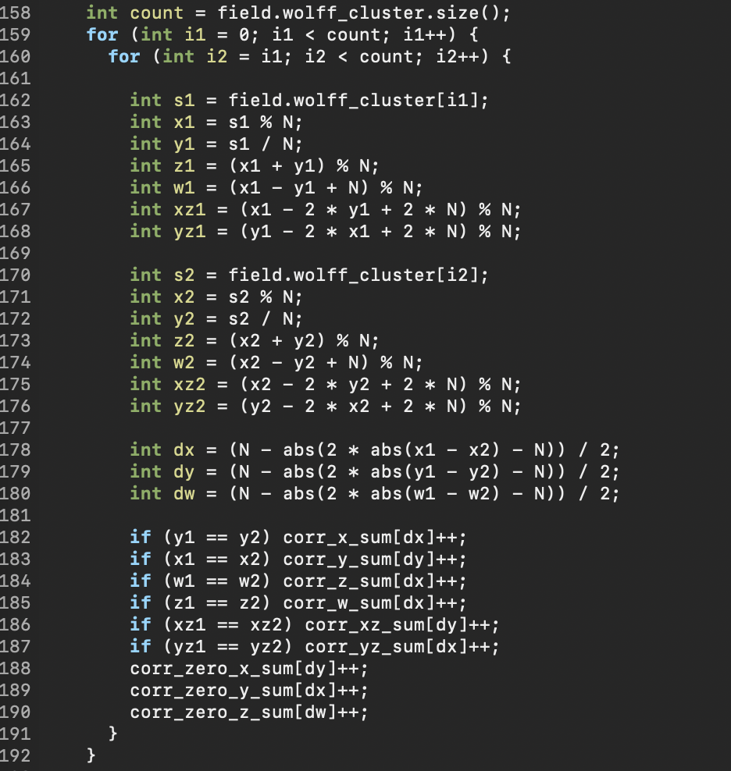
newQFE/examples/ising_flat_crit.cc
as of Jul 15, 2023
For the diagonal directions,
the denominator for the averaging
needs to be changed.
A simple way is to just set the counter.

