Slide 1
Presentation Baseline Algorithm
E-Commerce: Nicole Haberbusch, Markus Wasserbauer, Marc Kaiblinger

Slide 2

Technic: Retry
In this case we process a task again and again. It is the simplest technique that retries the failed task on the same resource.
Step by Step:
A task fails on a certain resource
Failed task is recognized
Task is sent again

Slide 3
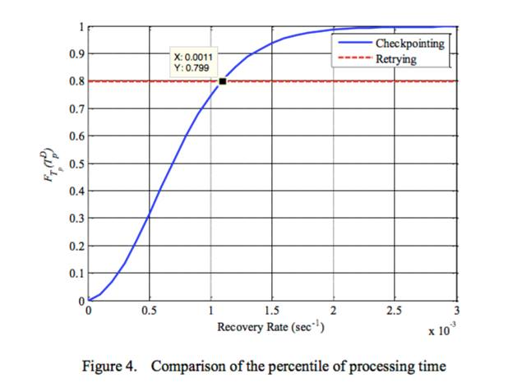
Decision making:
Note that the percentile of processing time of the cloud computing system using the retrying technique stays constant given the above parameters.

Slide 4
Improvement:
Change set of machines used for the retry
Use data which is already processed as new starting point

Slide 5
Questions?

Slide 6
References:
https://cdn.fbsbx.com/v/t59.2708-21/11228796_1107022289313393_970555555_n.pdf/FT_Cloud_ieee.pdf?oh=8824efb15f2a6c4ba3f2f7b85594186c&oe=5806C7DB&dl=1
http://ieeexplore.ieee.org/stamp/stamp.jsp?arnumber=6356962&tag=1

