Slide 1
ATCreate
Utility for entering experimental data
  XLS, text, DBF, CSV ..
Multiple sections, comments, extensible to new data definitions
Auto-format and self documenting

Slide 2
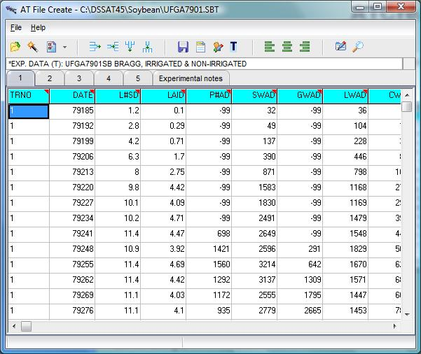
ATCreate
Header Definitions
Data Entry and column definition
Unit conversion

Slide 3
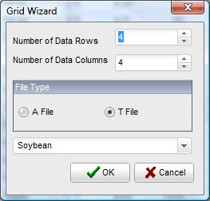
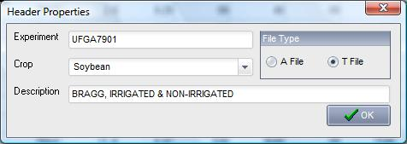
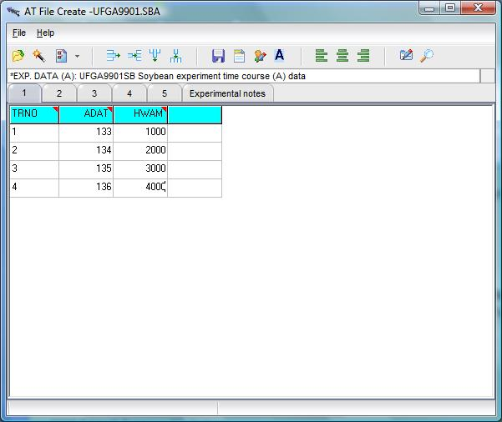
Grid definition
Define experiment ID
Then we import raw data or manually key in data.

Slide 4
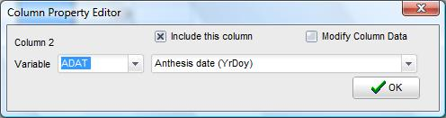
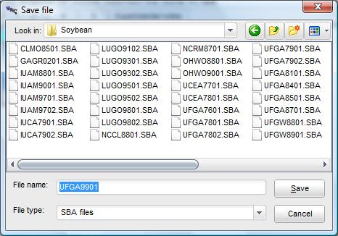
Column Definition ..
Select correct variable
Choose the correct units
If your variable units are not in the database, manually choose multipliers and Modify
Finally, save your work.

