Slide 1
WeatherMan Version 4.5
Weather Data Manager

Slide 2
WeatherMan
Weather management utility program
Import data
Export data in DSSAT format
Fill missing data
Generate stochastic weather data
Summarize weather data

Slide 3
Data quality
Missing data
Erroneous data
  rain < 0.0
  radiation =< 0.0
  Tmax < Tmin
  Tmax > Extreme_max
  Tmin < Extreme_min

Slide 4
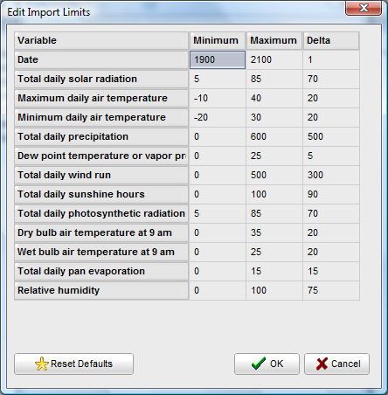
Range Checking
*RANGE CHECK VALUES
@ SRAD TMAX TMIN RAIN DEWP WIND SUNH PAR TDRY TWET EVAP
MIN : 5.0 5.0 -20.0 0.0 0.0 0.0 0.0 5.0 0.0 0.0 0.0
MAX : 85.0 40.0 30.0 600.0 25.0 500.0 100.0 85.0 35.0 25.0 15.0
RATE: 70.0 20.0 20.0 500.0 5.0 300.0 90.0 70.0 20.0 20.0 15.0
*FLAGGED DATA COUNT
@BEGYR BEGMN BEGDY ENDYR ENDMN ENDDY
1984 1 1 1988 12 30
@ TOTAL RAIN TMAX TMIN SRAD SUNH DEWP WIND PAR TDRY TWET EVAP
Total : 7284 1821 1821 1821 1821 0 0 0 0 0 0 0
Valid : 7276 1821 1821 1821 1813 0 0 0 0 0 0 0
Missing: 0 0 0 0 0 0 0 0 0 0 0 0
Error : 0 0 0 0 0 0 0 0 0 0 0 0
Above : 0 0 0 0 0 0 0 0 0 0 0 0
Below : 8 0 0 0 8 0 0 0 0 0 0 0
Rate : 0 0 0 0 0 0 0 0 0 0 0 0

Slide 5
Weather Generators
Dynamic generation of daily weather variables for temperature, solar radiation, and precipitation in CSM
Climate data as input
WGEN
  At least 5 years of daily data
SIMMETEO
  At least 5 years of monthly data

Slide 6
Weatherman
Import from text, CSV, XLS, or DBF files
Data is stored in a database and exported into DSSAT weather files
Interactive data management and climate analysis

Slide 7
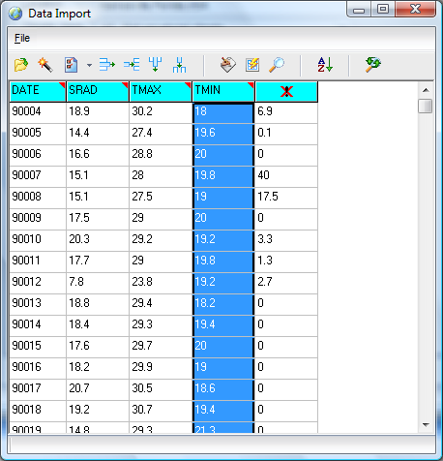
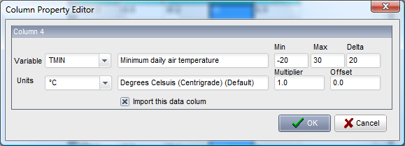
Data can be entered interactively of imported from text, CVS, XLS, or DBF files
Columns can be defined interactively

Slide 8
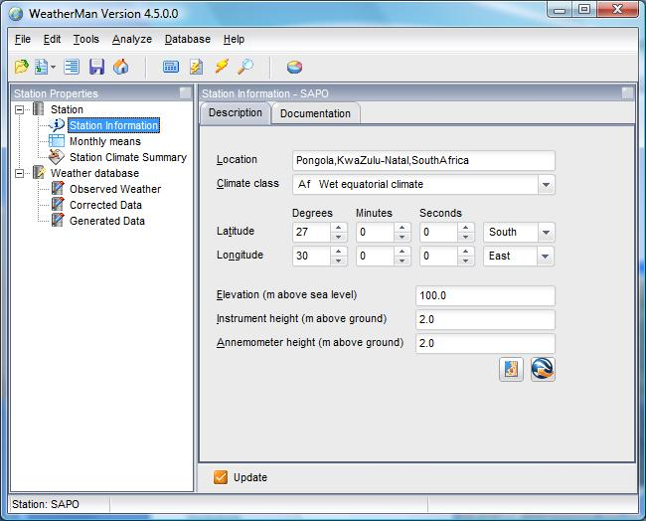
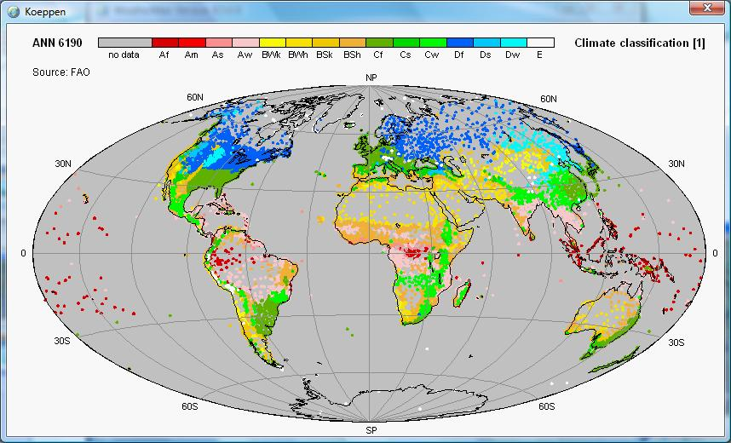
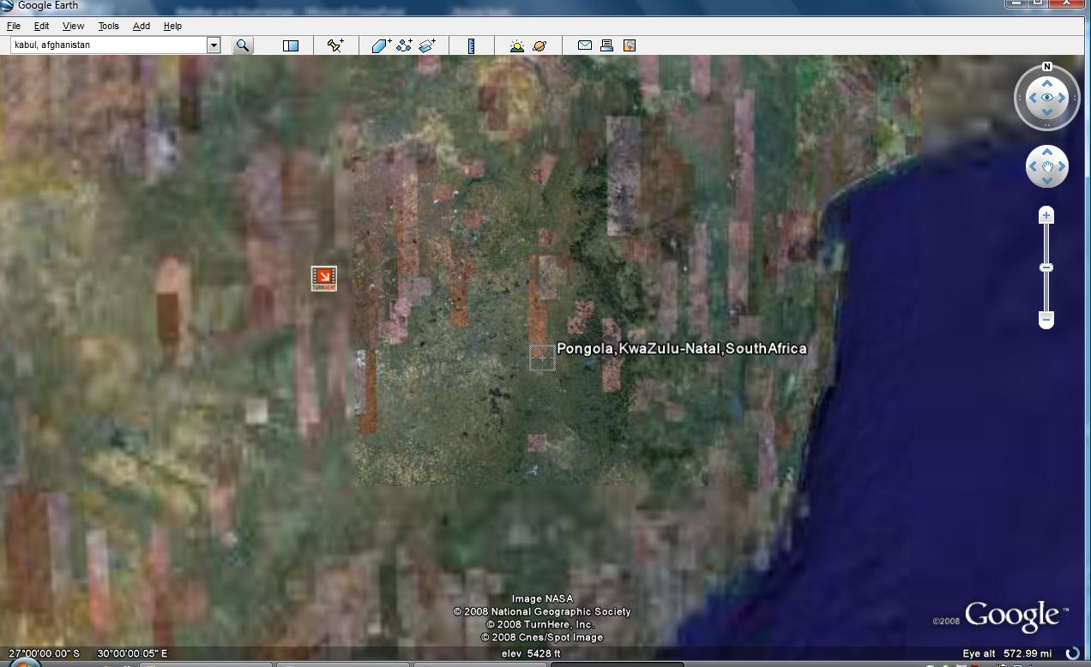
Station Information can be edited

Slide 9
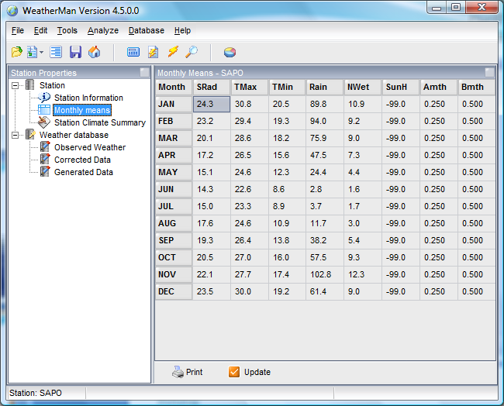
Monthly averages are calculated and can be edited

Slide 10
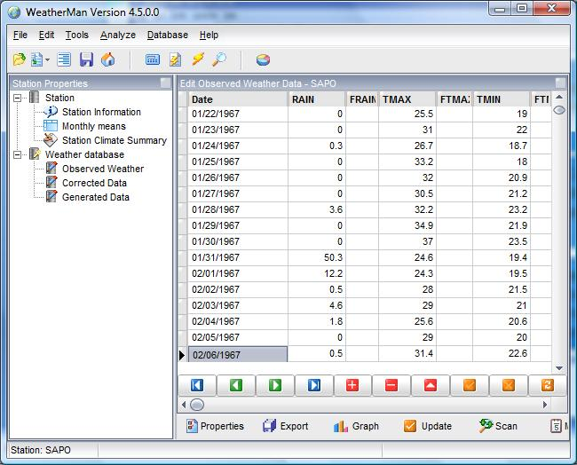
Data can be edited interactively ..
Observed weather is the
raw, uncorrected data
Imported into WM
Corrected Data is the
database with original
data corrected (missing
dates, Sunh, etc.)
The Generated database
contains stochastically
generated weather based
on the climate station.

Slide 11
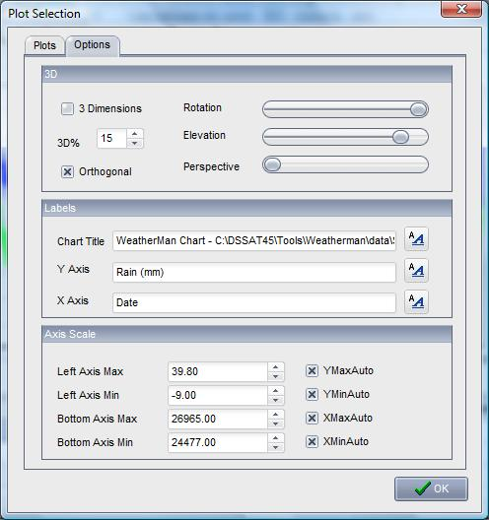
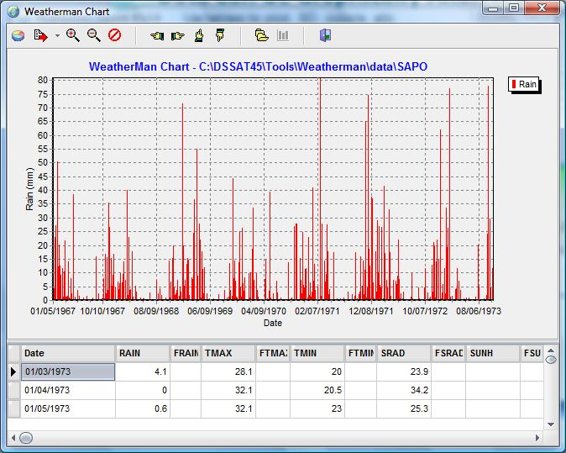
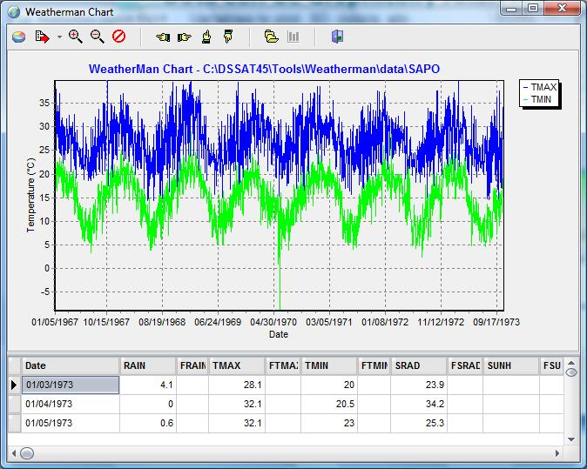
Data Can be Graphically Analyzed
Variables to plot, 3D, colors, etc
Can be dynamically edited.

Slide 12
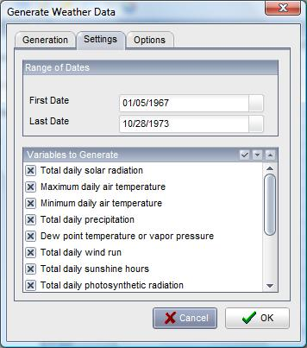
Stochastic Weather Generation
Fill in gaps in archival data
Generate data based on mean and variance
Scaled to match monthly targets

Slide 13
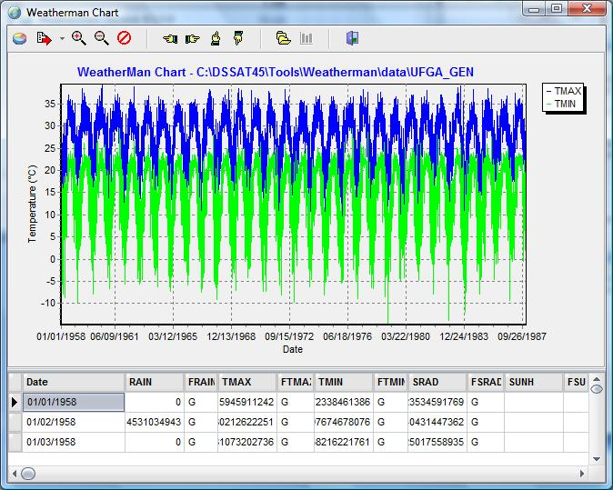
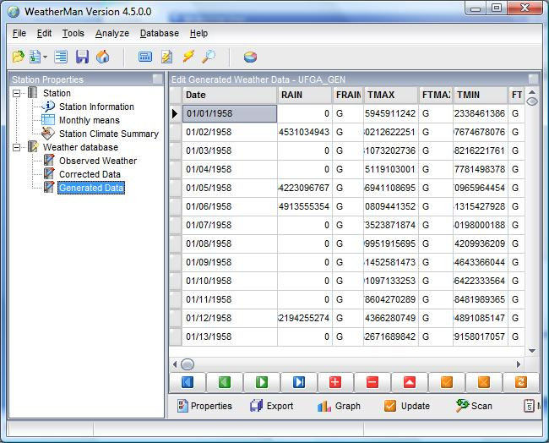
Stochastic Weather Generation
Separate databases are created from archival data
Corrected data can be a mix of measured and generated; Generated data is a statistically representative weather record
Data can be graphed, analyzed, and exported as WTG files

Slide 14
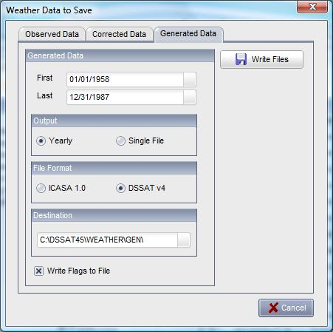

Data can then be exported for use in DSSAT …
WTH files are
exported to the
weather dir.
WTG files are Exported to the Gen directory.

Slide 15
Summary
DSSATv4.5 weather files are identical to earlier version
New weather generators (long-term targets, GCM) are being developed
Increased flexibility on import, editing, and graphing of archival weather data
A new single database contains all archival data; stations created in earlier versions can be imported

