Slide 1

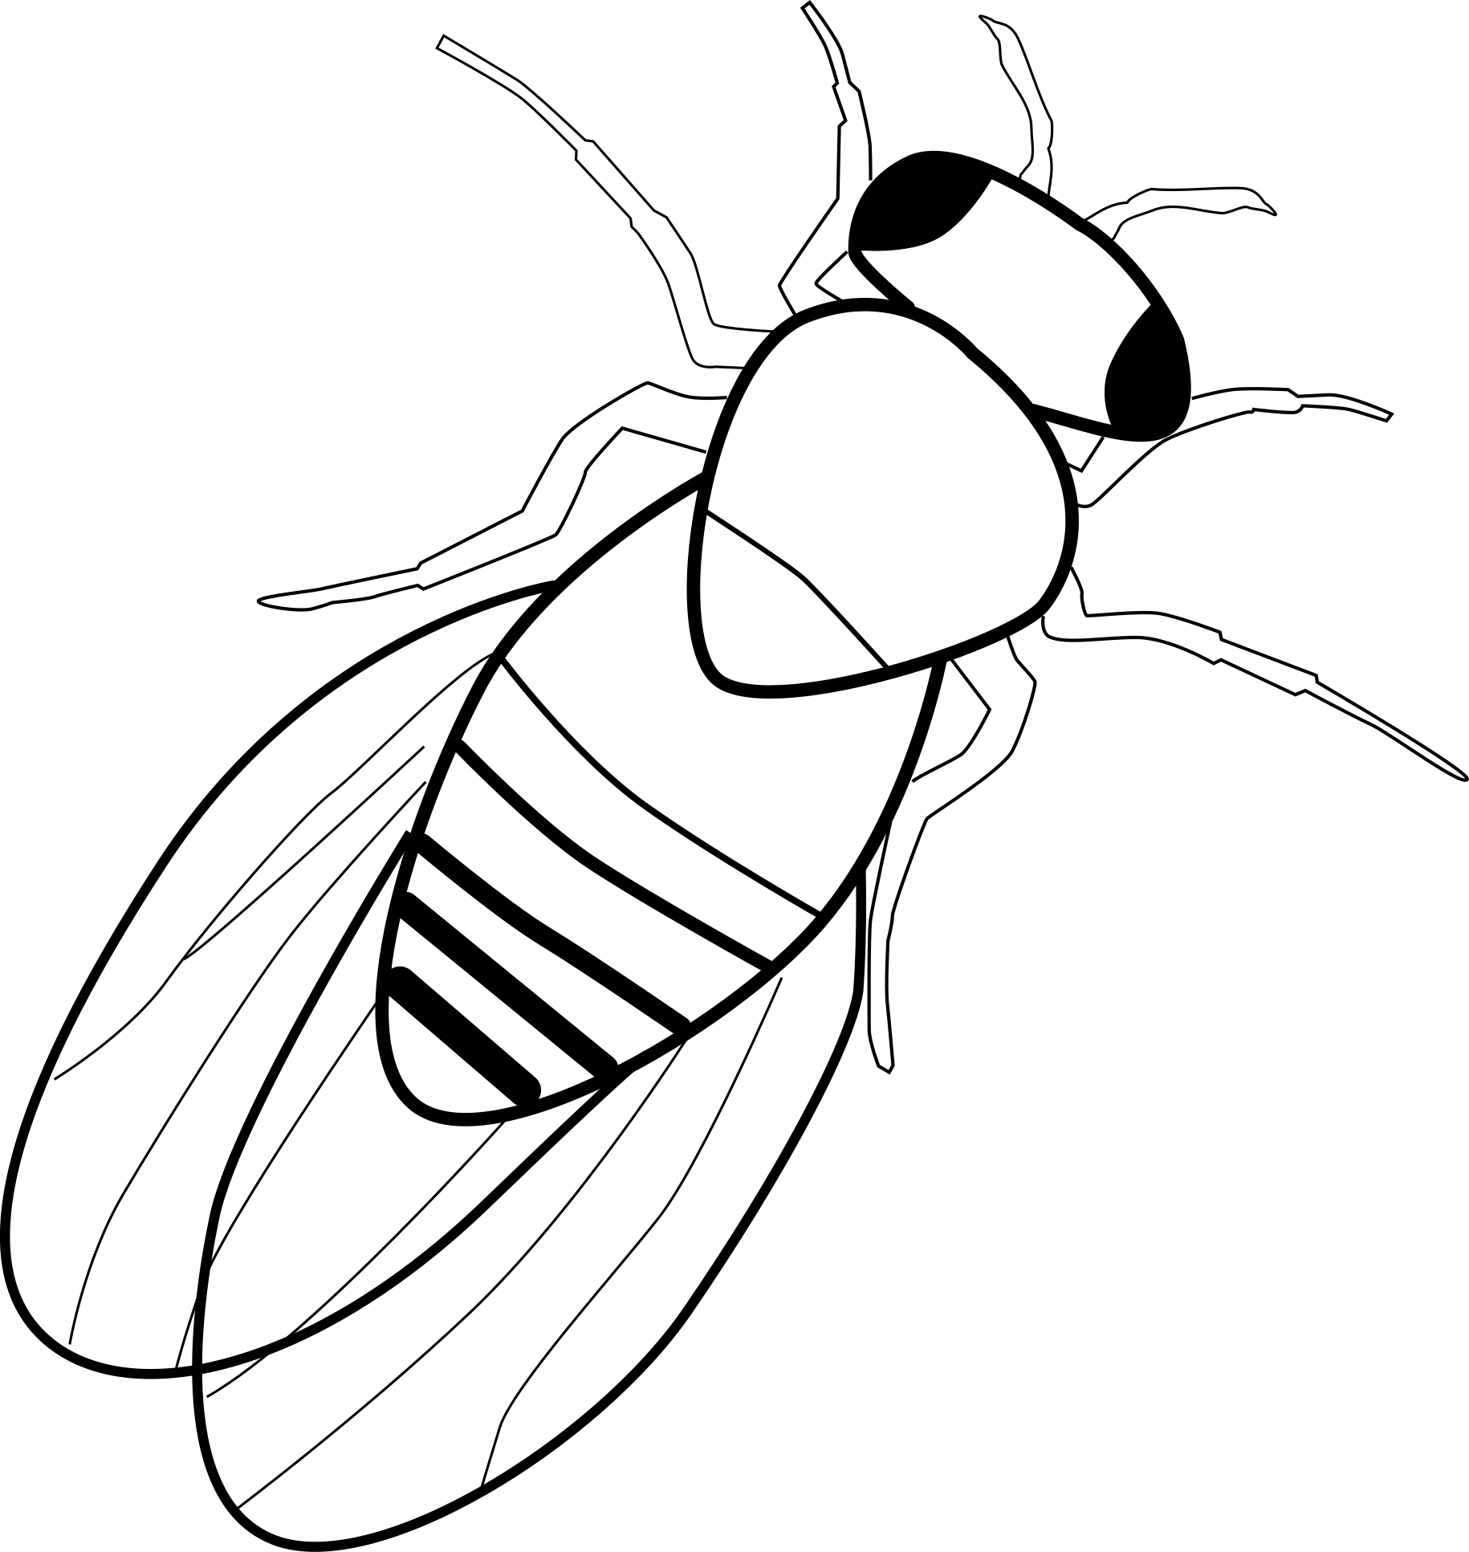
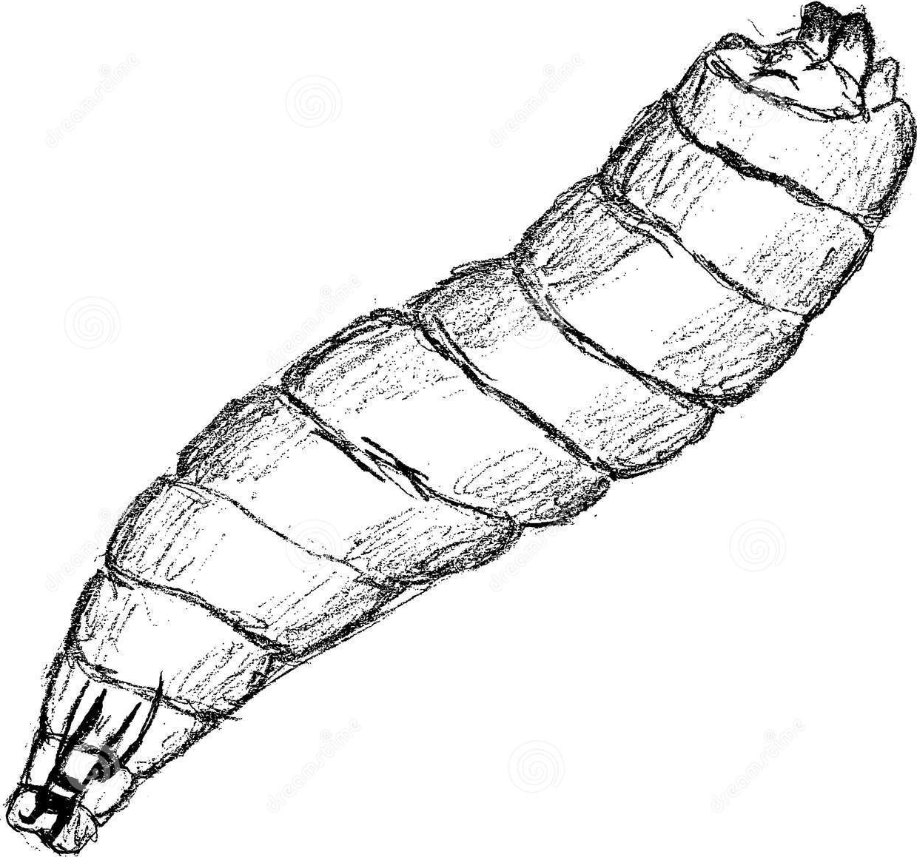
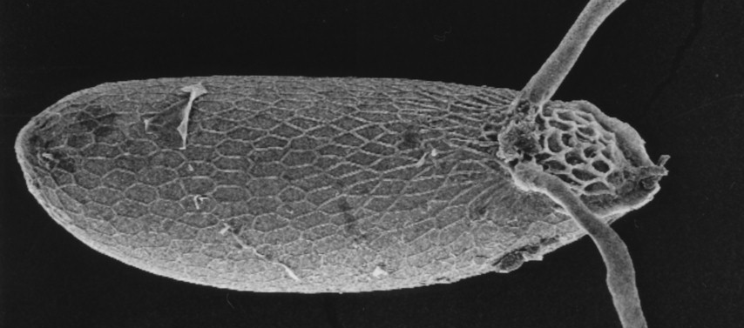
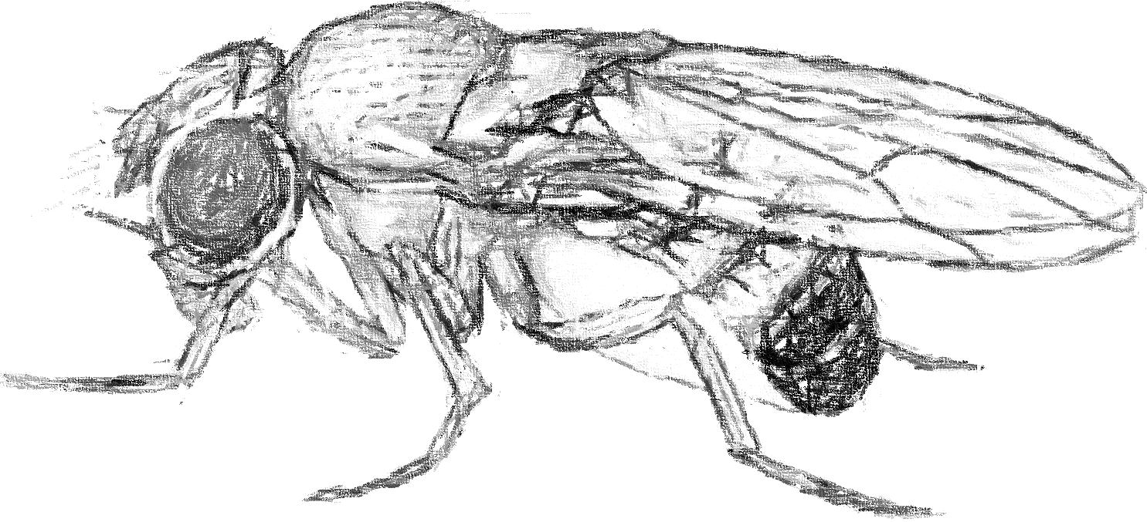
Outbred population
RESPONSE VARIABLES
PREDICTORS
larval diet
(fixed)
Fecundity
3 hour ovp, 3
days/wk
rich diet
poor diet
Adults
diet
(fixed)
sex
(fixed)
Lifespan
3 days/wk
cage (N=8)
(random)
rich diet
rich diet
poor diet
poor diet
phenotyping

