Slide 1
Modern Congestion Control Algorithms
Seminar
Yannik Schreiter
Benedikt Bode
Aachen, 2026-07-22

Slide 2
Motivation
What is Congestion Control and why do we need it?
Avoids congestion
Lower latency, packets loss and higher throughput
Why not just increase capabilities of the hardware?
An increase needs to happen for all of the hardware in the same amount:
Clock speed
Bandwidth of connection
Memory/Depth of waiting queue
Instead try to fit the hardware perfectly to have the best use of its capabilities
Notes:
Raja Jain derived 40 years ago, that if 2 of 3 go infinite, it still would not increase

Slide 3
Motivation
What is Congestion Control and why do we need it?
Avoid overloading network capabilities
Why not just increase capabilities of the hardware?
An increase needs to happen for all of the hardware in the same amount:
clock speed
bandwidth
waiting queue
Instead try to fully utilize the hardware capacities
Notes:
Raja Jain derived 40 years ago, that if 2 of 3 go infinite, it still would not increase

Slide 4
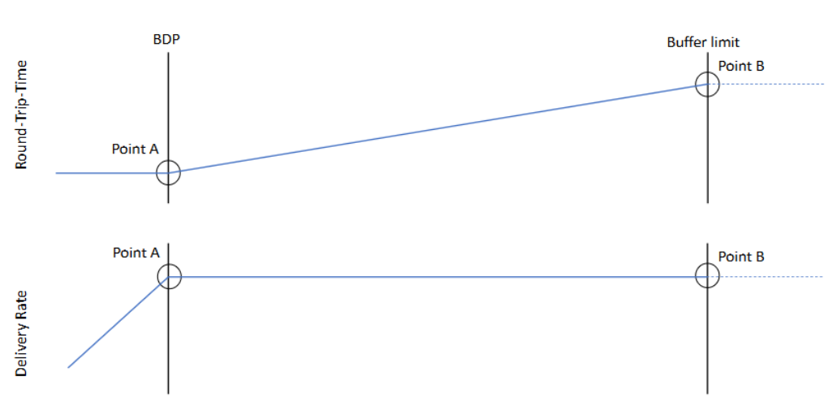
Goal of Congestion Control
What is the Goal of a Congestion Control Algorithm?
Goal: Point A:
Highest possible throughput while no unnecessary delay and packet loss
Notes:
Static increase of packets that are send: Point A is when no more packets should be send

Slide 5
Background
How to evaluate a CCA:
Queue length:
0 queue length ⬄ sending rate ≤ Bandwidth
Jain’s Fairness Index:
Value that shows how fair one flow to the others is
If value equals 1, then all flows get same share of the network capabilities
TCP Cubic
Starts with Cubically increase of congestion window
Amount of packets transmitted in a certain window
If packet loss occurs(Point B), then decrease congestion window
Else increase slowly congestion window

Slide 6
Approaches for Congestion Control
Bottleneck Bandwidth and Round-Trip Propagation Time(BBR)
Startup phase:
Rapidly increasing of sending rate till delivery rate stops increasing
Point A
ProbeBW:
Try to find out if Bandwidth increased or not
Increase sending rate to 1.25 then reduce to 0.75 to empty queue
ProbeRTT
Find lowest RTT
Empty queue by drastically reducing sending rate

Slide 7
Approaches for Congestion Control
Bottleneck Bandwidth and Round-Trip Propagation Time(BBR)
BDP = Bandwidth × RTT
ProbeRTT
Start Phase
ProbeBW

Slide 8
Approaches for Congestion Control
Active Queue Debt Compensation (AQDC) BBR
BDP= (Bandwidth × RTT) – Queue_Debt
ProbeRTT
Start Phase
Track debt
Track debt
ProbeBW

Slide 9
Approaches for Congestion Control
BBR – Extended State (BBR-ES)
ProbeRTT
Start Phase
BBR-NEW-STATE
ProbeBW

Slide 10
Approaches for Congestion Control
Active Queue Debt Compensation (AQDC) BBR
BBR may not drain queue after ProbeBW
BBR may not drain queue before ProbeRTT
To solve this AQDC tracks the debt inside the queue
BBR-Extendend State (BBR-ES)
Creates new phase between ProbeRTT and ProbeBW
Goal is to drain the queue

Slide 11
Approaches for Congestion Control
Copa
2 modes:
Default mode: try to maximize Utility function
Competetive mode: To compete with buffer filling flows
Should only be activated if there is another flow
Copa+
Competetive mode is unnecessarily activated
Introduces new parameter for function to stay better in default mode
Copa Dynamic
Instead of introducing new parameter change the problematic parameter and make it more dynamically
Notes:
Copa+ derived mathematically that Copa will arrive in Competetive mode after some time

Slide 12
Approaches for Congestion Control
Performance Congestion Control (PCC)
Takes all information it gets (RTT, Bandwidth, latency etc.) to calculate sending rate
Core idea for calculation is based on Game Theory
Highly complex
PowerTCP
Core Idea: Switches and routers of network now current use of network
Use In-Band Network Telemetry (INT) information

Slide 13
Approaches for Congestion Control
Christians Congestion Control Code (C4)
4 different states:
Start phase
start and find bottleneck’s bandwidth
Cruising state
stay at calculated perfect sending rate
Probing phase
Testing the network to determine if more is possible
Recovery phase
Recovery the networks recources after probing phase

Slide 14
Evaluation
BBR
Tries to be at Point A, but is a bit behind it
With small buffers on bottleneck:
BBR is less good, because its operating Point could be behind Point B
With large buffers on bottleneck:
BBR is only a bit behind Point A, therefore very good
AQDC BBR
Is more near Operating Point A than standard BBR
BBR-ES
Better Jains Fairness Index (often above 0.9)

Slide 15
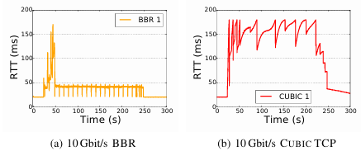
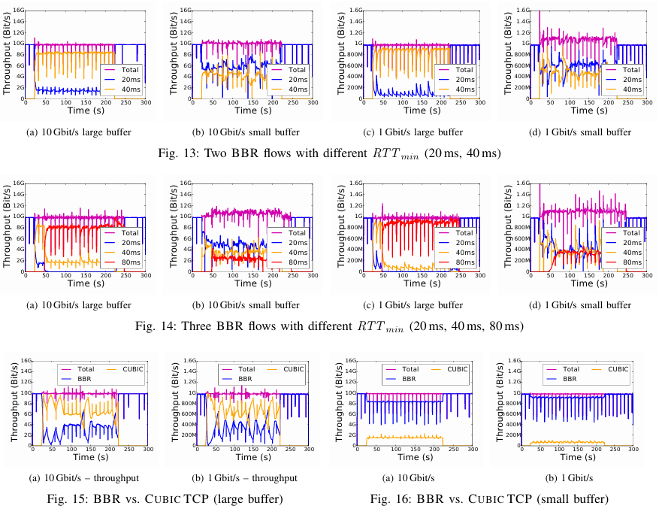
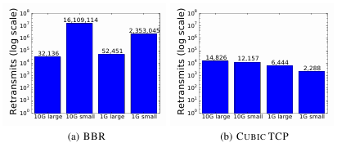
Evaluation
BBR
Lower RTT than Cubic
Better in networks with bottlenecks with large buffer
Higher amount of retransmissions than TCP Cubic

Slide 16
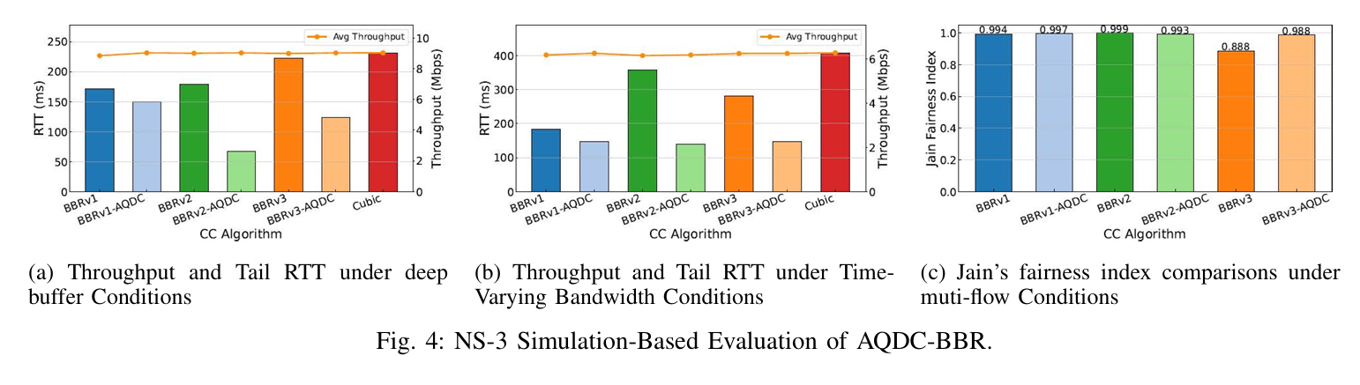
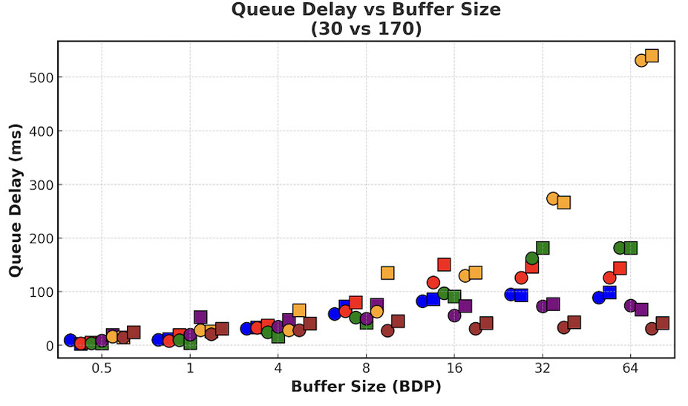
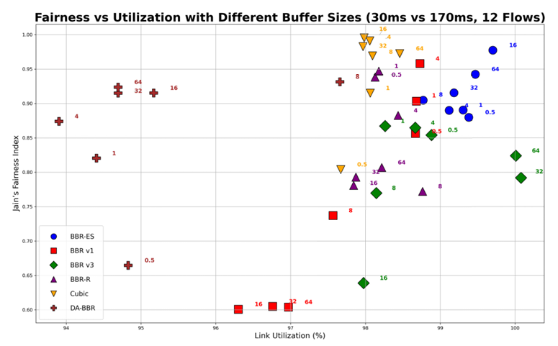
Evaluation
AQDC BBR
Is more near Operating Point A than standard BBR
Tail RTT is lower
BBR-ES
Better fairness and queuing delay while maintaining good link utilization
Notes:
Different BBR Versions: better use of ECN(explicit Congestion Control) and faster convergence in case of network changes
PDF: Probabilistic density function
CDF:Cumulative Distribution Function
BBR-ES(blue): different Dots represent buffersizes: 64: 64BDP Buffersize; 6 flows wit RTT 30ms vive versa
Quadrat: 12 flows, triangle 4 flows

Slide 17
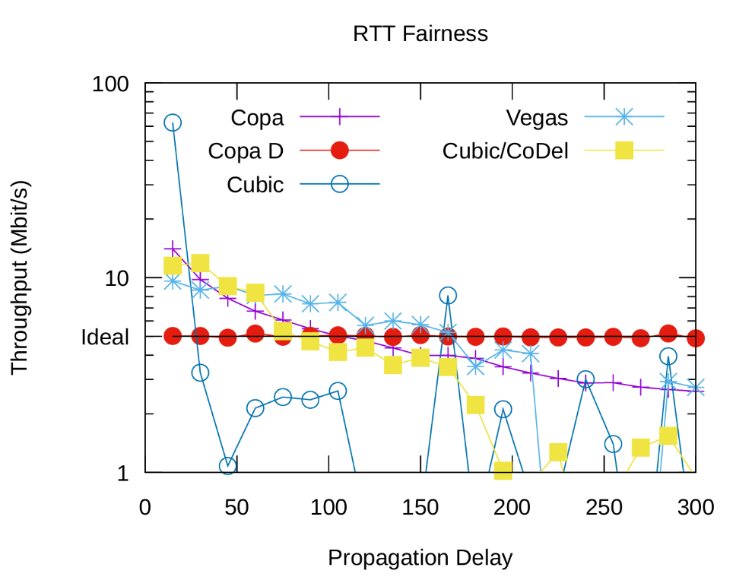
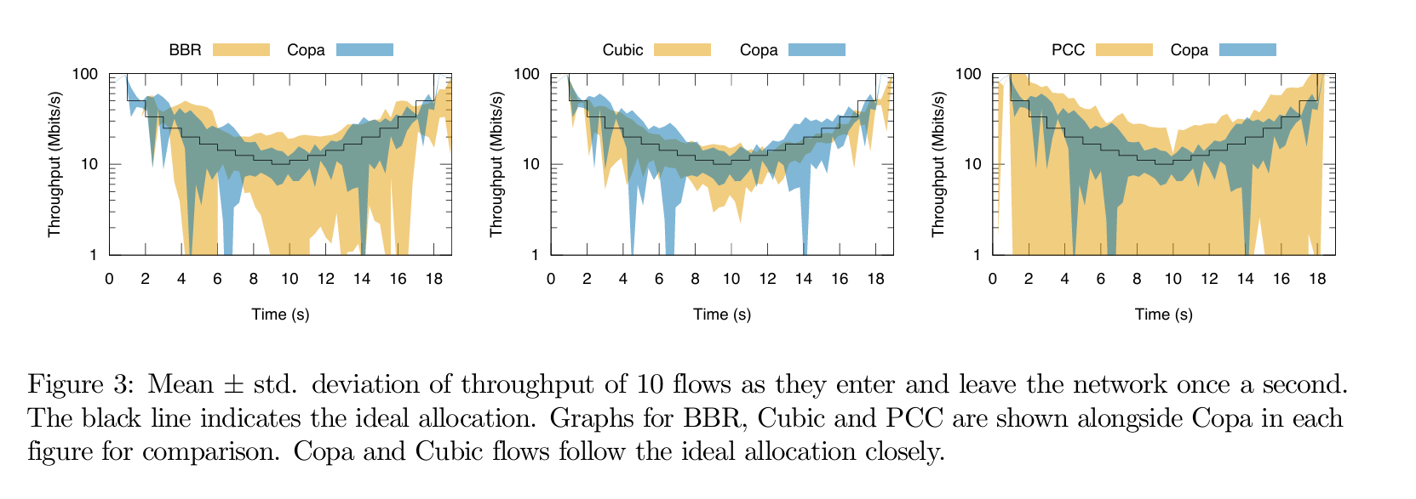
Evaluation
Copa
Not complex to understand (compared to PCC)
Copa default (Copa D)
Competetive mode deactivated
On Ideal line -> near perfect
Copa with Competetive mode is not perfect
Better in changing networks than BBR

Slide 18
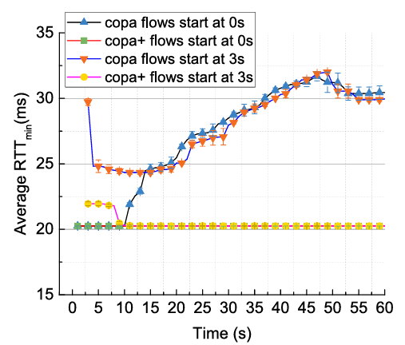
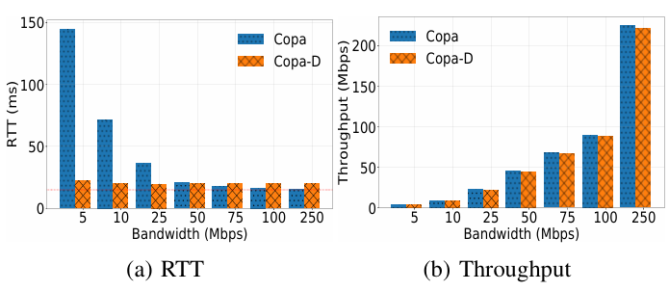
Evaluation
Copa+
Better control on mode switching => values near Copa default
Copa Dynamic
Lower RTT than Copa
Maintining same throughtput like Copa

Slide 19
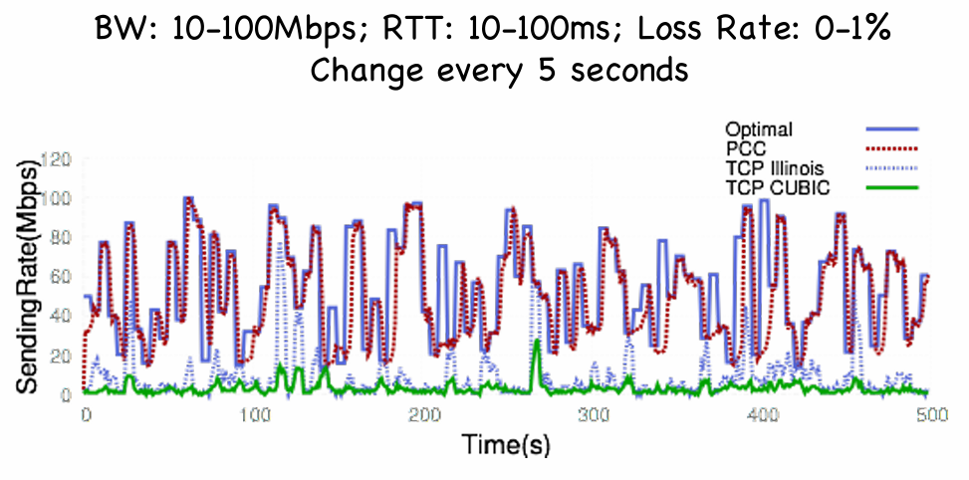
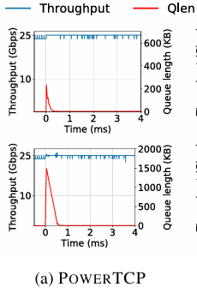
Evaluation
PCC
Good improvements to TCP Cubic
Nearly ideal
very good reaction to network changes
PowerTCP
Close to Point A
Only useful in special network (data centers)
Notes:
PCC: near ideal line, but not always. However very complex to understand: therefore not so easy to improve
PowerTCP: drains queue without losing throughtput
C4: no scientific values available, we don’t know if the numbers are true

Slide 20
Evaluation
PCC
Good improvements to TCP Cubic
Nearly ideal
PowerTCP
very good reaction to network changes
Close to Point A
Only useful in special network (data centers)
C4
Proved to be better in Wifi networks than BBR, TCP Cubic
Notes:
PCC: near ideal line, but not always. However very complex to understand: therefore not so easy to improve
PowerTCP: drains queue without losing throughtput
C4: no scientific values available, we don’t know if the numbers are true

Slide 21
Conclusion
Who is the best?
No perfect Congestion Control Algorithm is found yet
No one is always on Point A and is fair
Goal is to find lowest RTT and highest throughput
What’s next
New CCAs are specialised
PowerTCP usually only in Data Center
Other types of networks
Satelite communication
Thanks for listening

Slide 22
Thanks for listening

Slide 23
Evaluation
PCC

Slide 24
Evaluation
BBR

Slide 25
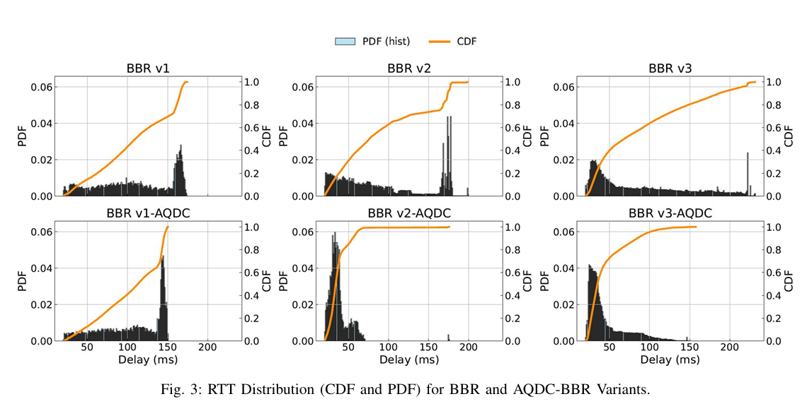
Evaluation
AQDC BBR

Slide 26
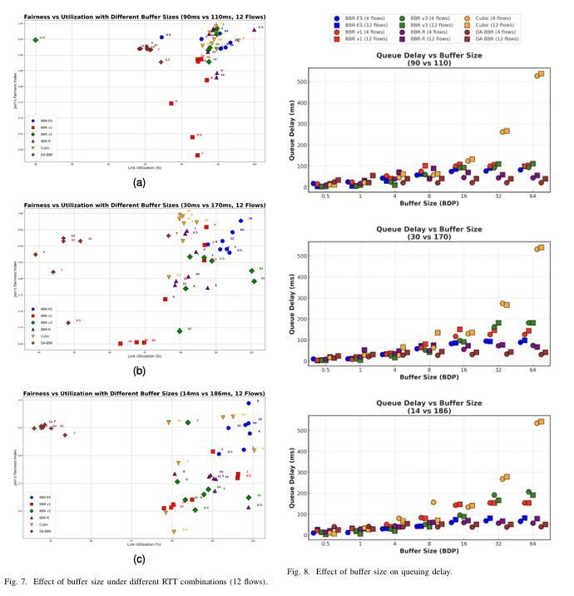
Evaluation
BBR-ES

Slide 27
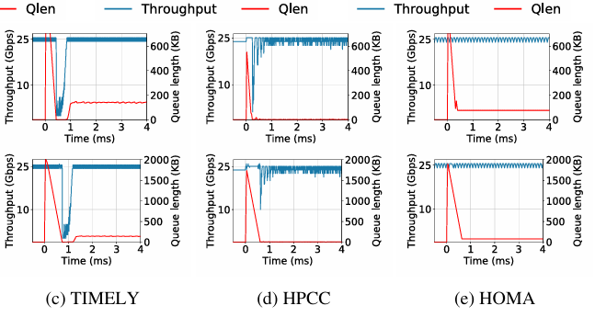
Evaluation
PowerTCP

Slide 28
Evaluation
Copa

Slide 29
Anmerkungen
Da TCP Cubic bei PCC und Copa ist kann man die miteinander vergleichen
AQDC und BBR-ES mit BBR vergleichen
Gleiches für Copa+ und Copa-D
5 oder 6 Folien für Eval
State machine für BBR:
Jains Fairness index eventuell weg wenn es nicht gebraucht wird
Eher sowas wie throughtput und Qlen erklären
Nochmal auf sprache gucken

