Slide 1
ADVLSI2 2026
Project Progress
CNN-based DRC | B0–B7.2 complete · B8.0 actionability next
Notes:
[Sources]
- MODEL_ROADMAP.md
- results/b6_multitask_unet/summary.json
[/Sources]
[Sources] - results/b7_full_layout/b7_1_summary.json and results/b7_full_layout/README.md; measured 2026-08-15; validation-only policy selection; B9 unopened.
[Sources] - results/b7_full_layout/b7_2_cnn_gpu_summary.json; measured 2026-08-20; Tesla T4; B9 unopened. - results/b7_full_layout/b7_2_klayout_competitiveness_summary.json; measured 2026-08-20; one warm-up and five KLayout repetitions. [/Sources]

Slide 2
Motivation
The number of rules has grown from a few hundred in 60nm nodes
to thousands of complex rules in 7nm nodes.
DRC checking is often slow and iterative process with traditional tools that runs many mathematical Boolean operations.
The speed of the rule checker has become a critical point in layout generation of custom circuits.
Real Time ML based DRC checker can help to speed up the design rule checking process because a neural network does not have to iterate over thousands of Boolean operations.

Slide 3
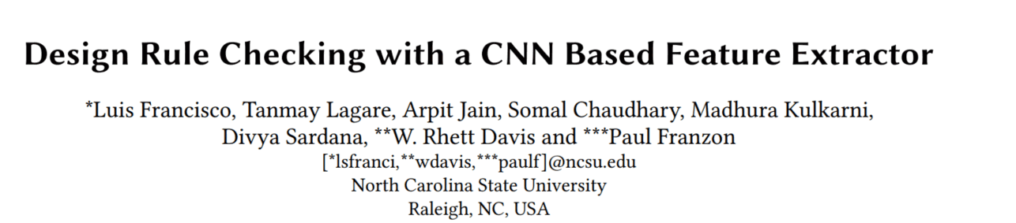
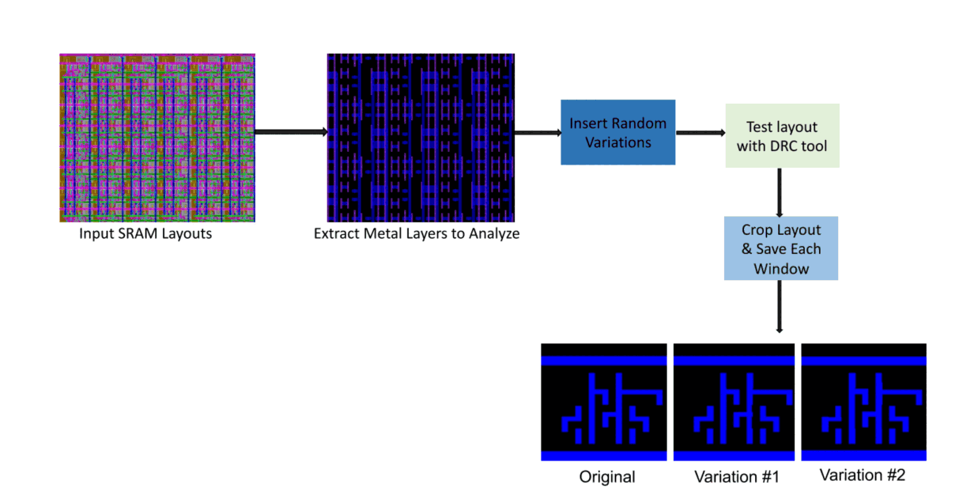
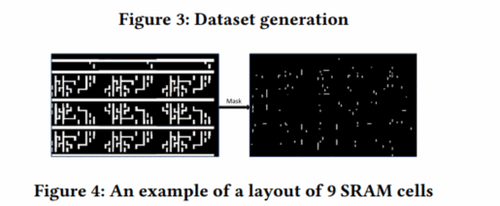
Article Review
50 DRC free SRAM designs designed using the 15nm free PDK.
5,000 variants of these designs were auto-generate using random parameters - total of ~ 250,000 layout clips.
Target was to detect 3 different violation types.
100,000 clips used for Training, 15,000 for Validation, and 5,000 for Testing.
Training took ~7 minutes on a standard 6-core CPU (no GPU acceleration required). 92% accuracy rate was achieved.

Slide 4
Proposal
Make our POC using mature node open source PDK – for example SkyWater 130nm.
Focus only on one DRC violation-
for example: “m1.2 - m1 to m1 spacing > 140nm”.
Layout data – Found “Tiny Tapout” free github database but may need to explore for additional sources.
Project maybe expanded in the future to combine also DRC fixing.
Notes:
https://github.com/TinyTapeout/tinytapeout-sky-26a/tree/main/projects
https://skywater-pdk.readthedocs.io/en/main/rules/periphery.html

Slide 5
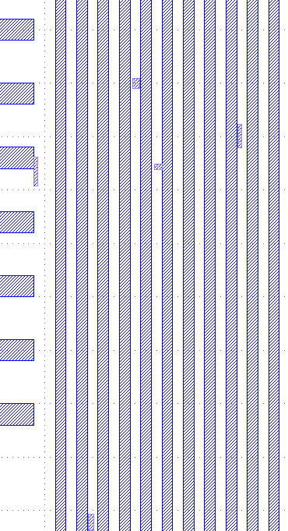
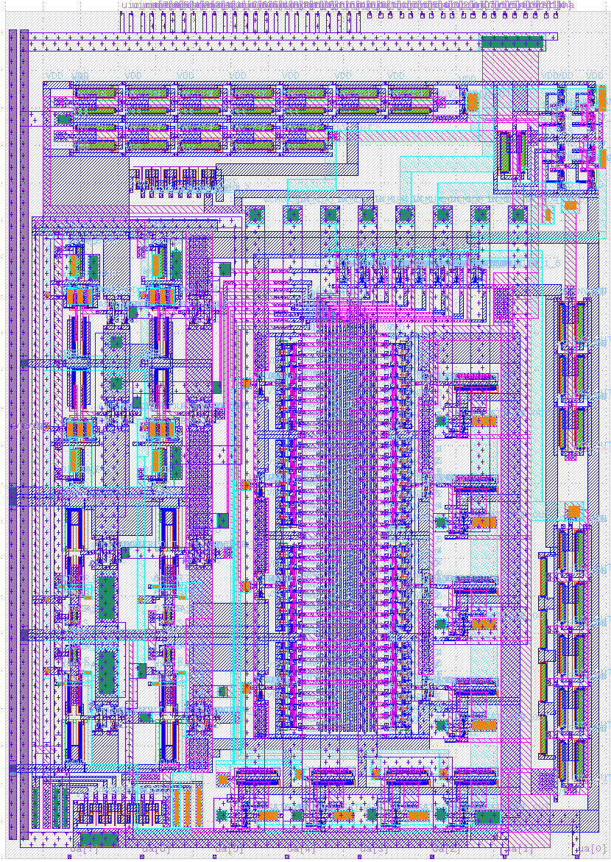
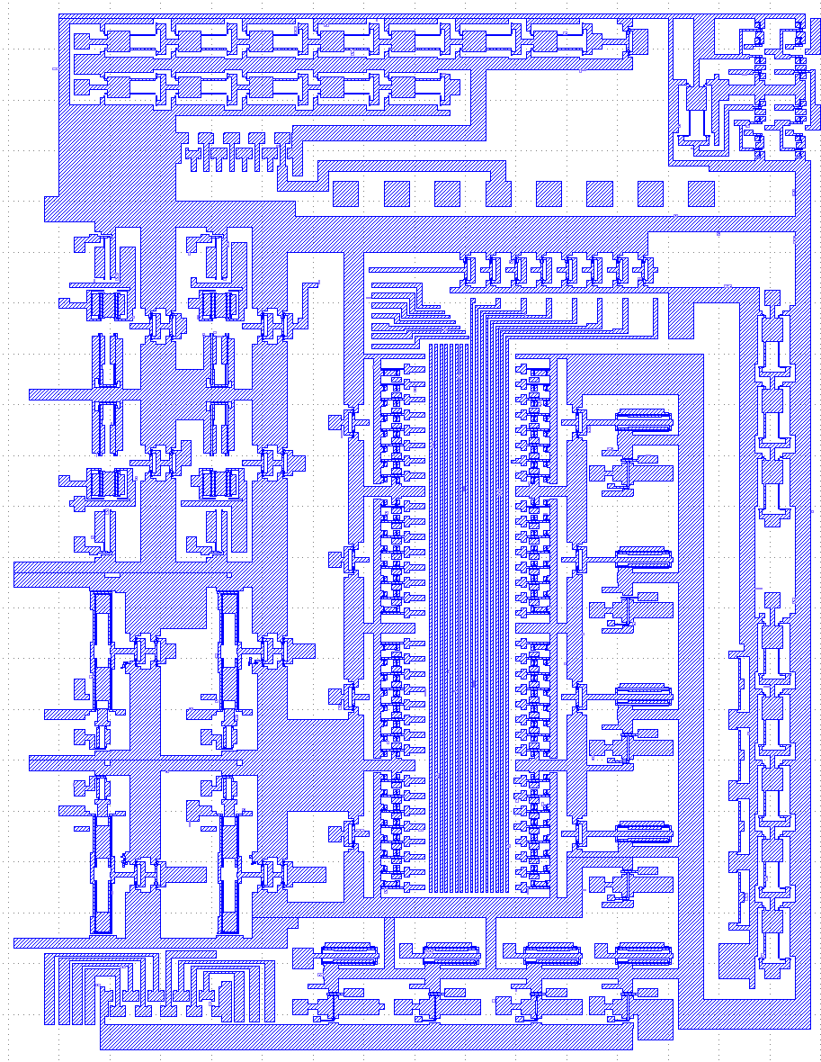
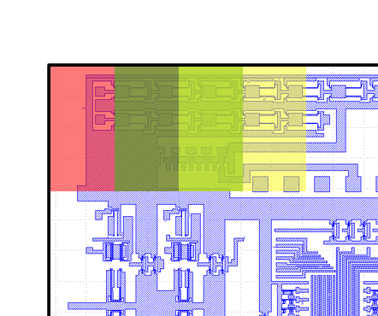
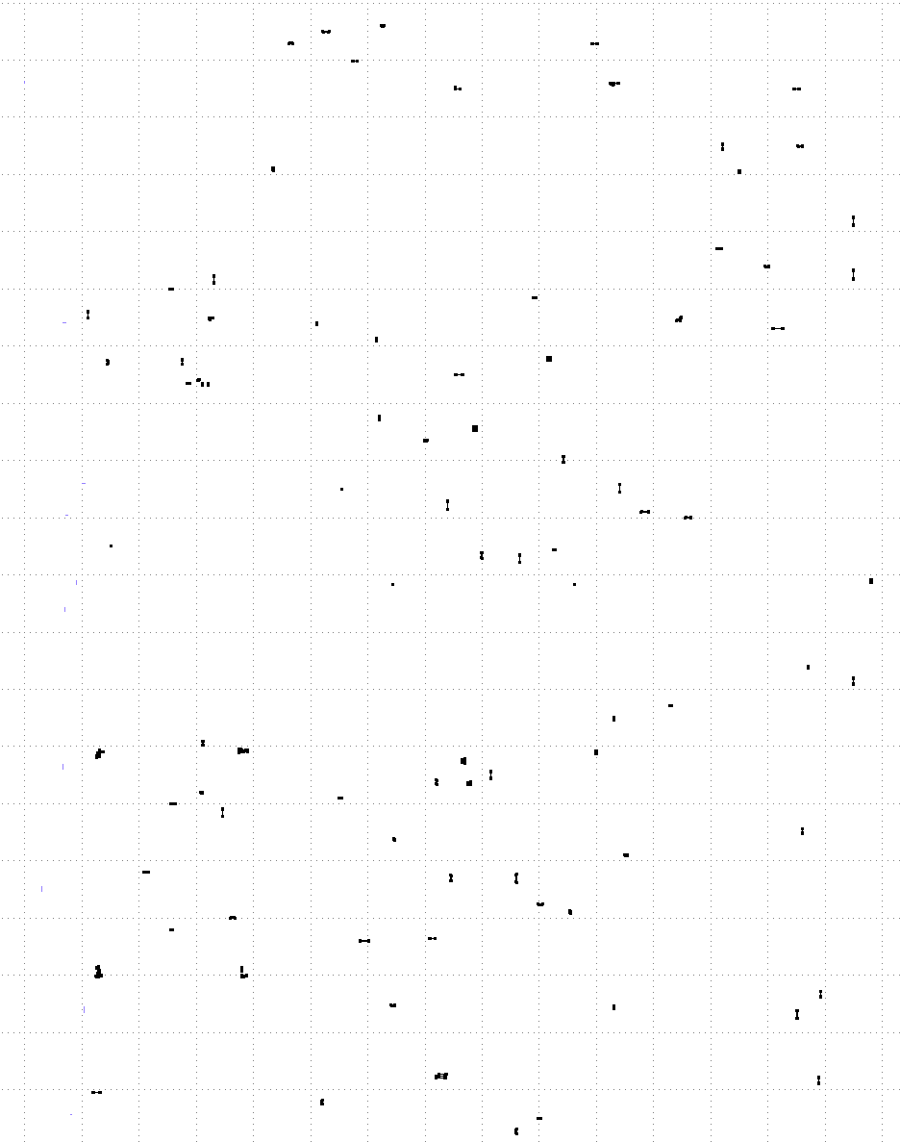
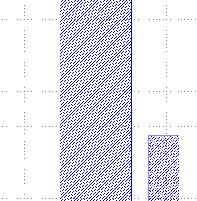
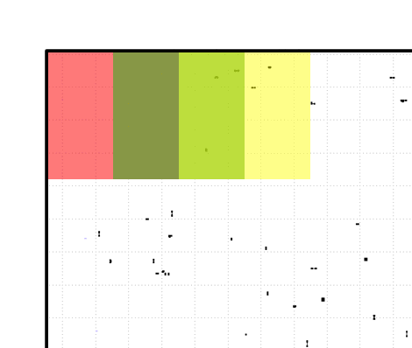
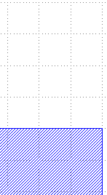
Dataset Generation Example - Sky130 Layout
Inject random m1.2 DRC violations
Clean GDS
m1 only GDS
DRC Error Report
(XML file)
Run DRC
Create Error Mask
[[1 1 1 ... 1 1 1]
[1 1 1 ... 1 1 1]
[1 1 1 ... 1 1 1]
...
[0 0 0 ... 0 0 0]
[0 0 0 ... 0 0 0]
[0 0 0 ... 0 0 0]]
violation
Data Classification & Balancing
Convert to Matrices
Corp
clean

Slide 6
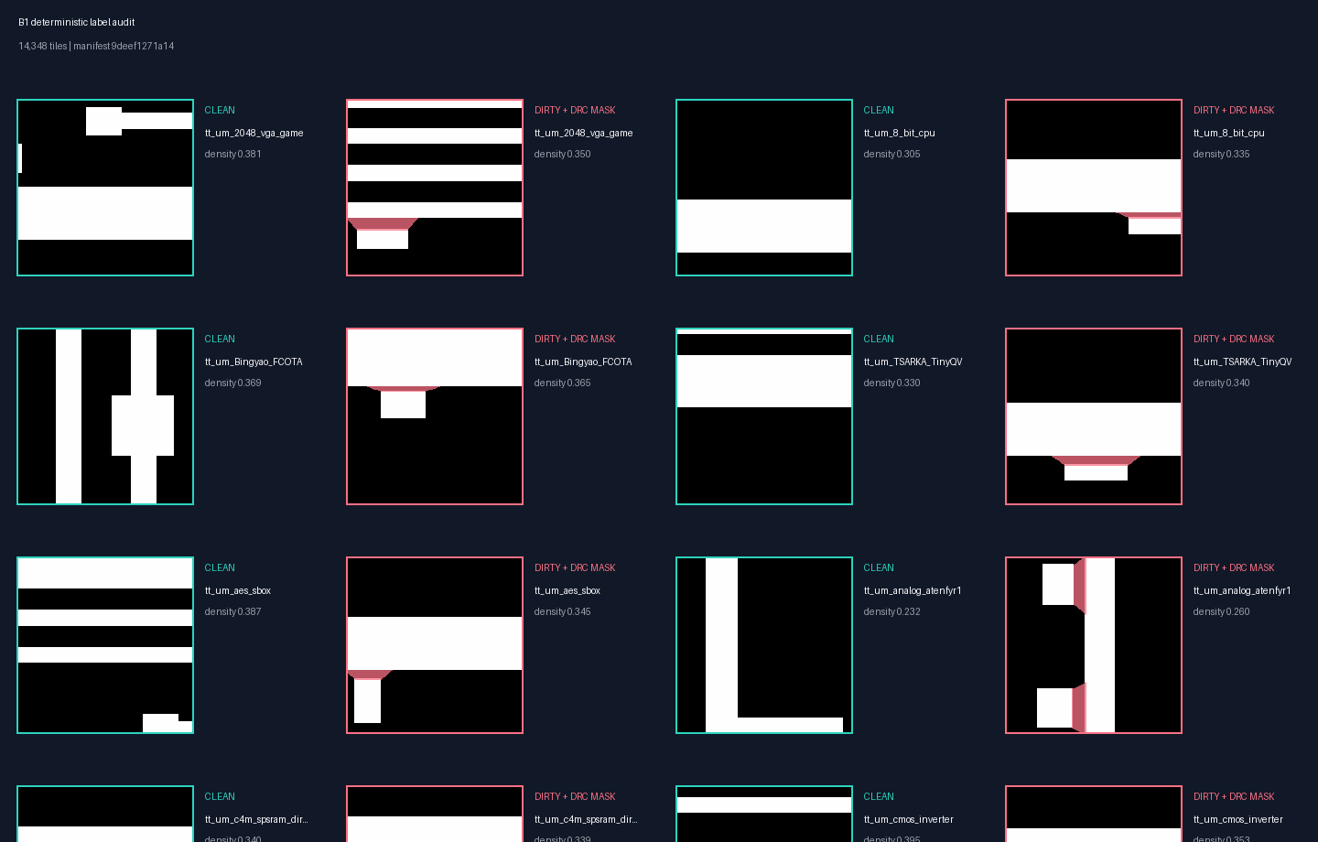
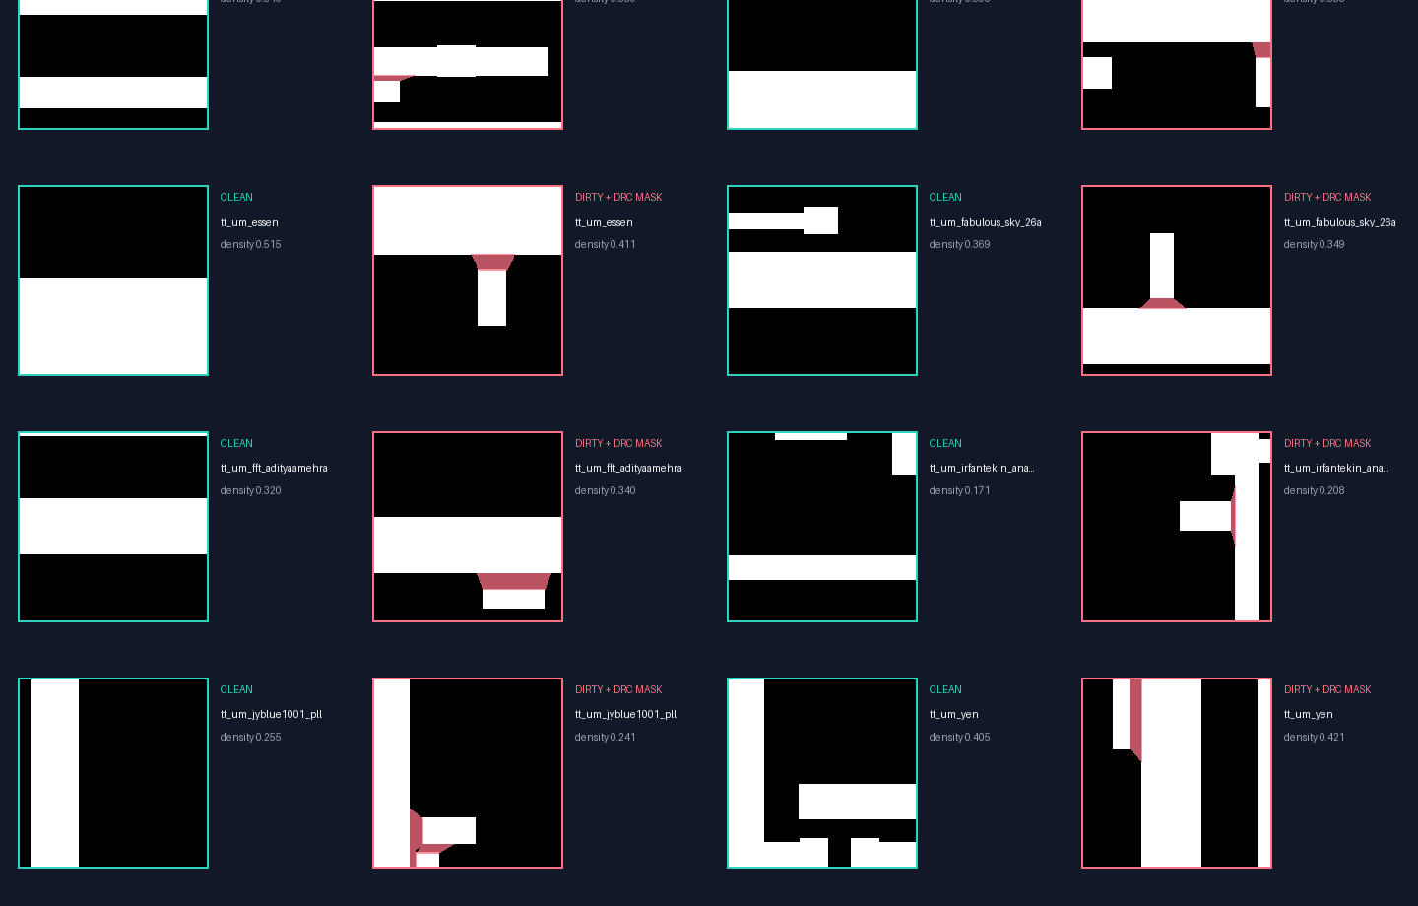
Example of dataset output:
Layout size: 150 µm × 200 µm
Window size: 2 µm × 2 µm
Window stride: 1 µm
Each window becomes a 200 × 200 binary matrix
About 500 layout clips were generated
[[0 0 0 ... 1 1 1]
[0 0 0 ... 1 1 1]
[0 0 0 ... 1 1 1]
...
[0 0 0 ... 1 1 1]
[0 0 0 ... 1 1 1]
[0 0 0 ... 1 1 1]]
[[1 1 1 ... 0 0 0]
[1 1 1 ... 0 0 0]
[1 1 1 ... 0 0 0]
...
[0 0 0 ... 0 0 0]
[0 0 0 ... 0 0 0]
[0 0 0 ... 0 0 0]
[[1 1 1 ... 1 1 1]
[1 1 1 ... 1 1 1]
[1 1 1 ... 1 1 1]
...
[0 0 0 ... 0 0 0]
[0 0 0 ... 0 0 0]
[0 0 0 ... 0 0 0]]

Slide 7
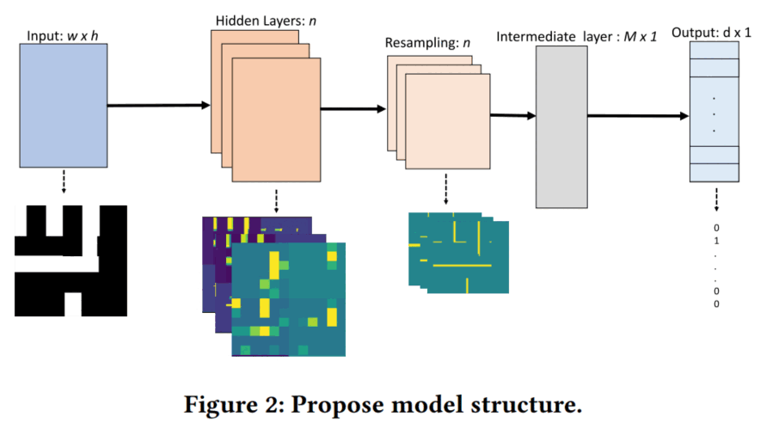
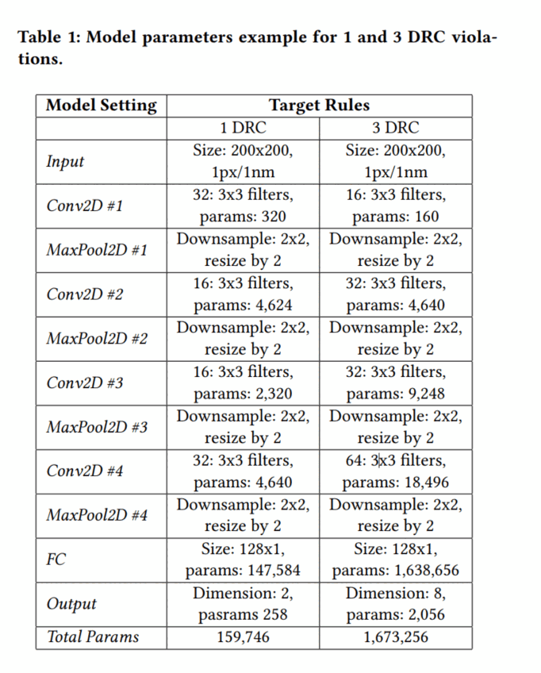
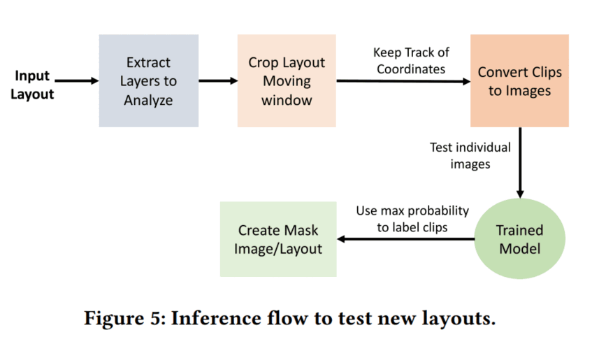
Project steps
Dataset generation - continue
CNN creation and training
Model Validation

Slide 8
Project Resources & Environment
Tools – Klayout (free) interface with Python APIs.
PDK – SkyWater 130nm Open source PDK.
IP database – Tiny Tapeout database (may need for more sources).
Model Training – Google Colab (offers access to GPU), University servers.

Slide 9
From proposal to measured system
B0–B7.2 complete · B8.0 actionability next
Notes:
[Sources]
- MODEL_ROADMAP.md
- results/b6_multitask_unet/summary.json
[/Sources]
[Sources] - results/b7_full_layout/b7_1_summary.json and results/b7_full_layout/README.md; measured 2026-08-15; validation-only policy selection; B9 unopened.
[Sources] - results/b7_full_layout/b7_2_cnn_gpu_summary.json; measured 2026-08-20; Tesla T4; B9 unopened. - results/b7_full_layout/b7_2_klayout_competitiveness_summary.json; measured 2026-08-20; one warm-up and five KLayout repetitions. [/Sources]

Slide 10
Project objective and contribution
Paper baseline
Our target
Tile-level binary classification
Reported up to 92% under the paper setup
No exact violation location
Competitive clean / dirty classification
Generalization to unseen layouts
Pixel-level localization → exact GDS coordinates
Cross-design OpenROAD action selection
Notes:
[Sources] - results/b7_full_layout/b7_2_cnn_gpu_summary.json; measured 2026-08-20; Tesla T4; B9 unopened. - results/b7_full_layout/b7_2_klayout_competitiveness_summary.json; measured 2026-08-20; one warm-up and five KLayout repetitions. [/Sources] [Sources] - B8_ACTIONABILITY_PROTOCOL.md [/Sources]

Slide 11
B0: reproducible pipeline established
6,060 labeled layout clips
Sky130 / m1.2 spacing rule
80/15/5 random tile split
Training-only rotations and reflections
Dataset ZIP → deterministic split
CNN training → best checkpoint
Validation each epoch
Held-out test → JSON metrics + weights

Slide 12
B0 benchmark results
79.2%
Test accuracy
0.786
Test F1
79.5%
Dirty recall
303
Held-out tiles
Validation accuracy by epoch
Validation F1 by epoch
75.6%
78.0%
0.733
0.761
67.3%
0.716
56.3%
56.3%
0.000
0.000
E1
E2
E3
E4
E5
E1
E2
E3
E4
E5

Slide 13
B0 result: functional, not yet paper-comparable
Predicted class
Clean
Dirty
Balanced predictions: 154 clean / 149 dirty
33 false alarms; 30 missed violations
Epochs 1–2 collapsed; recovery starts at epoch 3
Random tile split may leak layout families
Dataset and task differ from the paper
Decision: redesign evaluation before tuning
124
33
True
clean
30
116
True
dirty
Test set: 303 tiles

Slide 14
Two benchmarks support two different claims
Tile-random reference
Unseen-layout track
Preserve the clean / dirty classification task
Keep equivalent content inside one split
Internal reference; not a direct paper reproduction
Group variants of the same design family
Train and test on independent layouts
Report accuracy, F1, recall and per-layout variance

Slide 15
Roadmap after the KLayout audit
B1–B6 Baselines + localization — complete
B7.1 Internal full-layout policy — accepted
B7.2 KLayout audit — detector rejected
B8.0 Actionability pilot — next
B8.1 20+ family trajectory dataset — gated
B8.2–B8.3 Controller + AutoTuner comparison
B9 Sealed final holdout
B7.2: KLayout was 162×–256× faster; CNN recall stayed near 95%. Detector tuning is closed.
Notes:
[Sources]
- MODEL_ROADMAP.md
- results/b6_multitask_unet/summary.json
[/Sources]
[Sources] - results/b7_full_layout/b7_1_summary.json and results/b7_full_layout/README.md; measured 2026-08-15; validation-only policy selection; B9 unopened.
[Sources] - results/b7_full_layout/b7_2_cnn_gpu_summary.json; measured 2026-08-20; Tesla T4; B9 unopened. - results/b7_full_layout/b7_2_klayout_competitiveness_summary.json; measured 2026-08-20; one warm-up and five KLayout repetitions. [/Sources]

Slide 16
Phase dashboard
Phase
State
Primary output
Accuracy
F1
Δ F1
B2
Accepted
Frozen classifier baseline
90.38%
0.909
—
B3
Rejected
Recall gain failed confirmation
89.71%
0.907
−0.002
B4
Rejected
Compact model failed frozen test
89.36%
0.904
−0.005
B5
Closed
Ensemble + failure audit
90.47%
0.912
+0.003
B6.2
Accepted
Multi-task localization
95.51%
0.957
+0.015
B7.2 rejects the accelerator; B8.0 now tests whether OpenROAD actions create learnable design-specific headroom.
Notes:
[Sources]
- results/b2_baselines/summary.json
- results/b3_optimization/extension_summary.json
- results/b4_architecture/summary.json
- results/b5_ensemble/summary.json
- results/b5_failure_audit/summary.json
- results/b6_multitask_unet/summary.json
[/Sources]
[Sources] - results/b7_full_layout/b7_1_summary.json and results/b7_full_layout/README.md; measured 2026-08-15; validation-only policy selection; B9 unopened.
[Sources] - results/b7_full_layout/b7_2_cnn_gpu_summary.json; measured 2026-08-20; Tesla T4; B9 unopened. - results/b7_full_layout/b7_2_klayout_competitiveness_summary.json; measured 2026-08-20; one warm-up and five KLayout repetitions. [/Sources]

Slide 17
B1: evaluation foundation is now credible
14,348 labeled tiles
14 independent layout families
7,784 clean / 6,564 dirty
9 new families admitted in B1
0 contradictory labels
2,597 equivalent duplicates removed
Unseen split: 6,442 / 2,627 / 2,682
Source hashes + manifest gate verified
Notes:
[Sources]
- data/b1_current_audit/manifest.summary.json
- Manifest 9deef1271a145198a60abccf291ec499d53226075b4ccfa2061a215afbd01472

Slide 18
B1 visual audit: labels trace back to DRC geometry
Representative clean and dirty tiles are selected deterministically for every admitted family.
Pink overlays show the verified KLayout m1.2 violation geometry inside dirty tiles.
B1 confirmed coordinate registration; B6 will turn the same geometry into pixel-level segmentation targets.
Notes:
[Sources]
- data/b1_current_audit/manifest.summary.json
- Manifest 9deef1271a145198a60abccf291ec499d53226075b4ccfa2061a215afbd01472
- data/b1_current_audit/label_audit_grid.png

Slide 19
B2: the unchanged CNN generalizes across layouts
92.47% ± 0.61%
Tile accuracy
90.38% ± 0.84%
Unseen accuracy
0.919 / 0.909
F1: tile / unseen
2.09 pts
Accuracy gap
Test accuracy across seeds and protocol means
Dirty F1 across seeds and protocol means
92.89%
91.77%
92.75%
92.47%
90.38%
0.925
0.910
0.922
0.919
0.909
T42
T43
T44
T mean
U mean
T42
T43
T44
T mean
U mean
Notes:
[Sources]
- results/b2_baselines/summary.json
- results/b2_baselines/runs/tile_random_reference_seed_42.json
- results/b2_baselines/runs/tile_random_reference_seed_43.json
- results/b2_baselines/runs/tile_random_reference_seed_44.json
- results/b2_baselines/runs/unseen_layout_v1_seed_42.json
- results/b2_baselines/runs/unseen_layout_v1_seed_43.json
- results/b2_baselines/runs/unseen_layout_v1_seed_44.json
- Configuration d7fa939a1212; manifest 9deef1271a14

Slide 20
B2: 90.38% on unseen layout families
Bingyao FCOTA: 92.91% accuracy / 0.940 F1
VGA game: 89.76% accuracy / 0.887 F1
SRAM direct: 88.97% accuracy / 0.907 F1
All values are mean results across three fixed seeds
All three test families were unseen during training
Only 2.09 accuracy points below tile-random
Dirty-F1 gap is only 0.95 points
Decision: freeze B2 and begin controlled B3 tuning
Notes:
[Sources]
- results/b2_baselines/summary.json
- Three-seed per-layout aggregation for unseen_layout_v1
- Manifest 9deef1271a145198a60abccf291ec499d53226075b4ccfa2061a215afbd01472

Slide 21
B3: validation improved, but efficiency target missed
RMSprop 1e-3
B3.1 kept B2 recipe
+0.72 pts
Validation F1
+4.40 pts
Validation recall
26 epochs
Only 13.3% fewer
Validation dirty F1 by recipe
Validation dirty recall by recipe
91.36%
91.78%
91.78%
92.08%
90.38%
88.60%
89.81%
89.81%
93.00%
0.909
B2
Sched
Early
Thresh
U mean
B2
Sched
Early
Thresh
U mean
Notes:
[Sources]
- results/b3_optimization/b3_1_summary.json
- results/b3_optimization/extension_summary.json
- Manifest 9deef1271a145198a60abccf291ec499d53226075b4ccfa2061a215afbd01472
Selection used unseen-layout validation only. Frozen tests were not inspected until the validation gate passed.

Slide 22
B3: recall gain failed confirmation
Accuracy: 89.71% (−0.67 points vs. B2)
Dirty recall: 94.42% (+3.69 points)
Dirty F1: 90.72% (−0.22 points)
Accuracy exceeded the 0.5-point tolerance
Tile reference held: 92.52% accuracy
Selection used validation data only
Decision: retain B2 as frozen baseline
Next: B4 architecture test with B2 recipe
Notes:
[Sources]
- results/b2_baselines/summary.json
- results/b3_optimization/extension_summary.json
- results/b3_optimization/test/unseen_layout_v1__plateau_full__seed_42.json
- results/b3_optimization/test/unseen_layout_v1__plateau_full__seed_43.json
- results/b3_optimization/test/unseen_layout_v1__plateau_full__seed_44.json
The candidate status is failed_confirmation; B2 remains the accepted baseline.

Slide 23
B4: compact model failed confirmation
Validation F1: 93.61%
14.3× fewer parameters
ONNX: 172 KB vs. 2.41 MB
Validation gate passed
Unseen accuracy: 89.36%
Unseen F1: 90.36%
Tile recall: 91.36%
Reject B4; retain B2
Notes:
[Sources]
- results/b4_architecture/summary.json
- results/b4_architecture/README.md
[/Sources]

Slide 24
B5.1: ensemble passes validation gate
Selected F1: 93.87%
Selected recall: 92.21%
All three seeds beat B4 F1
Frozen tests unlocked
Blend: 25% B2 / 75% B4
B4-only correct: 110
B2-only correct: 68
Selection used validation only
Notes:
[Sources]
- MODEL_ROADMAP.md
- results/b5_ensemble/summary.json
- results/b5_ensemble/README.md
[/Sources]

Slide 25
B5.1: gains, but recall gate fails
Unseen accuracy: 90.38% → 90.47%
Unseen F1: 90.94% → 91.25%
Unseen recall: 90.73% → 93.39%
Unseen gate passed
Tile accuracy: 92.47% → 94.70%
Tile F1: 91.89% → 94.08%
Tile recall: 93.39% → 92.07%
Reject ensemble; keep B2
Notes:
[Sources]
- MODEL_ROADMAP.md
- results/b5_ensemble/summary.json
- results/b5_ensemble/README.md
[/Sources]

Slide 26
B5.2: audit closes classifier-only tuning
B4 led unseen validation in every seed
B2 dirty advantage: tile-random only
Joint disagreement gate failed
No stable ensemble mechanism
10 replicated density slices
All were clean-sample effects
Density bin changed by protocol
No B5.3; retain B2
Notes:
[Sources]
- results/b5_failure_audit/summary.json
- results/b5_failure_audit/README.md
[/Sources]

Slide 27
B6.1: exact localization data is ready
14 layout families
6,924 exact KLayout violations
6,924 unique owners
8,021 dirty + 8,021 clean tiles
1600 nm input + 160 nm halo
1280 nm gap-free owned output
200×200 image + 160×160 mask
All 7 visual-audit categories passed
Notes:
[Sources]
- MODEL_ROADMAP.md
- results/b6_localization_dataset/summary.json
- results/b6_localization_dataset/README.md
[/Sources]

Slide 28
B6.2 passes every development gate
Classification improves vs. B2
Localization passes; precision next
Accuracy: 95.51% (+1.50)
Dirty recall: 98.86% (+2.67)
Dirty F1: 95.66% (+1.51)
Same B6 tiles · 3 seeds
Mask Dice: 86.32%
Object F1: 84.23%
Vector-owner recall: 87.19%
Object recall 99.36%; precision 73.12%
Notes:
[Sources]
- results/b6_multitask_unet/summary.json
- results/b6_multitask_unet/runs/seed_42.json
- results/b6_multitask_unet/runs/seed_43.json
- results/b6_multitask_unet/runs/seed_44.json
[/Sources]

Slide 29
B7.1 passes all full-layout gates
Validation-only policy
Development confirmation
Classification threshold: 0.92
Segmentation threshold: 0.40
Minimum area: 16 px
Merge gap: 2 px
Violation recall: 95.51%
Candidate precision: 81.44%
Component F1: 87.92%
Exact-pair precision: 100%
Notes:
[Sources]
- results/b6_multitask_unet/summary.json
- results/b6_multitask_unet/runs/seed_42.json
- results/b6_multitask_unet/runs/seed_43.json
- results/b6_multitask_unet/runs/seed_44.json
[/Sources]
[Sources] - results/b7_full_layout/b7_1_summary.json and results/b7_full_layout/README.md; measured 2026-08-15; validation-only policy selection; B9 unopened.

Slide 30
B7.2 rejects the CNN as an accelerator
Validation batch
Development confirmation
CNN total: 4,693.87 s
KLayout median: 18.35 s
KLayout faster: 255.85×
CNN recall: 95.33%
CNN total: 1,392.87 s
KLayout median: 8.59 s
KLayout faster: 162.21×
CNN recall: 95.51%
Notes:
[Sources]
- results/b7_full_layout/b7_2_cnn_gpu_summary.json; measured 2026-08-20; Tesla T4; B9 unopened.
- results/b7_full_layout/b7_2_klayout_competitiveness_summary.json; measured 2026-08-20; one warm-up and five KLayout repetitions.
[/Sources]

Slide 31
B8.0 must prove there is an ML problem
Frozen pilot
7 Sky130HD design families
9 action configurations
2 paired seeds
126 full flows
Continue only if
Actions materially change outcomes
Winners differ by design
Oracle beats the best fixed action
Signal survives seeds
Pre-action features predict rank
Novelty: one cross-design recommendation versus per-design AutoTuner search at the same full-flow budget.
Notes:
[Sources]
- B8_ACTIONABILITY_PROTOCOL.md
- MODEL_ROADMAP.md
- https://openroad-flow-scripts.readthedocs.io/en/latest/user/InstructionsForAutoTuner.html
[/Sources]

