Slide 1

Факультет компьютерных наук, ОП Программная инженерия
Предикативный ввод
Выполнили: Чертанов Денис БПИ185
Сафонов Николай БПИ185
Калантаев Максим БПИ185
Москва, 2021

Slide 2

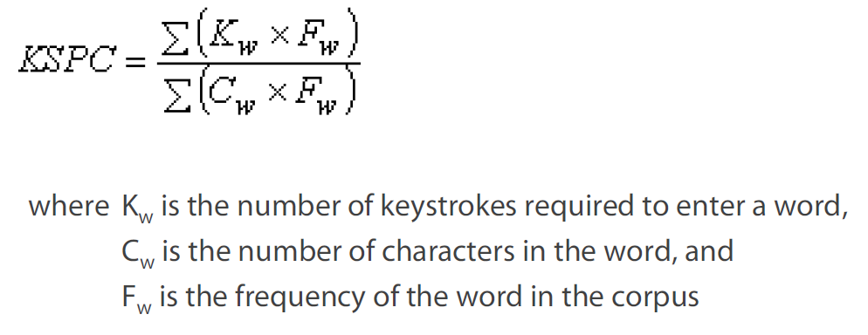
ФКН, Программная инженерия
Objective function
Main metric – KSPC metric
Keystrokes per character (KSPC) is the number of keystrokes, on average, to generate each character of text in a given language using a given text entry technique

Slide 3
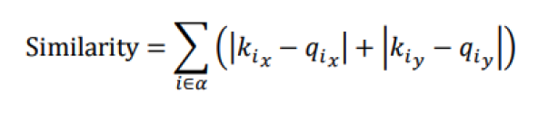
ФКН, Программная инженерия
Objective function
Secondary metric – Learning Performance (LP)
Learning Performance (LP) is the numerical indicator of the learning rate (based on calculating the similarity of the proposed keyboard with the default)
where 𝑖 is a letter in alphabet 𝛼,
the set of lowercase letters
from ‘а’ to ‘я,’ and 𝑘𝑖𝑥
and 𝑞𝑖𝑥
are the x-indices of the 𝑖 key
on the given keyboard layout and default

Slide 4
ФКН, Программная инженерия
algorithm
Simulated annealing

Slide 5

ФКН, Программная инженерия
Before starting simulated annealing we need to define 3 functions:
Energy function: it’s just our objective function
Decrease temperature function: ti = t0 / i * 1.1
Function that generates a new state: select new random button for one random letter
Probability of going into a bad state:

Slide 6

ФКН, Программная инженерия
conclusion
The best layout which was generated by algorithm (30000 steps)
{
"s" : ["б", "и", "р"],
"d" : ["д", "й", "о"],
"f" : ["з", "т", "у"],
"g" : ["г", "н", "ъ", "э", "я"],
"h" : ["в", "е", "ф", "ш"],
"j" : ["ж", "л", "с", "х", "ь"],
"k" : ["к", "п", "ц", "щ", "ы", "ю"],
"l" : ["а", "м", "ч"]
}

