Slide 1

Факультет компьютерных наук, ОП Программная инженерия
Предикативный ввод
Выполнили: Чертанов Денис БПИ185
Сафонов Николай БПИ185
Калантаев Максим БПИ185
Москва, 2021

Slide 2

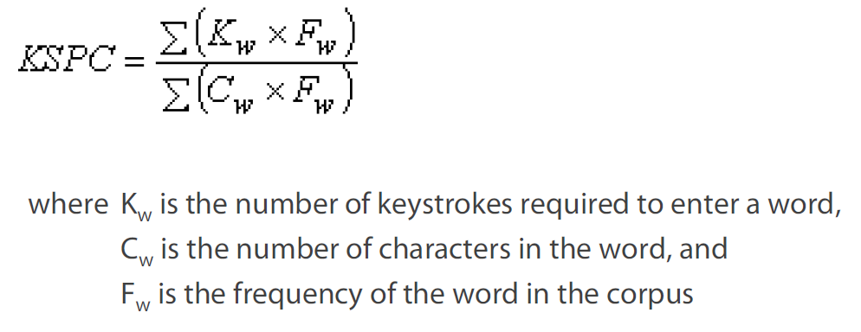
ФКН, Программная инженерия
Objective function
Main metric – KSPC metric
Keystrokes per character (KSPC) is the number of keystrokes, on average, to generate each character of text in a given language using a given text entry technique

Slide 3
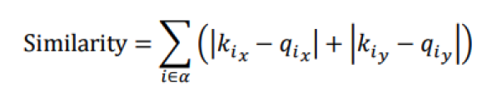
ФКН, Программная инженерия
Objective function
Secondary metric – Learning Performance (LP)
Learning Performance (LP) is the numerical indicator of the learning rate (based on calculating the similarity of the proposed keyboard with the default)
where 𝑖 is a letter in alphabet 𝛼,
the set of lowercase letters
from ‘а’ to ‘я,’ and 𝑘𝑖𝑥
and 𝑞𝑖𝑥
are the x-indices of the 𝑖 key
on the given keyboard layout and default

Slide 4
ФКН, Программная инженерия
algorithm

Slide 5
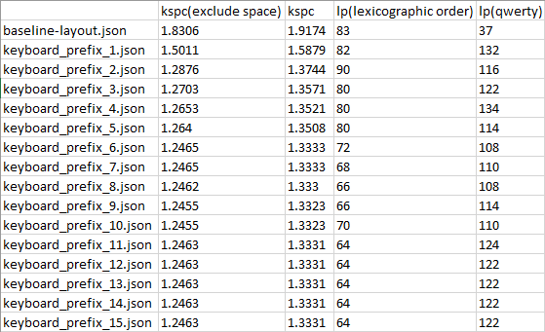
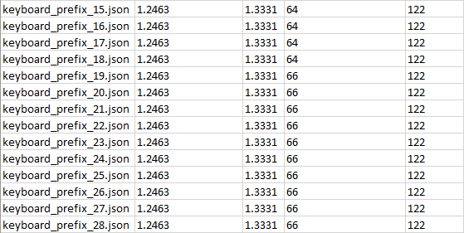
ФКН, Программная инженерия
metrics

Slide 6

ФКН, Программная инженерия
conclusion
Keyboard_prefix_10 is the best layout which was generated by algorithm
{
"s": ["о", "л", "ы", "ш"],
"d": ["а", "в", "г", "ю"],
"f": ["е", "к", "б", "ж"],
"g": ["и", "п", "я", "ц"],
"h": ["н", "м", "ч", "ф"],
"j": ["р", "у", "ь", "щ"],
"k": ["т", "д", "й", "э"],
"l": ["с", "з", "х", "ъ"]
}

