Slide 1
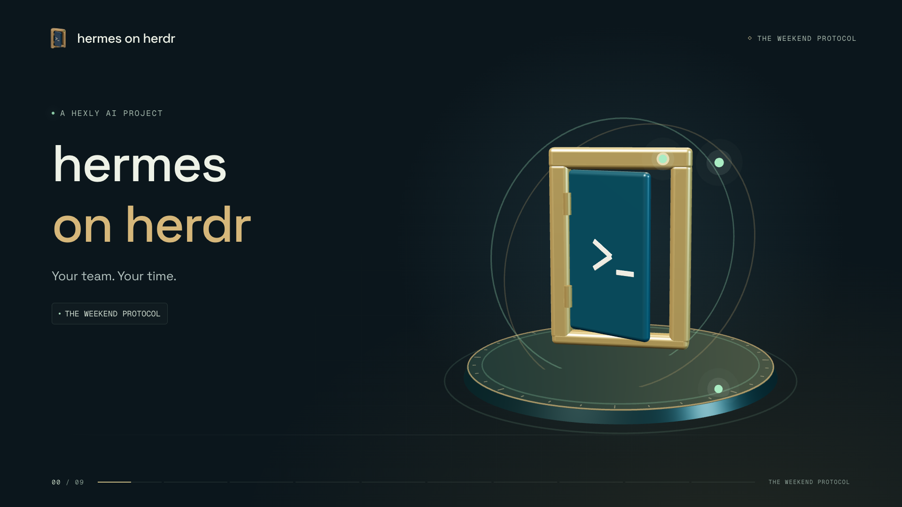
Notes:
Opening music; no narration.

Slide 2
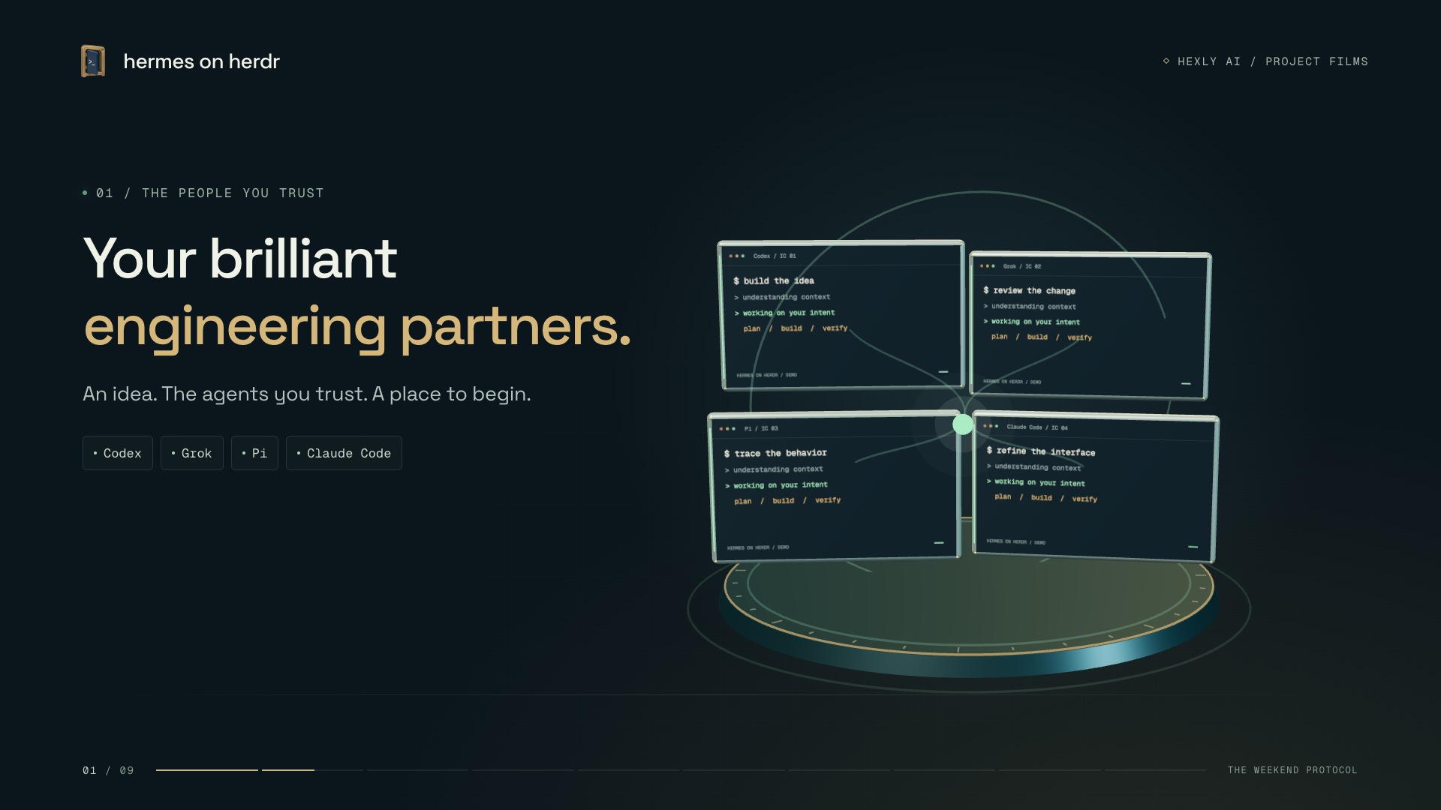
Notes:
Every programmer has a brilliant engineering partner they trust. Codex, Grok, Pi, or Claude Code. An idea becomes something you can build together.

Slide 3
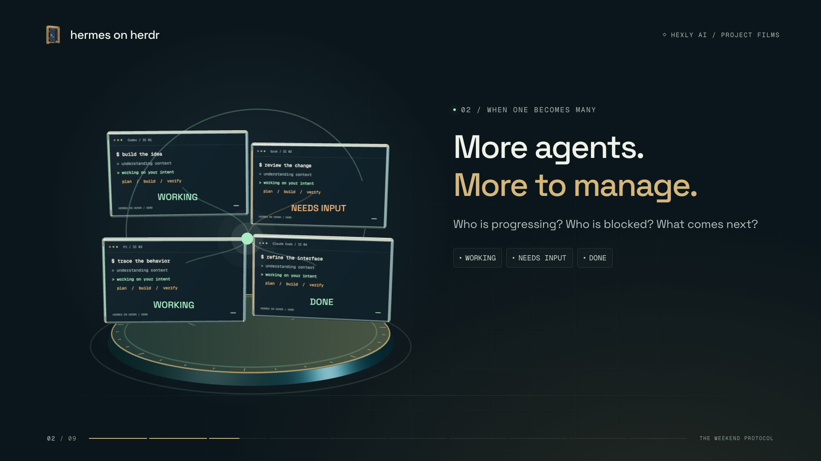
Notes:
Once you have your own multi-agent workflow, the real problem becomes management. Who is progressing, who is blocked, and who takes the next step?

Slide 4
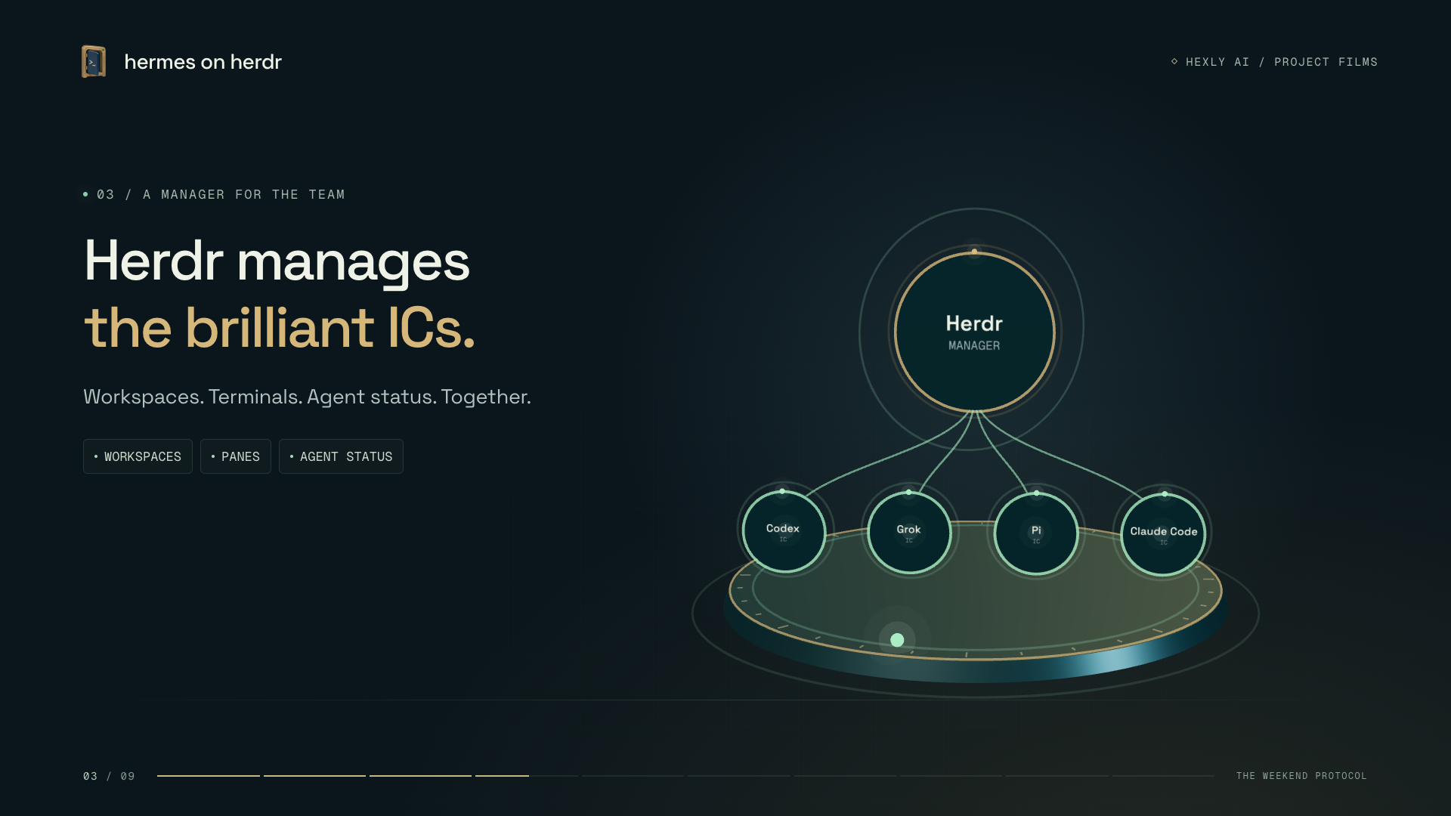
Notes:
Herdr is the manager for those brilliant individual contributors. It brings workspaces, terminals, and agent status together.

Slide 5
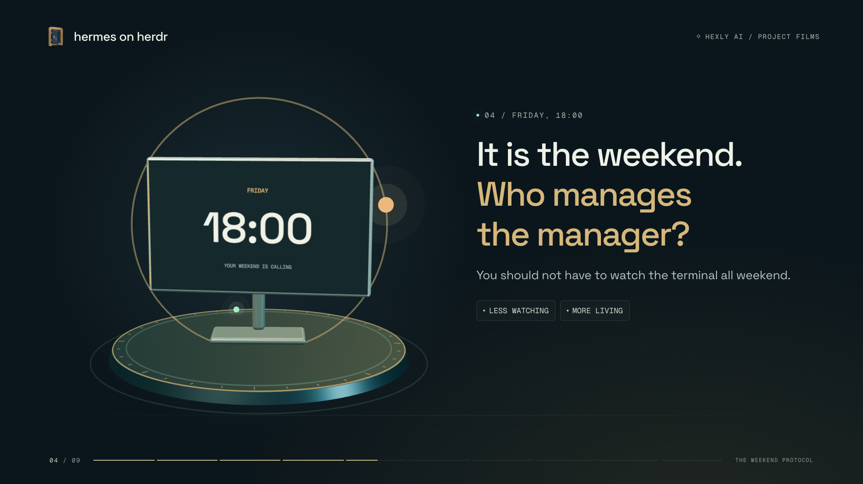
Notes:
But the weekend is here. You should not have to sit at your computer watching progress. Who manages the manager?

Slide 6
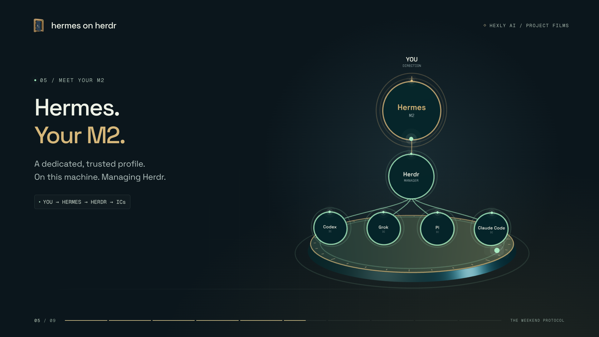
Notes:
Hermes on Herdr gives that job to a dedicated, trusted Hermes profile on this machine. Your M two: a manager for the manager.

Slide 7
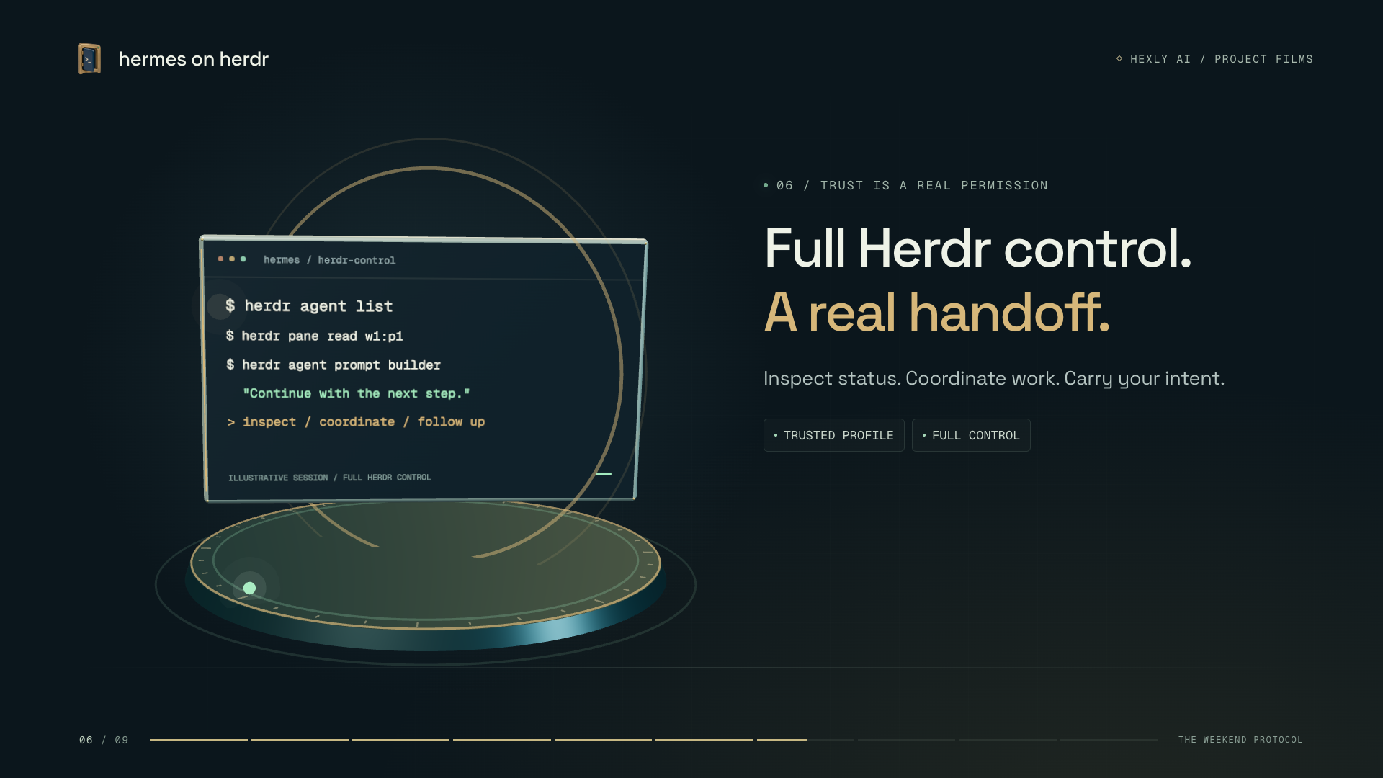
Notes:
This dedicated Hermes has full Herdr control. It can inspect status, coordinate work, and carry your instructions to the agents doing it.

Slide 8
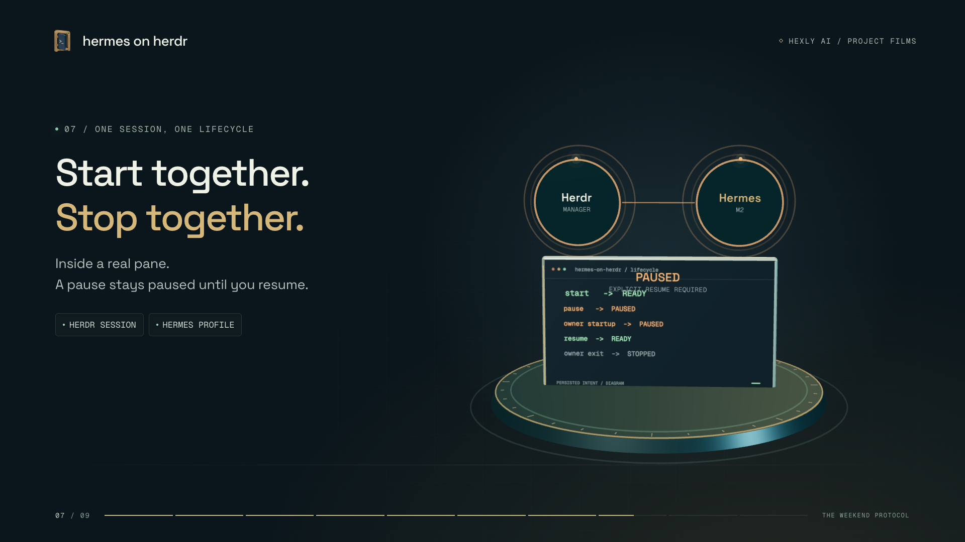
Notes:
When enabled, it starts with Herdr and stops with its session, inside a real pane. A pause stays paused until you explicitly resume.

Slide 9
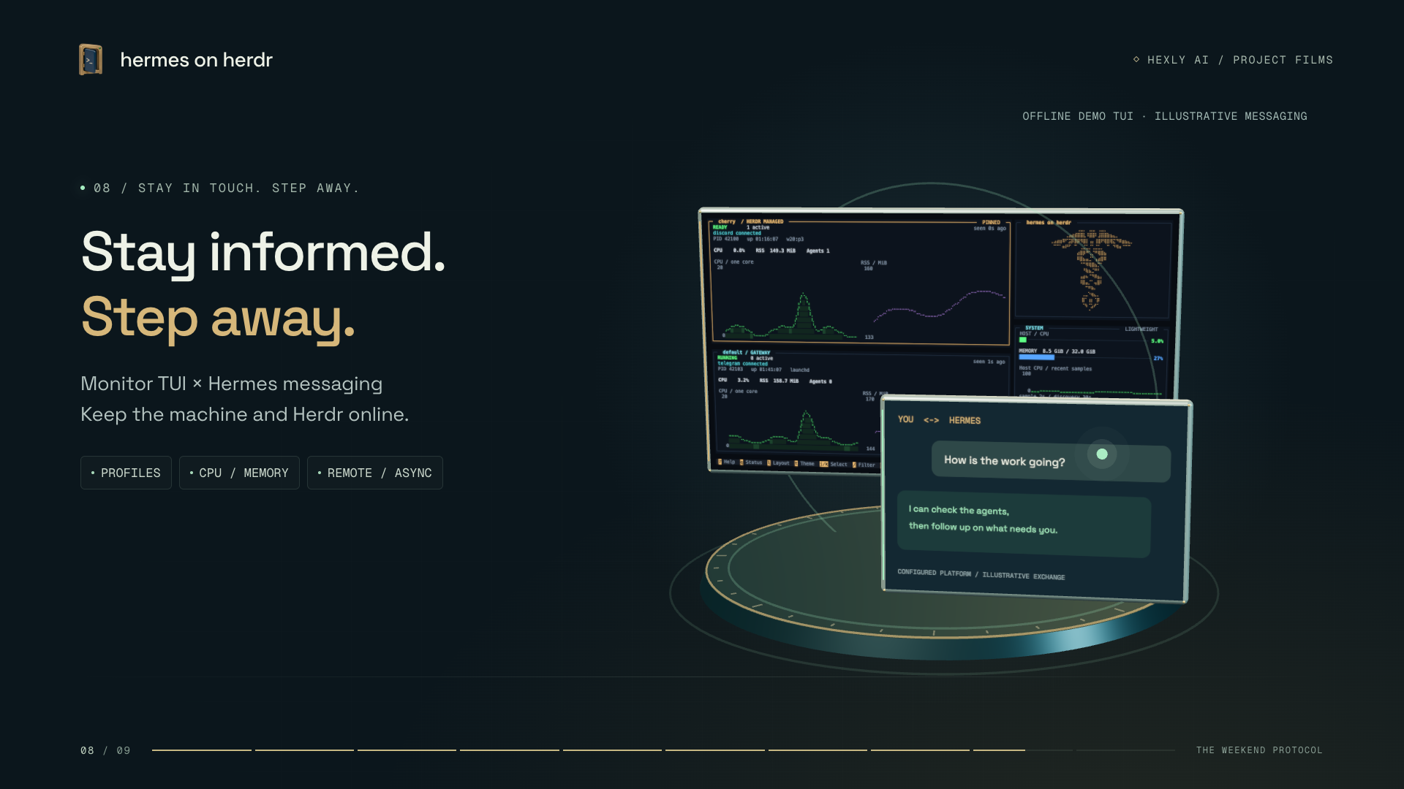
Notes:
Open the monitor T U I: your dedicated instance, multiple profiles, CPU, and memory in view. Check in remotely and asynchronously through your configured Hermes messaging platform. Keep the machine and Herdr online, and step away.

Slide 10
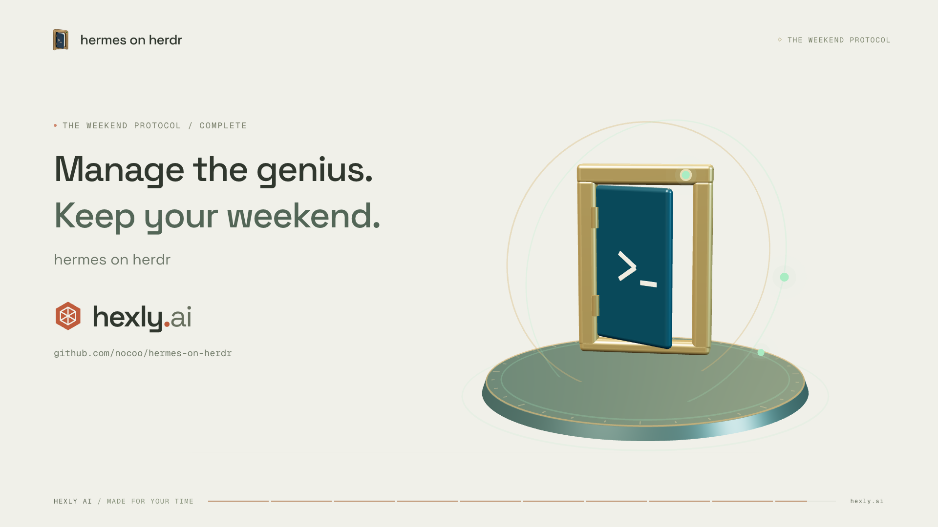
Notes:
Let the system manage the genius. Keep the weekend for yourself. Hermes on Herdr. By Hexly AI.

