Slide 1

Notes:
Hermes on Herdr.
Source: https://github.com/nocoo/hermes-on-herdr

Slide 2
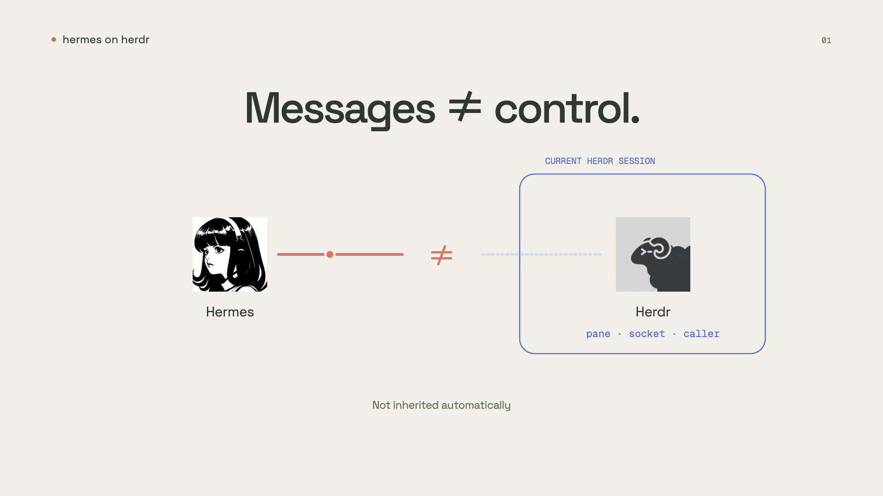
Notes:
An independent Hermes can receive your messages. But it does not automatically inherit your Herdr session's pane, socket, or caller context.
An external instance needs those relationships configured separately.
Source: https://github.com/nocoo/hermes-on-herdr

Slide 3
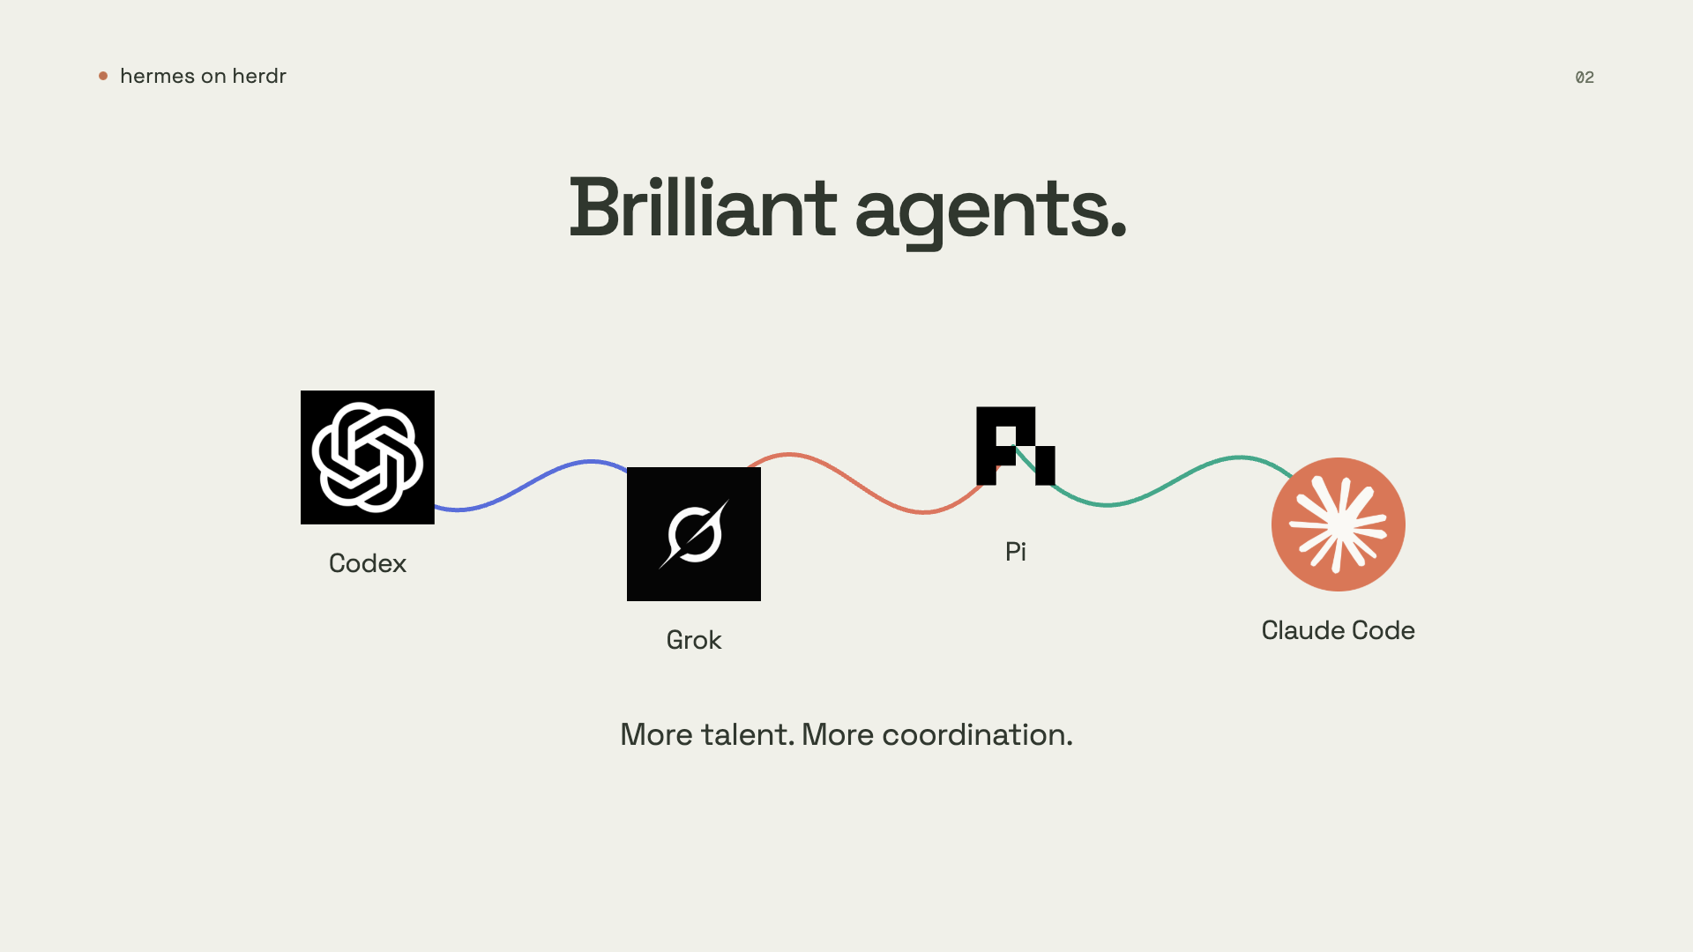
Notes:
You trust brilliant coding partners: Codex, Grok, Pi, Claude Code. As your workflow grows, coordination becomes the job.
Source: https://github.com/nocoo/hermes-on-herdr

Slide 4
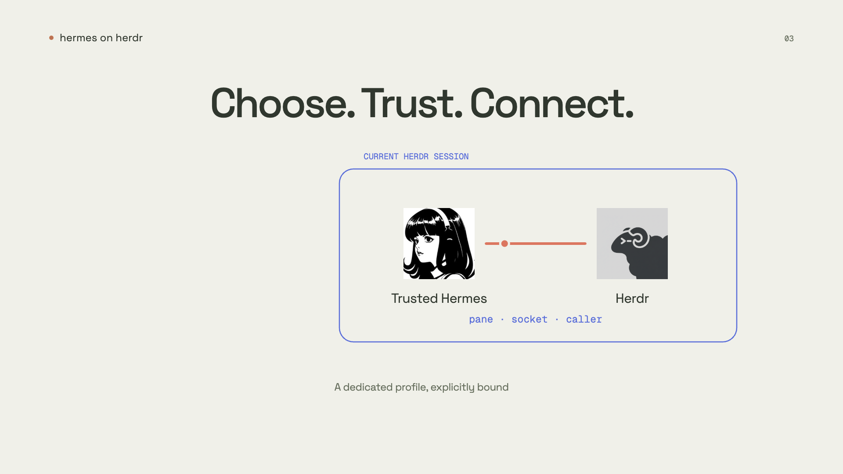
Notes:
The plugin makes the link explicit. Choose a dedicated Hermes profile you trust, and bind it to your current Herdr session.
Existing configured profile · explicit owner binding
Source: https://github.com/nocoo/hermes-on-herdr

Slide 5
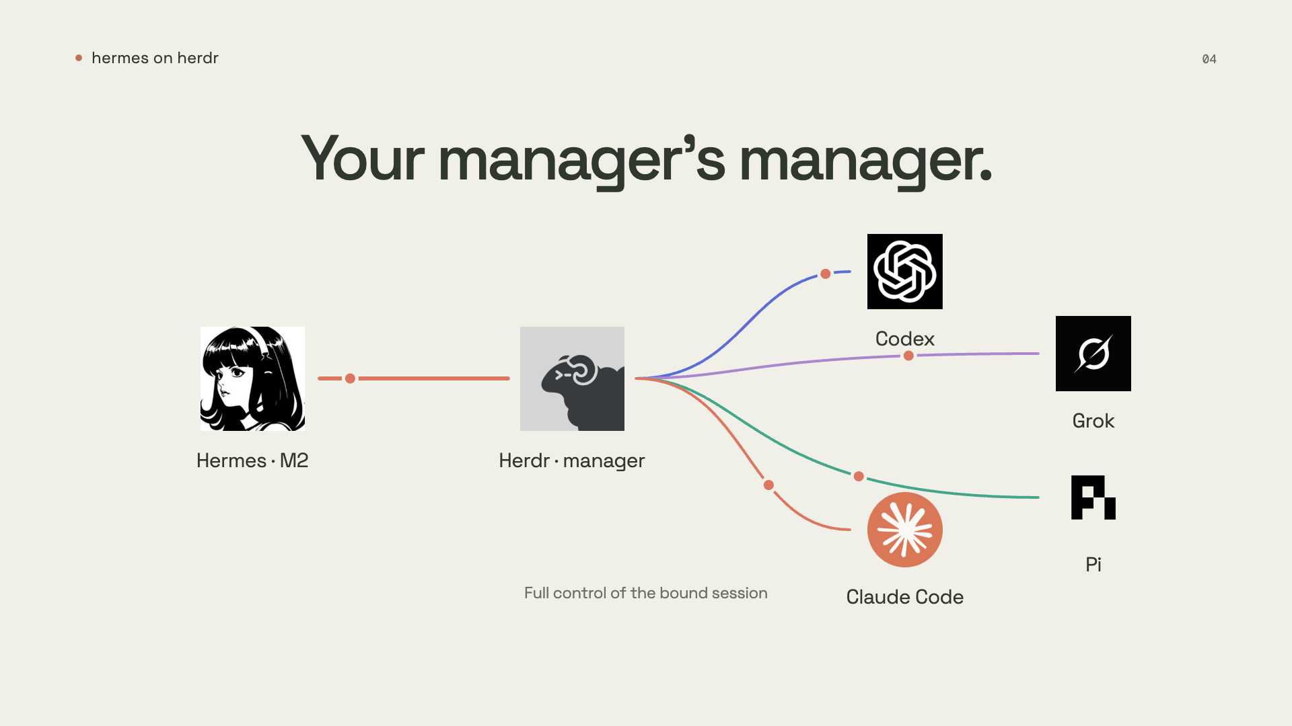
Notes:
Hermes becomes your M2, with full Herdr control in the bound session. It manages Herdr. Herdr coordinates your coding agents.
Full control of the bound session, under Herdr and plugin checks
Source: https://github.com/nocoo/hermes-on-herdr

Slide 6
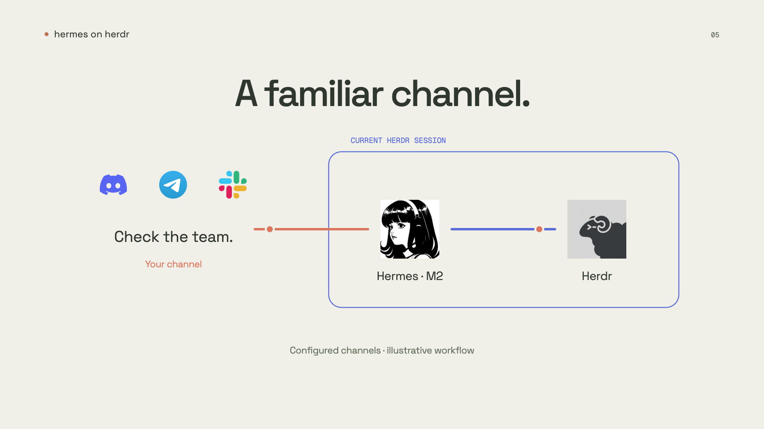
Notes:
Hermes already supports Discord, Telegram, and Slack. Configure a channel to reach your M2 from outside, while Herdr control stays local.
Discord connectivity recorded; Telegram / Slack integration unverified. Illustrative workflow · fresh end-to-end control not verified
Source: https://github.com/nocoo/hermes-on-herdr

Slide 7
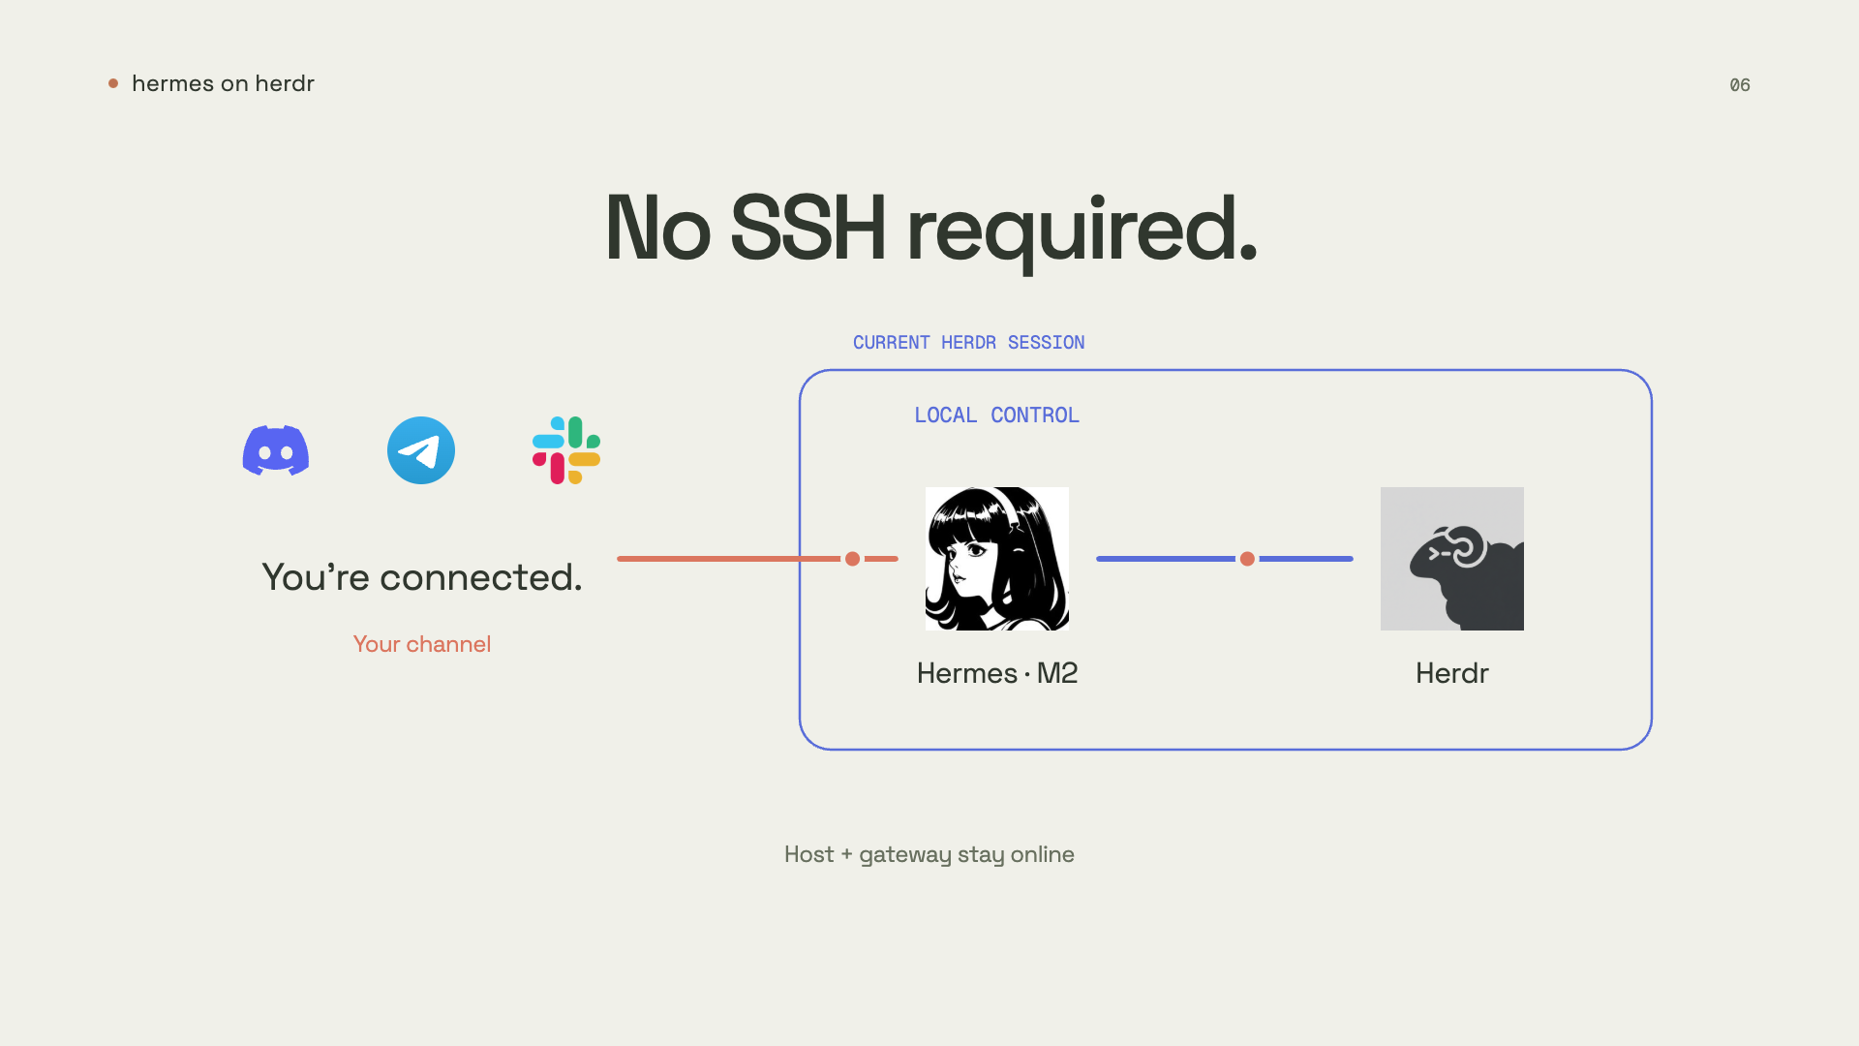
Notes:
No SSH. No remote desktop. No VPN or exposed Herdr control port. Keep the host, Herdr, and gateway online.
Configure channel access; messaging and model services must be reachable.
Source: https://github.com/nocoo/hermes-on-herdr

Slide 8
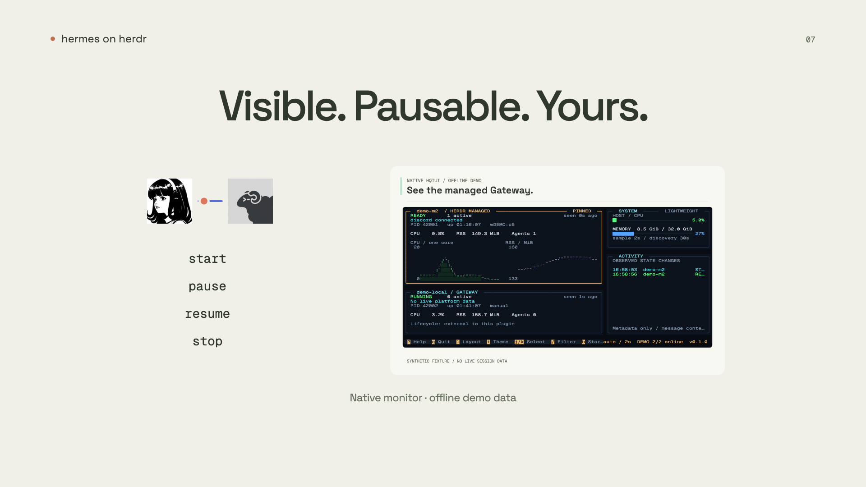
Notes:
The plugin ties the dedicated gateway to Herdr's lifecycle. Pause stays paused until you resume. The monitor TUI shows its state.
Native monitor · offline demo data Lifecycle is implemented; full cold-start / exit integration remains unverified.
Source: https://github.com/nocoo/hermes-on-herdr

Slide 9
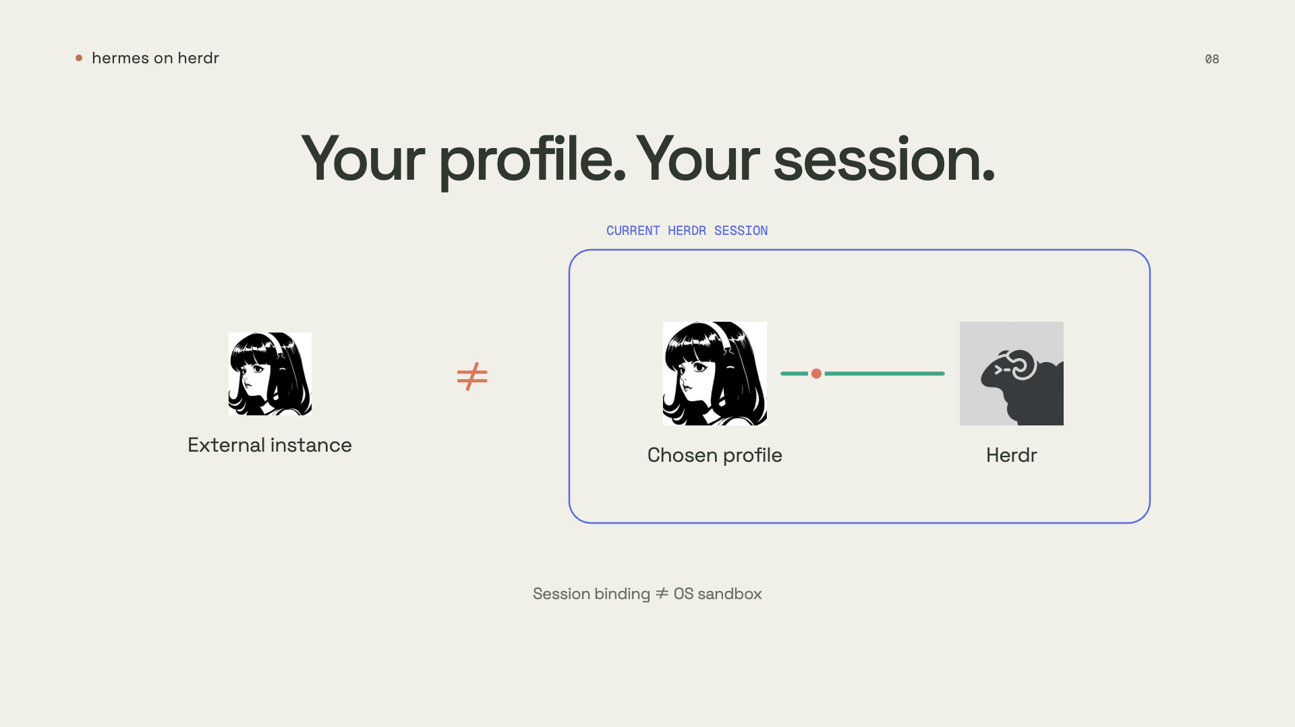
Notes:
Herdr and plugin boundaries still apply. Session binding is not an operating-system sandbox. Same-user terminal permissions remain broad.
No arbitrary external authorization · No public control plane
Source: https://github.com/nocoo/hermes-on-herdr

Slide 10
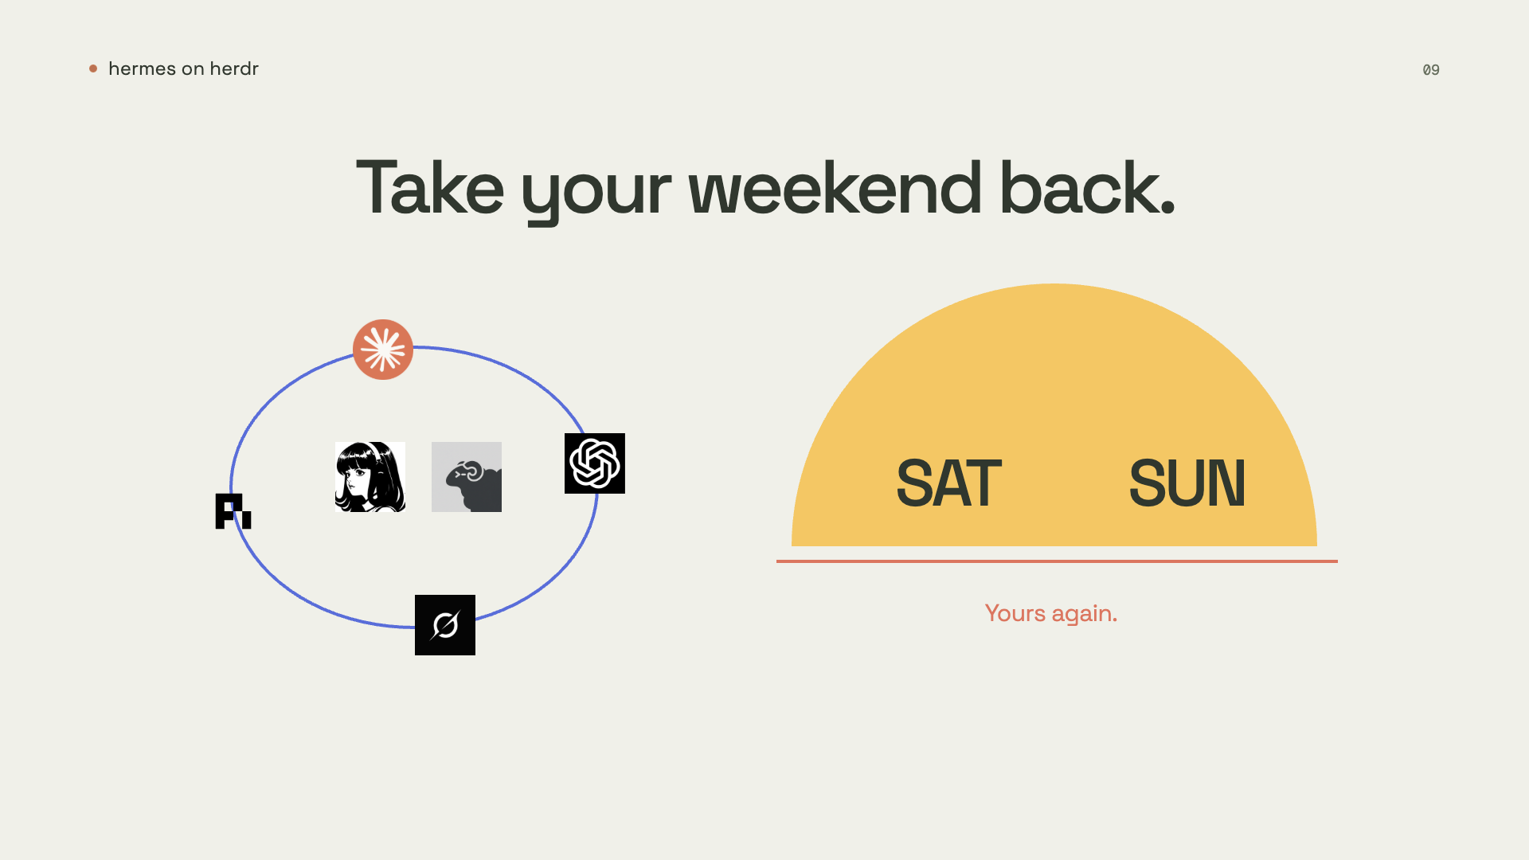
Notes:
Let the system manage the talent. Keep your judgment. Take your weekend back.
Source: https://github.com/nocoo/hermes-on-herdr

Slide 11

Notes:
Hermes on Herdr. By Hexly AI.
Source: https://github.com/nocoo/hermes-on-herdr

