Slide 1


Slide 2


Slide 3


W
h
a
t
i
s
?

Slide 4
W
h
a
t
i
s
?

Slide 5




Each Component by Open source

Slide 6




Support Different NOS

Slide 7
Many switches become one logical switch

Slide 8
VLAN
CLOS
Tree
VM
ware
BGP
QoS
SPAN
Multi APPs hot plug in/out

Slide 9

W
h
a
t
c
a
n
d
o
?

Slide 10

CLOS Topology
HostA
HostB
Internet

Slide 11
CLOS Topology
CLOS APPs plug in
APP Pool
VLAN
CLOS
Tree
vCenter
BGP
QoS
SPAN
HostA
HostB
Internet

Slide 12

CLOS Topology
With simple command:
Put Host A into VLAN 10,
Internet Into VLAN 20,
Route Host A to VLAN 20
HostA
HostB
Internet

Slide 13


CLOS Topology
Put Host A into VLAN 10,
Internet Into VLAN 20,
Route Host A to VLAN 20
VLAN 10
VLAN 20
HostA
HostB
Internet
Ares build all path automatically

Slide 14

Tree Topology
HostA
HostB

Slide 15

Tree Topology
VLAN & Tree APP plug in
APP Pool
VLAN
CLOS
Tree
vCenter
BGP
QoS
SPAN
HostA
HostB

Slide 16
Tree Topology
With simple command
Put Host A into VLAN 10, Host B Into VLAN 20
HostA
HostB

Slide 17
Tree Topology
Put Host A into VLAN 10, Host B Into VLAN 20
VLAN 10
VLAN 20
VLAN 10
VLAN 20
VLAN 10
VLAN 20
VLAN 10
VLAN 20
VLAN 10
VLAN 20
Ares build all path automatically
HostA
HostB

Slide 18
Tree Topology
Put Host A into VLAN 10, Host B Into VLAN 20
VLAN 10
VLAN 20
VLAN 10
VLAN 20
VLAN 10
VLAN 20
VLAN 10
VLAN 20
VLAN 10
VLAN 20
Ares build all path automatically
HostA
HostB

Slide 19


CLOS Topology + VMware
HostA
HostB
Internet

Slide 20
CLOS Topology + VMware
CLOS & vCenter APP plug in
APP Pool
VLAN
CLOS
Tree
vCenter
BGP
QoS
SPAN
HostA
HostB
Internet

Slide 21
CLOS Topology + VMware
vCenter Create
VM1 and VM2 at Tenant 1
VM3 and VM4 at Tenant 2
HostA
HostB
Internet

Slide 22

CLOS Topology + VMware
Create two VLANs for each Tenant
VMware vCenter Create VM1 and VM2 at Tenant 1
VM3 and VM4 at Tenant 2
VM1
VM3
VM2
VM4
HostA
HostB
Internet

Slide 23
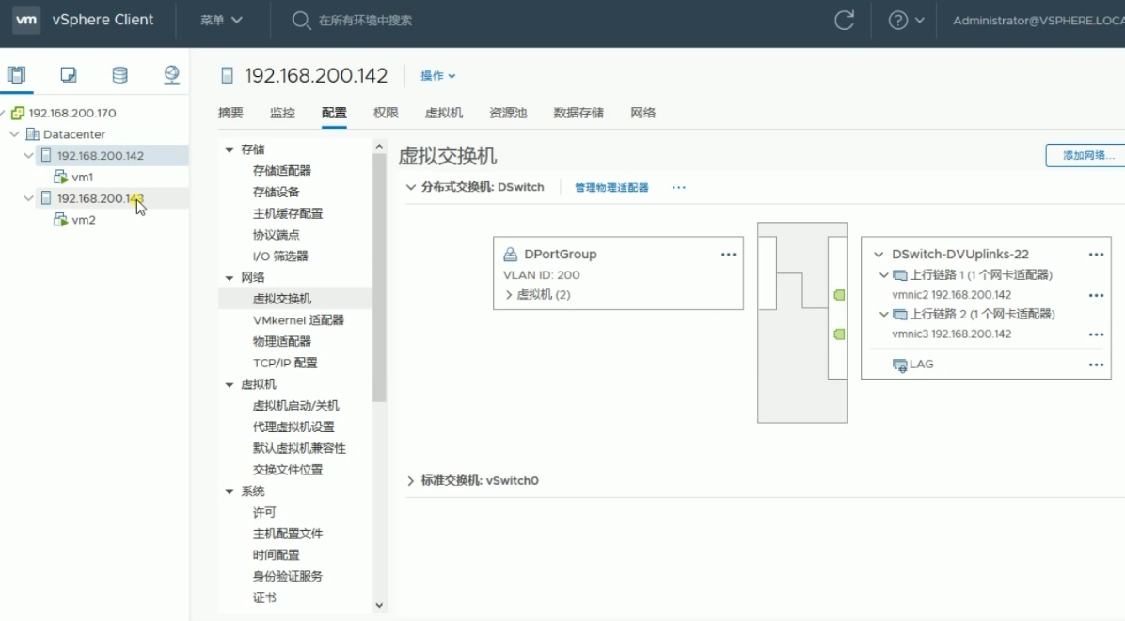
Snapshot of Ares & VCenter

Slide 24
BGP in Data Center Topology
Core POD
PODA
PODB
Rack A
Rack B

Slide 25
BGP in Data Center Topology
Core POD
BGP APP plug in
PODA
PODB
APP Pool
VLAN
CLOS
Tree
vCenter
BGP
QoS
SPAN
Rack A
Rack B

Slide 26
BGP in Data Center Topology
Auto provision BGP Topology
BGP ASN /IP/Neighbor
Core POD
PODA
PODB
BGP ASN /IP/Neighbor
BGP ASN /IP/Neighbor
BGP ASN /IP/Neighbor
BGP ASN /IP/Neighbor
Ares automatically provision IP and BGP configuration
Rack A
Rack B

Slide 27
EVPN Topology
Other Vender

Slide 28
EVPN Topology
EVPN APP plug in
Other Vender
APP Pool
VLAN
CLOS
Tree
vCenter
BGP
EVPN
SPAN

Slide 29

EVPN Topology
Setup VTEP with other Vender Switch or our self
BGP
Other Vender
VxLAN
VTEP
VTEP
VTEP

Slide 30
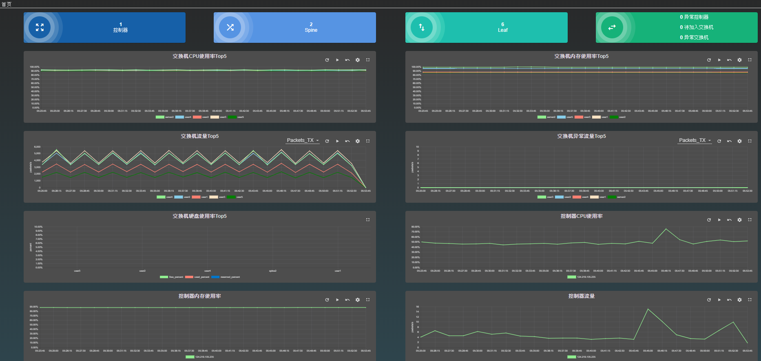
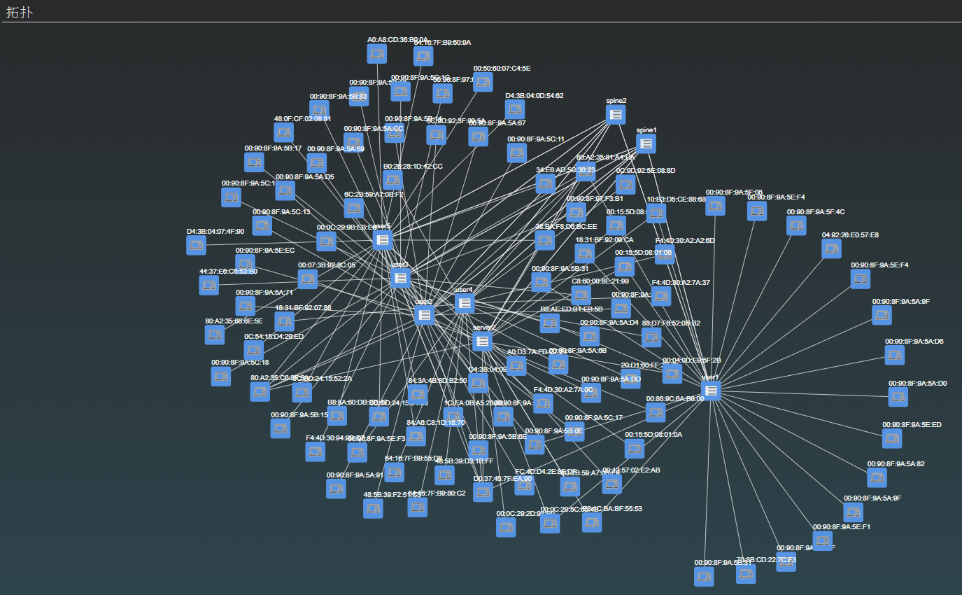
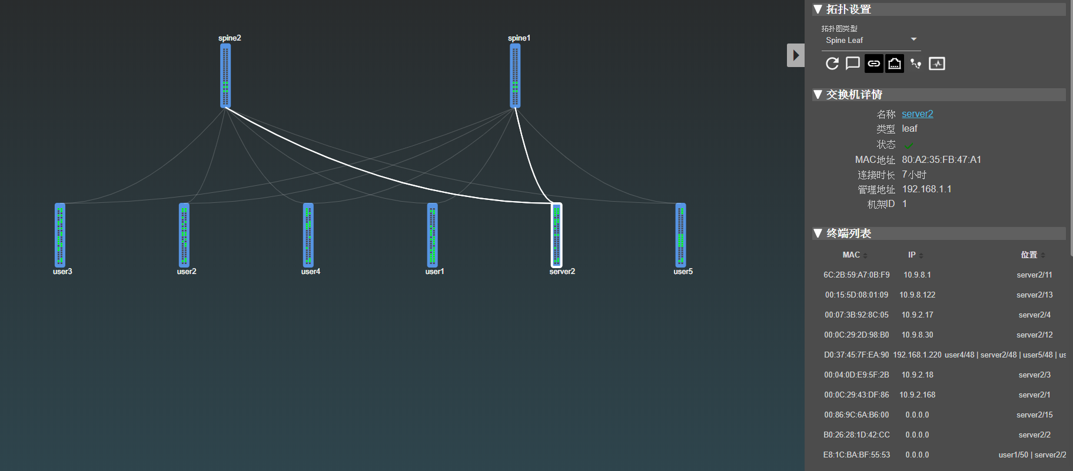
Ares Screen Shot

