Slide 1

Ares Demo and Quick Start guide

Slide 2
Server Requirement
A Server Which can run VM
HW spec:
At least 8G ram.
At least 8 core a CPU.
HD at leaf 20Gb
Get the VM
http://124.219.108.10/Ares/mars_staticfabric.ova
Useraccount/password: mars/mars

Slide 3
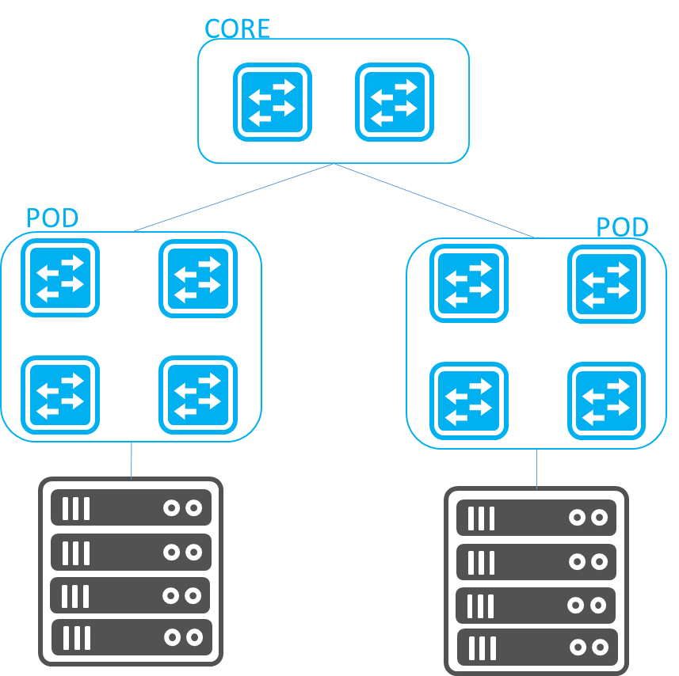
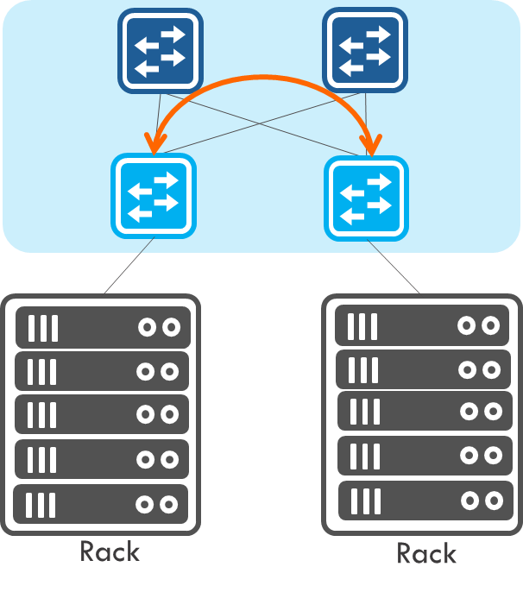
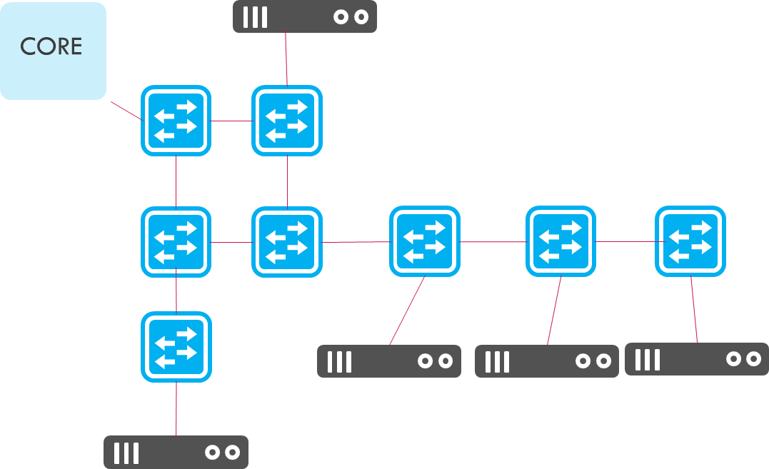
Ares SDN Controller short Introduction
Base on Open Source, ONOS/ELK/Nginx.
Support multi-protocol SB interface, RestAPI/Netconf/Openflow/SNMP.
Support multi-topology auto deploy.
Plug in/out APP for different scenario.
RFC 7938
Auto BGP provision

Slide 4
Why using Ares SDN Controller
Plug in/out APP Platform for user choosing suitable APP for their fabric.
No touch provision fabric.
User only take care the ToR/Leaf switch with server.
Provide programmable API for user to using script control network.
An open platform for user install their own APP.
Blue print provision style for user to provision their network before switch really connect.
Cooperate with VMware to provide auto adjust fabric.
Rerf: AresIntroduction.pptx

Slide 5
Start Ares
1. Update this controller IP by using script “update_controller_ip.sh”
2. Start controller by script “restart_mars.sh”
3. After waiting some minutes according to VM CPU.
4. Login from Web browser: https://<controller_IP>
5. If mars can’t login, please check the docker logs. It shall has “End wait MARS boot”.
docker logs mars
6. Mars is running by docker. Each new mars docker image has one day unlimited license.

Slide 6
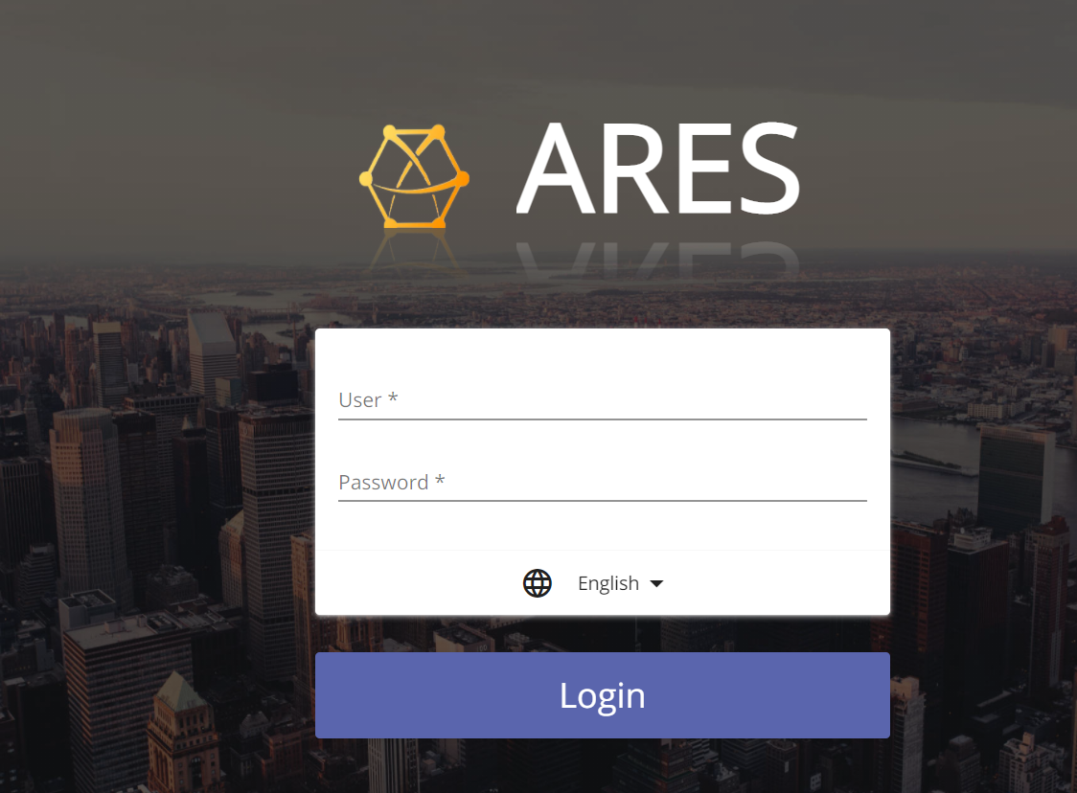
Login into your Ares
NOTE: You can visit our demo site https://210.63.204.29/ karaf/karaf
Login your Mars “ https://<your server IP> , default account/password is karaf/karaf

Slide 7
Demo - Topology
Case 1: Underlay auto provision
Case 2: VxLAN tunnel by EVPN
HW:
Spine: AS7712
Leaf: AS5835
Spine 1
Spine 2
SW:
Edgecore-SONiC_20210505_054937_ec202006_205.bin
Leaf 1
Leaf 2
32
32
VxLAN: 192.168.10.193/24
Host IP: 192.168.100.101/26
VxLAN: 192.168.10.195
Host IP: 192.168.200.201/26

Slide 8
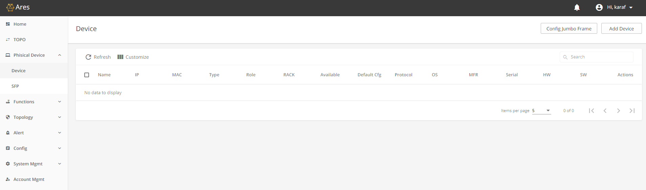
Add device

Slide 9
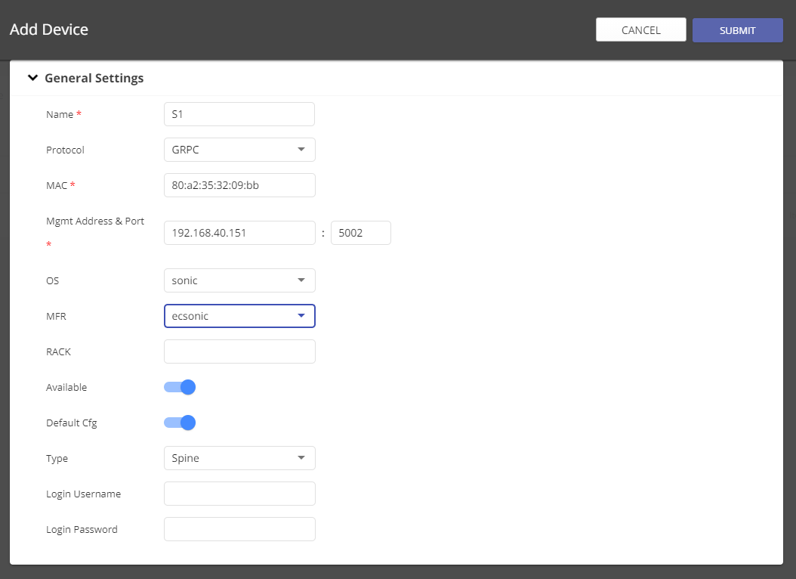
Input Necessary Information:
Device Name
Using which protocol to management
Device MAC (mgmt. port)
Management Address: Device IP and management port.
OS: chose sonic
MFR: chose ecsonic
Type: Spine or leaf

Slide 10
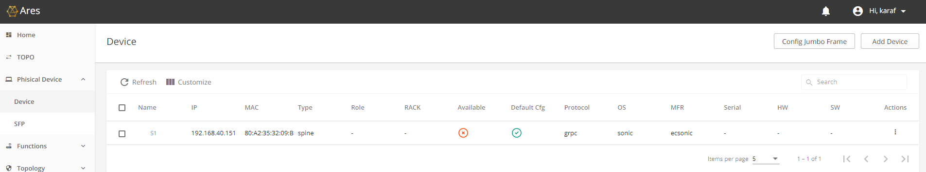
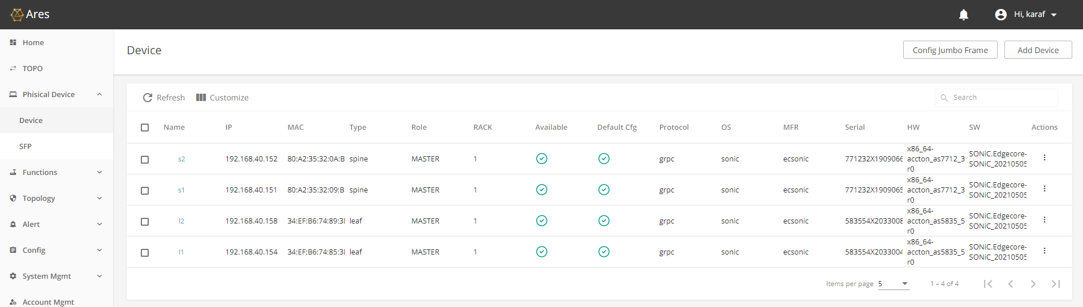
After Added a device you can find our it try to connect in Available column.
Please keep add other devices as you want

Slide 11
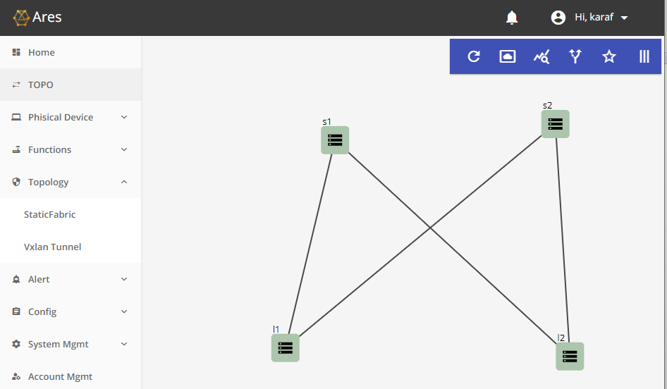
You can check the TOPO page to check the device link status

Slide 12
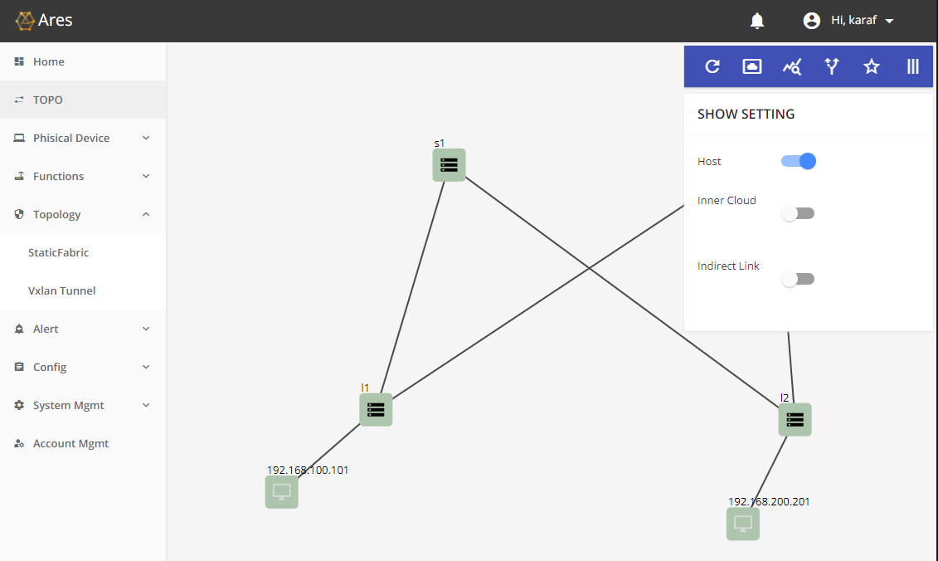
Using special icon to display more information

Slide 13
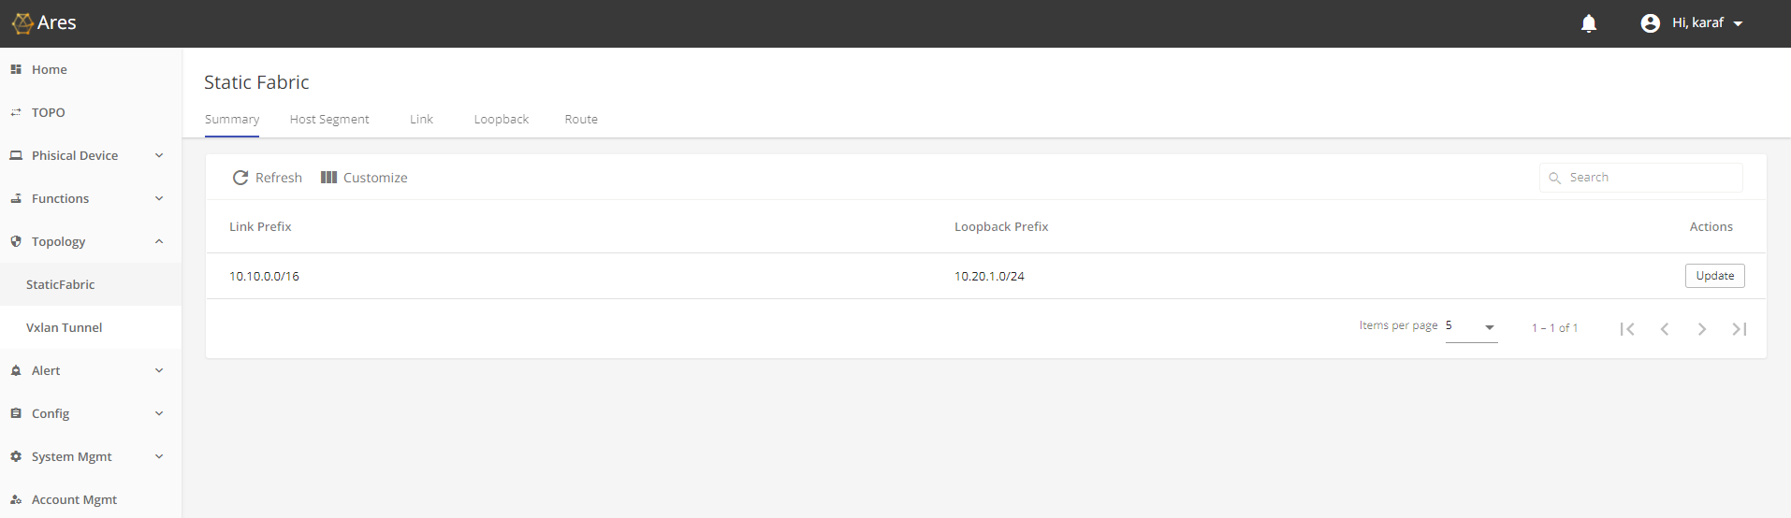
Provision Host segment for each host.

Slide 14
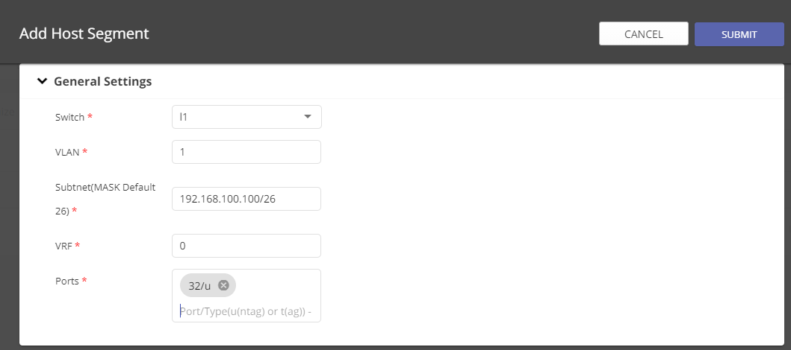
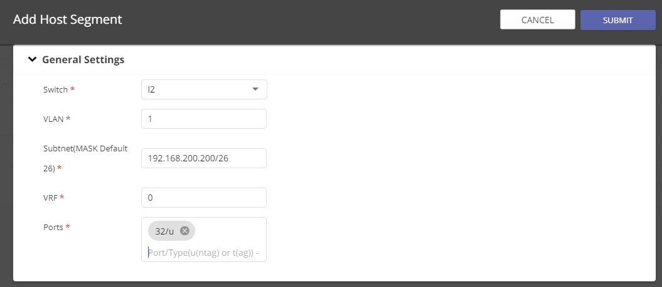
Provision the necessary host segment information
Please use comma (,) to finish input port.

Slide 15
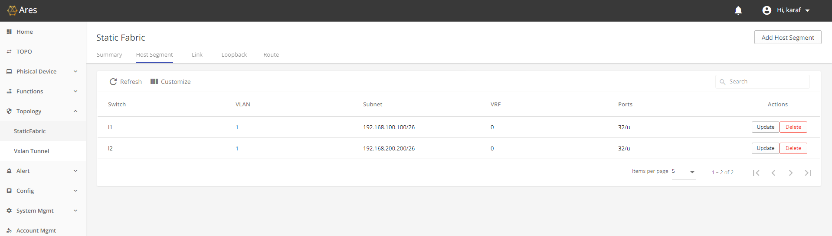
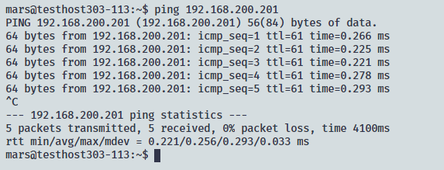
Check the result, and using Ping to verify the connectivity between two hosts.

Slide 16
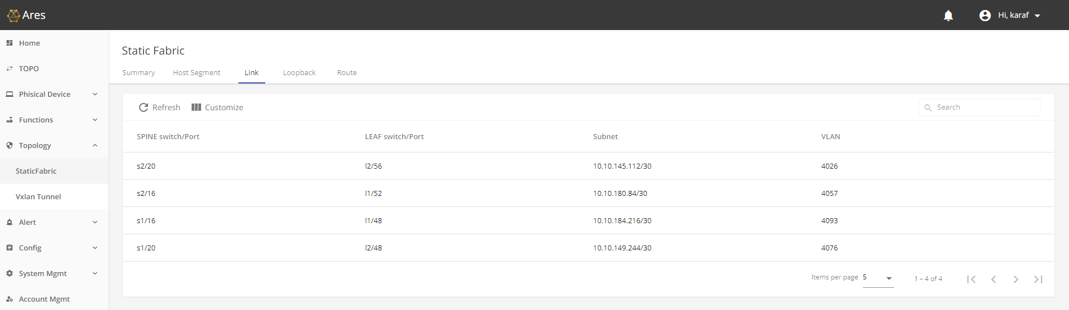
Link page display each link was allocated which subnet

Slide 17
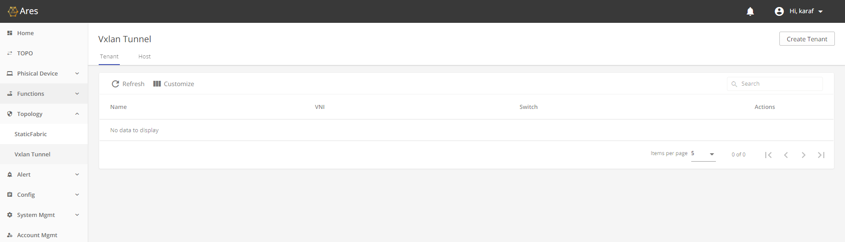
Provision VxLAN tunnel for two VxLAN hosts.
Create tenant on switches
Add host to tenant on which switch

Slide 18
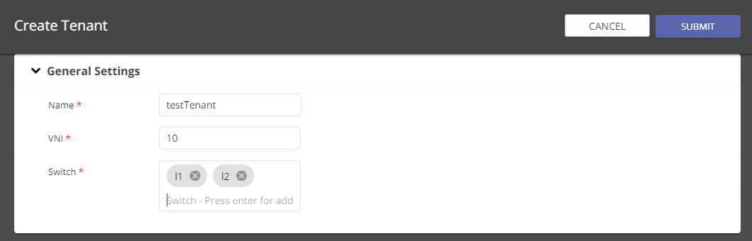
Create tenant on switches

Slide 19
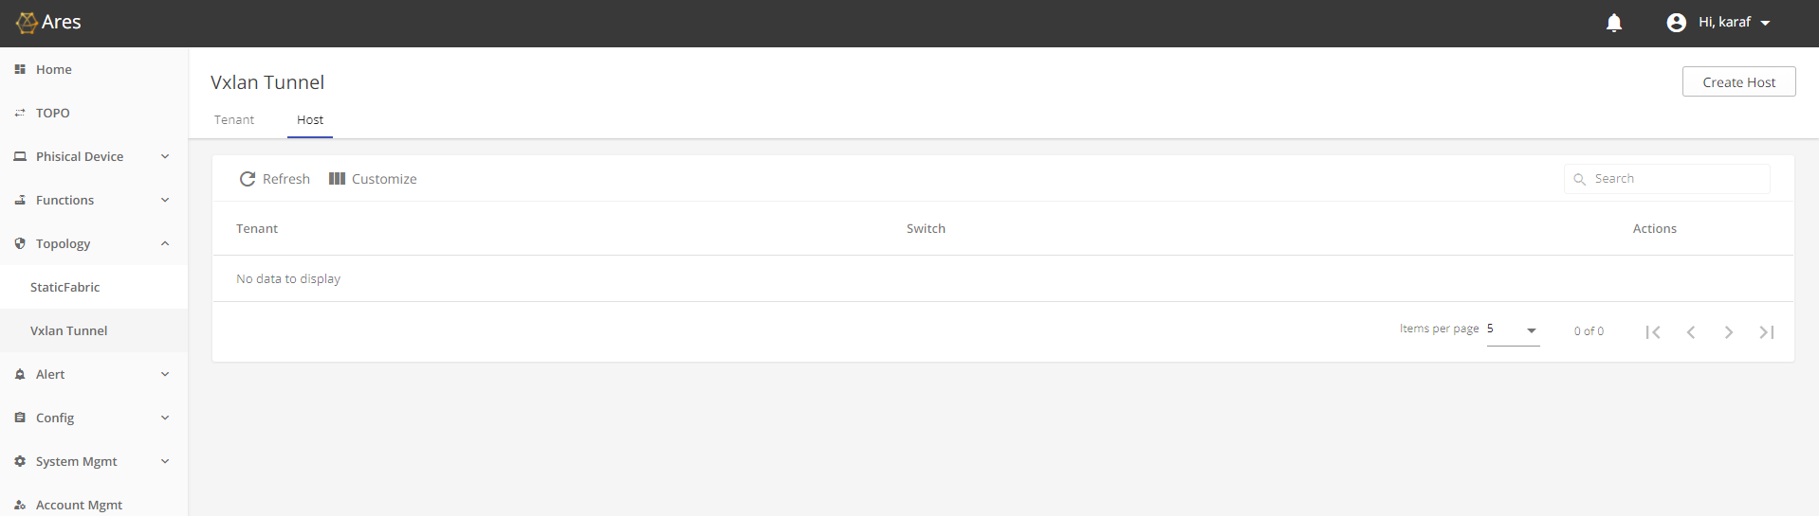
Add hosts to tenant - 1

Slide 20
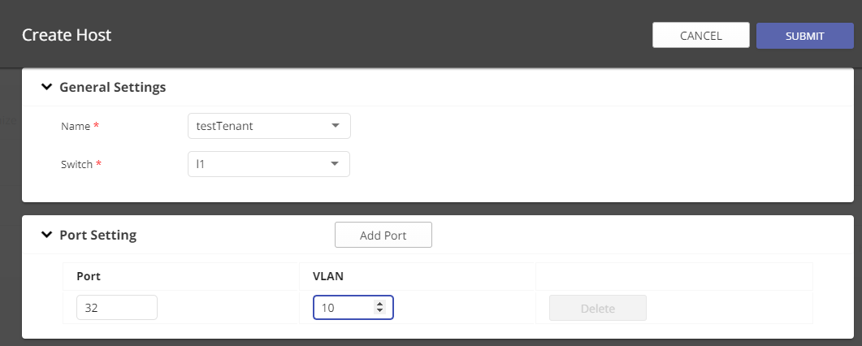
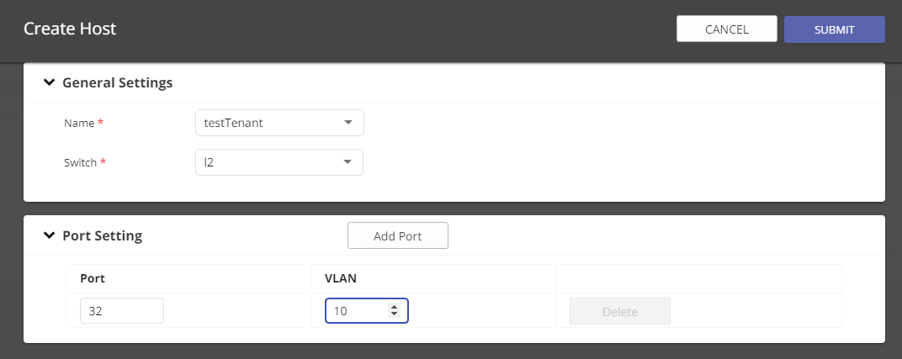
Add hosts to tenant - 2

Slide 21
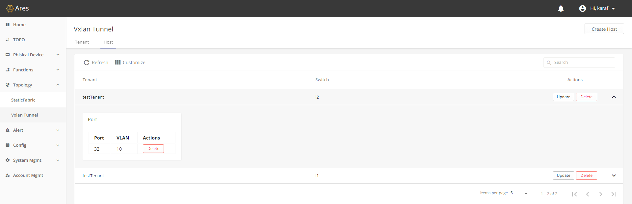
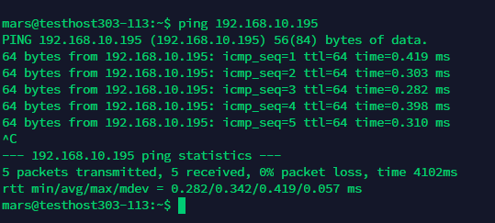
Testing VxLAN hosts connectivity by ping another host

