Slide 1
Ares Applications

Slide 2
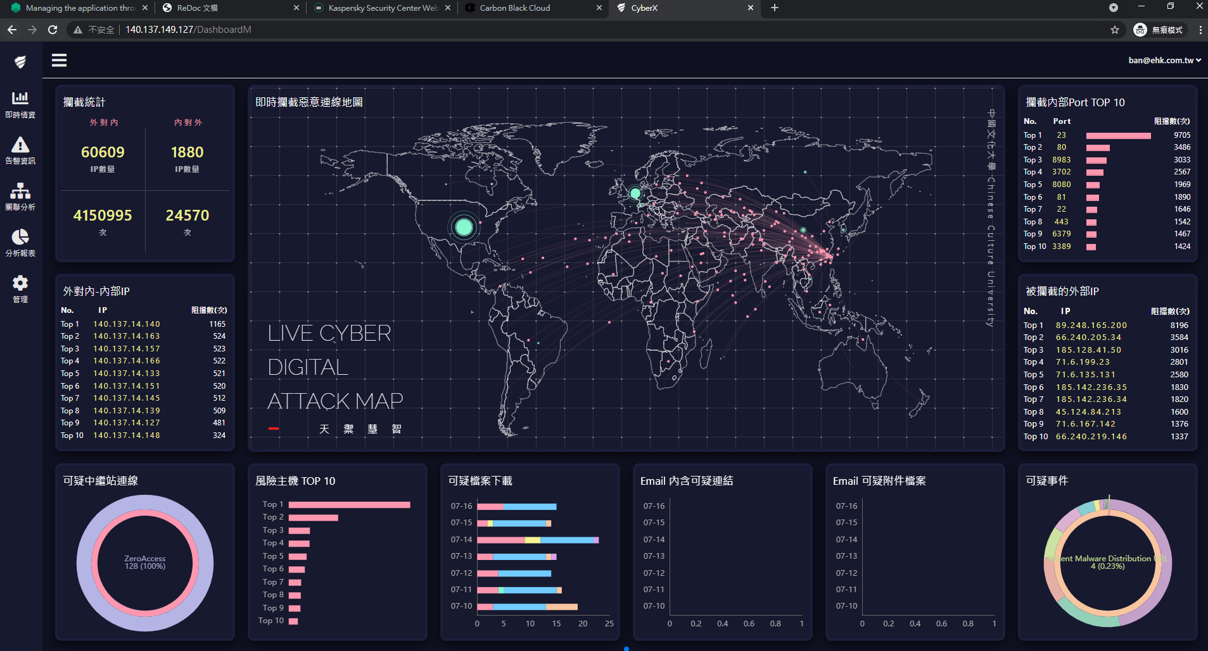



CyberX Platform – Security E<->W traffic [done]
APT
Cyber X
IO/IT
Firewall
IOC Sentiment
IO/IT
White/Black list
EDR
Rules
LOG
Switch control
IO/IT
Notes:
https://www.eacs.pro/

Slide 3
Smart Gateway
1. When detect a link bandwidth over threshold or link has problem, auto change to another line.
2. When link bandwidth over threshold, redirect some traffic to other link
3. Different IP subnet/ IP/ content can use different up link.
4. Third-party tools like DPI can auto programing device using which up link.

Slide 4


Smart Gateway
ISP A
ISP B
ISP C
ISP A
ISP B
ISP C
Traffic can according to different reason to different ISP. For example, bill, target, QoS, ….
Notes:
PBR (Plicy Based Rouing) or only ACL

Slide 5
Service Chain
1. According to different flows put into different service chain to check flows which saving the security device resource.
2. easily to bypass some flows without modify any security device configuration.
3. Using different service chain to load balance security check device resource.
4. Easily to eliminate the security device fail problem.

Slide 6
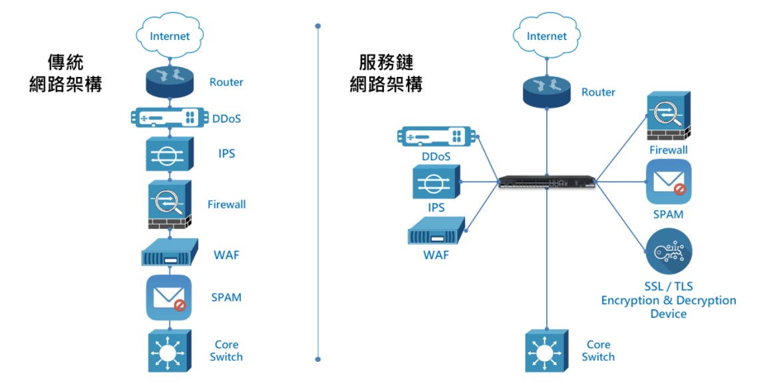

Slide 7





Service Chain L2/L3
Case 1: According to different policy using different chain.
Case2: LB on same NFVs to enlarge bandwidth capacity

Slide 8

EcCloud Integration (Under developing)
ecCloud display global WiFi equipment,
Ares display local site WiFi equipment and physical switch connectivity.

Slide 9

Retail store management
Ares in cloud manage many retail store network.
NOTE: with ecCloud, but ecCloud can do it by itself except switch is not supported by ecCloud

