Slide 1

CLOS topology Static Routing Fabric

Slide 2
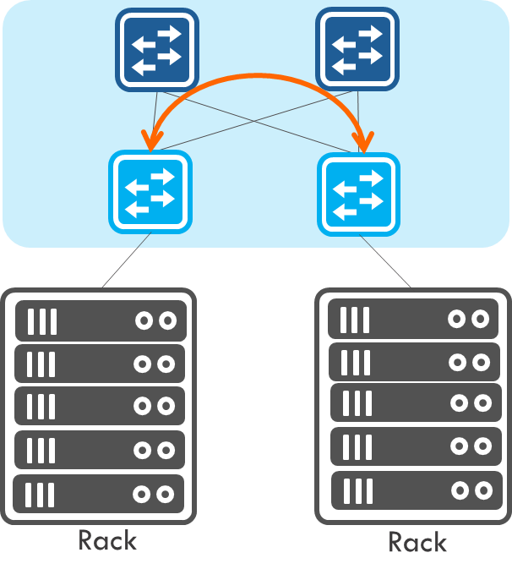
Scenario
Small or Medium size topology under 64 switches.
Ares uses static route to maintain fabric and VxLAN between hosts to have L2 connectivity.
For
Host basically using L3 to connect each other but skip the routing protocol.
Hosts also want to have L2 connectivity.
Have tenant concept in hosts.
Notes:
Host NIC card can have two IPs, one for VxLAN tunnel target host, another for L3 routing.
Or Host NIC card using VLAN interface to assign IP.

Slide 3
Server Requirement
A Server Which can run VM
HW spec:
At least 8G ram.
At least 8 core a CPU.
HD at leaf 20Gb
Get the VM
http://124.219.108.10/Ares/mars_staticfabric.ova
Useraccount/password: mars/mars

Slide 4
Start Mars
1. Update this controller IP by using script “update_controller_ip.sh”
2. Start controller by script “restart_mars.sh”
3. After waiting some minutes according to VM CPU.
4. Login from Web browser: https://<controller_IP>
5. If mars can’t login, please check the docker logs. It shall has “End wait MARS boot”.
docker logs mars
6. Mars is running by docker. Each new mars docker image has one day unlimited license.

Slide 5
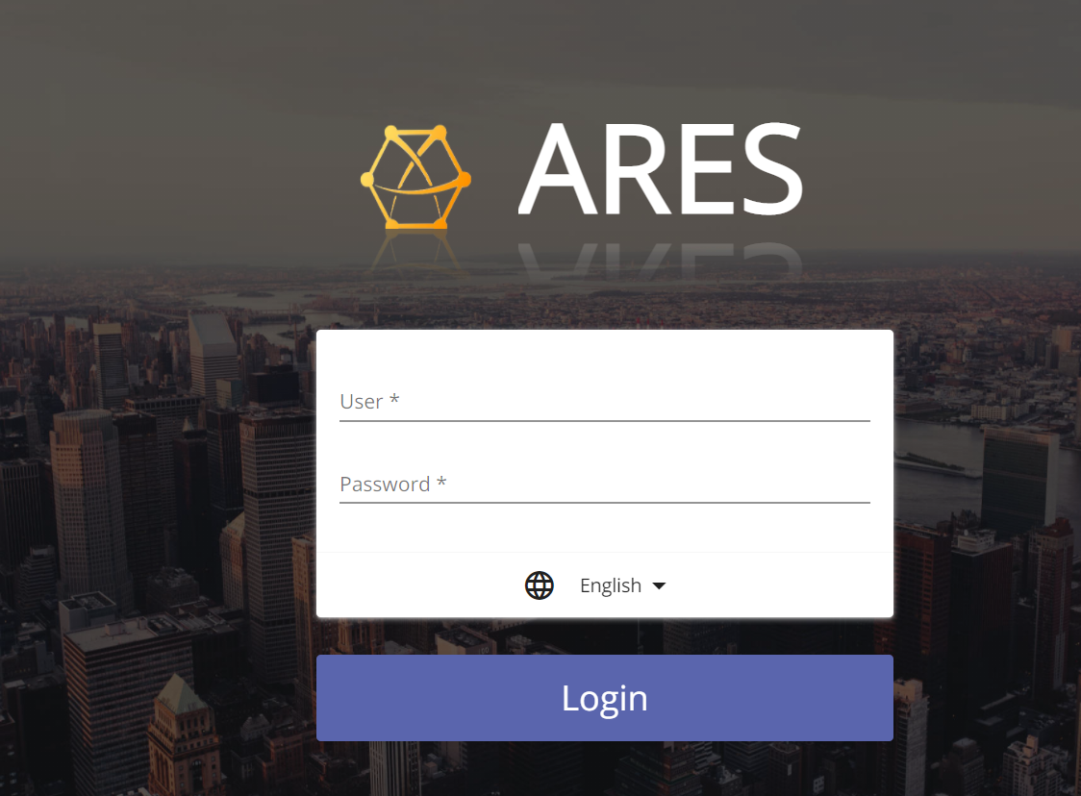
Login into your Mars
NOTE: You can visit our demo site https://210.63.204.29/ karaf/karaf
Login your Mars “ https://<your server IP> , default account/password is karaf/karaf

Slide 6
Demo - Topology
Case 1: Underlay auto provision
Case 2: VxLAN tunnel by EVPN
HW:
Spine: AS7712
Leaf: AS5835
Spine 1
Spine 2
SW:
Edgecore-SONiC_20210505_054937_ec202006_205.bin
Leaf 1
Leaf 2
32
32
VxLAN: 192.168.10.193/24
Host IP: 192.168.100.101/26
VxLAN: 192.168.10.195
Host IP: 192.168.200.201/26

Slide 7
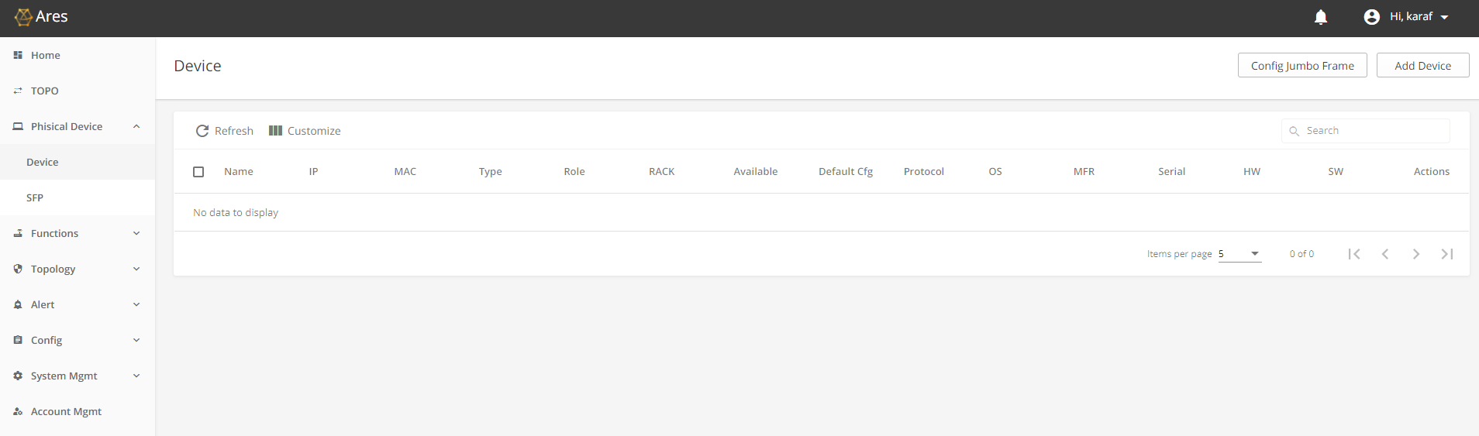
Add device

Slide 8
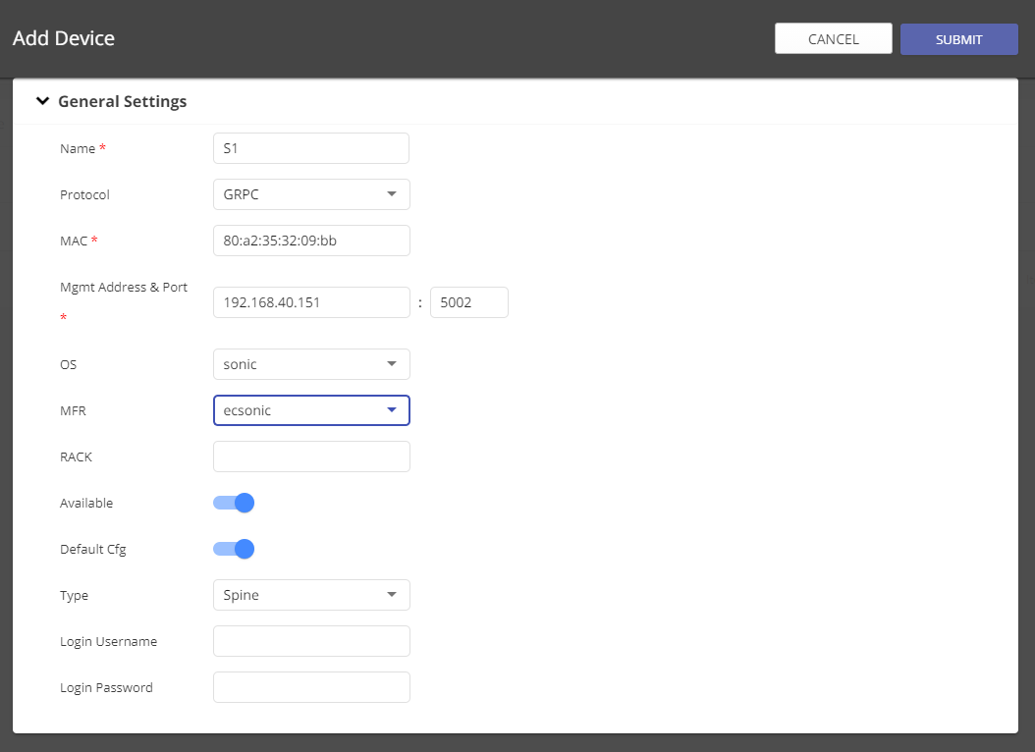
Input Necessary Information:
Device Name
Using which protocol to management
Device MAC (mgmt. port)
Management Address: Device IP and management port.
OS: chose sonic
MFR: chose ecsonic
Type: Spine or leaf

Slide 9
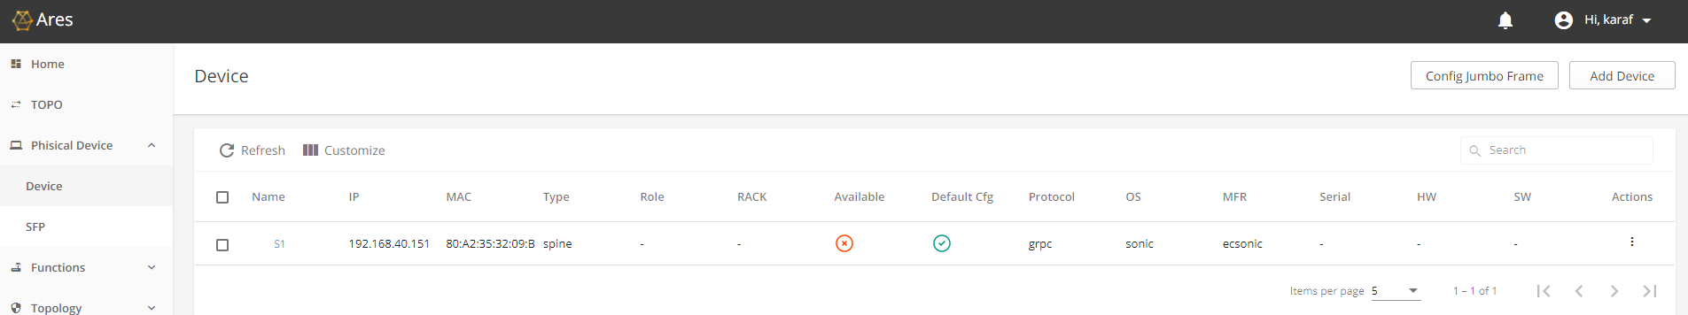
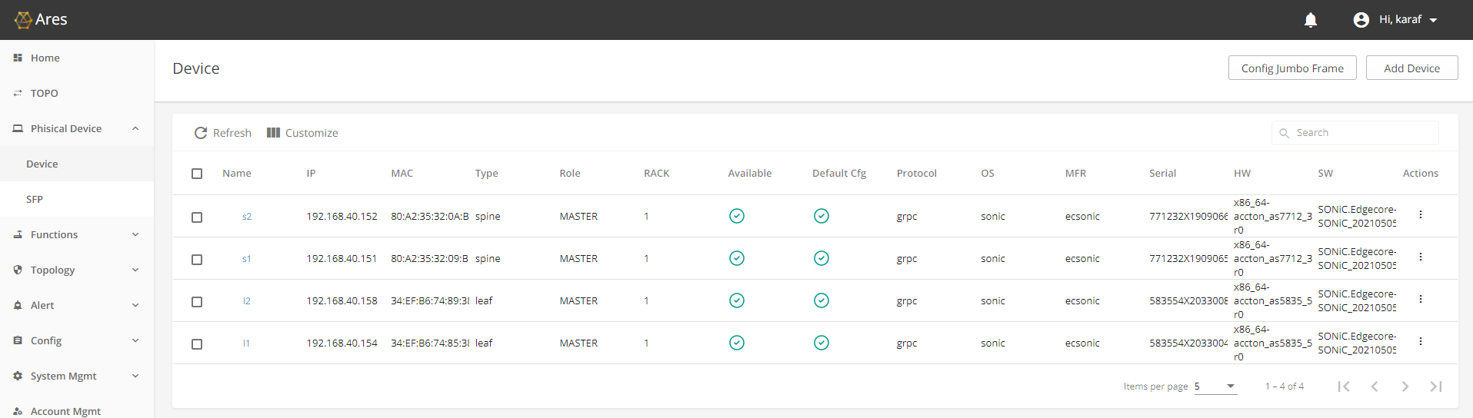
After Added a device you can find our it try to connect in Available column.
Please keep add other devices as you want

Slide 10
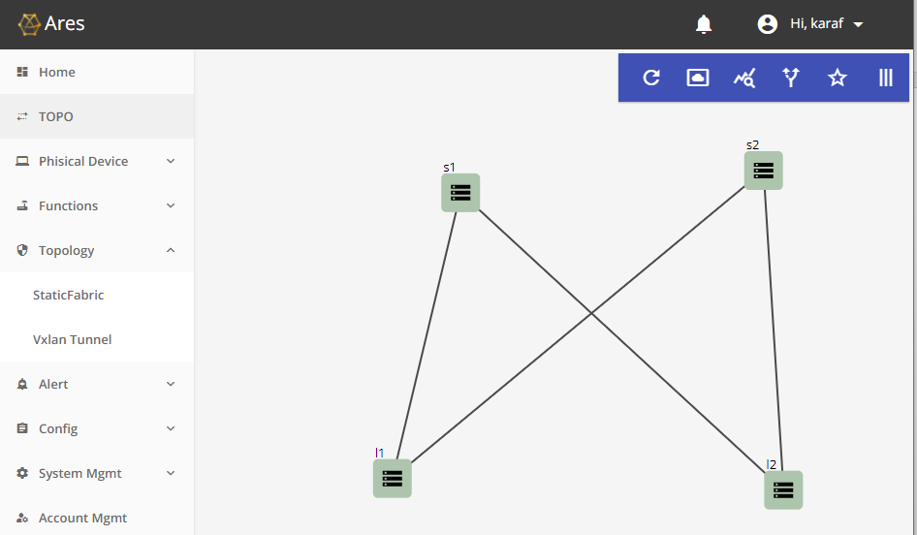
You can check the TOPO page to check the device link status

Slide 11
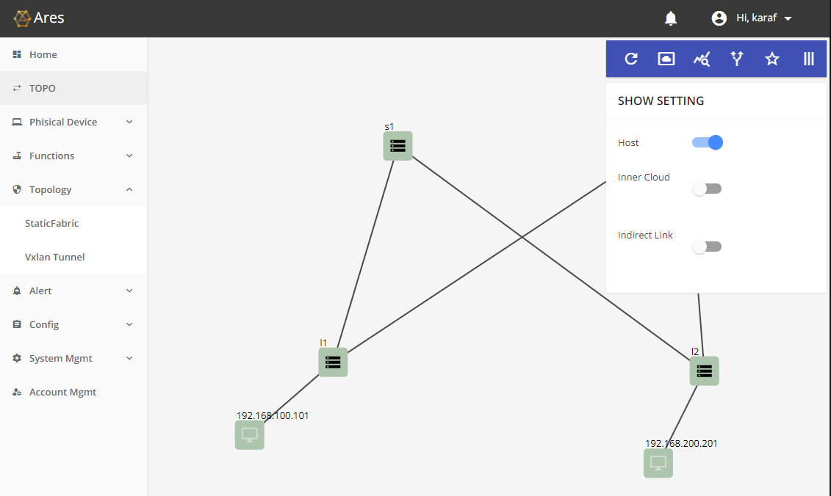
Using special icon to display more information

Slide 12
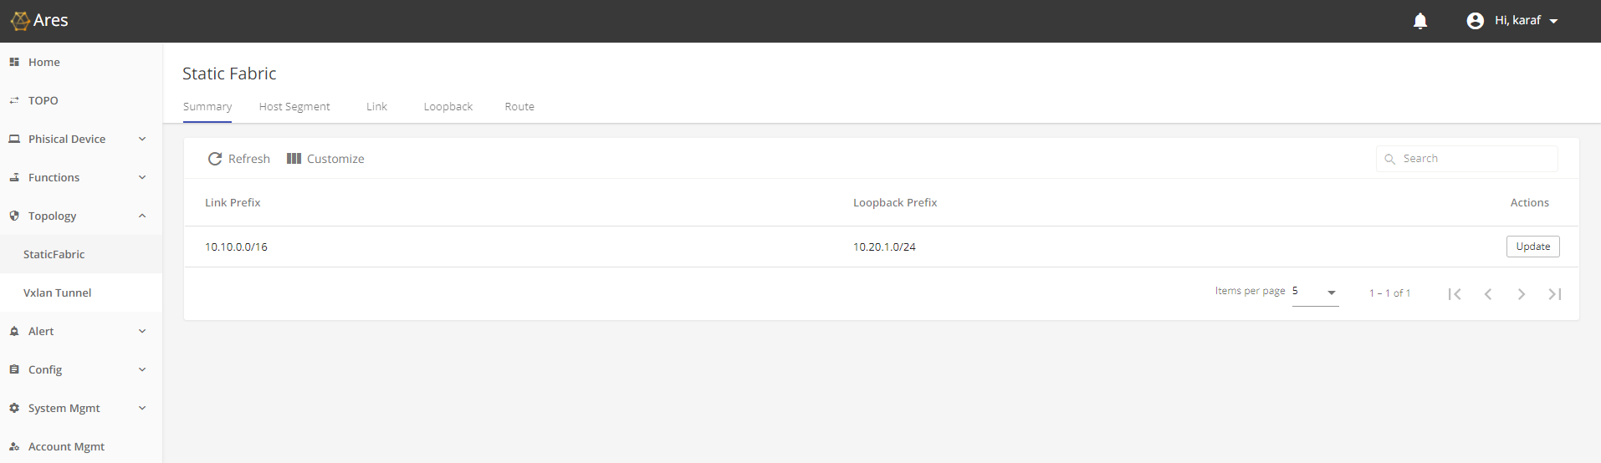
Provision Host segment for each host.

Slide 13
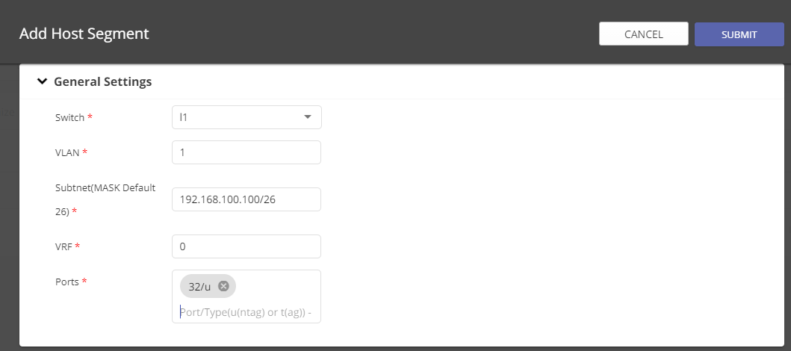
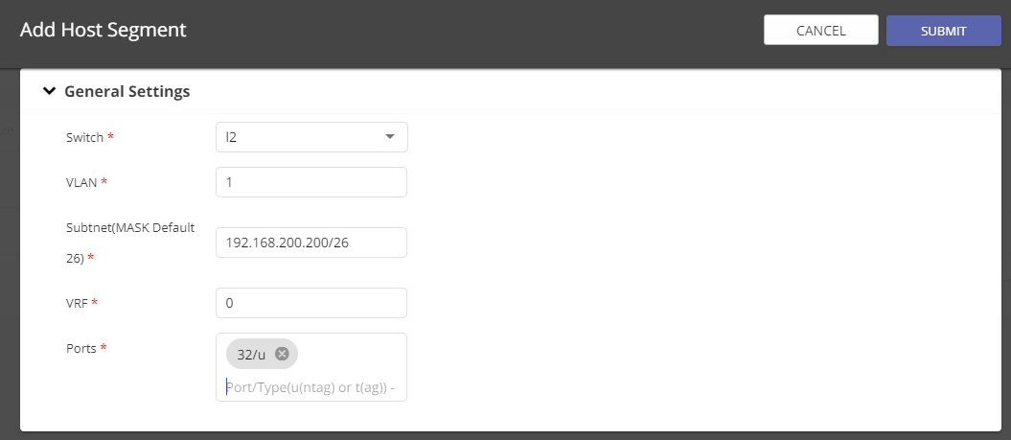
Provision the necessary host segment information
Please use comma (,) to finish input port.

Slide 14
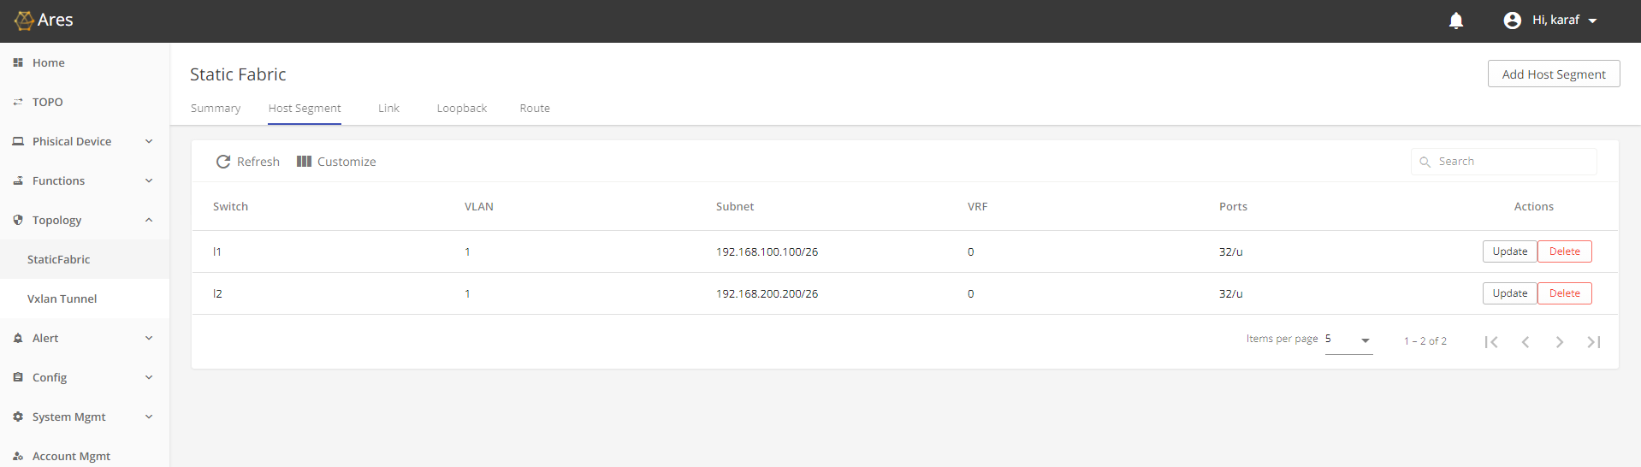
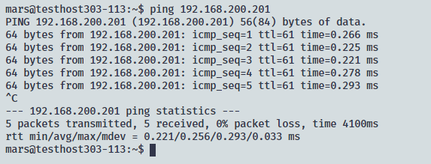
Check the result, and using Ping to verify the connectivity between two hosts.

Slide 15
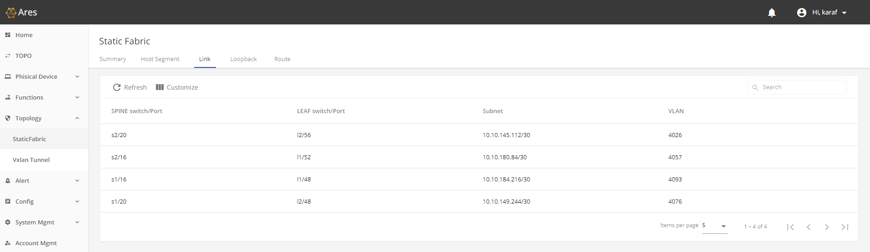
Link page display each link was allocated which subnet

Slide 16
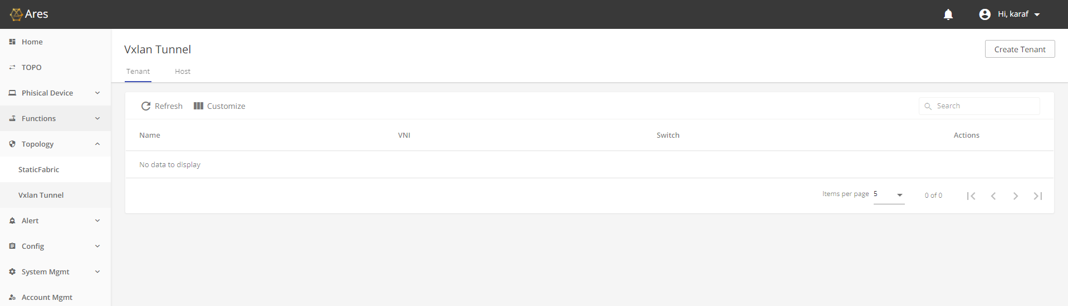
Provision VxLAN tunnel for two VxLAN hosts.
Create tenant on switches
Add host to tenant on which switch

Slide 17
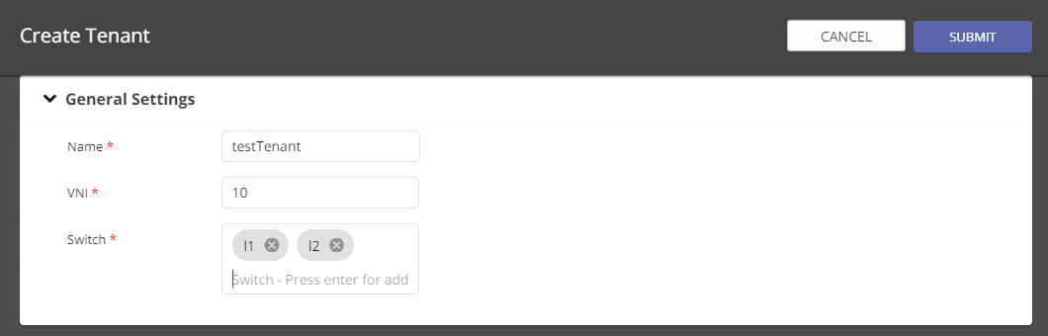
Create tenant on switches

Slide 18
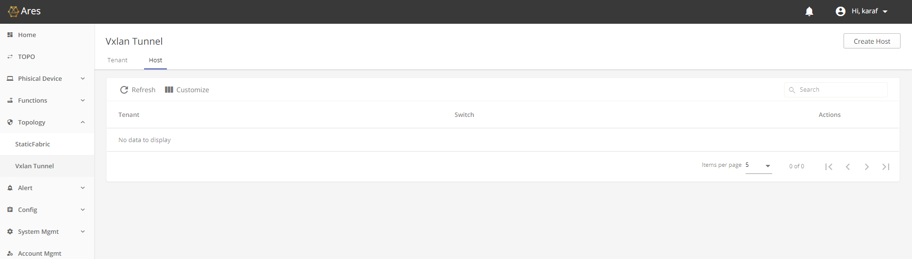
Add hosts to tenant - 1

Slide 19
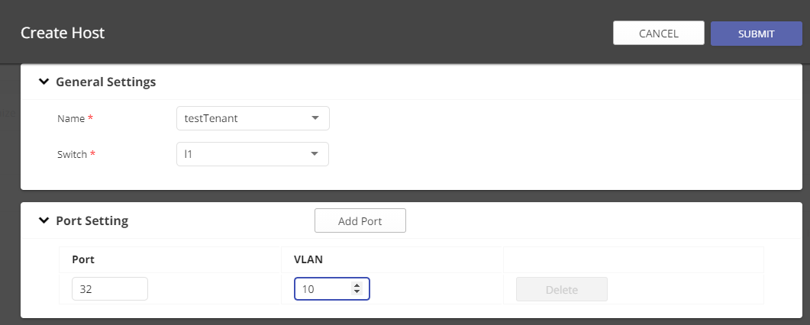
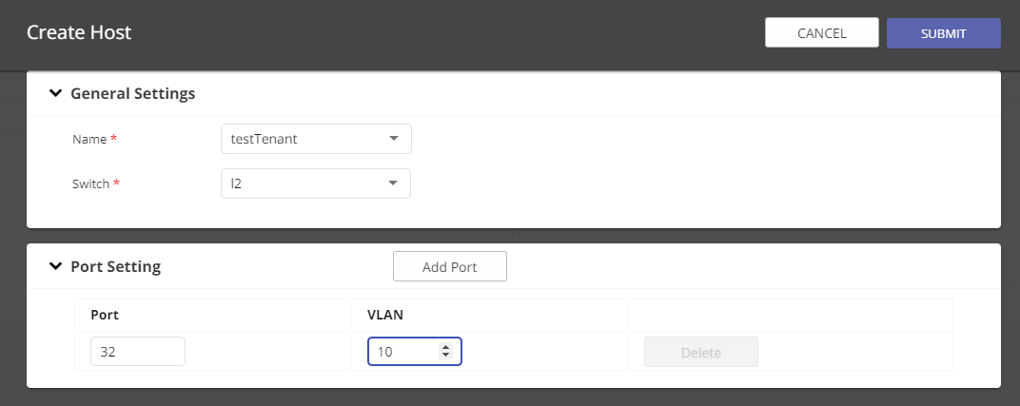
Add hosts to tenant - 2

Slide 20
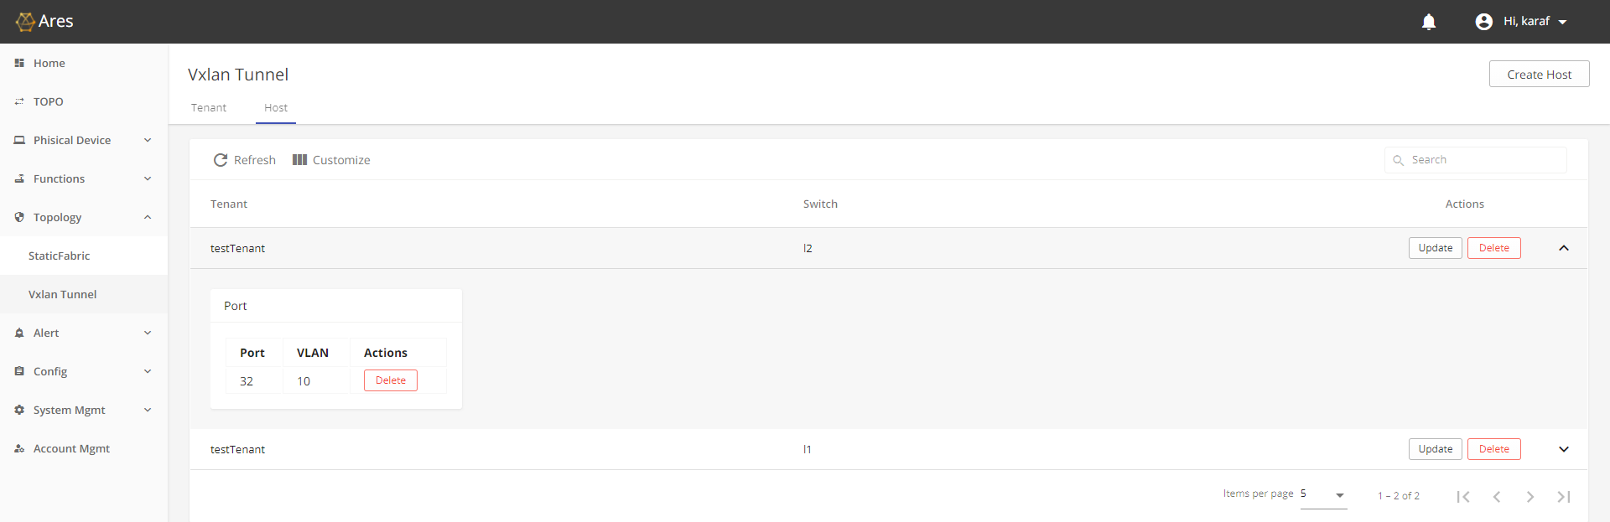
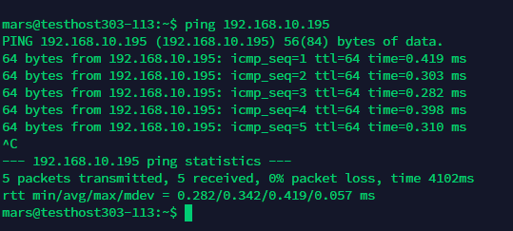
Testing VxLAN hosts connectivity by ping another host

