Slide 1

Integrated with Vmware vCenter (BGP topology and VxLAN)

Slide 2
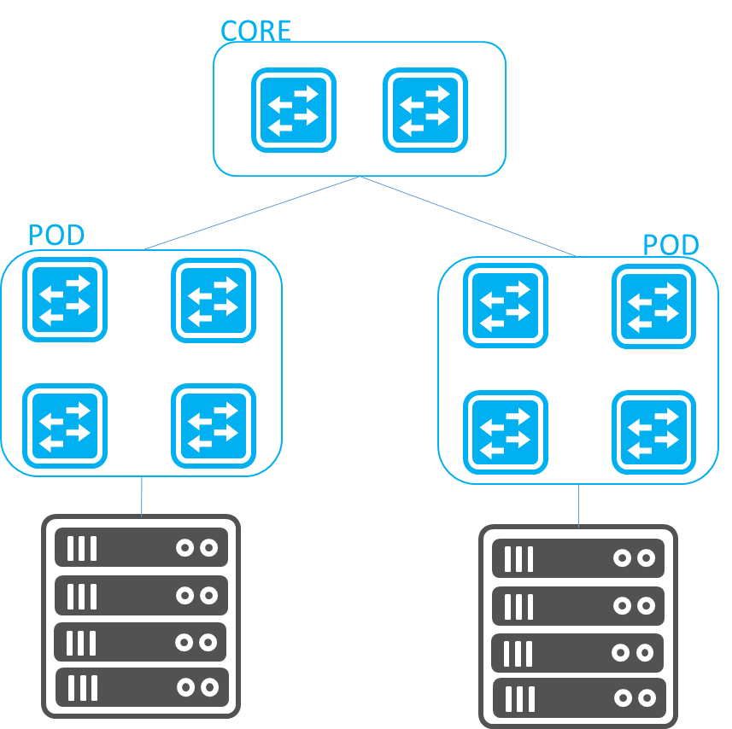
Scenario
Large or Medium size topology for switches over 64.
Ares uses eBGP with different AS to maintain topology.
For
Host running BGP.
Host want L2 Connectivity.
Have tenant concept in hosts
RFC 7938
Auto BGP provision
Notes:
Host NIC card can have two IPs, one for VxLAN tunnel target host, another for L3 routing.
Or Host NIC card using VLAN interface to assign IP.

Slide 3
Requirement
SDN network
Hardware
AS7712-32X
AS5835-54X
Software
SONiC-OS-Edgecore-SONiC_20210611_061351_ec202006_242
Ares
Git Commit: 927840b5e691d3f13b526faf9c68fd75687c83fb
vCenter
Hardware
ProLiant DL380 Gen10
Software
VMware ESXi 7.0.2
vCenter Server 7.0.2

Slide 4
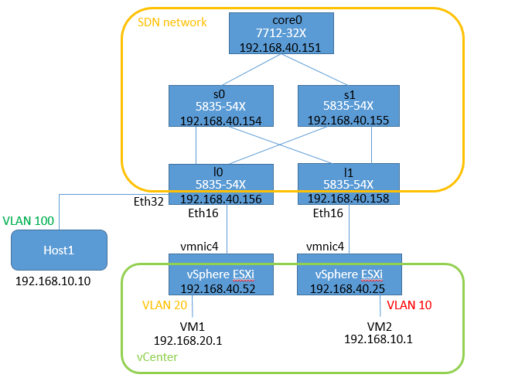
Topology – Ares + VMware + VxLAN Demo Case1: Vxlan tunnel between VM and external Host
SDN network
Controlled by Ares
Use BGP topology
vCenter
Use two ESXi hosts
VxLAN tunnel
Host1
VM2

Slide 5
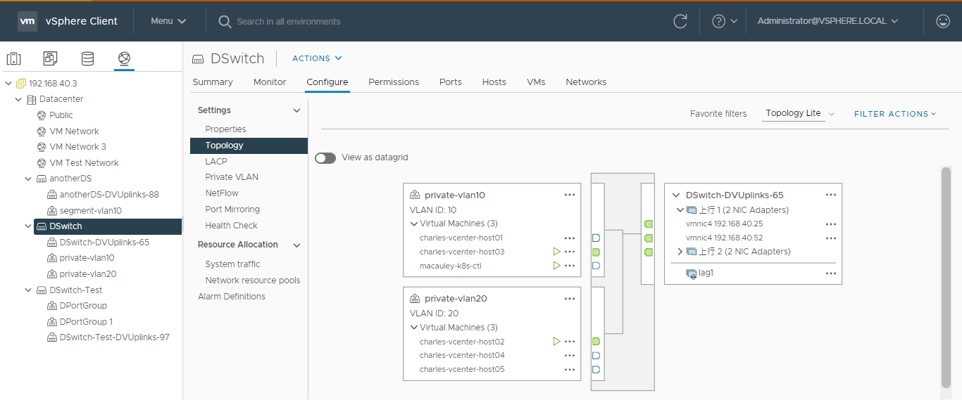
vCenter Setting – Distributed Switch Topology
VM2
VM1

Slide 6
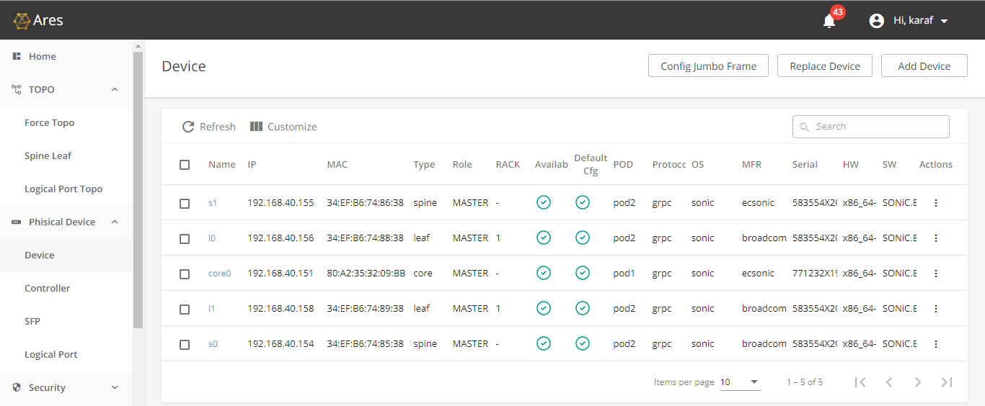
Ares Setting – Add devices

Slide 7
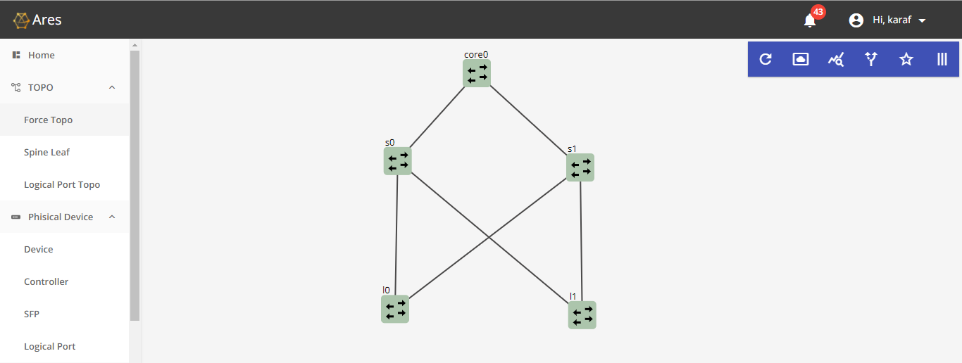
Ares Setting – devices topology

Slide 8
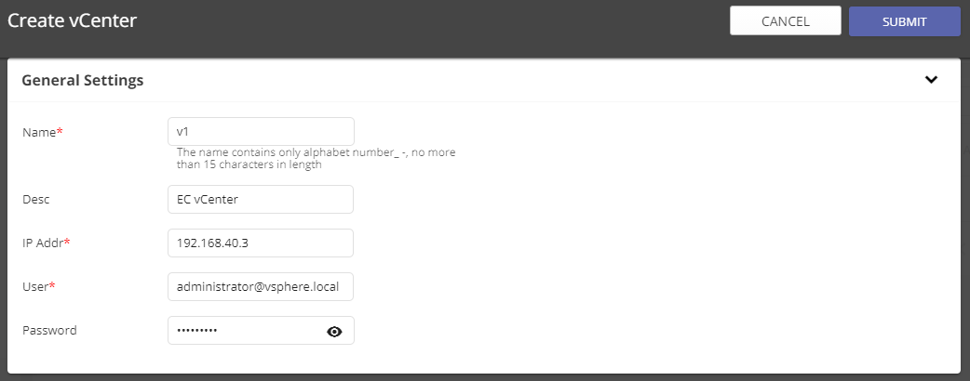
Ares Setting – Create vCenter

Slide 9
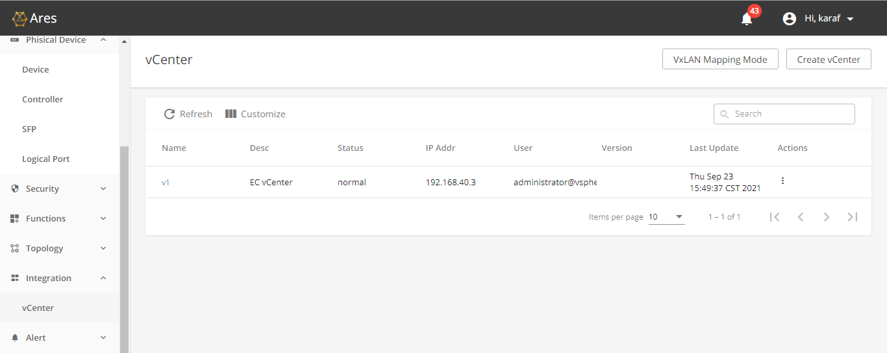
Ares Setting – vCenter status

Slide 10
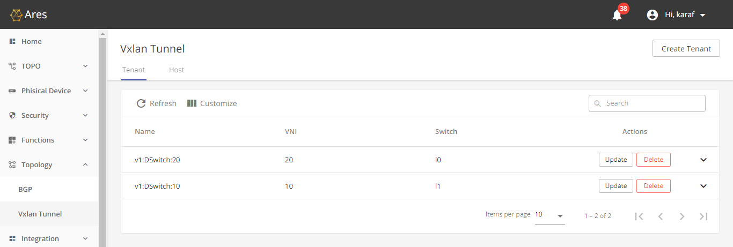
Ares Setting – Vxlan tunnel Tenant
Ares will create vxlan tunnel tenant and host automatically.

Slide 11
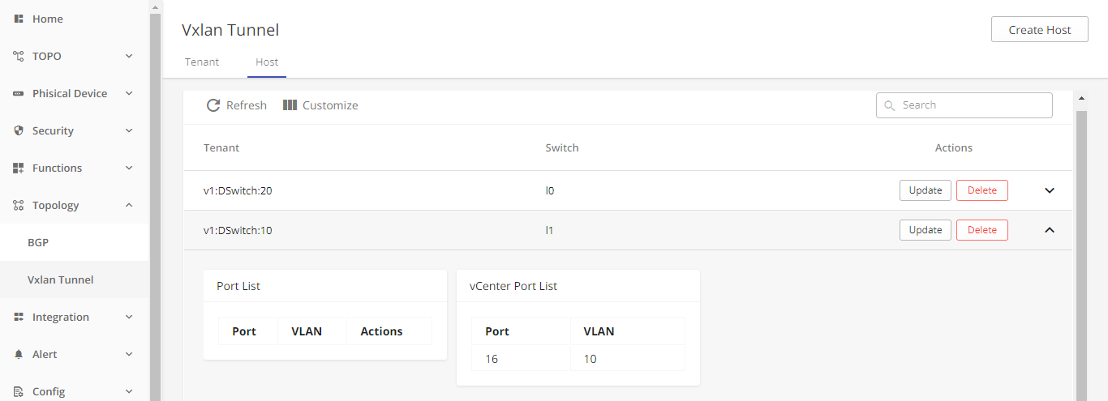
Ares Setting – Vxlan tunnel Host

Slide 12
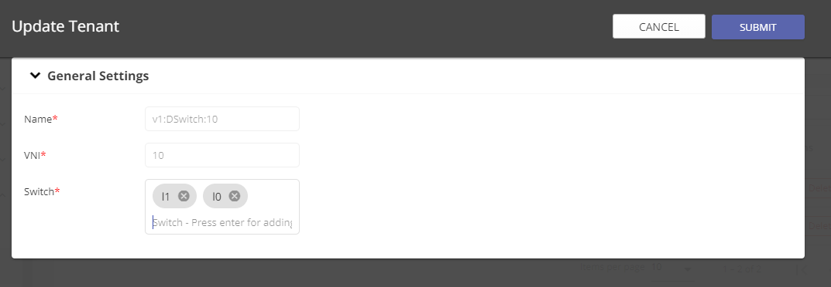
Ares Setting – Add device into tenant
Add l0 device into v1:Dswitch:10 Tenant,
because Host1 is in l0 device.

Slide 13
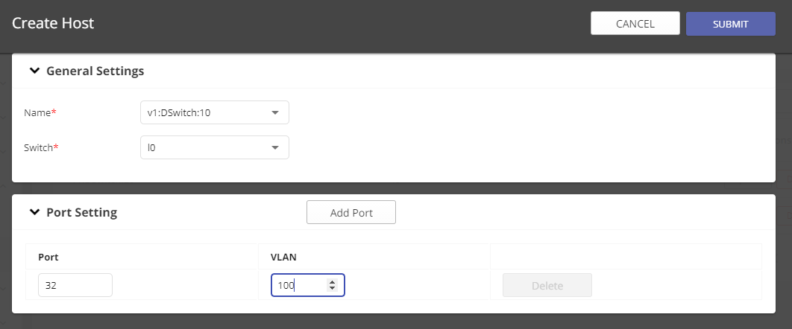
Ares Setting – Create host for tunnel
Host1 is in Ethernet32 and VLAN 100

Slide 14
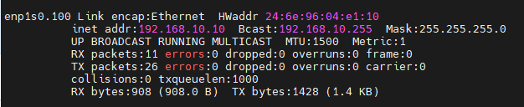
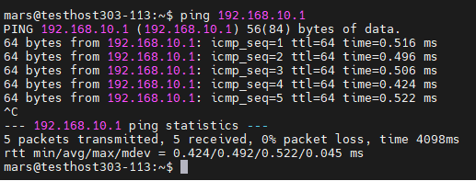
Vxlan tunnel check
Host1, IP is 192.168.10.10 use tag 100
Host1 ping VM2

