Slide 1
Enterprise scanairo

Slide 2
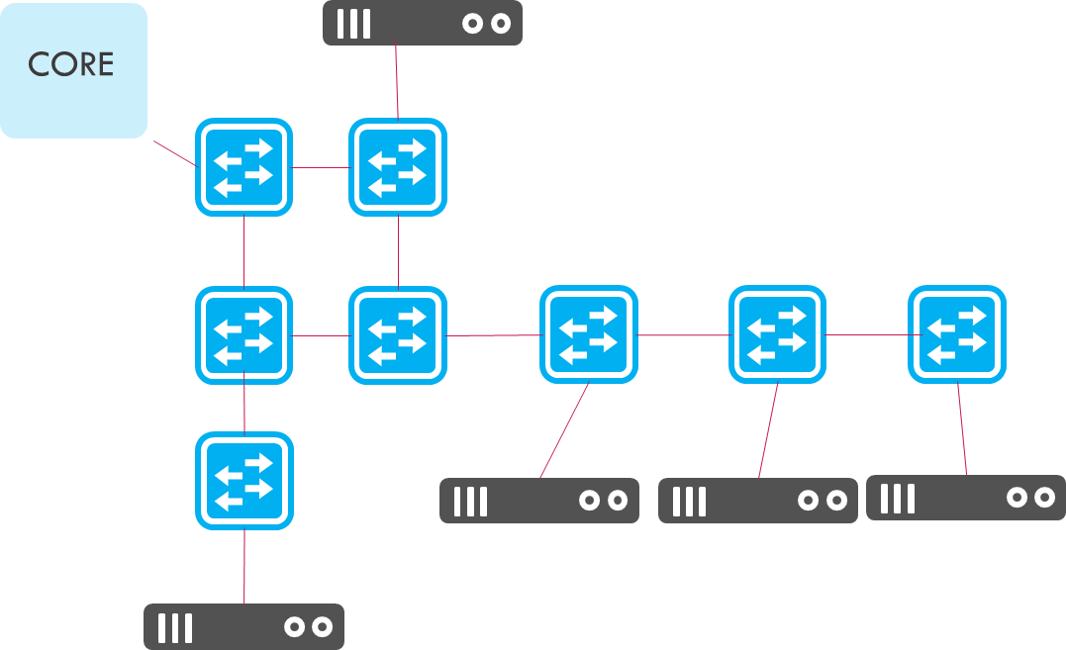
Scenario (Legacy switch)
Small enterprise.
Tree Topology.
Ares automatically provision fabric link according to Host provisioned features, like VLAN/DHCP/PPPoE/….

Slide 3
Scenario (openflow switch)
Small enterprise.
Mesh Topology.
L3 Routing/ L2 Switching
Plug and play
White/black list
Support Profinet (OT network)
L3
L3

