Slide 1

CLOS topology Static Routing Fabric

Slide 2
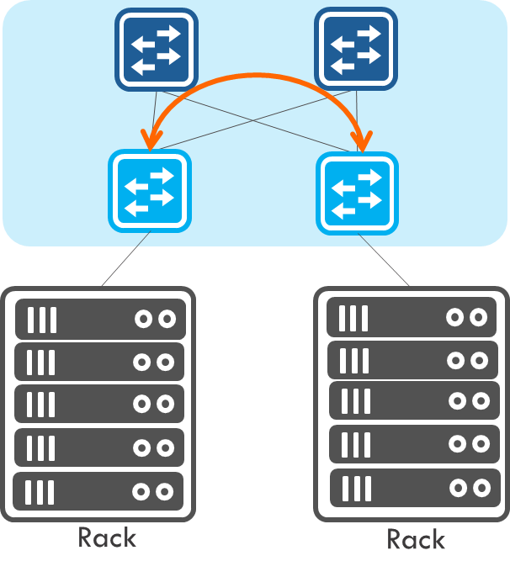
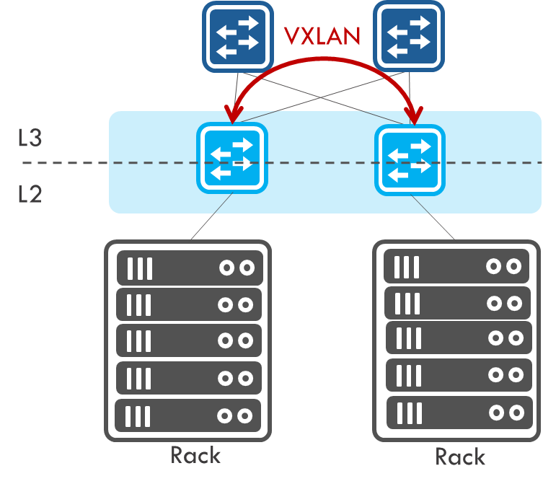
Scenario
Small or Medium size topology under 64 switches.
Ares uses VLAN/VRF to have traffic separated or use VxLAN tunnel to have traffic separated depend on controlled switches.
For
Host using L3 or L2 to connect each other but skip the routing protocol.
Have tenant concept in hosts.
Notes:
Host NIC card can have two IPs, one for VxLAN tunnel target host, another for L3 routing.
Or Host NIC card using VLAN interface to assign IP.

Slide 3
Tenant A
router
Segment
A
Segment
B
H
H
H
H
Tenant N
router
Segment
A
Segment
B
H
H
H
H

Slide 4
