Slide 1
Routing topology Detection

Slide 2
Scenario – AS domain
Detection AS domain topology by one of
OSPF
IS-IS
BGP-LS
Searching possible routing path
Needn’t contact all devices just one device.

Slide 3
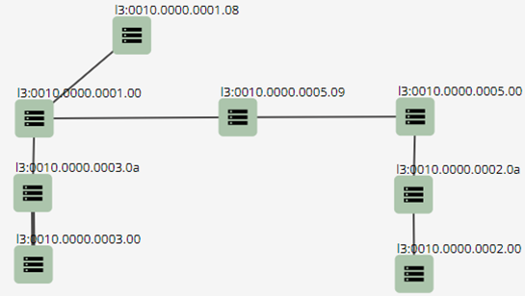
IS-IS example with Arista Router

