Slide 1
Mars + K8s

Slide 2
Test environment
SDN network
BGP Topology
spine0
leaf0
leaf1
20.200.30.17/31
Mgmt Switch
20.200.50.17/31
20.200.30.16/31
192.168.40.215
192.168.40.216
20.200.50.16/31
Pod-network=10.100.0.0/16
Pod
Pod
K8S
master
node1

Slide 3
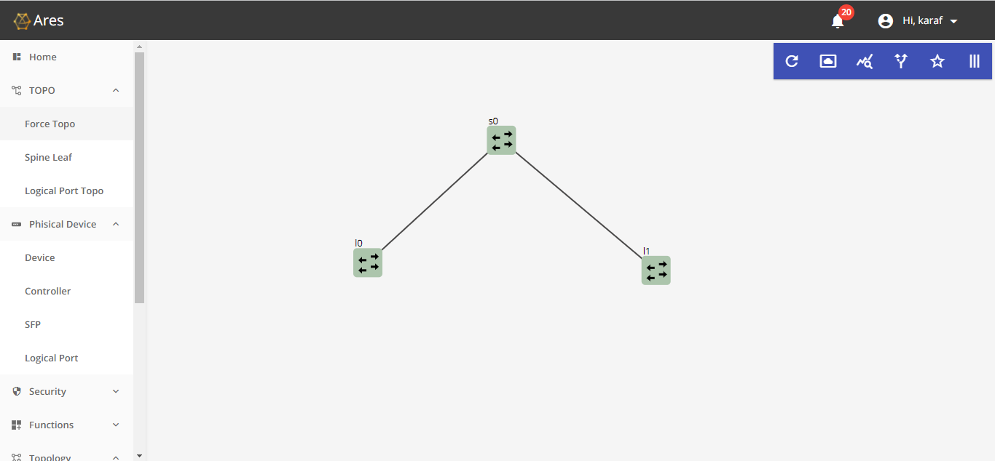
Start Mars with BGP topology

Slide 4
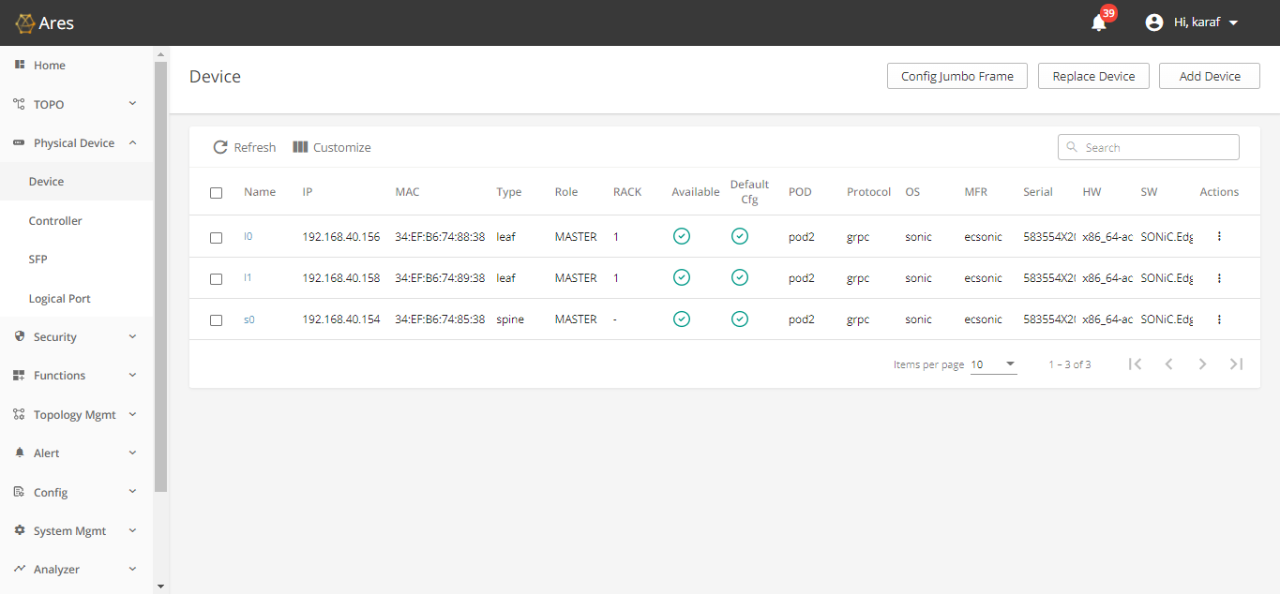
Add devices

Slide 5
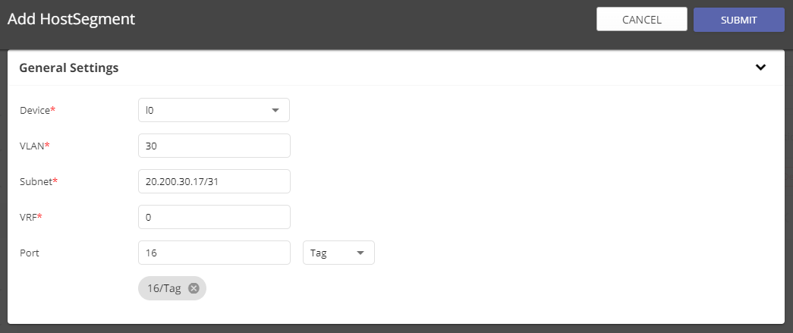
Configure BGP host segment for leaf0

Slide 6

Configure BGP host segment for leaf1

Slide 7
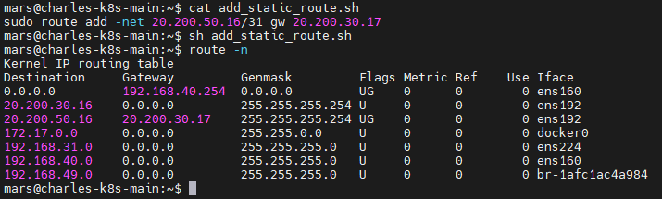
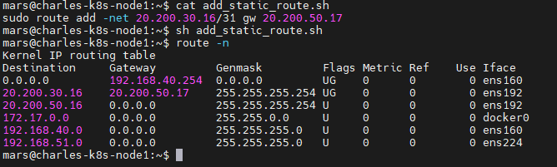
Add static route for main and node1

Slide 8
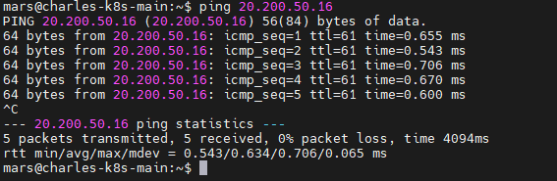
Check the connection from main to node1

Slide 9
Configure nodes to use the assigned node IP
mars@charles-k8s-main:~$ sudo vi /etc/default/kubelet
// Add the following
KUBELET_EXTRA_ARGS=--node-ip 20.200.30.16
mars@charles-k8s-node1:~$ sudo vi /etc/default/kubelet
// Add the following
KUBELET_EXTRA_ARGS=--node-ip 20.200.50.16

Slide 10
Setup K8s master with Calico
// Execute the following command in master
sudo kubeadm init --pod-network-cidr=10.100.0.0/16 --apiserver-advertise-address=20.200.30.16
rm -r $HOME/.kube
mkdir -p $HOME/.kube
sudo cp -i /etc/kubernetes/admin.conf $HOME/.kube/config
sudo chown $(id -u):$(id -g) $HOME/.kube/config
kubectl taint nodes --all node-role.kubernetes.io/master-
kubectl apply -f ./calico_yaml/calico_assign_intf.yaml

Slide 11
Setup the node1
// Let node1 join k8s cluster
kubeadm join 20.200.30.16:6443 --token s7kbn4.d33kzxm4psk064ex \
--discovery-token-ca-cert-hash sha256:7f85820df550465941f12782e1172540839a59d10b7bc175d7d12b0a378b3bd5
Note: Use ‘kubeadm token create --print-join-command’ to get correct info

Slide 12
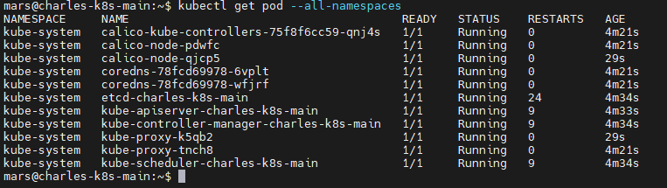
Check all pods status

Slide 13
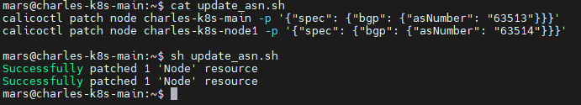
Configure each node’s ASN

Slide 14
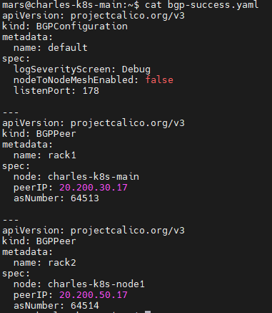
Configure BGP Configuration and BGP Peer

Slide 15
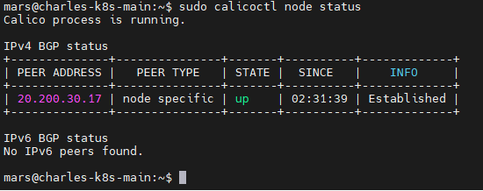
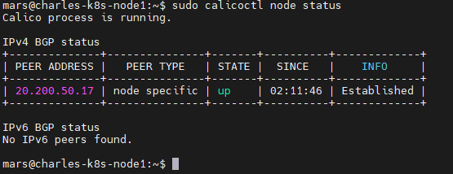
Check BGP peer status

Slide 16
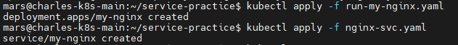

Create nginx service

Slide 17
// run-my-nginx.yaml
apiVersion: apps/v1
kind: Deployment
metadata:
name: my-nginx
spec:
selector:
matchLabels:
run: my-nginx
replicas: 2
template:
metadata:
labels:
run: my-nginx
spec:
containers:
- name: my-nginx
image: nginx
imagePullPolicy: Never
ports:
- containerPort: 80
// nginx-svc.yaml
apiVersion: v1
kind: Service
metadata:
name: my-nginx
labels:
run: my-nginx
spec:
ports:
- port: 80
protocol: TCP
selector:
run: my-nginx

Slide 18
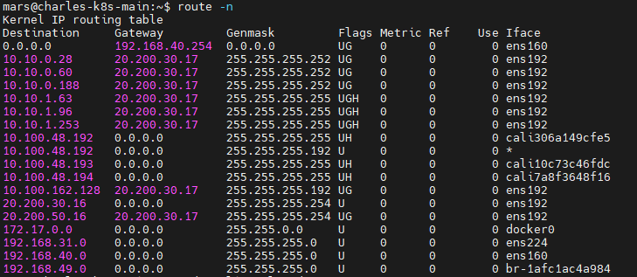
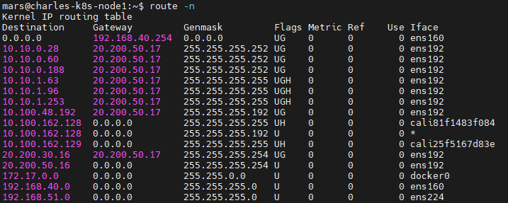
Check routing table

Slide 19
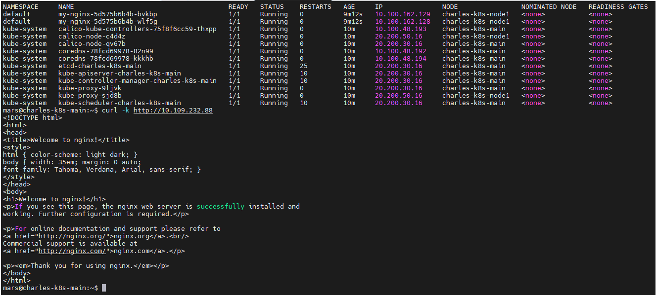
Check connection with curl from master
Nginx pods are in the node1, we test the connection from master. So, we can confirm SDN network is fine for K8s.

Slide 20
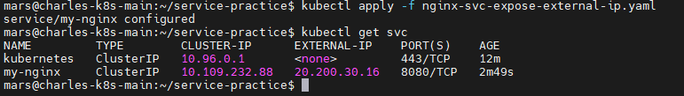
Expose nginx service for outside network
apiVersion: v1
kind: Service
metadata:
name: my-nginx
labels:
run: my-nginx
spec:
ports:
- name: http
port: 8080
targetPort: 80
selector:
run: my-nginx
externalIPs:
- 20.200.30.16

Slide 21
Add normal host to test environment
SDN network
BGP Topology
spine0
Host1 IP: 10.10.100.113 gateway: 10.10.100.254/24
leaf0
leaf1
20.200.30.17/31
Mgmt Switch
20.200.50.17/31
20.200.30.16/31
192.168.40.215
192.168.40.216
20.200.50.16/31
host1
Pod-network=10.100.0.0/16
Pod
Pod
K8S
master
node1

Slide 22

Add host segment for host1

Slide 23
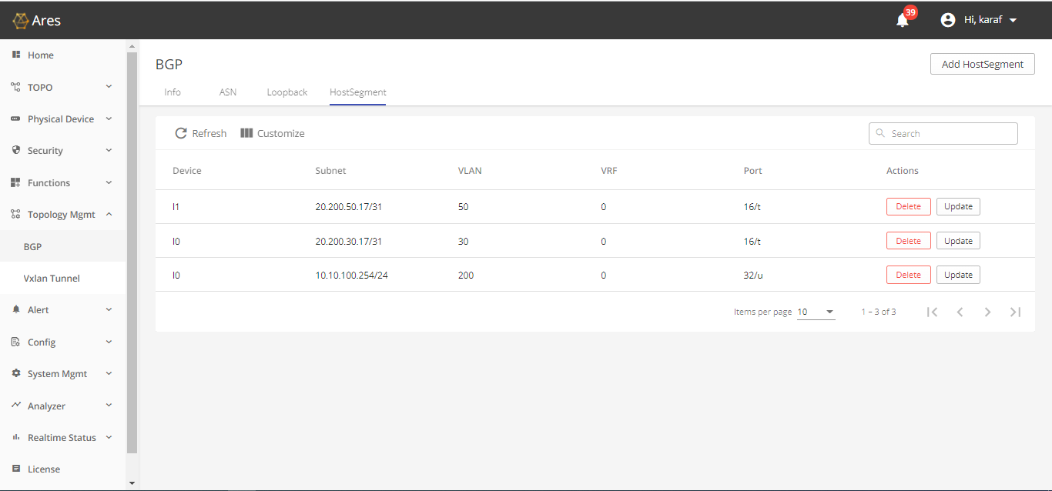

Slide 24
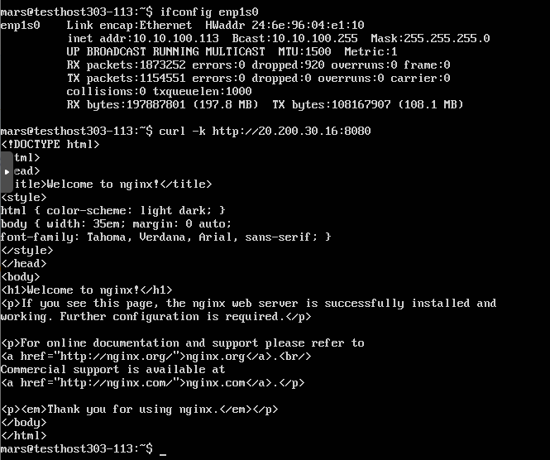
Use normal host to connect the service

