Slide 1
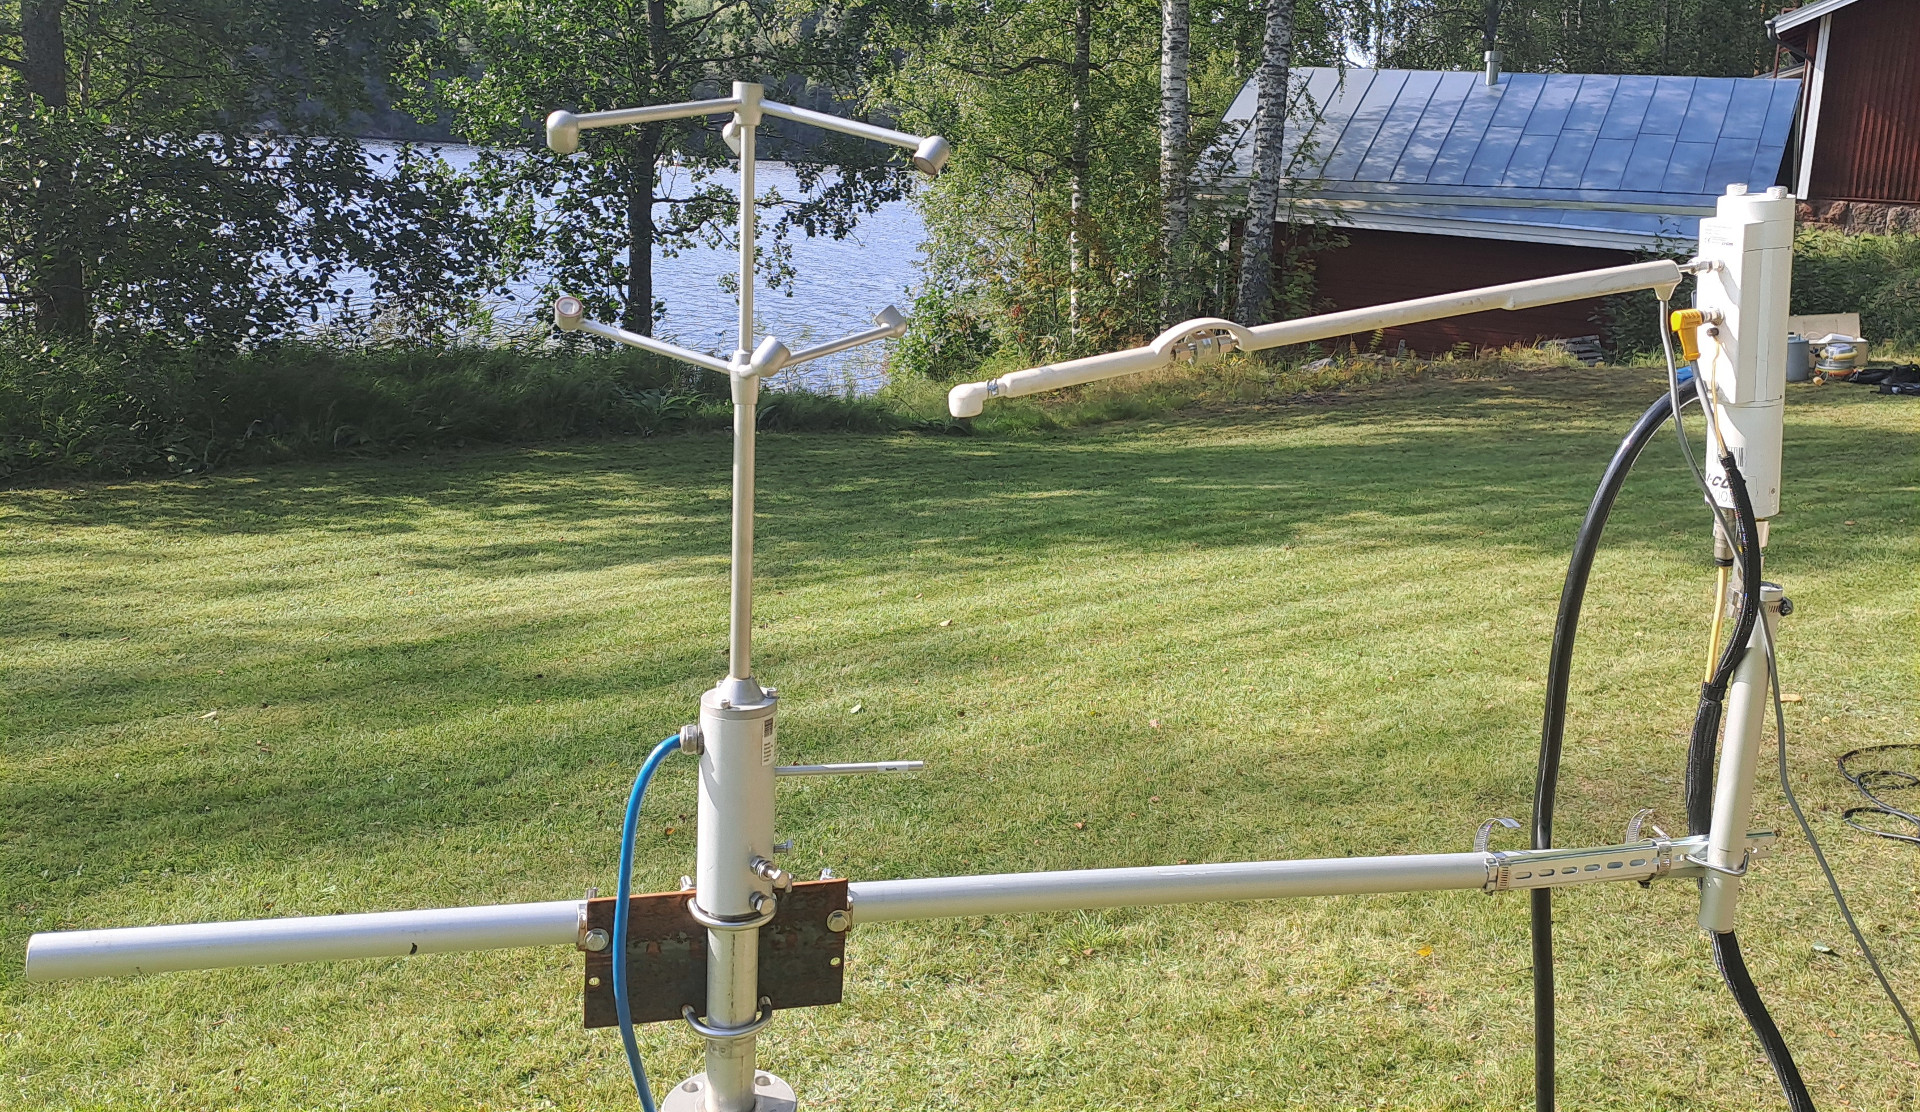
sonic
gas analyzer
inlet tube
filter
rain cap
prevailing wind direction
flow tube

Slide 2
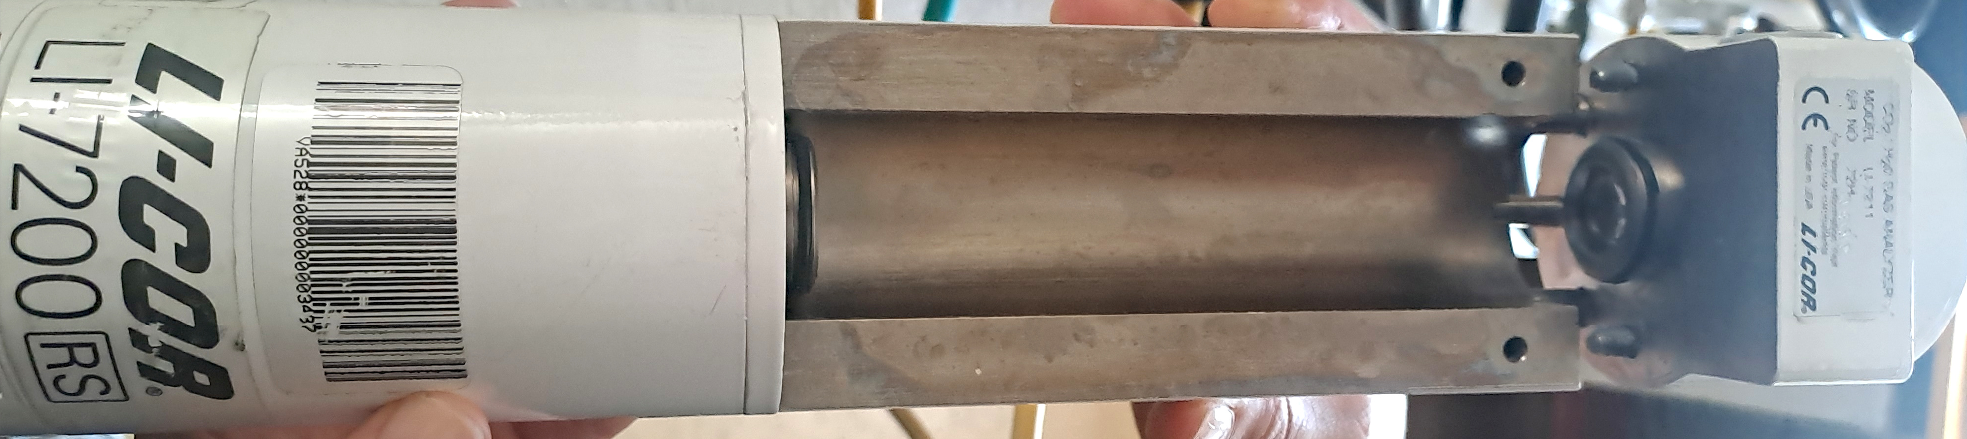
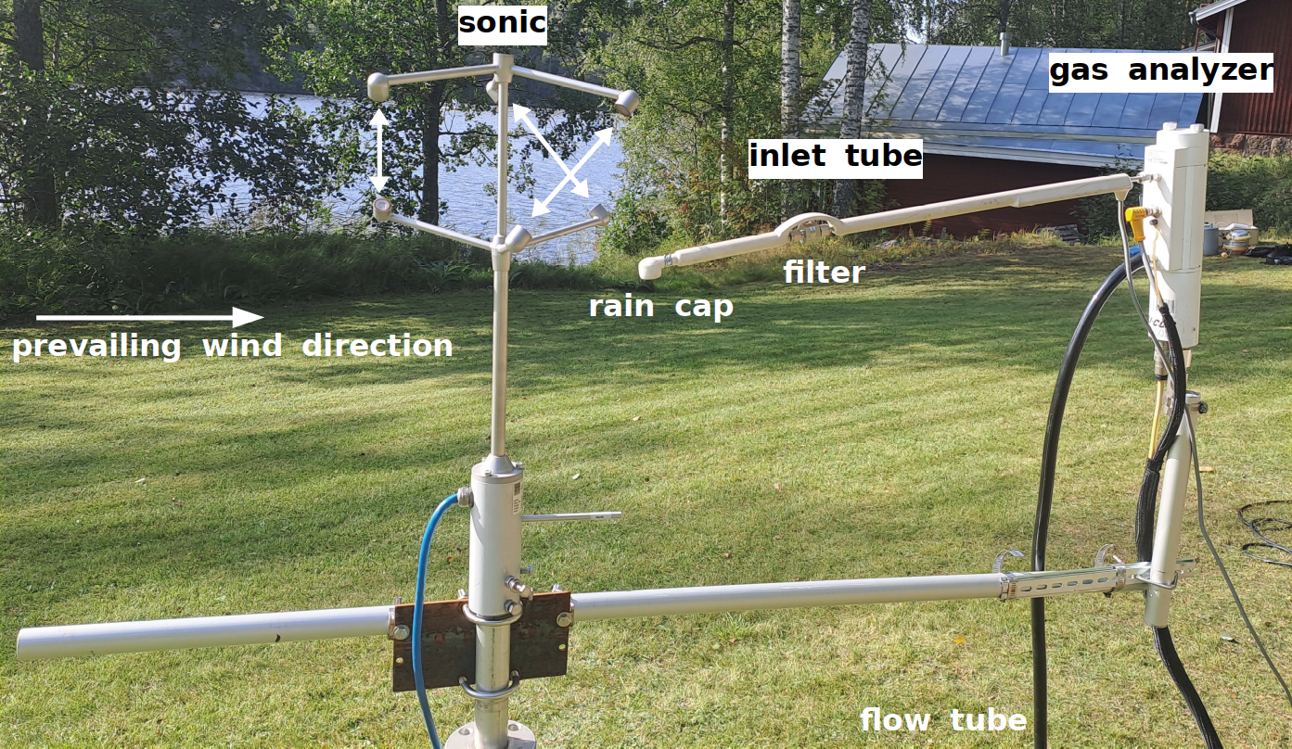
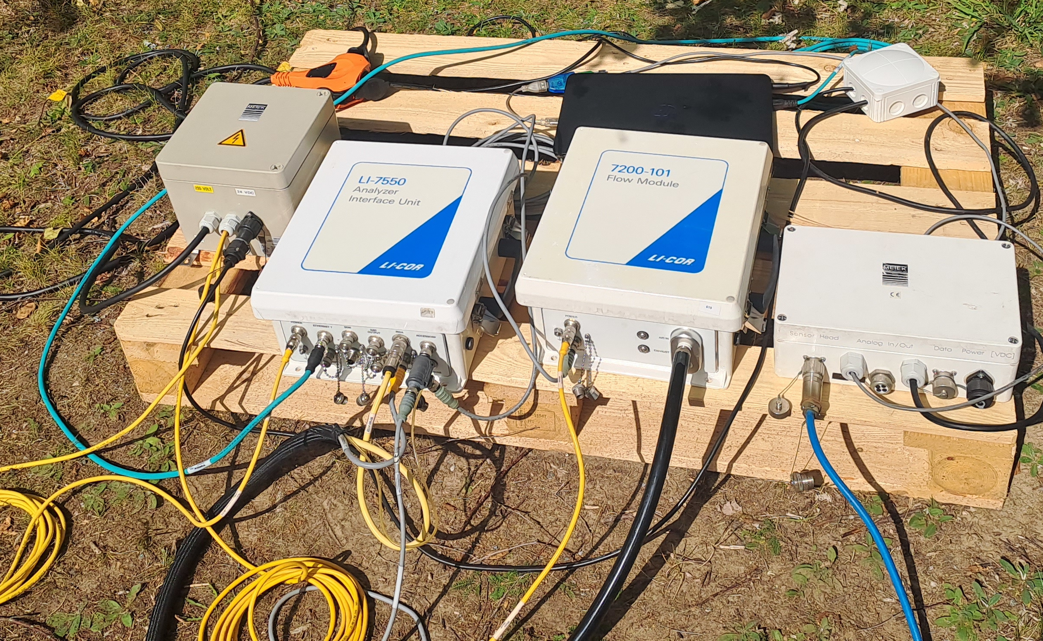
gas analyzer (opened)
analyzer interface and flow module

