Slide 1
Windows 10 Forensics & Introduction to Exploit Kits
Presented By: Betrant Titus (AM.EN.P2CSN18006)
1

Slide 2
We can all see, but can you observe?
- A.D. Garrett

Slide 3
Outline
Introduction
Abstract
Problem Statement
Introduction to Windows Forensics
Typical digital evidence collection routine on Windows
Introduction to Windows 10

Slide 4
Outline (contd.)
Enhanced digital evidence collection routine on Windows 10
Components of digital evidence collection
Forensic tools used
Adding third-party applications into the mix
Repurposing lists built for system maintenance for artifact collection

Slide 5
Outline (contd.)
Exploit Kits
Introduction to Exploit Kits
Under the hood of an EK: what makes an EK, and how it works
Prevalent EKs found today

Slide 6
1.
Introduction
An overview of what the field is and why the current state is not enough

Slide 7
Abstract
Windows is the most widely used system for personal computers; makes it an large attack surface.
Primary reason why malware authors target Windows.
Standardized practices in existence to gather evidence on older versions of Windows (Windows 2K/XP, Vista, 7, 8).
But the latest iteration of Windows brings many changes to the table that make existing digital collection practices obsolete.

Slide 8
Problem Statement
Main problem: There are no practices that implement a comprehensive digital evidence collection on a suspect Windows 10 machine.
Additionally, digital evidence collection still performed with outdated tools.
No quick method to extract full set of artifacts on a live session.

Slide 9
First, a primer.
Let’s look at some of the underlying concepts before we get started.

Slide 10
2.
Typical digital evidence collection routine on Windows
Let’s look at how forensic routines are performed on a typical Windows machine

Slide 11
Phases of the forensics routine
Preservation and collection
Write blockers are used on the drives to avoid unnecessary writes by any processes including forensic tools, and then imaging suites are used to build bit-perfect copies of the drives.
Processing and analysis
Identification of files, and extraction of sensitive data is done with forensic tools designed to do the same.
Reporting
A report containing the timeline of the attack/crime is built alongside supporting evidence, and is presented as a report that fulfills certain standards pertaining to jurisdiction.
11

Slide 12
Areas of artifact collection
Windows Registry
The Registry contains many types of sensitive information including password hashes, logon logs, plaintext credentials, and much more.
MRU Lists
The MRU (Most Recently Used) lists display the files recently accessed/modified on the system and the user that accessed/modified it.
Device History & Autoruns
This shows the list of devices that were connected to the system, such as external storage, peripherals, etc.
Saved Networks
This shows the list of all saved SSIDs, authentication keys and its related metadata of every network the system was connected to.
Event Logs
This shows the detailed list of all the administrative-level events that happened on the system, such as configuration changes.
Browser Data
This is the set of data extracted from the system containing information such as browsing history, saved session cookies and more.
12

Slide 13
3.
Introduction to Windows 10
A quick overview of the latest iteration of the Windows OS from a forensic standpoint

Slide 14
Windows 10 : What’s new?
Whilst Windows 10 shares many core functions with previous versions of Windows, some things are completely new and unique.
These include new ways of searching for files and programs on your computer, browsing the web and accessing entertainment.
It includes a redesigned Start menu, Cortana, Microsoft Edge, a new Windows store, Windows Hello, Microsoft Continuum and much more.

Slide 15
Central areas of attention
Integration with Microsoft account
Windows 10 adds options to authenticate and utilize a Microsoft account as the primary account on a machine with it installed. It syncs a lot of items, preferences and more.
Microsoft Edge
This is the new face of IE. Codenamed Project Spartan, it uses a custom rendering engine to deliver an optimized browsing experience. Data sync works with a Microsoft account.

Slide 16
Central areas of attention
Windows Timeline
A new feature introduced in Windows 10 that helps you keep track of all the windows and applications you’ve been using. Integrated into the Task View, and syncs with Microsoft account.
Cortana & Telemetry
Cortana is the virtual assistant that comes with Windows 10. It, alongside the telemetry services present in Windows 10 collects a staggering amount of data on the user that uses it.

Slide 17
4.
Enhanced digital evidence collection routine on Windows 10
The proposed routine that aims to build a more comprehensive set of artifacts

Slide 18
Application Execution
File Knowledge
Network Activity
User Activity
Browser Usage
External Device Usage
Components of digital evidence collection

Slide 19
Application Execution Artifacts
UserAssist
ShimCache (Windows Compatibility)
Amcache.hve
Last-Visited MRU
Windows 10 Timeline
RecentApps
Jump Lists
System Resource Usage Monitor
Background Activity Moderator
Prefetch

Slide 20
File Knowledge Artifacts
Open/Save MRU
Email Attachments & Skype History
Download list
Thumbcache
Thumbs.db
IE/Edge file://
Search (WordWheelQuery)
Last-visited MRU
Recycle Bin
ShellBags
Jump Lists
Office Recent files
.lnk files (Shortcuts)
Recent Files

Slide 21
Network Activity Artifacts
Cookies
Network History
WLAN Event Log
WLAN profiles
Browser search terms
System Resource Usage Monitor
Timezone

Slide 22
User Activity Artifacts
Last Login
Last Password Change
RDP usage
Services events (Event Log)
Logon types
Authentication events
Success/Fail logons

Slide 23
Browser Usage Artifacts
History
Cookies
Cache
Flash & Super cookies
Session restore
Google Analytics cookies

Slide 24
External Device Usage Artifacts
Key Identification
First/Last times
User/Owner
PnP events (Event Log)
Volume serial number
Drive letter & Volume name
.lnk files (Shortcuts)

Slide 25
GMER
MiTeC toolkit
DFRC toolkit
RegRipper
4Discovery toolkit
FastIR
Artifact Extractor
SysInternals Suite
Forensic tools used

Slide 26
Adding third-party applications into the mix
Motivation: Nobody uses a barebones OS as-is.
Typical user installs third-party applications like browsers, multimedia players, games, utilities and so on.
These applications generate artifacts that are not accounted for by conventional OS forensic routines.
Solution: Try and generate database for artifacts generated by such applications.

Slide 27
Repurposing lists built for system maintenance for artifact collection
Similar to ad-block lists, there are lists made for system maintenance.
Mostly contains the entries to artifacts generated by third-party applications.
Using a small program used to query such paths, we can populate and retrieve all artifacts from third-party applications.
Example of such a list is Winapp2.

Slide 28
5.
Exploit Kits
A short discussion on what these famed servers of mass terror are

Slide 29
Introduction to Exploit Kits
Simply put, EKs are tools to automate exploitation of vulnerabilities.
But they do not target specific system/network; they run mass exploitation “campaigns”
They contain a user-friendly interface for weaponizing exploits and launching such campaigns.
These interfaces also show statistics of all the systems infected, exploits used and so on.

Slide 30
Introduction to Exploit Kits
These are so simple that they can be used by anyone with basic knowledge of computers.
Thus, these are licensed by EK authors to cybercriminals for a exorbitant fee. ($1000-$3500)
Cost aside, getting hold of one is very hard.

Slide 31
Under the hood of an EK: what makes an EK, and how it works
Most EKs contain mainly four components:
Campaign server
Exploit database server
Compromised webpages
Exploit pages
The typical workflow is discussed in the coming slides.

Slide 32
Campaign server
Exploit database server
Cybercriminal
Landing page / malicious link
Exploit
page
Components of an Exploit Kit
Victim

Slide 33
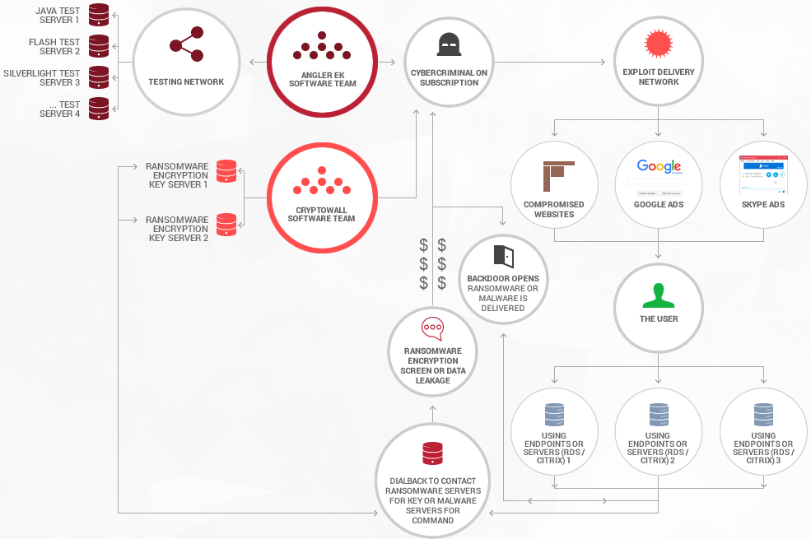
Typical Exploit Kit workflow

Slide 34
Prevalent EKs found today
RIG EK:
Most popular EK as of now.
Contains many Flash, Silverlight and JavaScript exploits.
Has also been used for cryptomining.
Angular EK:
One of the most extensive EKs in history, in terms of exploit variety and count.
Disappeared from the internet by mid-late 2016.
One of the highest revenue generating EKs.

Slide 35
Prevalent EKs found today
GrandSoft EK:
Old exploit kit that made a comeback.
Used to distribute GandCrab in Jan 2018.
Used to drop huge variety of payloads.
Simplistic and can be easily detected.
Magnitude EK:
Usage concentrated in South Korea.
Dropped Flash support, only uses IE for exploitation now.
Comes with it’s own payload named Magniber.

Slide 36
Prevalent EKs found today
Terror EK:
Rose to the scene after decline of Angler, Neutrino and SunDown EKs.
Uses exploits and payloads from other EKs.
Optionally uses URL shorteners to disguise exploit and landing pages.

Slide 37
Demo time!
Let’s see what we’ve been discussing about in reality!

Slide 38
References
https://github.com/MoscaDotTo/Winapp2
https://docs.microsoft.com/en-us/sysinternals/downloads/sysinternals-suite
https://boncaldoforensics.wordpress.com/2018/10/07/all-installed-apps-artifact-windows-10-forensics/
https://www.sans.org/security-resources/posters/windows-forensic-analysis/170/download
https://cclgroupltd.com/2018/05/03/windows-10-timeline-forensic-artefacts/
http://forensic.korea.ac.kr/
http://mitec.cz
https://github.com/SekoiaLab/Fastir_Collector
https://github.com/Silv3rHorn/ArtifactExtractor

Slide 39
Thank You!
Any questions?

