Slide 1
DEVOPS and AWS

Slide 2
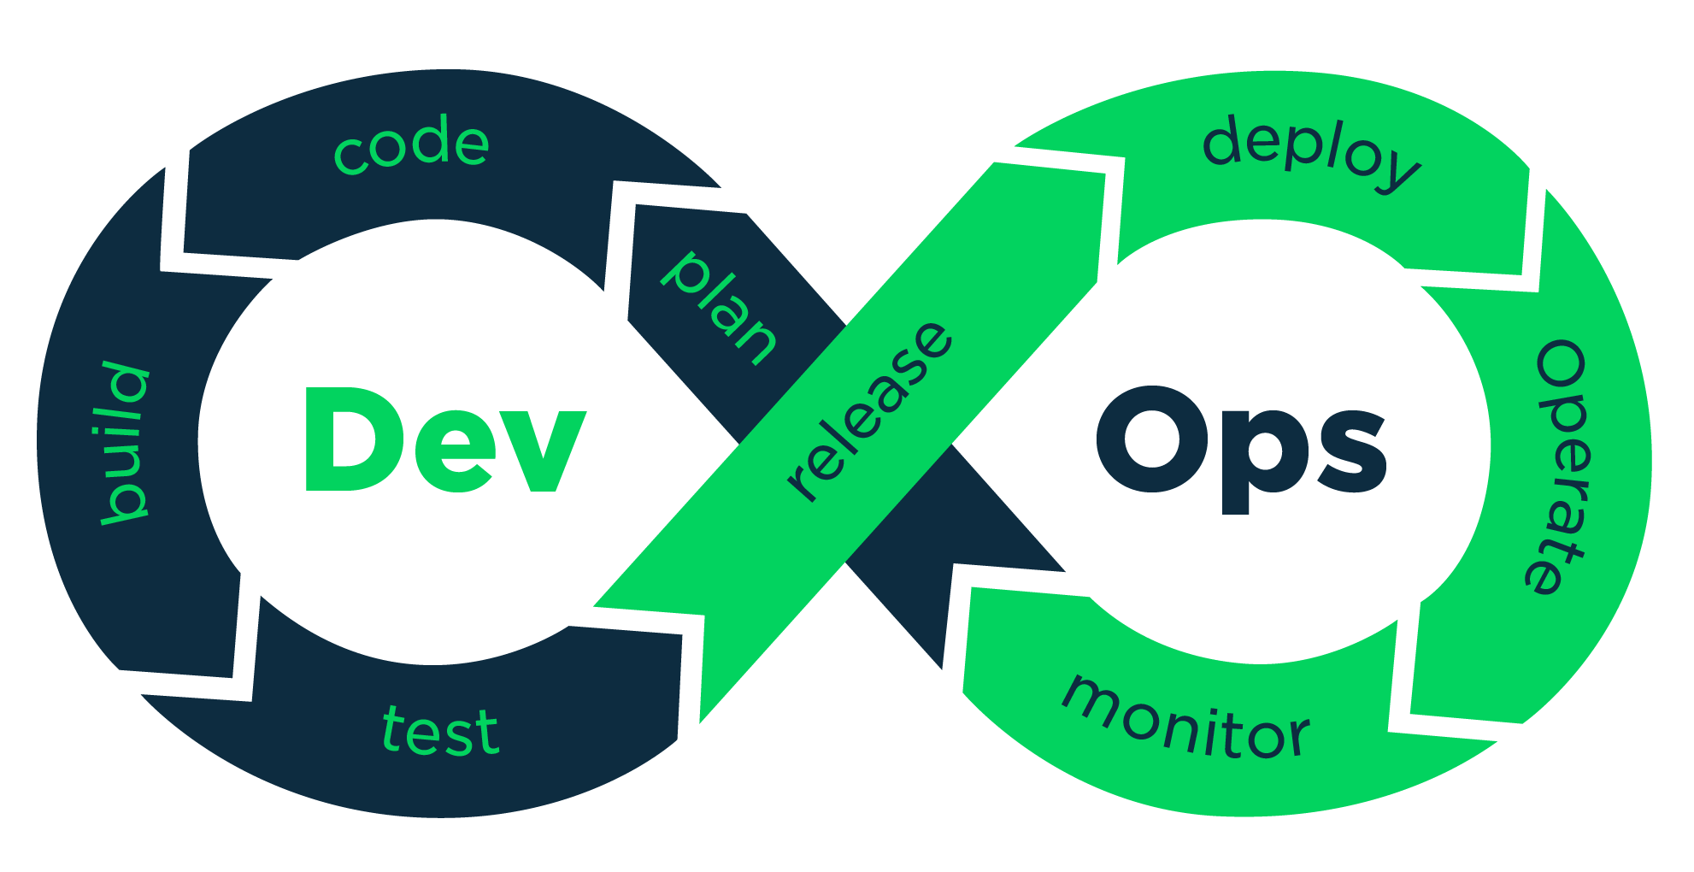
What is devops?
DevOps is a set of practices that combines software development (Dev) and IT operations (Ops). It aims to shorten the systems development life cycle and provide continuous delivery with high software quality. DevOps is complementary with Agile software development; several DevOps aspects came from Agile methodology.

Slide 3
First things first
What is Software Development
Different phases of software Development
Types of Software Development Models
Agile method – What is scrum?
Scrum Team
Environment Issues, handling IWOMM problem
Devops and why Devops?
Different Tools in Devops World
Session Wrap-up (Resume Preparation, Interviews, Recordings, Workshops etc)

Slide 4


Software development
Sinopec Banking LLC:
a new banking firm looking for an application software for their business activities
Trident Software Solutions :
a Software Development Company with some noteworthy clients. In the business for the past many years.

Slide 5

Software development
Sinopec Banking LLC:
a new banking firm looking for an application software for their business activities
Trident Software Solutions :
a Software Development Company with some noteworthy clients. In the business for the past many years.
Product Owner/
Project Manager
Product Owner : principles and guidelines, business to the company, adding value, cost estimates, severity of the product, timeframe, trade off, updates to customers, active through out the project.

Slide 6
Software development lifecycle
Gathering
Requirements Analysis
Design
Coding
Testing
Implementation
Maintenance

Slide 7
Requirements gathering
Sinopec Banking LLC:
a new banking firm looking for an application software for their business activities
Client’s requirements:
Customer Account Creation
Withdrawals
Deposits
Loans
Net Banking
Phone Banking
Email Statements
Assets
Fixed Deposits
Credit/Debit cards
Mobile Application

Slide 8
analysis
Requirements Gathering
Analysis
Platform - .net or java
Performance
Severity of the application
Security features etc.,

Slide 9
design
Requirements Gathering
Analysis
Design
Blueprint of the entire project
ER Diagrams, Data flow diagrams, User interfaces
Where to start? What are the dependencies?

Slide 10
coding
Requirements Gathering
Analysis
Design -
Coding – 6months
Developing application
Takes all requirements into consideration and follow design strategies
Takes time to build entire application - Monolith
What if Requirements change ?

Slide 11
Testing
Requirements Gathering
Analysis
Design
Coding – 6months
Testing - 1.5
Based on the application, several tests are performed on the application like
Manual Testing, Automation Testing, Black box testing, White box testing, functional testing, integration testing, Unit Testing, UI Testing, End to End testing, Sanity testing, Performance Testing, Load Testing, Stress Testing, UAT,

Slide 12
deployment
Requirements Gathering
Analysis
Design
Coding – 6m
Testing – 1.5
Implementation
Deploying the application on the Client’s environment

Slide 13
maintenance
Requirements Gathering
Analysis
Design
Coding – 4months
Testing -1.5months
Implementation
Maintenance
Ensuring the application is running fine and
Performing updates, security patches etc.,

Slide 14
Waterfall model - Cons
Requirements change
Lack of involvement of customer/business
Accuracy of estimations -
Schedule and cost overruns
Not much time left for testing or fix the defects etc.,

Slide 15
Software development models
Waterfall Model
Iterative Model
Spiral Model
Incremental Model
V Model
Agile Model

Slide 16
Agile model – Extreme programming scrum framework (Crystal, DSDM, FDM…)
In simple terms : agile : incremental process of software development
Agile understands all the requirements can’t be collected in the beginning of project
Requirements can be changed or collected through the development cycle
Tests early and often, higher quality
Reduced risk and earlier software release
Client’s requirements:
1. Customer Account Creation
2. Withdrawals
3. Deposits
4. Loans
5. Netbanking
6. Phone Banking
7. Email Statements
8.Assets
9.Fixed Deposits
10. Credit/Debit cards
11.Mobile Application
Account Creation
Deposits
Fixed Deposits
DEVELOPMENT
Quality Assurance
Production Env
Account Creation
Deposits
Fixed Deposits
Account Creation
Deposits
Fixed Deposits

Slide 17
Agile model scrum framework (Crystal, DSDM, FDM…)
Sprint 1 | Sprint 2 | Sprint 3 | Sprint 4 | Sprint 5 | Sprint 6 | Sprint 7
Acc Create Deposits Fxd Dep | Loans | NetBnk Phone Bnk | Email ATM | Assets FD’s | Cred/Deb | Mobile App
Client’s requirements:
Customer Account Creation
Withdrawals
Deposits
Loans
Netbanking
Phone Banking
Email Statements
Assets
Fixed Deposits
Credit/Debit cards
Mobile Application
Account Creation
Deposits
Fixed Deposits
Loans
Netbanking
PhoneBnk
Email
Account Creation
Deposits
Fixed Deposits
DEVELOPMENT
Quality Assurance
Account Creation
Deposits
Fixed Deposits

Slide 18
Agile model
In simple terms : agile : incremental process of software development
Agile understands all the requirements can’t be collected in the beginning of project
Requirements can be changed or collected through the development cycle
Tests early and often, higher quality
Reduced risk and earlier software release
Client’s requirements:
Customer Account Creation
Withdrawals
Deposits
Loans
Netbanking
Phone Banking
Email Statements
Assets
Fixed Deposits
Credit/Debit cards
Mobile Application
Account Creation
Deposits
Fixed Deposits
DEVELOPMENT
ROI

Slide 19
Environment issues
Developers developed a web application on some platform.
Testing environment is not getting desired results on developer’s application
Somehow testing passed
Production Environment is not getting the desired result
Development | QA | Production
IE, Chrome, Edge | IE, Chrome, Firefox | Firefox,
XAMPP (Web application) | Artifact Deployed
Windows 10 | Windows 7 | Linux
Docker | Docker | Docker
 |  | Server(200) – 5000(java)
 |  | Cloud

Slide 20
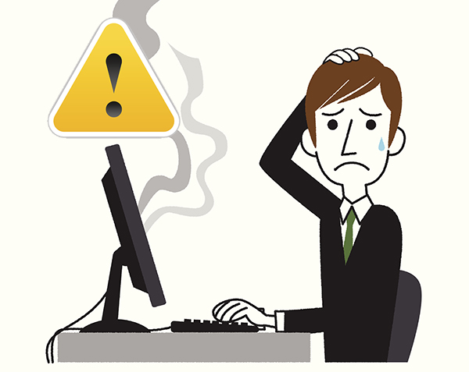
Environment issues
Developers developed a web application on some platform.
Testing environment is not getting desired results on developer’s application
Somehow testing passed
Production Environment is not getting the desired result
Developer says, IT WORKED ON MY MACHINE
Development | QA | Production
IE, Chrome, Edge | IE, Chrome, Firefox | Firefox, Safari
XAMPP (Web application) | Artifact Deployed | Artifact Deployed
Windows 10, tomcat8: 8080 | Windows 7, tomcat8 :9090 | Linux

Slide 21
What is devops?
DevOps is a set of practices that combines software development (Dev) and IT operations (Ops). It aims to shorten the systems development life cycle and provide continuous delivery with high software quality. DevOps is complementary with Agile software development; several DevOps aspects came from Agile methodology.

Slide 22
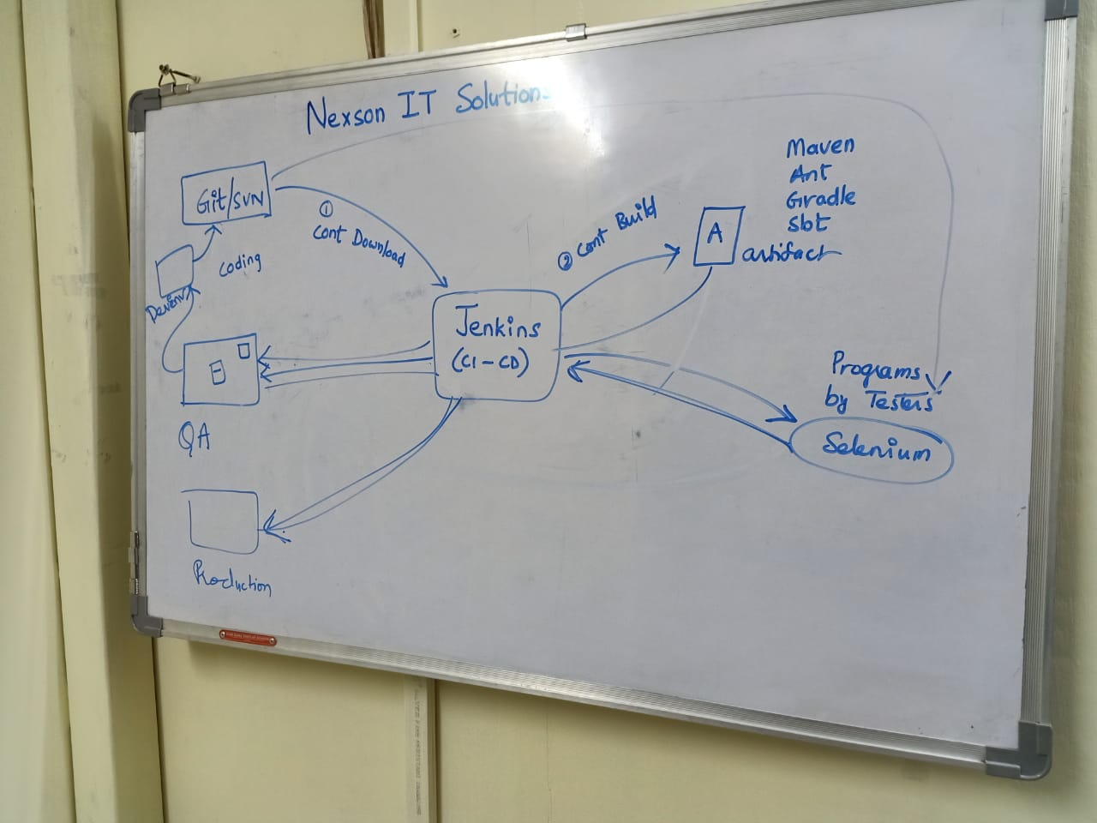
automation

Slide 23
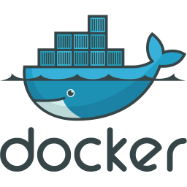
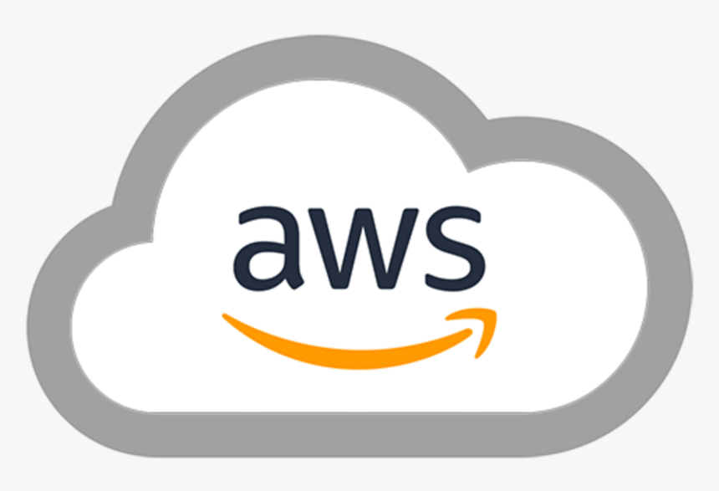
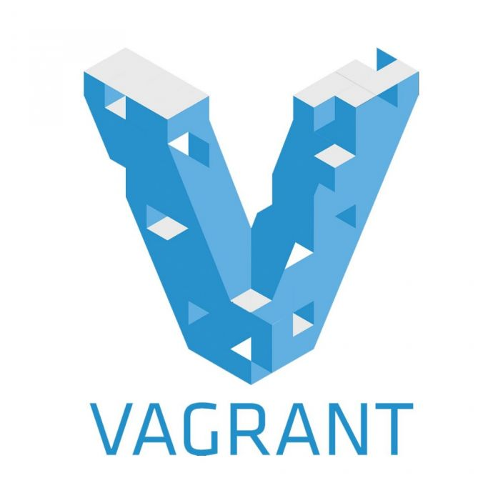
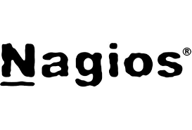

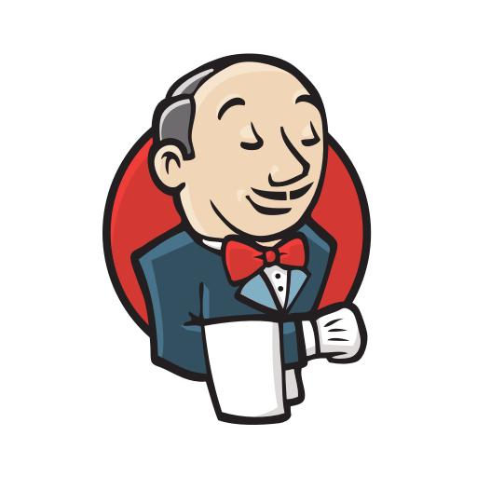
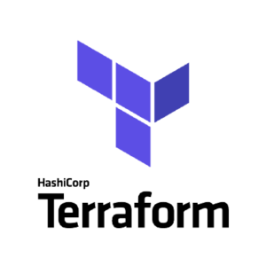
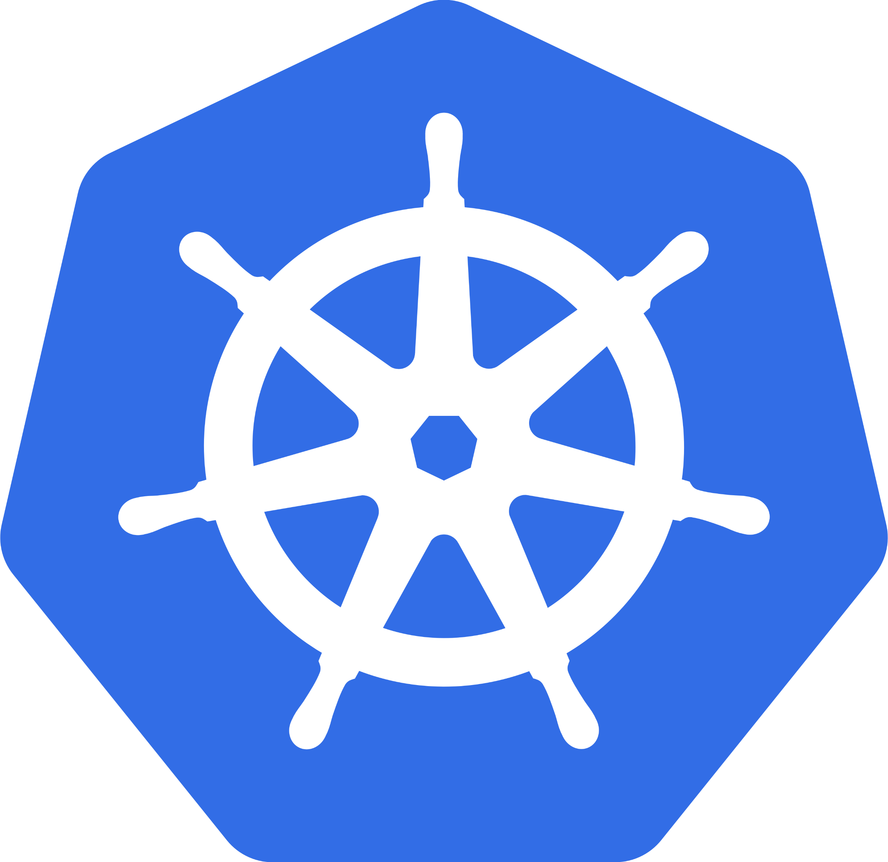


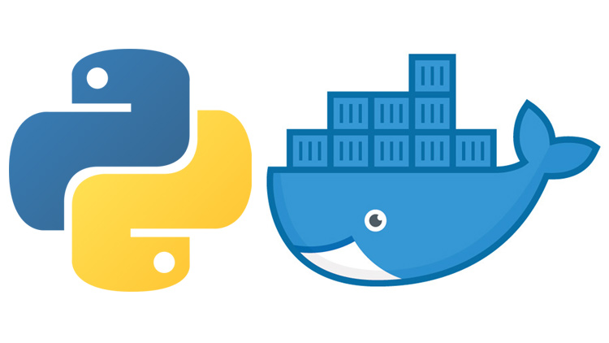
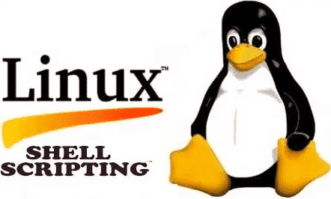

Devops tools

Slide 24
Tools in devops
Linux Administration and Shell Scripting
Git – Version Controlling
Jenkins – CI CD (Continuous Integration and Continuous Delivery)
Maven – Build Tool
Docker – Containerization

Slide 25
Tools in devops
Ansible –Configuration Management
Kubernetes – Container Orchestration
Python Docker Automation
Jira – Issue tracking (in-depth project analysis)
AWS – Cloud Infrastructure
Terraform – Infrastructure as a code
Nagios - Monitoring

Slide 26
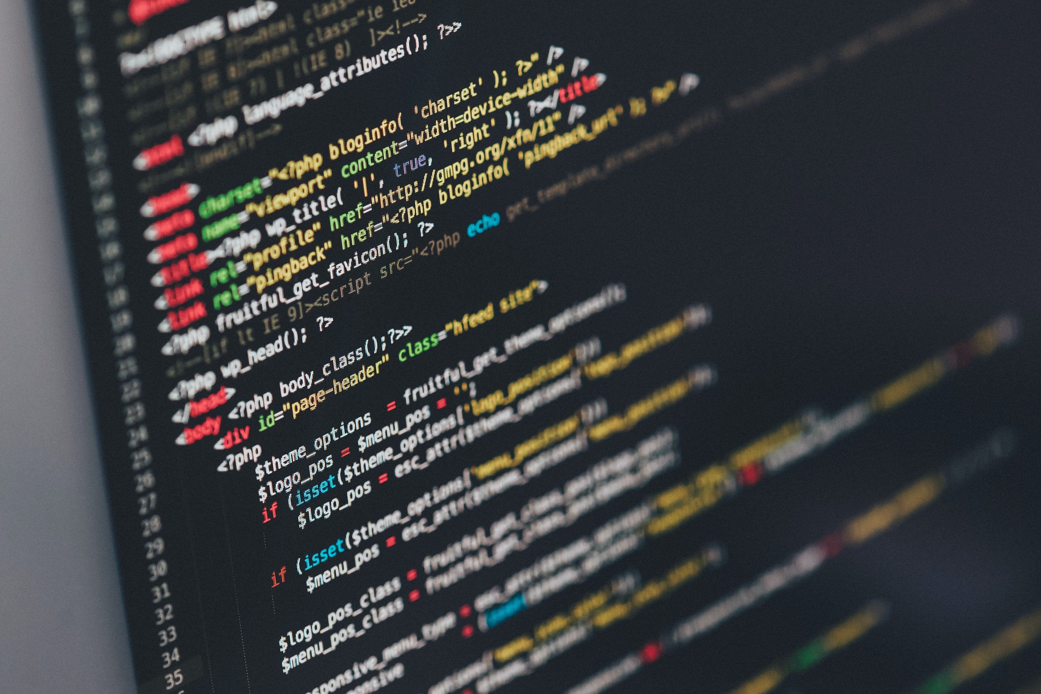
Coding in devops?
Hell! Lot of coding in Devops
You got to write some 100s of lines of code and code and code…….

Slide 27
SCRipting in devops?
Scripting is required only up to a certain Extent. May be 15%
We will take responsibility to simplify your coding skills.

Slide 28
Different jobs around devops
Linux Administrator
Build & Release Engineer
Devops Engineer
Senior Devops Engineer
Devops Lead
Cloud Architect

Slide 29
How to transition career in devops
I’m a fresher. How can I add experience and move to Devops?
I’m from Non IT background. How can I showcase my skills in Devops?
I’m from IT but working on some other technology. How can I relate my experience and shift to Devops?
I don’t have a Degree in Computer Science. I don’t have percentages and few companies are rejecting me in the initial stage itself

Slide 30
Before virtualization
I have a software application that runs only on Linux Operating System. How can I access that application?
Have a fresh installation of Linux on your machine
Dual boot operating system
Application
Dependencies
Linux Operating System
Bare Metal
Application
Dependencies
Windows and Linux Operating System(dual boot)
Bare Metal

Slide 31
Virtualization
Application
Operating System (Linux)
Hypervisor (Virtualbox/VMWare)
Operating System (Win 10)
BareMetal
Application
Docker Engine
Operating System (Win10)
BareMetal
Application | Application
Docker Engine
Operating System
BareMetal

Slide 32
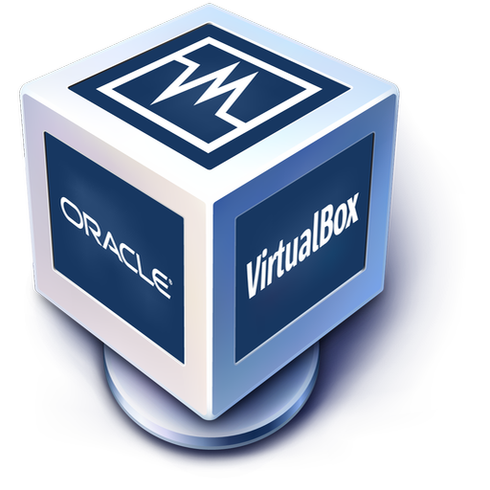
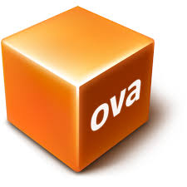
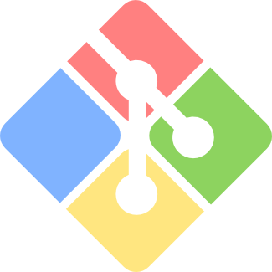
For practice sessions
Virtualization
AWS Cloud

Slide 33
Tools we are going to learn in Devops Course
Devops tools

Slide 34
Thank You

