Slide 1
Hadoop: An Overview
Bryon Gill Pittsburgh Supercomputing Center

Slide 2
What Is Hadoop?
Programming platform
Filesystem
Software ecosystem
Stuffed elephant

Slide 3
What does Hadoop do?
Distributes files
Replication
Closer to the CPU
Computes
Map/Reduce
Other

Slide 4
MapReduce
Map function
Maps k/v to intermediate k/v
Reduce function
Shuffle/Sort/Reduce
Aggregates results of map
Data
Data
Data
Map
Shuffle/Sort
Reduce
Results

Slide 5
HDFS: Hadoop Distributed File System
Replication
Failsafe
Predistribution
Write Once Read Many (WORM)
Streaming throughput
Simplified Data Coherency
No Random Access (contrast with RDBMS)

Slide 6
HDFS: Hadoop Distributed File System
Meta filesystem
Requires underlying FS
Special access commands
Exports
NFS
Fuse
Vendor filesystems

Slide 7

HDFS
Source: https://hadoop.apache.org/docs/current/hadoop-project-dist/hadoop-hdfs/HdfsDesign.html

Slide 8
HDFS: Daemons
Namenode
Metadata server
Datanode
Holds blocks
Compute node

Slide 9
YARN: Yet Another Resource Negotiator
Programming interface (replaces MapReduce)
Include MapReduce API (compatible with 1.x)
Assigns resources for applications

Slide 10
YARN: Daemons
ResourceManager
Applications Manager
Scheduler (pluggable)
NodeManager
Worker Node
Containers (tasks from ApplicationManager)

Slide 11
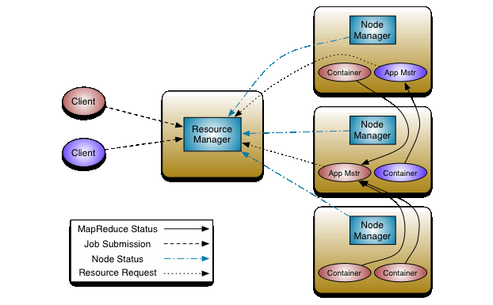
YARN
Source: https://hadoop.apache.org/docs/current/hadoop-yarn/hadoop-yarn-site/YARN.html

Slide 12
Using Hadoop
Load data to hdfs
Fs commands
Write a program
Java
Hadoop Streaming
Submit a job

Slide 13
Fs Commands
“FTP-style” commands
hdfs dfs –put /local/path/myfile /user/$USER/
hdfs dfs –cat /user/$USER/myfile # | more
hdfs dfs –ls
hdfs dfs –get /user/$USER/myfile

Slide 14
Moving Files
#on bridges: hdfs dfs –put /home/training/hadoop/datasets /
# if you don’t have permissions for / (eg. shared cluster) # you can put it in your home directory # (making sure to adjust paths in examples): hdfs dfs –put /home/training/hadoop/datasets

Slide 15
Writing a MapReduce Program
Hadoop Streaming
Mapper and reducer scripts read/write stdin/stdout
whole line is key, value is null (unless there’s a tab)
Use builtin utilities (wc, grep, cat)
Write in any language (python)
Java (compile/jar/run)

Slide 16
Simple MapReduce Job (HadoopStreaming)
cat as mapper
wc as reducer
hadoop jar \ $HADOOP_HOME/share/hadoop/tools/lib/hadoop-streaming*.jar \ -input /datasets/plays/ -output streaming-out \ -mapper '/bin/cat' -reducer '/usr/bin/wc -l

Slide 17
Python MapReduce (HadoopStreaming)
hadoop jar $HADOOP_HOME/share/hadoop/tools/lib/hadoop-streaming*.jar \ -file ~training/hadoop/mapper.py -mapper mapper.py \ -file ~training/hadoop/reducer.py -reducer reducer.py \ -input /datasets/plays/ -output pyout

Slide 18
MapReduce Java: Compile, Jar, Run
cp /home/training/hadoop/*.java ./ hadoop com.sun.tools.javac.Main WordCount.java jar cf wc.jar WordCount*.class hadoop jar wc.jar WordCount /datasets/compleat.txt output

Slide 19
Getting Output
hdfs dfs –cat /user/$USER/streaming-out/part-00000 | more
hdfs dfs –get /user/$USER/streaming-out/part-00000

Slide 20
Further Exploration
Write a Hadoop Streaming wordcount program in the language of your choice
Advanced: Extend the word count example to use a custom input format splitting the text by sentence rather than by line.

Slide 21
Questions?
Thanks!

