Slide 1
Session 6:
Cable Damage and Repair
Case Study Breakout Session
nodal/ys
Facilitator: Jocelinn Kang

Slide 2





The Resilience Cycle
Prevent
Detect
Protection,
Risk reduction
Monitoring, Threat alerts,
Notification
Recover
Respond
Restore service,
Share and integrate learnings
Address threat, Permitting,
Mobilise repair vessel

Slide 3
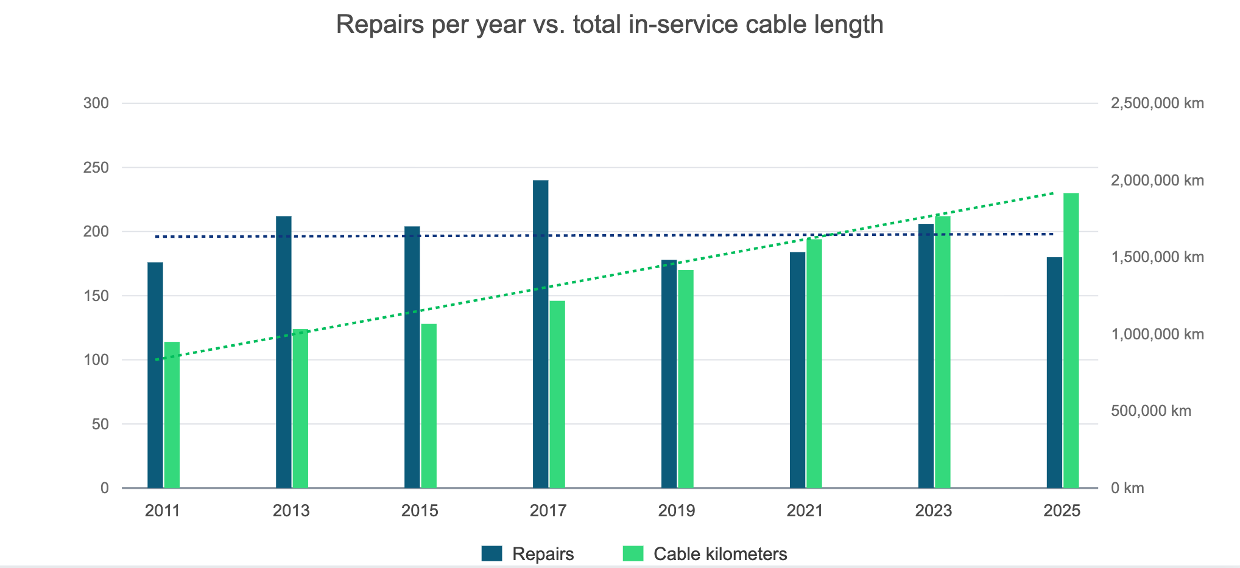
Repairs per year vs. total in-service cable length

Slide 4
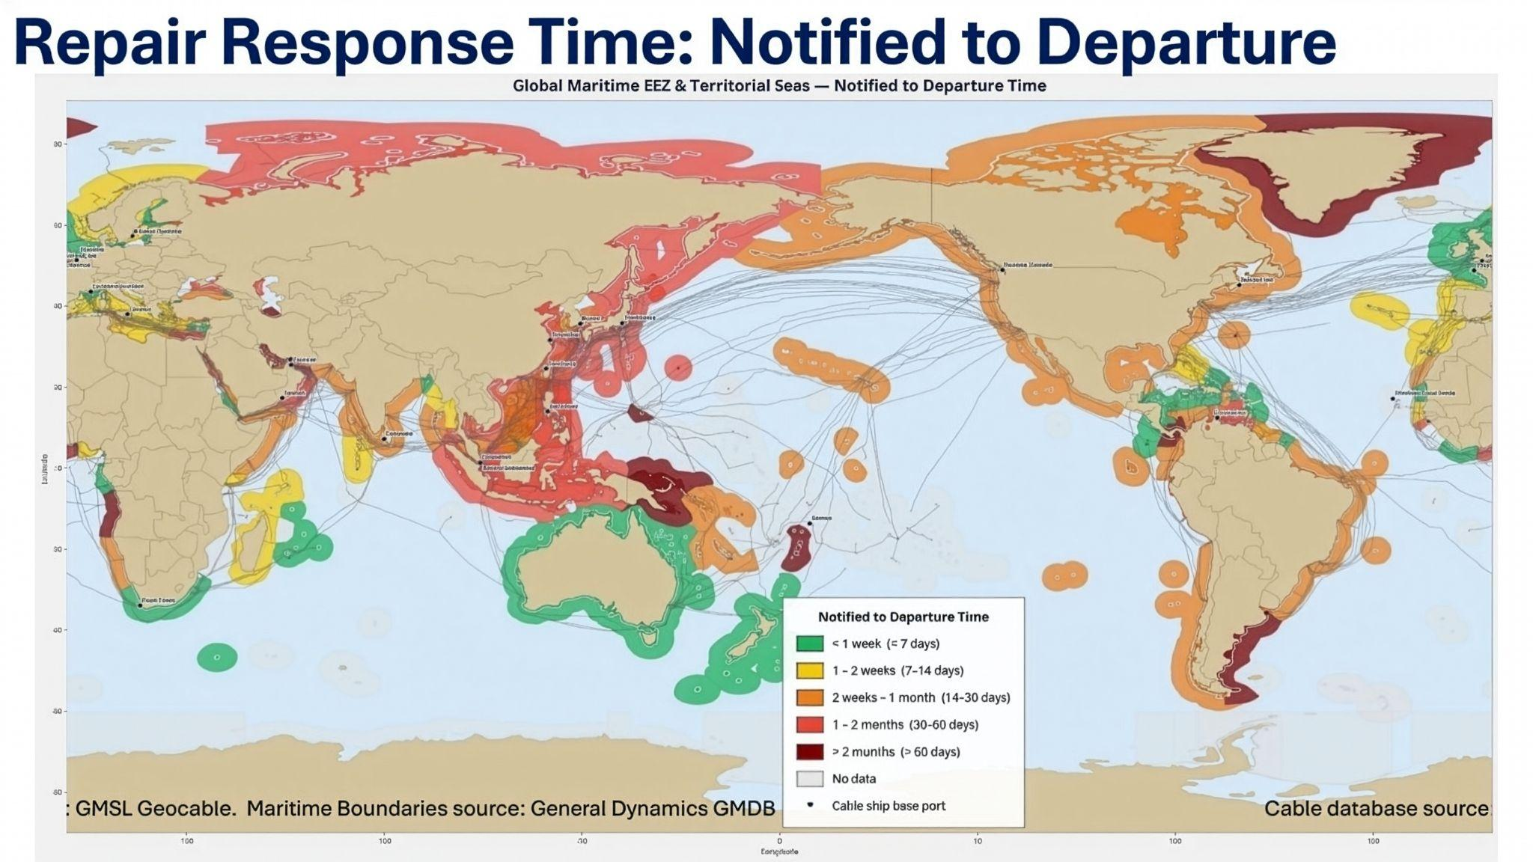
Source: International Cable Protection Committee. Modified to Asia-Pacific map centre by Nodalys.

Slide 5
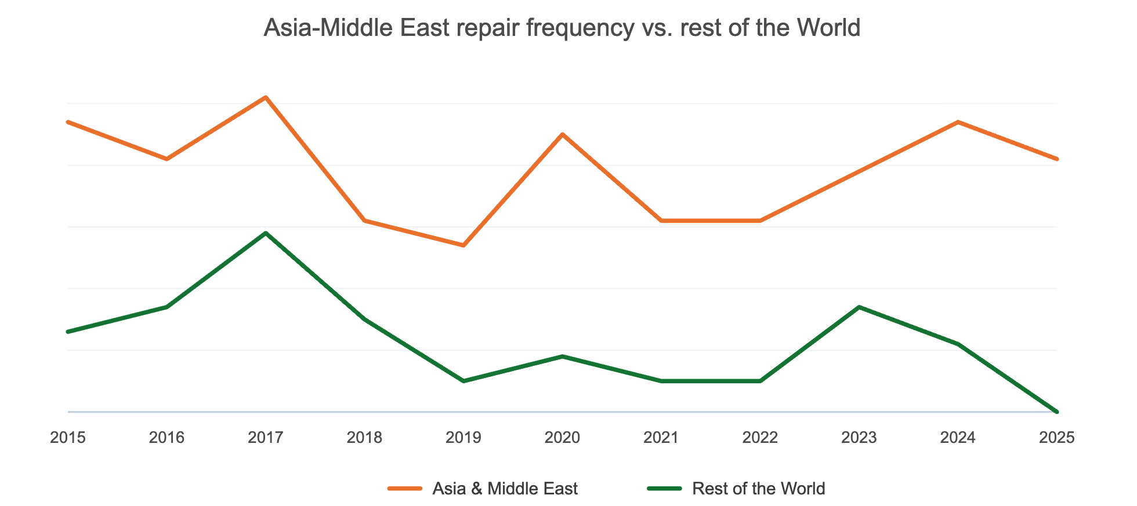
Asia-Middle East repair frequency vs. rest of the world
Source: International Cable Protection Committee.

Slide 6
Cable Damage and Repair
Scenario Exercise
nodal/ys

Slide 7
You are members of the
Country A Cable Repair Coordination Forum
The Forum convenes government regulators, cable owners, and repair operators to facilitate cross-stakeholder coordination and harmonisation of regulations and procedures for cable repairs, including technical and logistical aspects, with the aim of addressing issues and providing solutions to support submarine cable maintenance and repair.

Slide 8
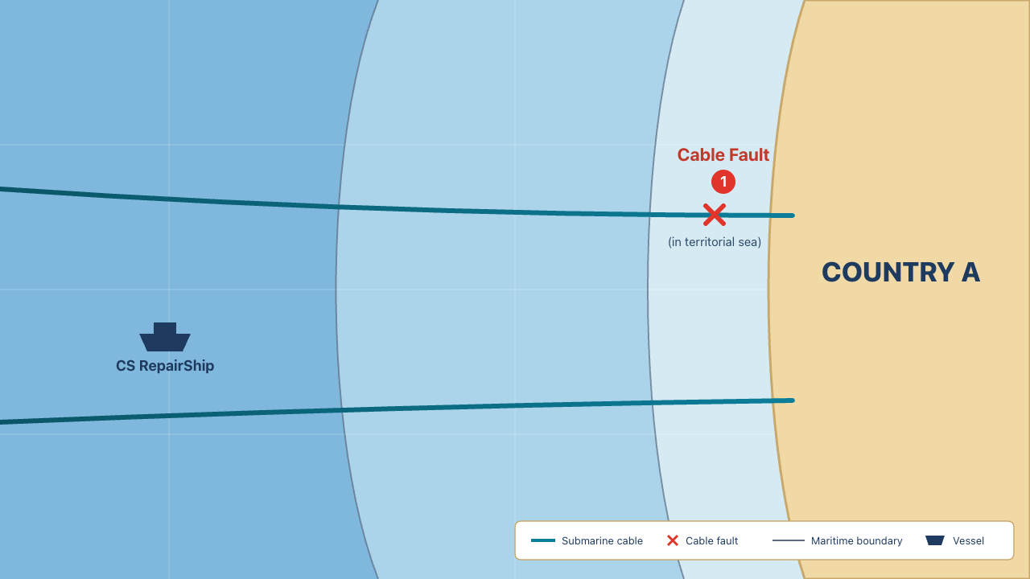
Scenario 1: Cable Fault (in territorial sea)
Country A's submarine cable has been cut within its territorial sea by a ship anchor. It's causing internet slowdowns for businesses and millions of everyday users.
The CS RepairShip can perform the repair. It is flagged to Country Z.
The vessel can be ready to sail within 24 hours, but the repair ship operator has some regulatory processes to go through first and will not mobilise until they know they are able to get to the repair site, fearful of legal penalties or military interception.

Slide 9
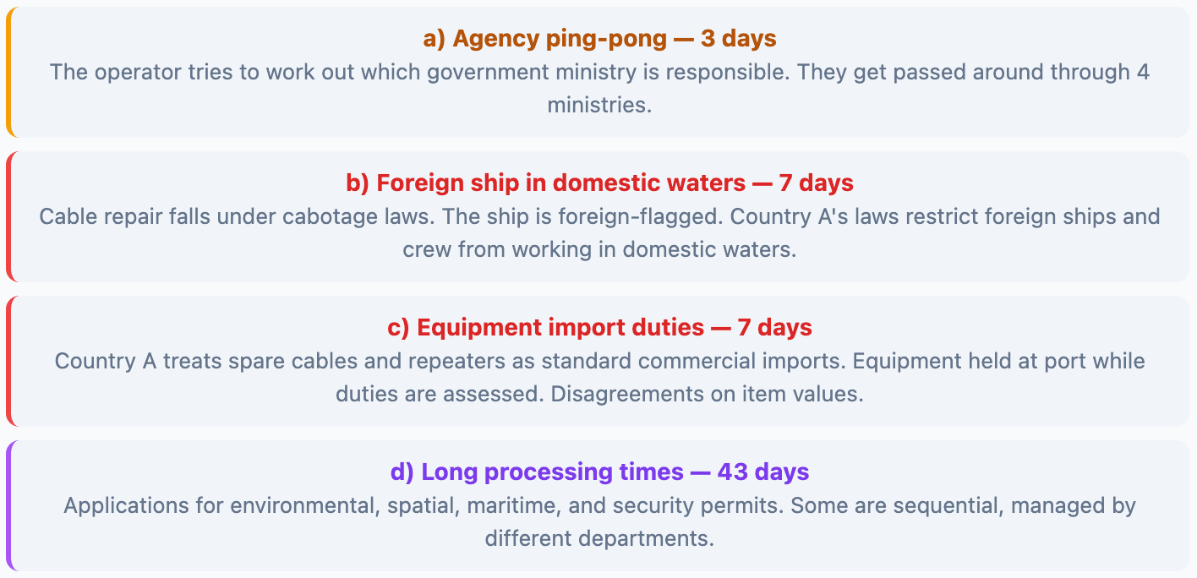
Scenario 1 continued
The repair operator encounters the following:

Slide 10
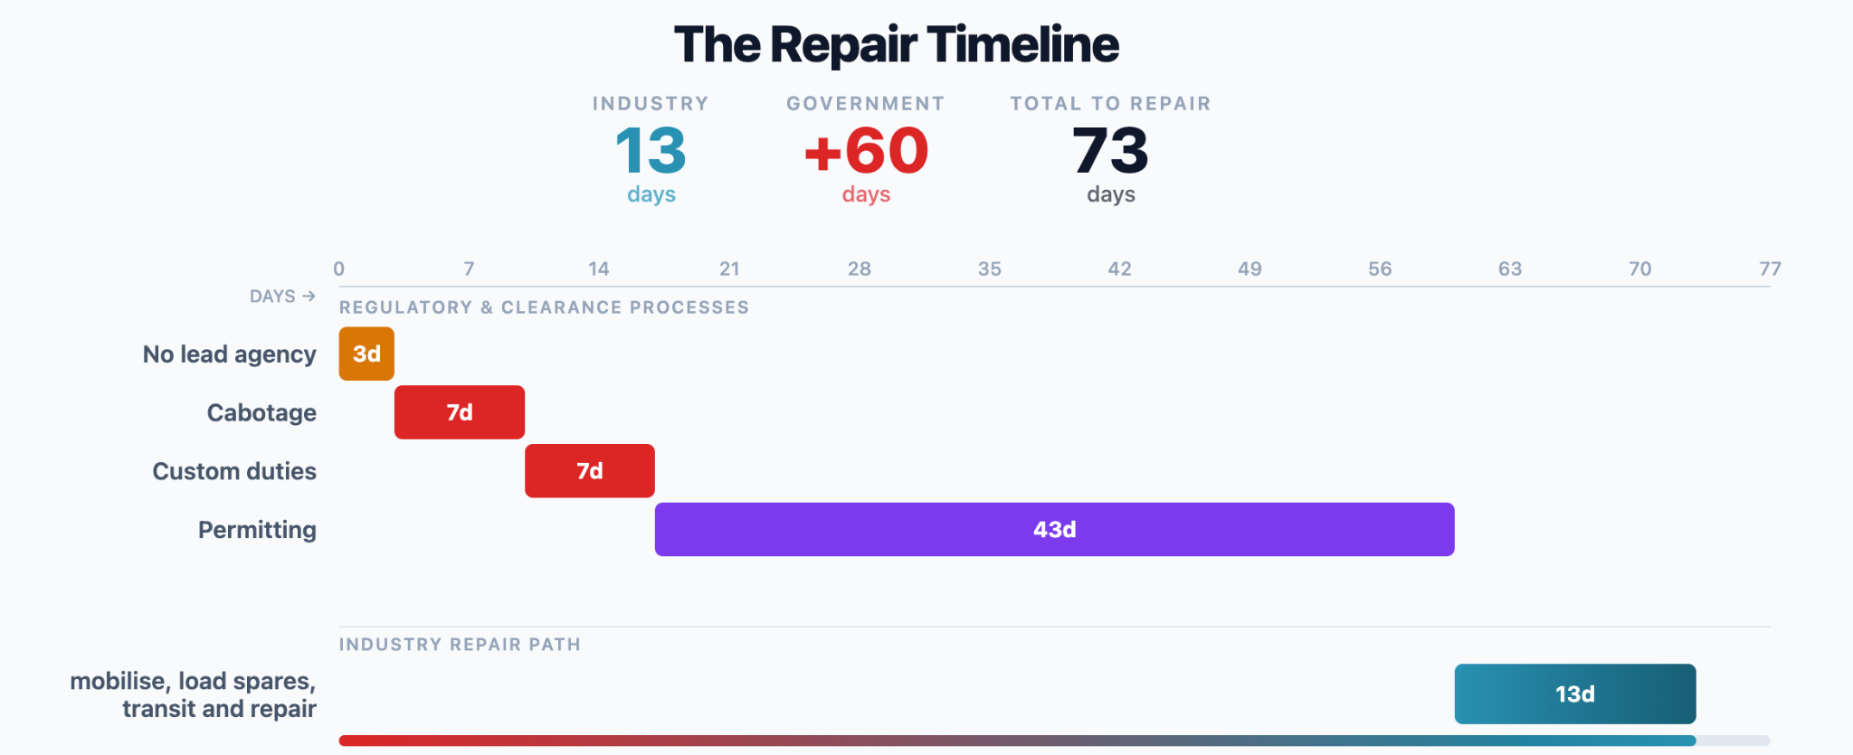
The Repair Timeline

Slide 11
Question 1
How would you make the processes (a) - (d) faster and more streamlined so the repair ship can start fixing the fault sooner?
a) Agency ping-pong (3 days): The operator tries to work out which government ministry is responsible. They get passed around through 4 ministries.
b) Foreign ship in domestic waters (7 days): Cable repair falls under cabotage laws. The ship is foreign-flagged. Country A's laws restrict foreign ships and crew from working in domestic waters.
c) Equipment import duties (7 days): Country A treats spare cables and repeaters as standard commercial imports. Equipment held at port while duties are assessed. Disagreements on item values.
d) Long processing times (43 days): Applications for environmental, spatial, maritime, and security permits. Some are sequential, managed by different departments.

Slide 12
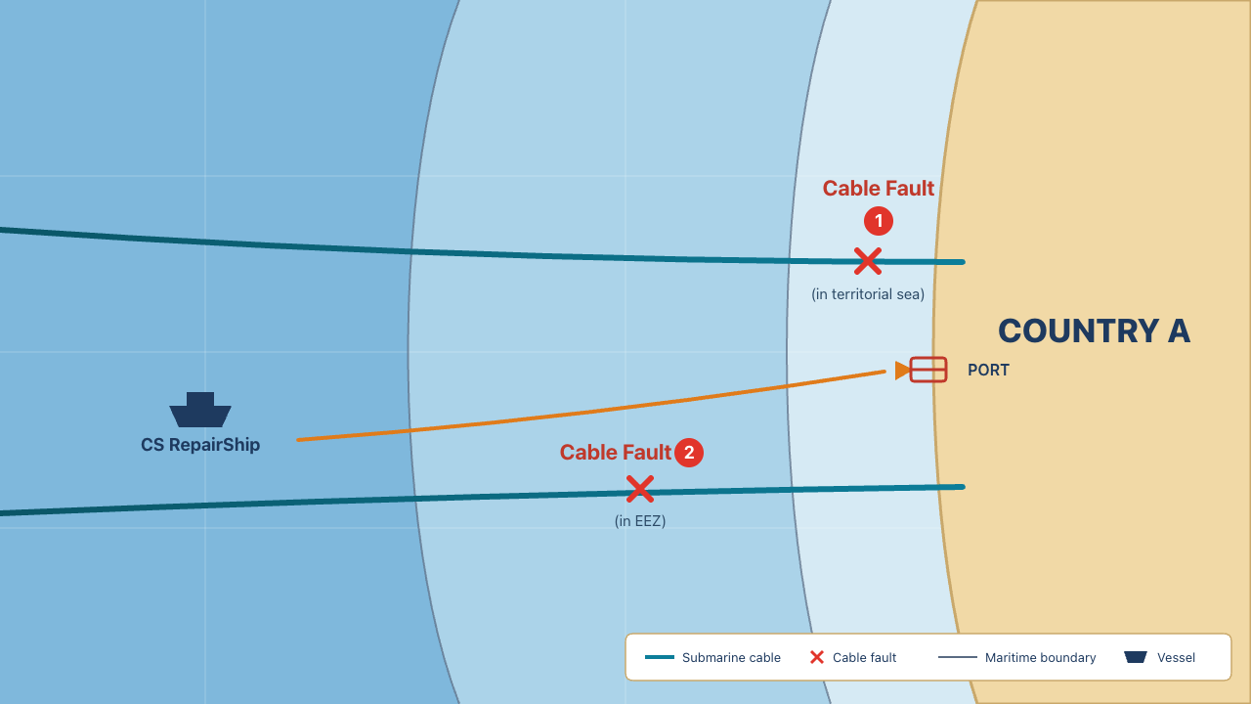
Scenario 1.5: Cable Fault (in EEZ)
A fishing trawler has just cut through Country A's second submarine cable in Country A's EEZ. Both cables are now down. The internet is practically unusable.
e) Customs duties, taxes, and fees for EEZ transit, forced port entry. (3 days): Despite the fault being in the EEZ, Country A requires the vessel to make a detour and dock at port to clear immigration, pay port fees, and formally process the temporary importation of the subsea cable equipment spares.
This adds 3 days in addition to the other processes in Question 1.

Slide 13

Question 1 & 2
How would you make the processes (a) - (e) faster and more streamlined so the repair ship can start fixing the fault sooner?
a) Agency ping-pong (3 days): The operator tries to work out which government ministry is responsible. They get passed around through 4 ministries.
b) Foreign ship in domestic waters (7 days): Cable repair falls under cabotage laws. The ship is foreign-flagged. Country A's laws restrict foreign ships and crew from working in domestic waters.
c) Equipment import duties (7 days): Country A treats spare cables and repeaters as standard commercial imports. Equipment held at port while duties are assessed. Disagreements on item values.
d) Long processing times (43 days): Applications for environmental, spatial, maritime, and security permits. Some are sequential, managed by different departments.
e) Port entry for cable fault in EEZ (3 days): Despite the fault being in the EEZ, Country A requires the vessel to make a detour and dock at port to clear immigration, pay port fees, and formally process the temporary importation of the subsea cable equipment spares.

Slide 14






Question 3: Reflecting on your own country’s experience…
Has your country adopted or tried to adopt any practices to streamline or expedite cable repairs? If so...
a) Motivation
b) Challenges
c) Ongoing
What were the key triggers that motivated change?
What challenges were faced, and how were they overcome?
What challenges do you continue to face?

