Slide 1

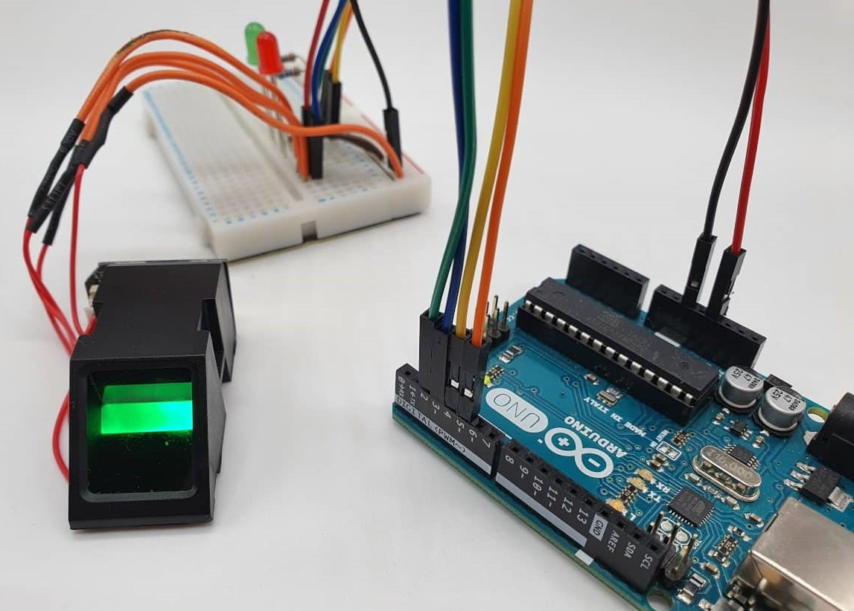
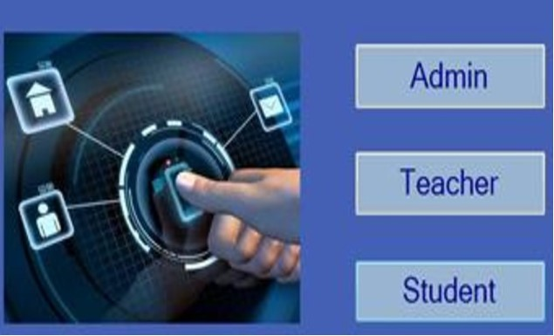

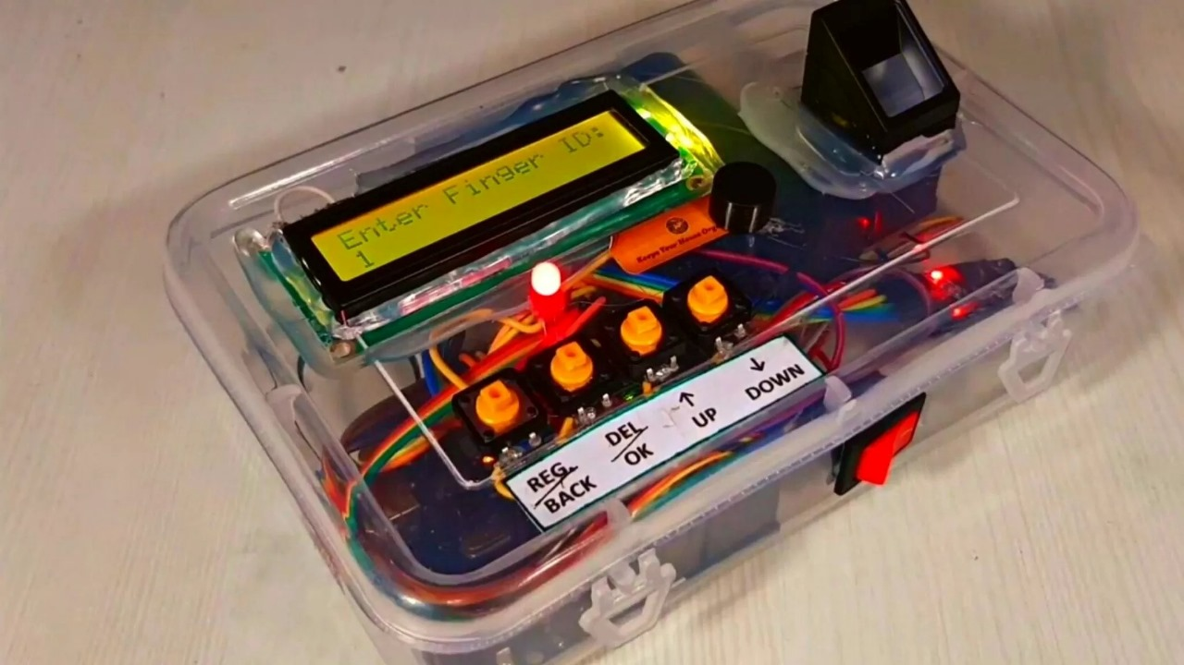
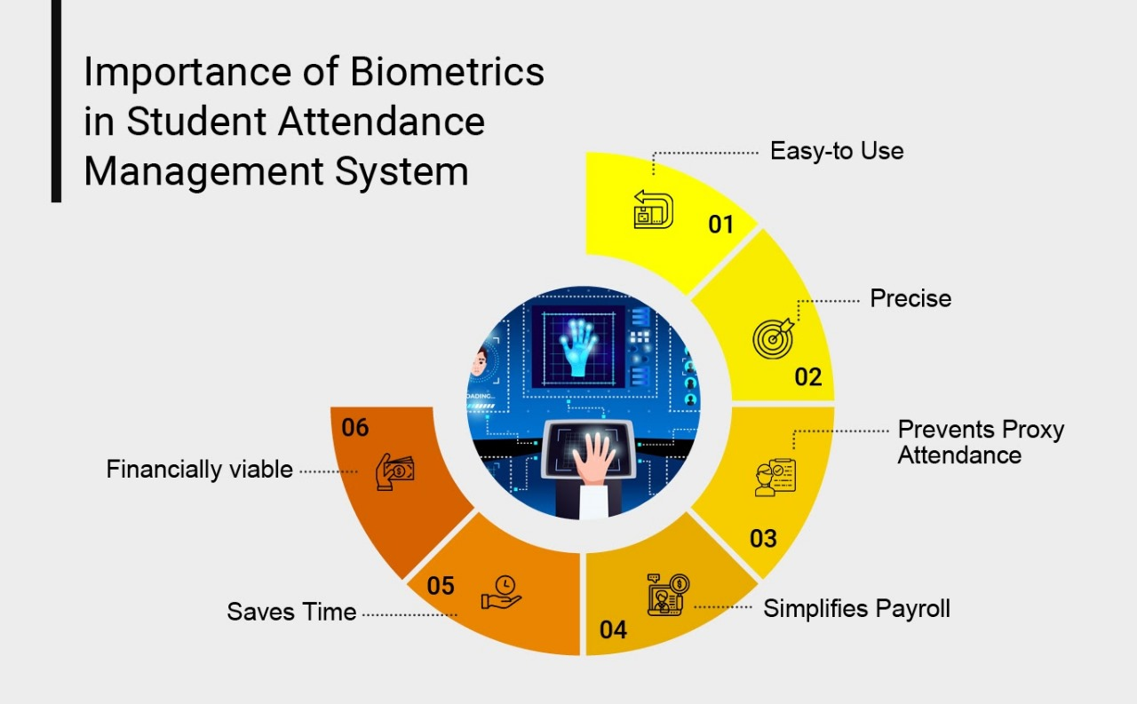
TMI(101):TINKERING PART
TEAM MEMBERS:
Aryan Singh-23410008
Megha Agrawal-23324011
Shruti-23411036
Monika Choudhary-23112064
Faculty supervisors/ Advisors: Prof. Ekant Sharma
Prof. Mennakshi Rawat
Problem Statement
Prototype/Experiment Details
Fingerprint biometric attendance system
selecting a project of daily use based on fingerprint sensing
product selection
setting up the hardware and software
cost analysis
documentation
presentation
BUT WHY DO WE NEED THIS??
In modern era, it increasingly difficult to secure physical location and digital data.
SO, HERE ARE SOME REASONS WHY WE NEED IT!!!
Accuracy
Time efficiency
Data security
Reduced administrative
work
Methodology
Results & Discussion
Arduino IDE is used to program the different components of the project.
Adafruit fingerprint sensor and DS3231 are the arduino libraries used to program the optical sensor and RTC Module.
The fingerprint is scanned using the optical fingerprint sensor.
The LED and buzzer indicate whether the fingerprint matches with any of the already stored fingerprints.
Fingerprint biometric Attendance system
We researched about fingerprint sensors and selected a project based on daily use like a fingerprint attendance system.
exploring the topic and selecting a project
1
Product Selection
we learned about the components our project will be needing and collected all the basic information about their working and their role in out project. Then we studied the backend process of the project and did the cod regarding that.
.
2
learning about the components and code of the project
Integrated hardware and software
we did the software work using arduino and stored the code in it. the hardware and all the components were connected and the set up was done properly.
Conclusion & Applications
3
Biometric Attendance system has a wide application in schools, colleges, business organizations, and offices where marking of attendance is required accurately with time.
The main features of this device mainly include accuracy, better performance, robustness based on exclusive fingerprint biometric technology.
programming the components and setting up the project
Course TMI -101 (Tinkering)
Presentation Group # & POSTER ID #

