Slide 1
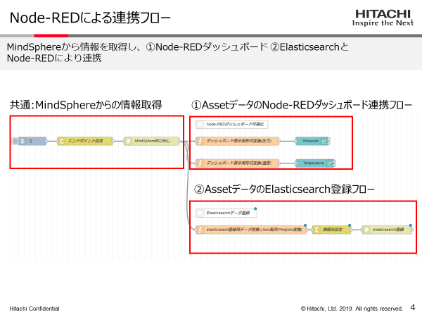
Description for Node-RED flow
[Idea] We’d like to draw a simple description of the flow on workspace.
[Problem] To describe the flow, we need to paste the flow on PowerPoint and add description of it.
Requests from business division
When we explain about the flow, we always paste flow on PowerPoint file and add description of it.
If Node-RED UI has the following function, we can use flow as description material.
・Rectangles which highlight flows
・Text which is placed on editor
We feel that the current comment node has few functions as tool to describe flows.

Slide 2
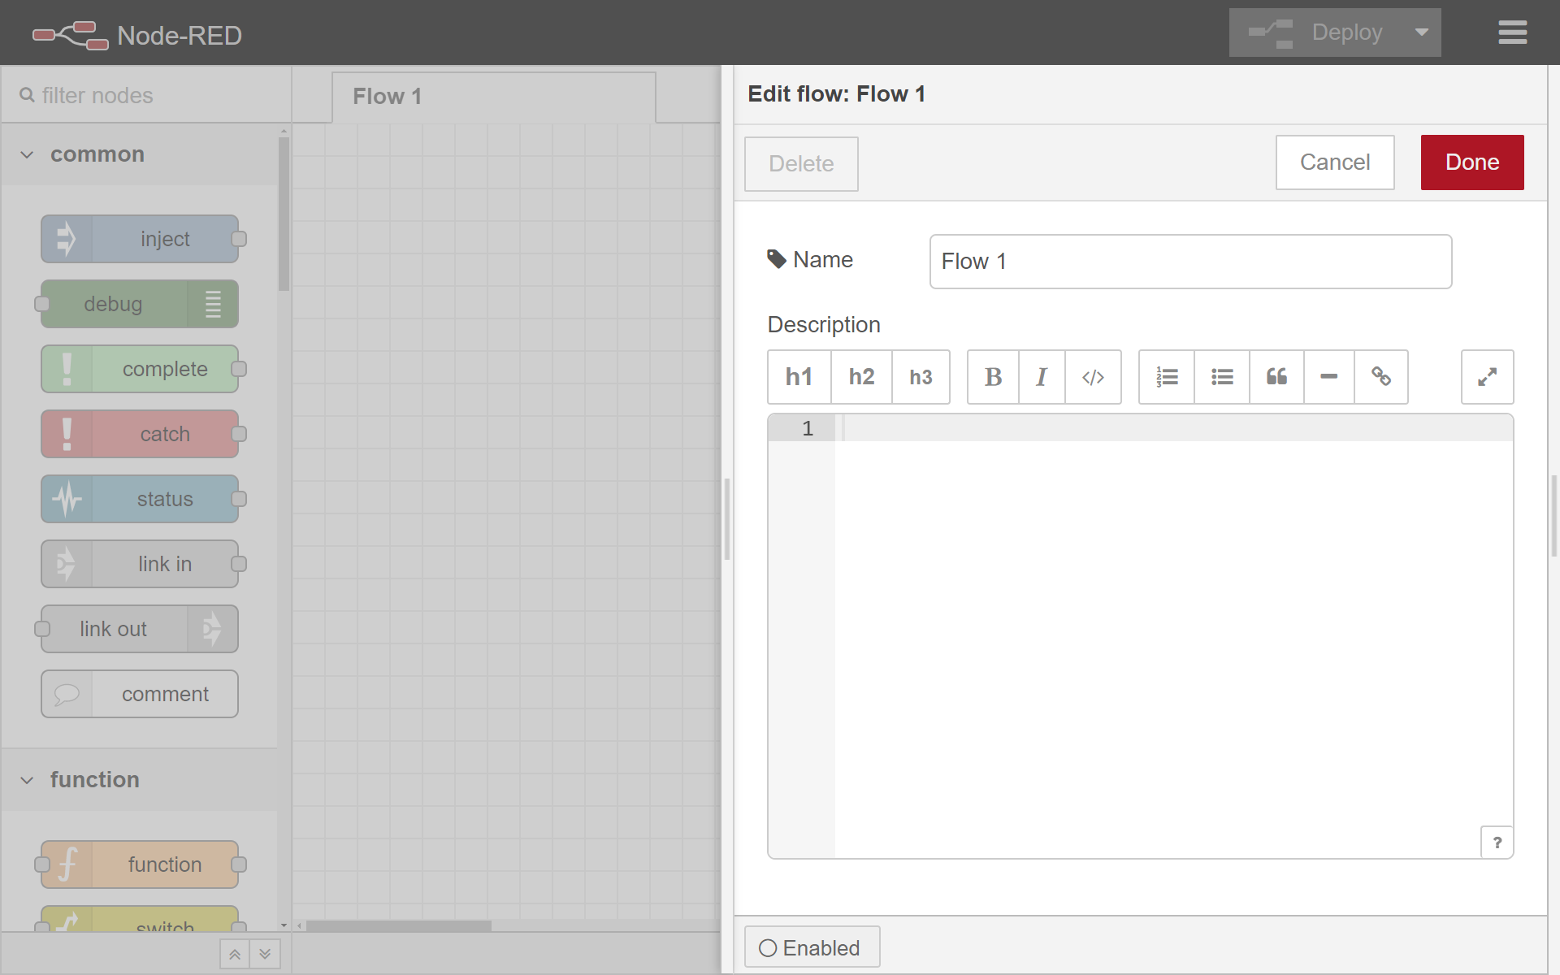
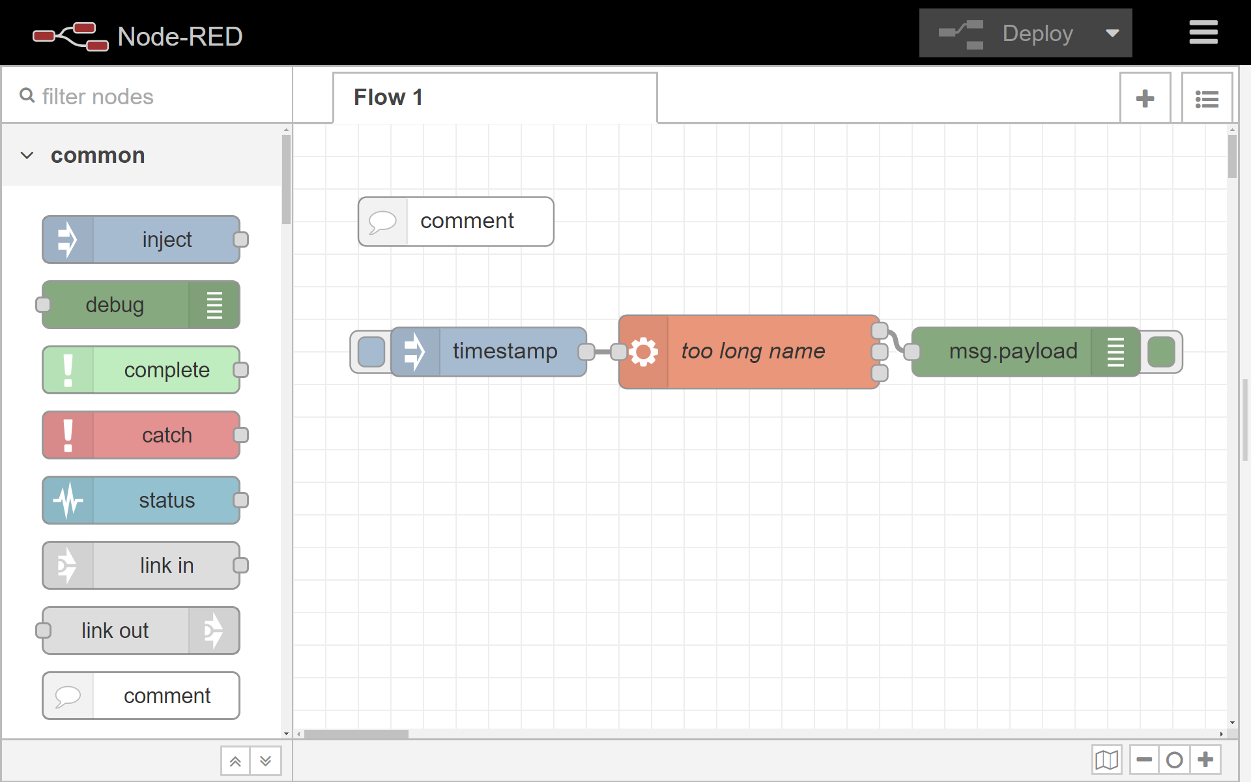
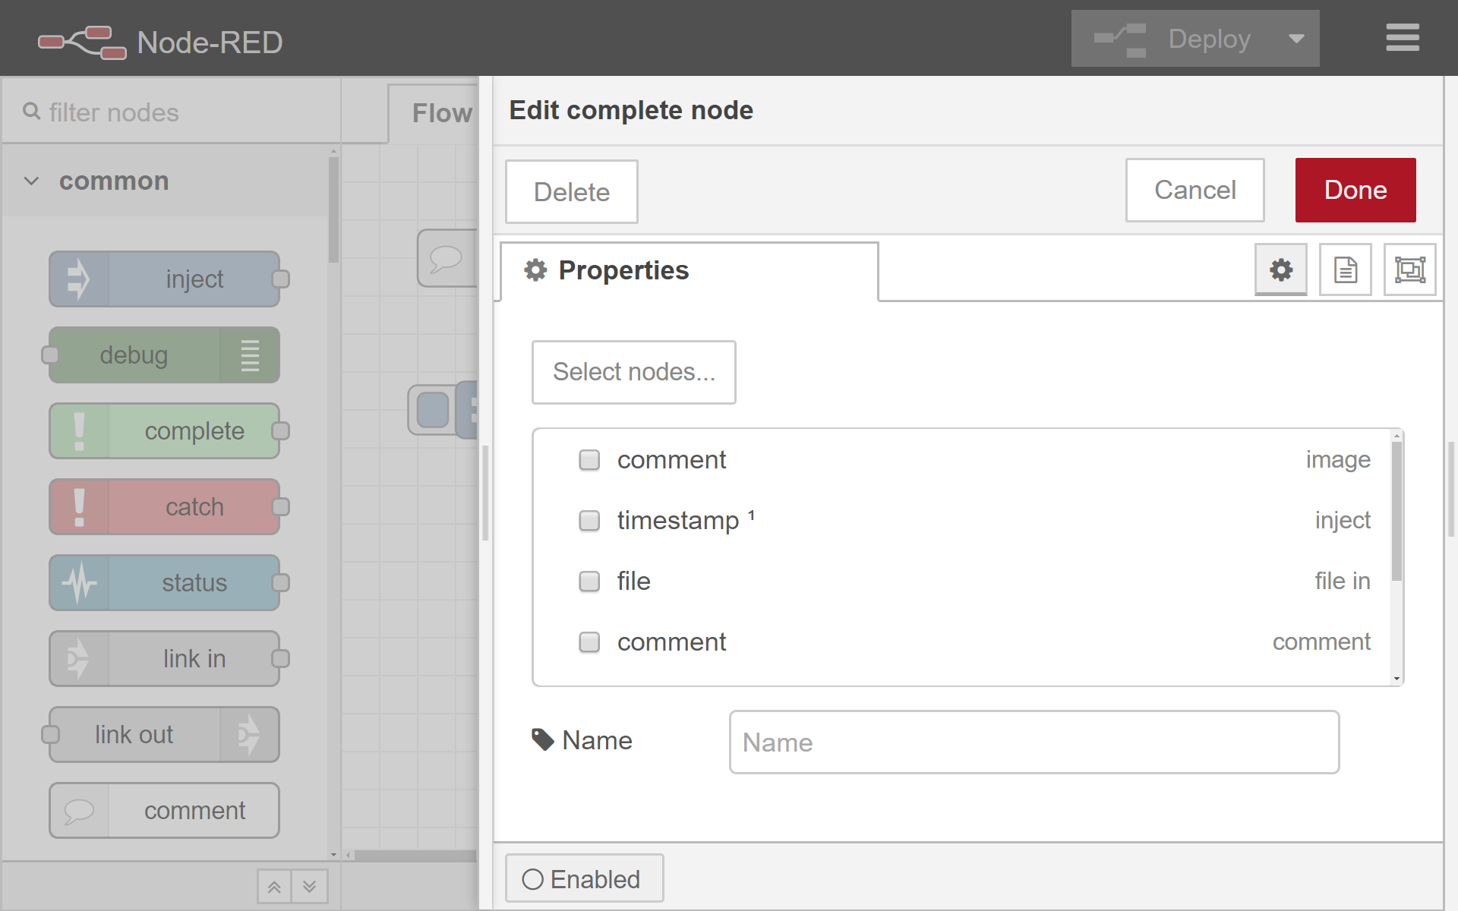
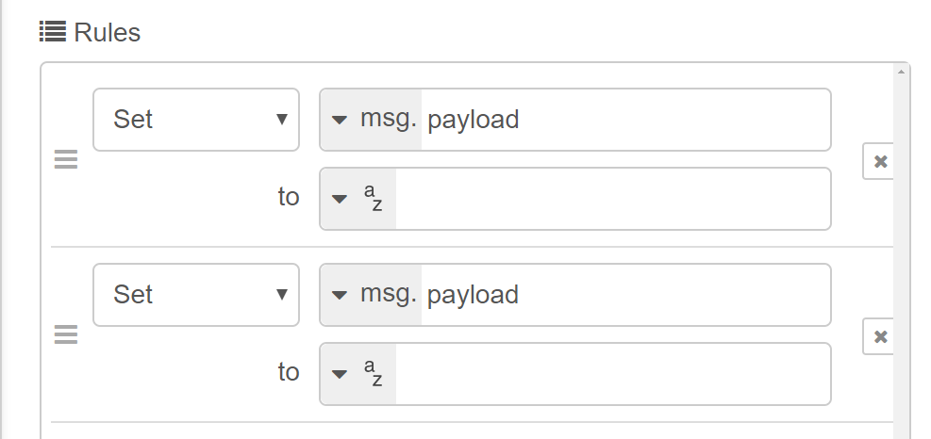
Idea 1: Tab enhancement
Tab property has a list to configure rectangles (Each item has “select nodes” button).
After clicking the button, the editor shows “Select nodes” UI to select nodes.
After selecting nodes, the editor shows a rectangle which covers nodes selected.
Pros: Maintaining compatibility because it is core functionality
Cons: Annotation of each flow may be difficult. (We need an additional function to describe each flow...)
Rectangles:
Auto size adjustment when node length is changed
Color:
▼red
Background:
▼none
Color:
▼green
Background:
▼aqua

Slide 3
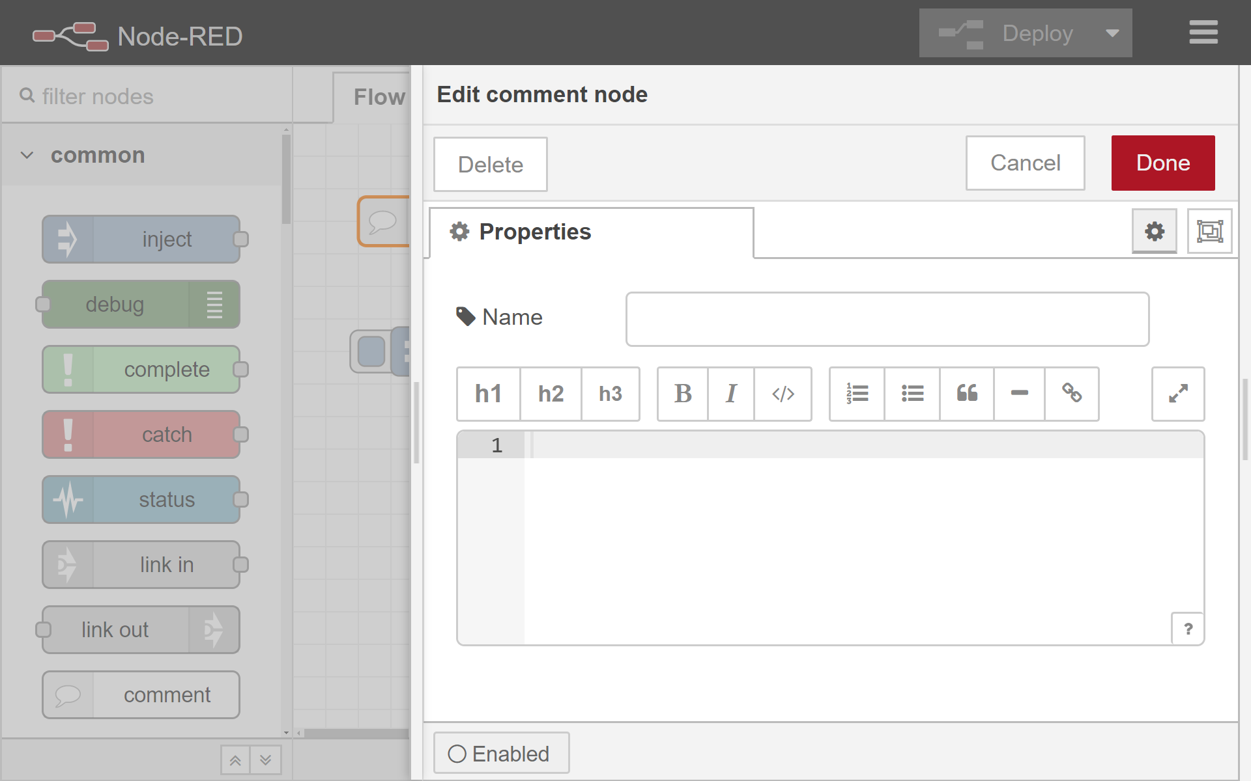
Idea 2: Comment node enhancement
Comment node property has a checkbox to use a rectangle.
When the checkbox is checked, the editor shows “select nodes” UI.
After a user select nodes, the editor shows the rectangle which covers them.
Pros: - It will be easy for users to understand the new function because they already tend to use comment nodes to describe their flow. - Comment node can be used for custom annotations for selected nodes. - As 3rd party node, other developers can enhance the node. (Oval etc.)
Cons: Some editor API may be needed to support the functionality. (Redraw etc.)
Auto size adjustment when node length is changed
Show rectangle

Slide 4
Question
# | Question
1 | Can I write document about tab or/and comment node enhancement for design note?

Slide 5
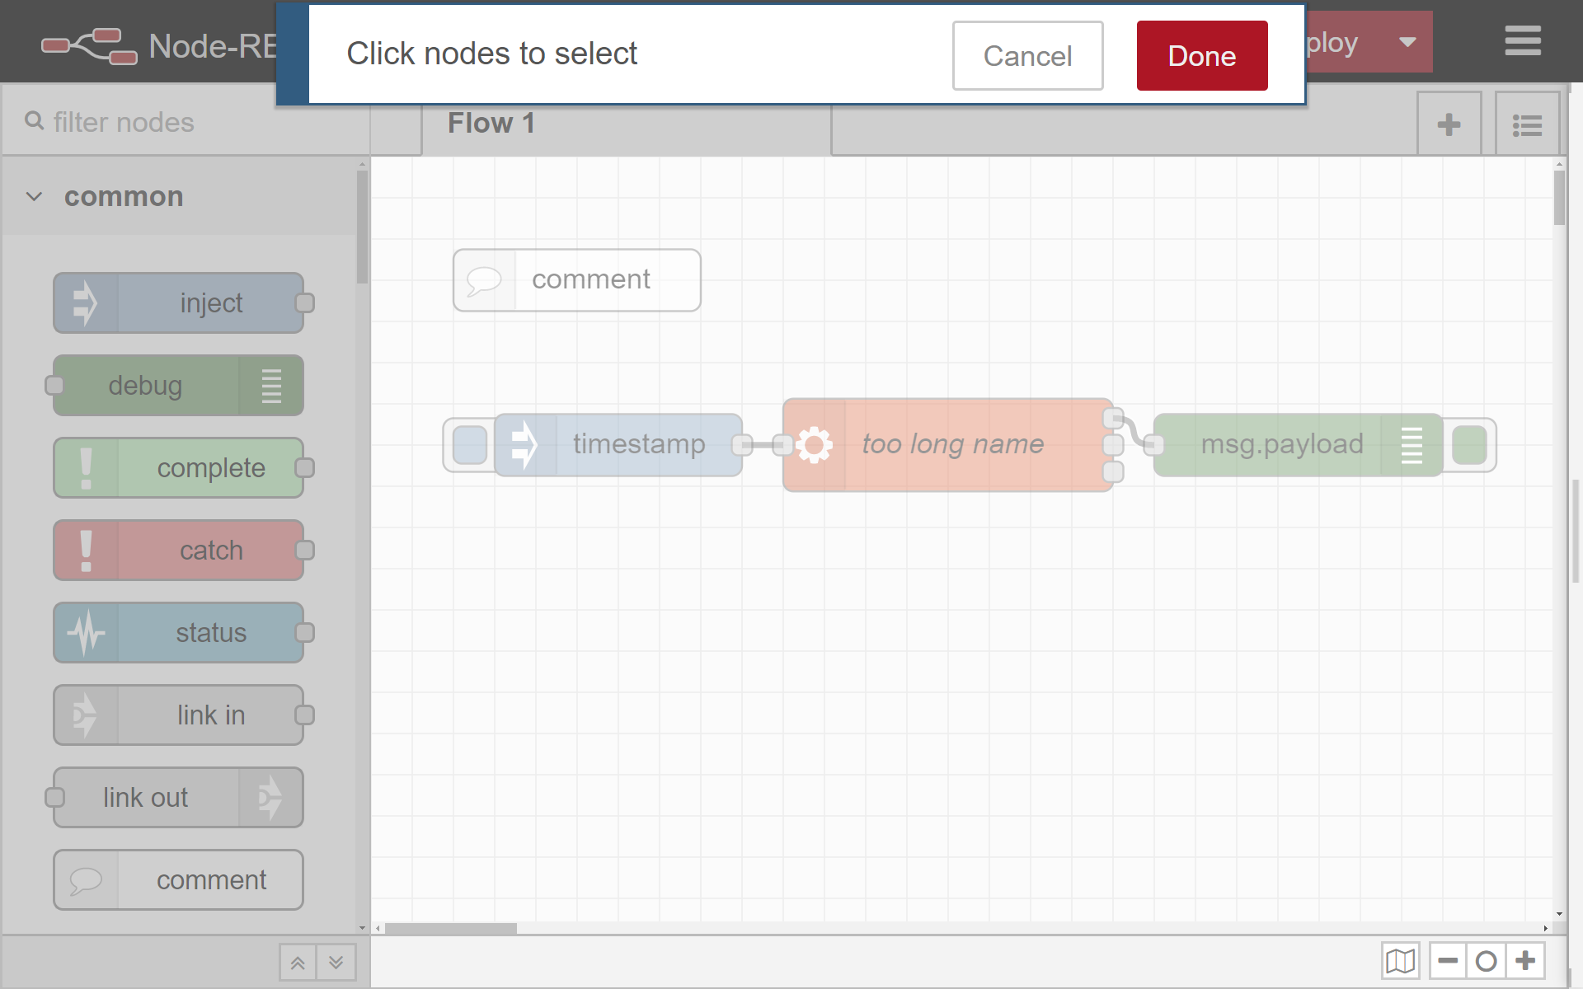
Additional idea: Selecting nodes enhancement
If node selection UI supports mouse dragging to select multiple nodes, it will be a more instinctive UI.
Drag to select nodes

