Slide 1
‘Timeout’ flows
Yuma Matsuura
Hitachi Solutions, Ltd.
Notes:
本資料では、フローテストの実行コマンドの仕様、詳細処理を共有する

Slide 2
Current Status
Design: https://github.com/node-red/designs/pull/14/files
Draft PR: https://github.com/node-red/node-red/pull/2377
Please comment and review this design.
Notes:
mochaで並列実行できるのであればそうしたい
現状はシングル

Slide 3
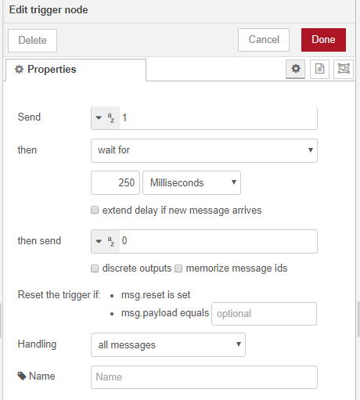
Enhancements of “trigger” node
A "trigger" node pass a message to the next node, and wait for the defined time to send a message again.
Adding options, which are "discrete outputs" and "memorize message ids", on the node, this node sends 2nd message to the other wired node, and memorise the message id in the flow context.
These options can be selected when "with for" is selected in the "then" property.
Notes:
mochaで並列実行できるのであればそうしたい
現状はシングル

Slide 4
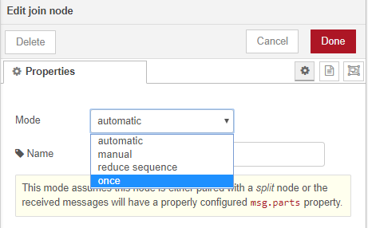
Enhancements of “join” node
A "join" node waits for multiple messages and combines them.
Adding an option on the node, this node behave an opposite action.
The node with “once” option will pass through a message to the next node only once.
After that, the node will ignore the same message.
Notes:
mochaで並列実行できるのであればそうしたい
現状はシングル

Slide 5
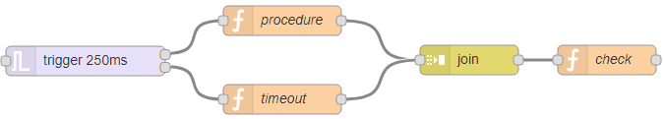
Example
In this case, the "trigger" node sends a message to the "procedure" node, and keeps its id in the flow context.
①The "procedure" node sends the message to the "join" node.
If the "join" node could find its id in the flow context, the message would be sent to the "check" node and the "join" node would delete the id in the flow context.
②After 250ms, the "trigger" node sends the same message to the "timeout" node, and the "timeout" node sends it to the "join" node. The "join" node cannot find the message id because the id was already deleted. The message will be ignored.
If the "procedure" node takes time, the "join" node sends a message from the "timeout" node to the "check" node. The "check" node checks where the message comes from. After that the "check" node will be able to deal with a timeout error.
①
②
check the payload
payload=“timeout”
Notes:
mochaで並列実行できるのであればそうしたい
現状はシングル

