Slide 1
Admin API
Hiroyasu Nishiyama

Slide 2
Updating & Exporting Admin API
We would like to make following changes on Admin HTTP API for installing initial flow from our template manager tool:
make POST /flows API to accept contents of flow.json and flow_cred.json
eliminates need to merge flow and credentials in advance
less susceptible to changes in flow format
make project related APIs public
currently 25 API for project manipulation are defined
among these, we only need POST /projects for our purpose
we think the following APIs are needed in many cases and do not deeply depend on git implementation:
GET /projects - get list of projects
POST /projects - create new project
DELETE /projects/:id – delete project
If these are acceptable, we would like to make PR (code & doc).

Slide 3
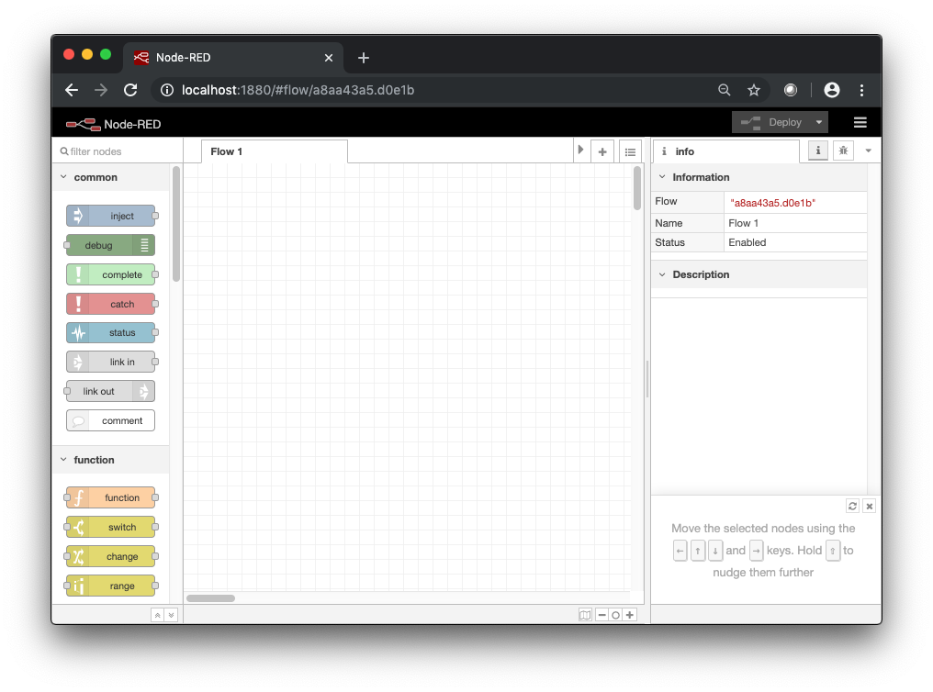
Use of Admin API in Template Manager
(3) Deploy flow to user env.
POST /flows
Node-RED-API-Version: v2
{
rev: "<<revision>>",
flows: [ <<nodes>> ],
credentials: { <<credentials>> },
credentialSecret: "<<secret>>"
}
Template
Manager
repository
deploy flow
Flow User
(1) Add flow to repo.
- flow.json
- flow_cred.json
...
want to remove dependency on
flow/credential
representation
(2) Create project for user env.
POST /projects?user=<<user>>
{
<<metadata>>
}
Flow Developer

