Slide 1
Exportable SUBFLOW
Hiroyasu Nishiyama

Slide 2
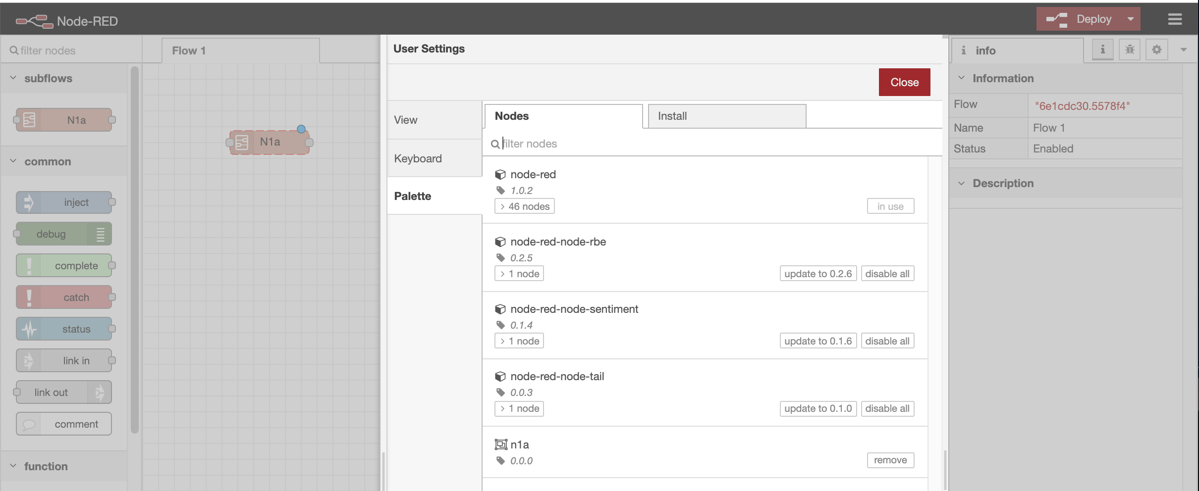
Exportable Subflow: Status
Not progressing well due to other, HITACHI internal, work.
Exporting & importing sealed subflow completed. Currently implementing phase 3:
- delete interface for sealed subflow, - error & recovery of unknown node within imported subflow.
sealed subflow w. error
sealed subflow entry

