Slide 1
Dashboard UI Module
Hiroyasu Nishiyama

Slide 2
UI Module: Status
Rethinking about proposal on UI Module discussed at last visit to Hursley
Initial Proposal:
Extend SUBFLOW to make it possible to contain UI widgets and its layout info.
Layout info. of SUBFLOW is included in SUBFLOW template/instance.
Latest Proposal:
Separate layout info. of SUBFLOW to ui_module config node.
Layout info. of a SUBFLOW is included in corresponding ui_module
Problem:
How to export/import UI Module?
Solution Idea
use first proposal (with some extension mechanism?)
extend dashboard/runtime to be able to export SUBFLOW+ui_module
create new placeholder node (ui_module_marker) that should be included in SUBFLOW of UI Module. ui_module_marker includes layout info. of corresponding SUBFLOW. ui_module config node is used to remember order property of SUBFLOW (UI Module) instance.

Slide 3
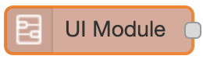
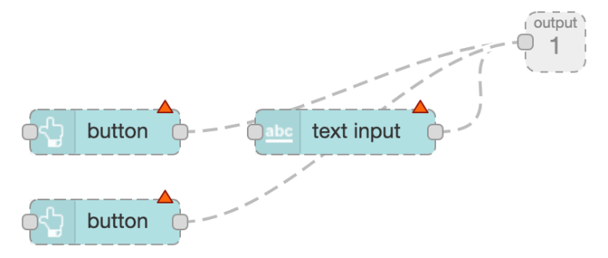
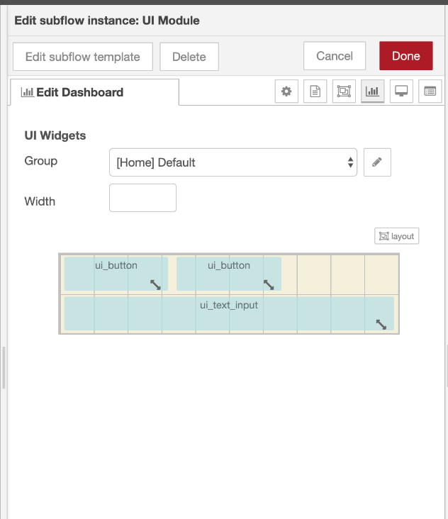
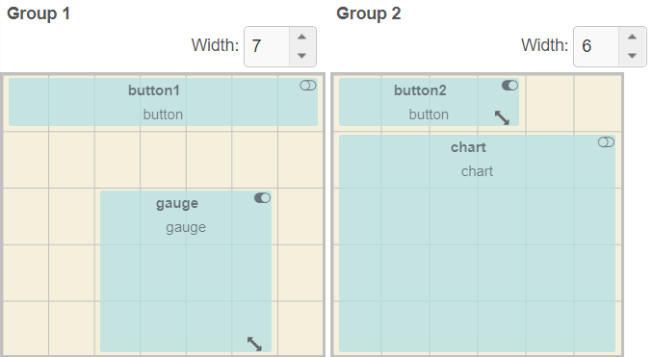
Proposals on UI Module layout
SUBFLOW template
SUBFLOW instance
SUBFLOW template
SUBFLOW instance
layout of contained UI widgets
layout (order) of UI Module
layout (order) of UI Module
marker
layout of contained UI widgets
(a) Extend SUBFLOW
SUBFLOW instance
ui_module
(c) Use Marker Node
layout of contained UI widgets + UI Module
export
JSON
(b) Extend Import/Export

Slide 4
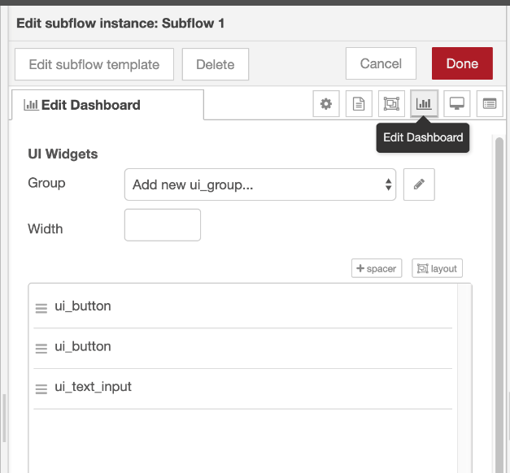
First Proposal: SUBFLOW as UI Module
Since UI Module consists of a set of nodes, using SUBFLOW as UI Module is natural extension
Add interface to specify internal layout of SUBFLOW
UI Module (SUBFLOW) has "Edit Dashboard" Tab in settings panel.
It can specify group, width, and layout.
Layout can be switched between order-based layout and GUI-based layout (toggle by layout button).
UI Module (SUBFLOW)
containing 3 widgets
(a) order mode
(b) layout mode
Settings Panel of UI Module

Slide 5
Latest Proposal#1
Node-RED editor and Dashboard should be kept independent.
One approach is to extend ui_group to have height information other is to introduce new kind of config node (e.g. ui_module) which contains layout information of corresponding SUBFLOW.
UI Module contains:
corresponding subflow: 1 to 1 relation
layout information: width, height, and order within widgets (or position)
target group and order in the group
UI widgets within SUBFLOW are ignored from layout candidate list of Dashbord (This may cause comatibility problem of existing flows)
Target group and layout information of UI widgets within a SUBFLOW can be set from UI Module settings panel

Slide 6
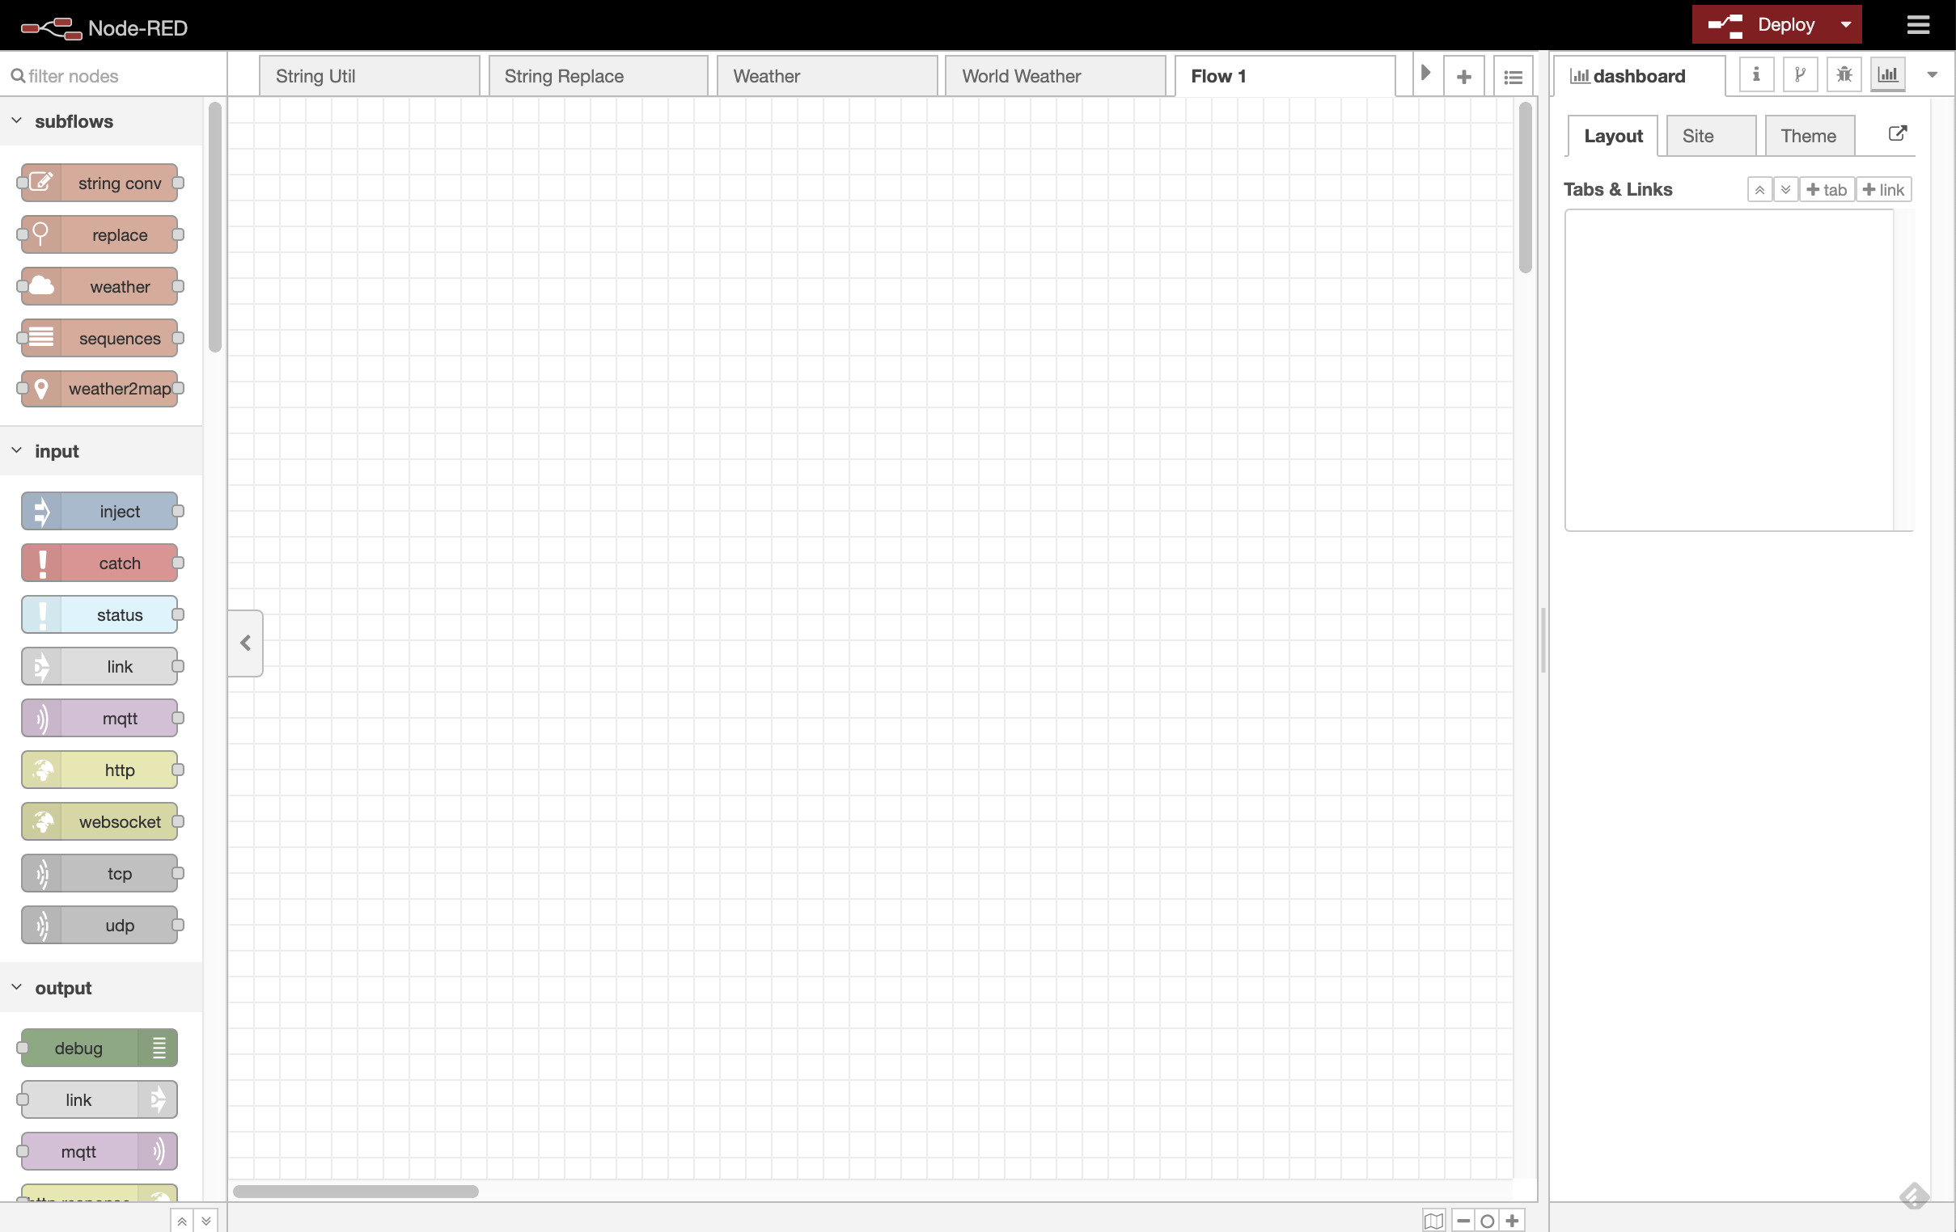

Latest Proposal#2
(2) push +SUBFLOW button
(1) place SUBFLOW instance
>TAB
>GROUP
+SUBFLOW
SUBFLOW
(3) push EDIT button
on SUBFLOW
(4) open SUBFLOW
edit panel
(5) set target group and layout of each UI widget
SUBFLOW information in Dashboard is represented by ui_module config node
ui_module can set following
corresponding SUBFLOW
pick one from list of candidates: SUBFLOW containing UI widgets not associated to other ui_module
layout information: width, height, and order of UI widgets within module
order mode and layout mode is provided
no UI is needed for specifying environment variable for dashboard group

