Slide 1
UI Module function prototype version
Kazuhiro Ito

Slide 2
Summary
A prototype version of the UI module function was created for the purpose of verifying the implementation.
In this prototype version, based on the following design notes, the addition of Config nodes and support for existing functions are implemented, and the layout function of UI modules and the display of widgets in modules on the dashboard are not implemented.
・ Design note URL
https://github.com/node-red-hitachi/designs/tree/ui-module/designs/ui-module
This document summarizes the outline of the modified parts of the prototype version, the operation procedure for checking the operation, and the extracted issues.

Slide 3
Modifications and operation flow
Since the UI module (subgroup template / instance) is automatically generated by the widget placed under the subflow, it is executed according to the normal subflow creation procedure.
* The layout in the UI module is implemented by editing the generated subgroup, but it is not implemented in this prototype. The dashboard display is blank.
1. Creation of subflow
Automatic generation of subgroup templates
2. Subflow instance placement
Automatic generation of subgroup instances
3. Edit subgroup instance / template
Prototype Modification
4. Layout and display on dashboard
(Display area of subgroup is blank)

Slide 4
Subgroup template generation (1/2)
Create a subflow and check that the subgroup template is automatically generated.
Create a tab [Tab1] and a group [Group1] on the dashboard in advance, and perform the following operations.
Operating procedure
1. Create a subflow [Subflow 1] and place a widget node.
Set the widget node to belong to [Tab1]-[Group1].
2. Click the Dashboard tab in the sidebar.
Confirm that the widget node is not displayed in [Tab1]-[Group1].
3. Click the Information tab in the sidebar.
Confirm that “[Subflow1]ui subgroup template” is registered in
[Subflows]-[Subflow1]-[Configration nodes]-[ui_subgroup_t] and can be edited.
・Note
The ID of the placed widget is set in the widgetOrder of the ui_subgroup_t node.
However, editing the layout has not been implemented yet.
Also, the size of the generated template, regardless of the size of the placed
widgets, is fixed at width 6 x hight 6.

Slide 5
Subgroup template generation (２/2)
Operation procedure *GIF animation

Slide 6
Add subgroup instance(1/2)
Place a subflow instance and verify that a subgroup instance is created automatically.
Operating procedure
Place a [Subflow 1] instance on the [Flow 1] tab.
Click the Dashboard tab in the sidebar. Confirm that there is no change in [Tab1]-[Group1].
Click the Information tab in the sidebar. Confirm that “[Subflow 1] ui subgroup instance” is registered in [Global Configuration Nodes]-[ui_subgroup_i] and can be edited.
４．Edit “[Subflow 1] ui subgroup instance” and make it belong to [Tab1]-[Group1].
５．Click the Dashboard tab in the sidebar.
Confirm that “[Subflow 1] ui subgroup instance” is added to [Tab1]-[Group1]
on the tab. Also, confirm that the edit screen of the “[Subflow 1] ui subgroup instance”
node opens by pressing the edit button.

Slide 7
Add subgroup instance(2/2)
Operation procedure *GIF animation

Slide 8
Subgroup layout change(1/2)
In the layout editor, make sure you can edit the placement of the subgroups.
Operating procedure
Click the Dashboard tab in the sidebar.
Select the Layout tab, select [Tab1], and press the [Layout] button.
The dashboard layout editor screen opens and makes sure that the subgroups are displayed with a fixed size widget.
When you change the layout and run the deploy, make sure that the dashboard shows blank areas for the subgroups. Also, make sure that the widgets in the subflow are not displayed on the dashboard.
*Note
In this prototype version, it is verified that the widgets in the UI Module(Subflow) are excluded from the placement.
Note that the flow does not work properly because the widgets placed in the
subflow are not displayed.

Slide 9
Subgroup layout change(2/2)
Operation procedure *GIF animation

Slide 10
Extracted issues
The following problems were identified in the operation verification of the prototype version.
When displaying the dashboard, information on the Subflow instance to which the widget to be displayed belongs is required, but the information cannot be obtained.
Importing ui_subgroup_t and ui_subgroup_i nodes does not update some node properties.

Slide 11
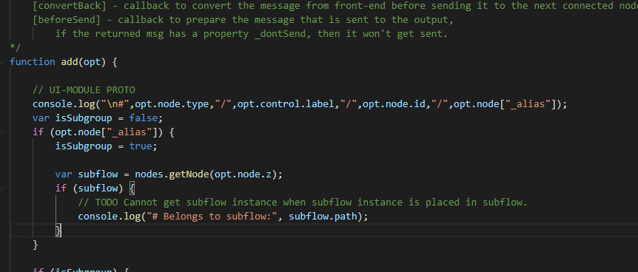
Extracted issues ＃１
When displaying the dashboard, information on the Subflow instance to which the widget to be displayed belongs is required, but the information cannot be obtained.
I want to get the information of the subflow to which the widget belongs from
the widget information of the add (opt) argument opt of ui.js and use it,
but in the RED.nodes.getNode () method, the "null" value is returned.
* The following functions are available in RED.nodes.
createNode(), getNode(), eachNode(), addCredentials(), getCredentials(), deleteCredentials(), registerType()
・getNode() ・・・Get node instance information
・eachNode() ・・・Get node definition information

Slide 12
Extracted issues ＃１
By modifying RED.nodes getNode (), it became possible to get a Subflow instance.
$ diff -c node-red-1.1.3/packages/node_modules/@node-red/runtime/lib/nodes/flows/Flow.js
node-red-test/packages/node_modules/@node-red/runtime/lib/nodes/flows/Flow.js
*** node-red-1.1.3/packages/node_modules/@node-red/runtime/lib/nodes/flows/Flow.js 2020-08-05 22:59:25.000000000 +0900
--- node-red-test/packages/node_modules/@node-red/runtime/lib/nodes/flows/Flow.js 2020-09-10 16:19:08.590920800 +0900
***************
*** 26,31 ****
--- 26,33 ----
var nodeCloseTimeout = 15000;
var asyncMessageDelivery = true;
+ var subflow_instaces = {}; // UI-MODULE TEST
+
/**
* This class represents a flow within the runtime. It is responsible for
* creating, starting and stopping all nodes within the flow.
***************
*** 208,213 ****
--- 210,218 ----
node
);
this.subflowInstanceNodes[id] = subflow;
+
+ subflow_instaces[id] = subflow; // UI-MODULE TEST
+
subflow.start();
this.activeNodes[id] = subflow.node;
***************
*** 371,376 ****
--- 376,387 ----
// Node not found inside this flow - ask the parent
return this.parent.getNode(id);
}
+
+ node = subflow_instaces[id]; // UI-MODULE TEST
+ if (node) { // UI-MODULE TEST
+ return node; // UI-MODULE TEST
+ } // UI-MODULE TEST
+
return undefined;
}
Save the generated subflow instance before calling the widget
node ui.add ().
RED.nodes.getNode (<subflow instance ID>) can be used to
get it.
Log output example in prototype version
# Belongs to subflow: f380c40.ec0534/db1d9ba1.94a228
From the path of the Subflow instance, the path (red part) of
the parent-child relationship of the subflow instance to which
the widget belongs can be obtained and can be used to specify
the position when laying out the module.

Slide 13
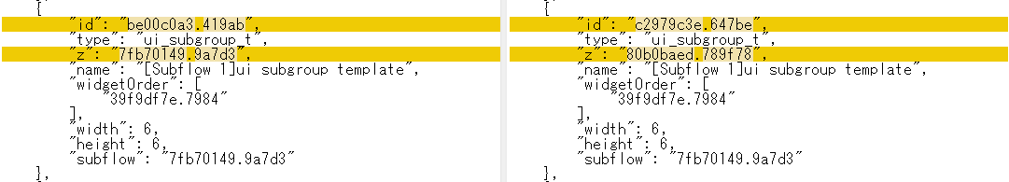
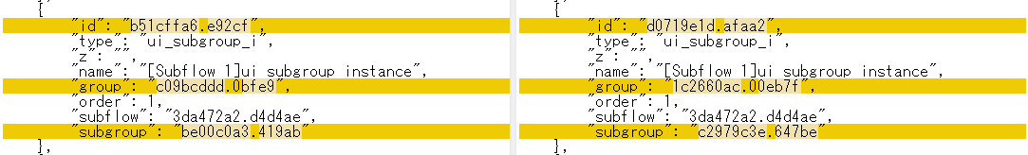
Extracted issues # 2
When importing ui_subgroup_t and ui_subgroup_i nodes, the IDs of some renumbered node properties are not updated.
* This is because the RED.nodes.import () function does not support ID update (remap) of widget node and subflow node references, and it may be necessary to support it.
[ ui_subgroup_t flow JSON ]
Before import
After import
Widget ID of widgetOrder and
ID of Subflow template are not
updated.
[ ui_subgroup_i flow JSON ]
Before import
After import
The ID of the Subflow instance
is not updated.
* Since "subgroup" is a config node, it was possible to update the ID.

