Slide 1
Exporting SUBFLOW as Node
Hiroyasu Nishiyama

Slide 2
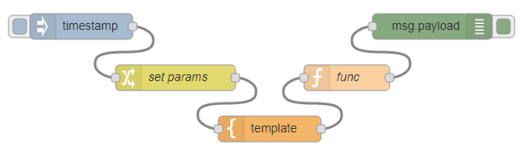

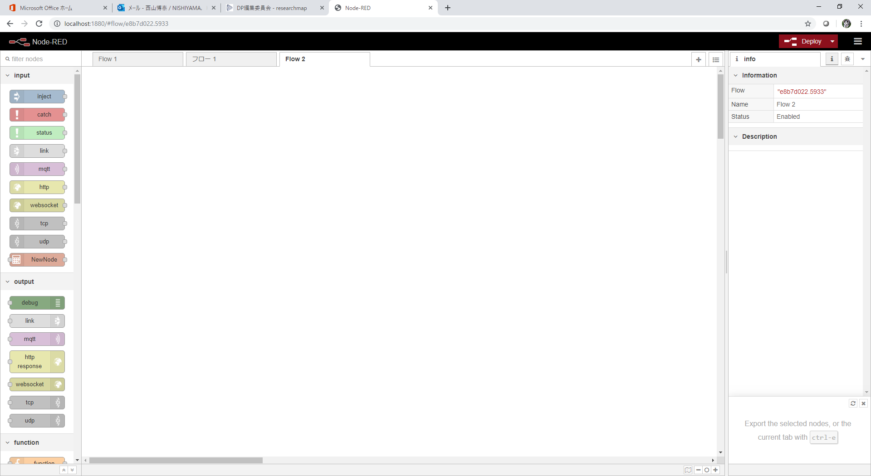
Sharing Process of Node & SUBFLOW
current proposed
future
export
JSON
SUBFLOW
template
(exported)
SUBFLOW
template
add
convert
JS+ HTML+ ...
better name?
(SUBFLOW module. SUBFLOW package)
import
(copy&paste)
flow library?
(SUBFLOW) Node
import
(copy&paste)?
npm publish
JS+ HTML+ ...
npm publish
install
Node
NPM repo.
Node-RED editor

Slide 3
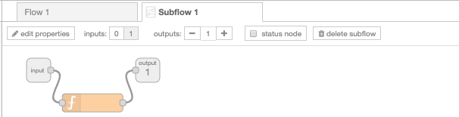
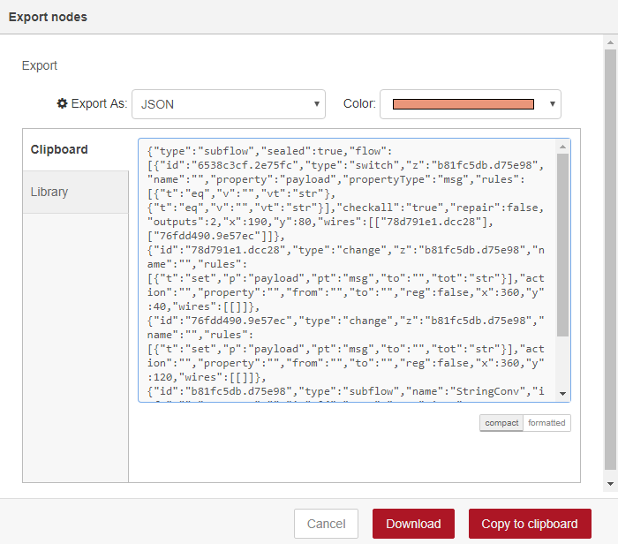
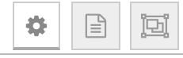
SUBFLOW Export Process
Add interface for providing node information of SUBFLOW to "Edit subflow template" panel.
Subflow Export dialog can be opened from "Subflow template" or new "Edit subflow template" panel.
Export button in "Subflow Export Dialog" is disabled if required field of "Edit subflow template" Panel is not filled.
export ...
Subflow template
JSON
Edit Info
export ...
Name
node-red-...
exported
SUBFLOW
template
Version
0.1.0
Author
nisiyama
License
Apache 2.0
Keywords
node-red, ...
Description
...
Subflow Export Dialog
Sealed
Include All
Edit subflow template Panel

Slide 4
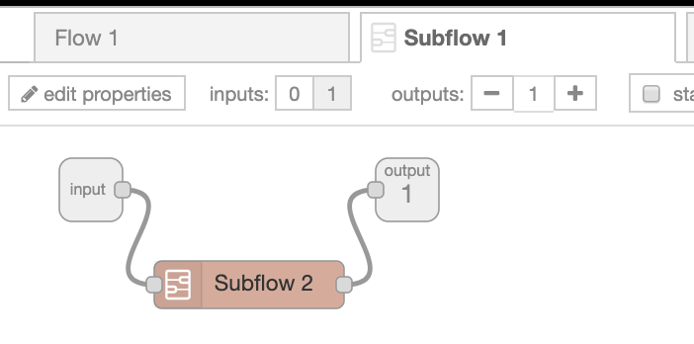
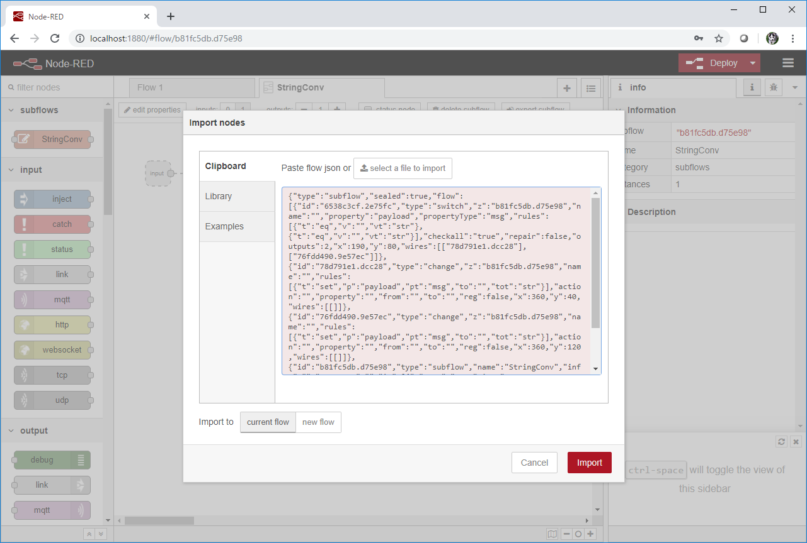
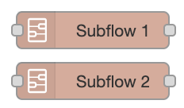
Exporting Nested SUBFLOW
Export only "Subflow 1"
(if "Include All" not checked)
Subflow template (Subflow 1)
[Subflow 1 uses Subflow 2]
"Subflow 2"
become missing
Export "Subflow 1" and used subflows
(if "Include All" checked)
When exporting a SUBFLOW in sealed mode, other SUBFLOWs used in exported SUBFLOW can also be exported when "Include All" is checked.
If the exported SUBFLOW is sealed, internally used SUBFLOWs are hidden from palette.
"Subflow 2" imported but hidden

Slide 5
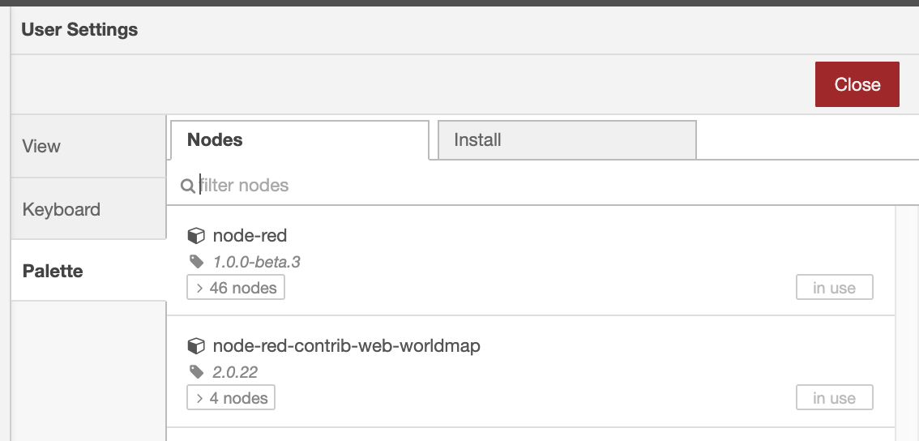
Uninstalling SUBFLOW
JSON
Import "Subflow 1"
node-red-...
exported
SUBFLOW
template
remove
Uninstall "Subflow 1"
All imported SUBFLOW templates are listed on Nodes list of "manage palette" panel.
Imported SUBFLOW template can be uninstalled from the palette.
If subflow is not sealed, it can also be uninstalled using "delete subflow" button of its edit tab.
If imported subflow is sealed and "include all" is checked, all imported subflow is uninstalled when top level subflow is uninstalled.

Slide 6
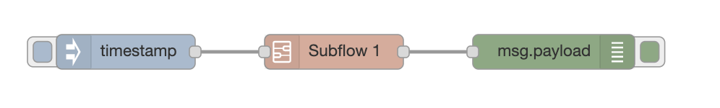
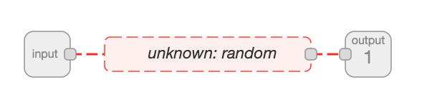
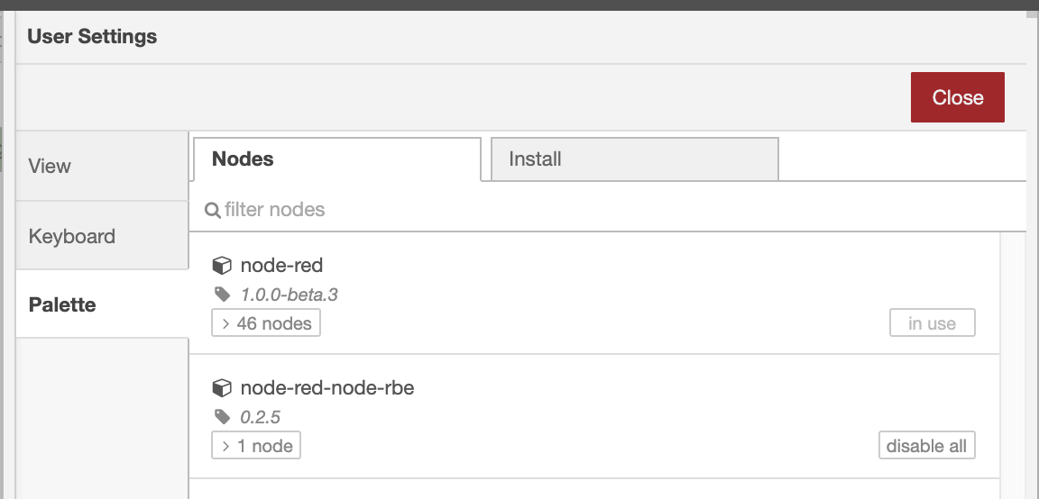
Unknown Node in Sealed SUBFLOW
Imported SUBFLOW Template
not sealed
sealed
Edit template
When sealed SUBFLOW template is imported, if nodes contained in the template are not installed, imported SUBFLOW template appear with dotted line similar to unknown node on Node-RED Editor and are disabled.
List of nodes contained in SUBFLOW but not installed can be found in Manage palette/Palette/Nodes list.
nod-red-contrib-subflow
unknown node:
random
Imported SUBFLOW Template

