Slide 1
Dashboard layout tool
Kazuhiro Ito

Slide 2
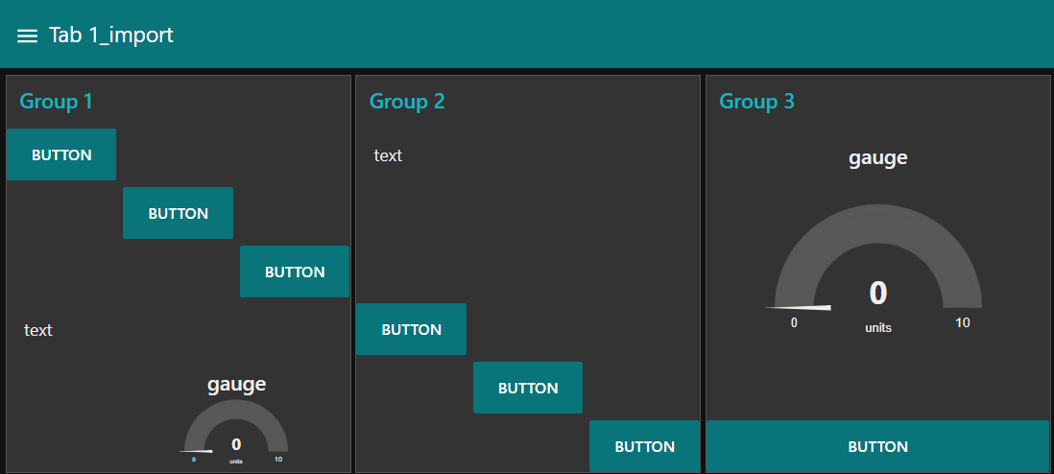
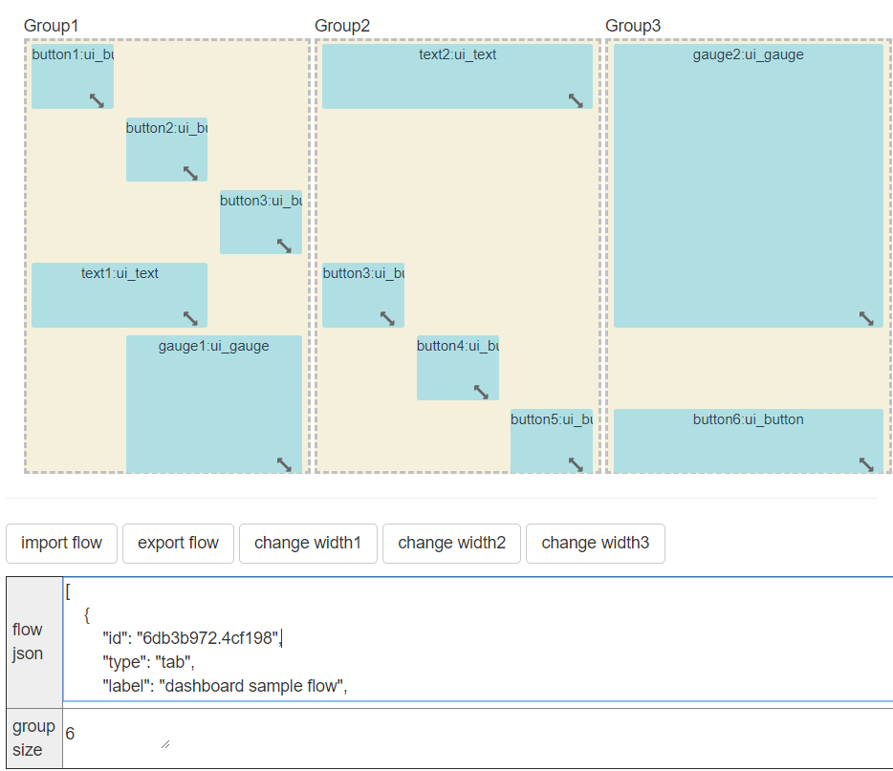
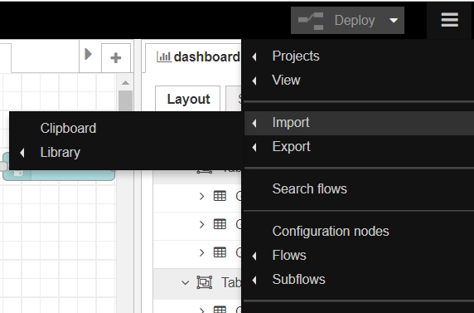
Layout editing tool prototype
We have created prototype of layout editing tool.
Using the tool, We confirmed that the dashboard layout can be edited by editing the ui_xxxx node information contained in the exported flow.json.
■Layout editing tool prototype
Gridstack_demo_group.html
[HTML+JavaScript(gridstack.js)]
4. Layout is reflected on
dashboard screen.
1. Edit layout information of
exported flow.json.
2. Output flow.json reflecting
the edited layout.
3. Import the flow.json
which output at tool.

Slide 3
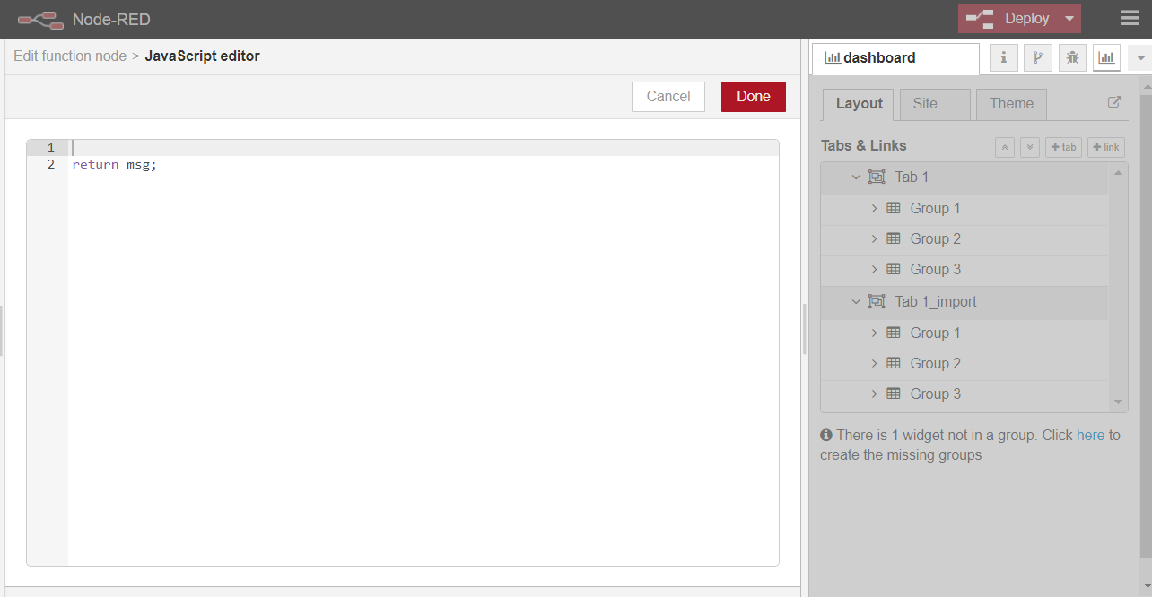
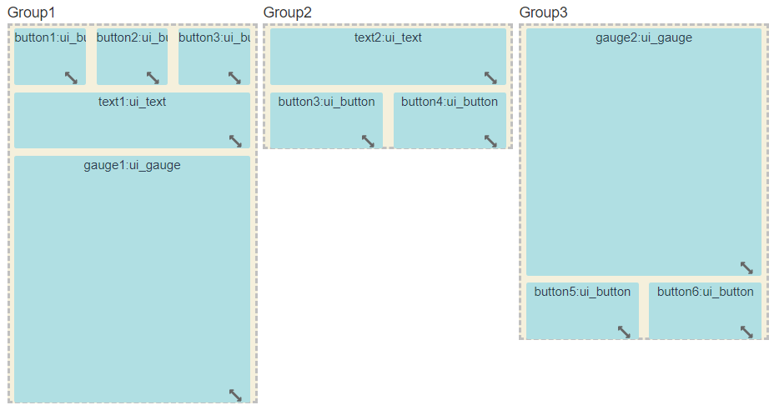
Implementation of layout editing screen
How to incorporate layout editing tools into node-red-dashboard.
Add layout editing screen to dashboard sidebar 'ui_base.html'.
Editing the layout by editing the node information held by the RED object. ‘RED.nodes.node () which is data corresponding to flow.json.’
Reflect the edited layout on the dashboard screen with the deploy button.
‘There is no implementation change.’
dashbord > layout editor
Reflect the edited layout with
the deploy button.
2. Edit the information of RED object
and change the layout.
Added layout editing
screen implementation.
“Additional Screen”
Layout edit screen

