Slide 1
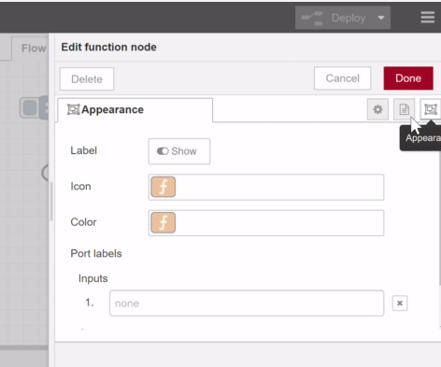
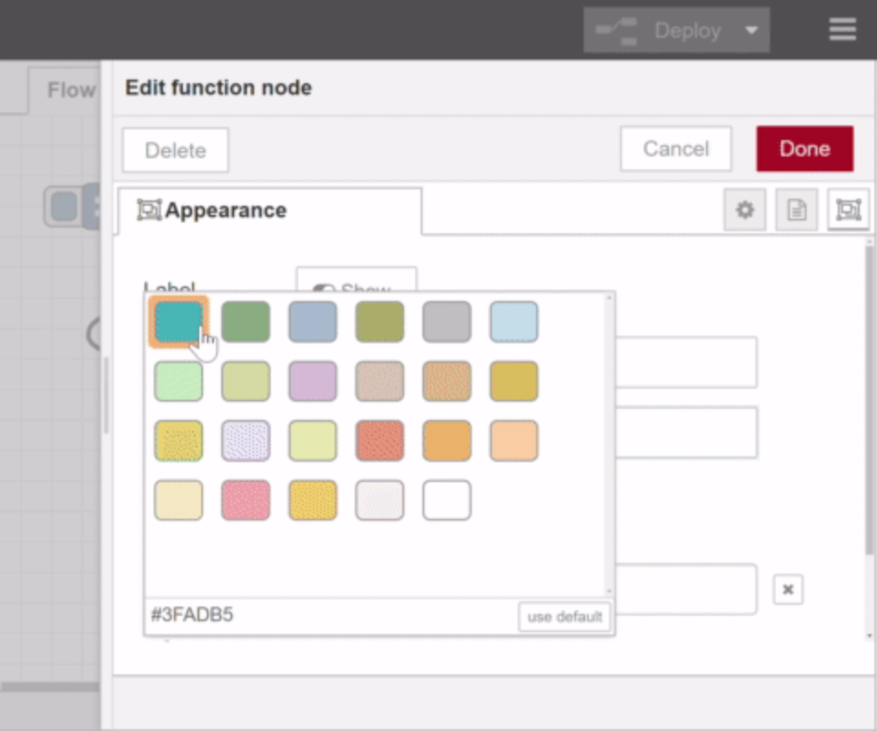
Changing subflow node’s color
# | Question
1 | Can I add the function to change the node’s color for subflow UI?
I misunderstood that changing the node’s color is for all nodes.
I’d like to suggest the function for only subflow node because I heard that changing node’s color function is for subflow.
Node-RED users can change node color.
(The screenshot is for function node)

Slide 2
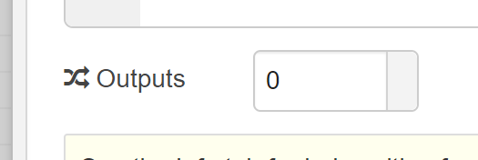
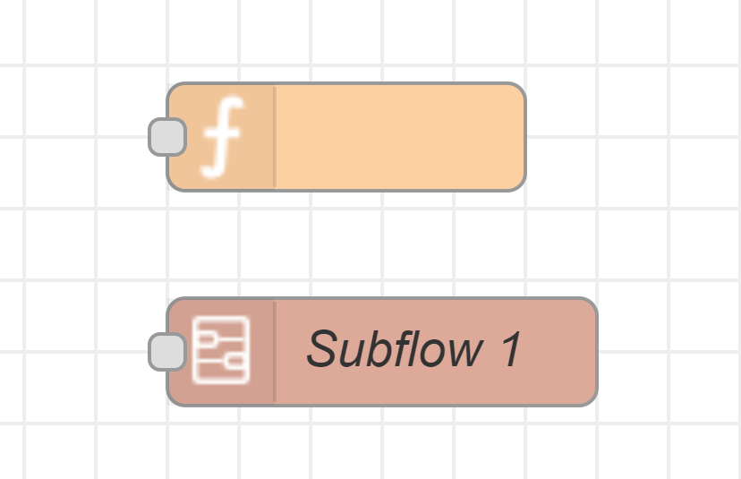
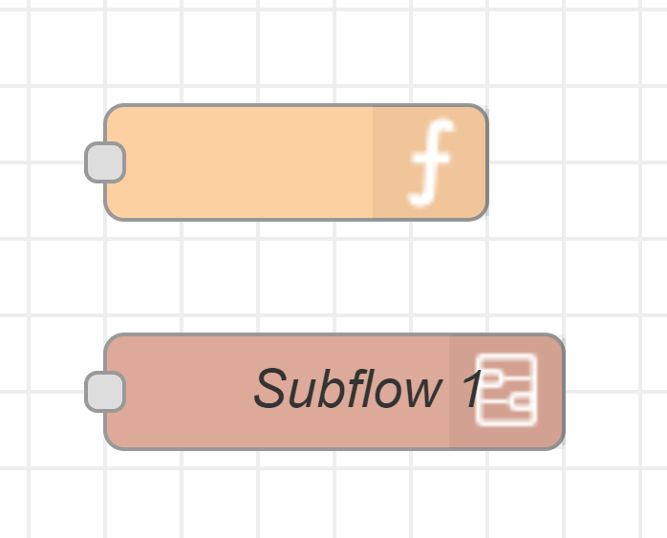
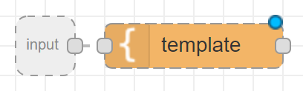
Automatic placing of node icon
# | Question
1 | Can I add the automatic placing functionality for subflow and function nodes?
[Current] Right port disappeared but the icon location isn’t changed.
[To be] Icon will be placed on the right side.
When a user set “0” in outputs
When the subflow uses input only

