Slide 1
Standalone Node-RED
2020/04/28
Kazuhito Yokoi

Slide 2

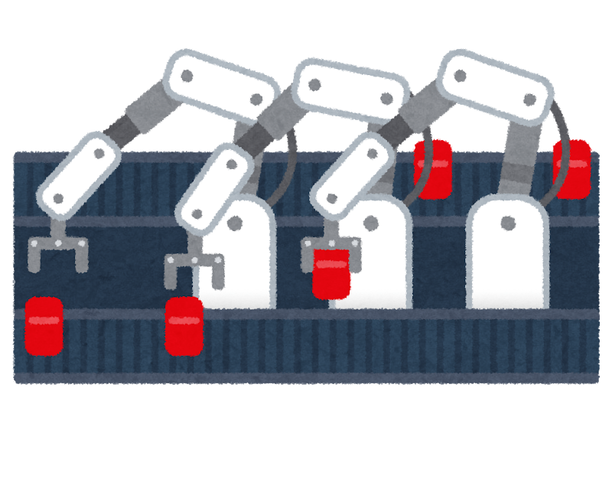

Background
Offline installation is needed for edge environments.
The first requirements in the offline installation
- Packaging of Node-RED and nodes
- Version up without internet connections
There are two methods for offline installation.
- Method 1: Docker image
- Pros: Packaging and updating operations are simple.
- Cons: Docker environment is required.
The Container should be restarted to connect new devices.
- Method 2: Standalone Node-RED
-> We’d like to discuss it using this slide.
Internet
Edge
environment

Slide 3
Use cases and discussion points
We considered four use cases in the standalone Node-RED.
[Discussion points]
Requirements and suggestions in use case 1 which we focus on
Suggestion about windowless mode related to the use case 4
[Use case 1]
Standalone application for flow development
[Use case 2]
Edge gateway tool
to handle sensor data
[Use case 3]
Dashboard app
as portable
[Use case 4]
BaaS which provides REST API
Local PC
Edge gateway
Kiosk PC
BaaS server
Flow editor
Flow editor
Dashboard
REST API
Access
Gitlab
Handle data
Mobile
app
Sensor
DB
Touch UI
Develop flow
Flow developer
Dashboard user
OT engineer
Administrator

Slide 4
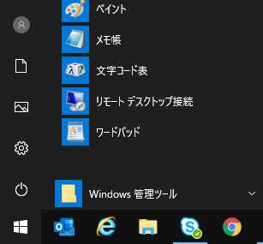


Requirement: Installer / portable application
There’re two types for the distribution of the standalone Node-RED.
Installer
- Beginner users can install Node-RED without CLI operations.
- Easy update using installer including nodes.
Portable application
- It is suitable for the shared PC. Especially, environments where the installation is restricted by administrator or organization policy.
Update using installer
The flow data is saved
in the same file path.
Install
Uninstall
flow
setup1.0.5.exe
Node-RED
Install
setup1.0.6.exe
Installer
Portable application

Slide 5
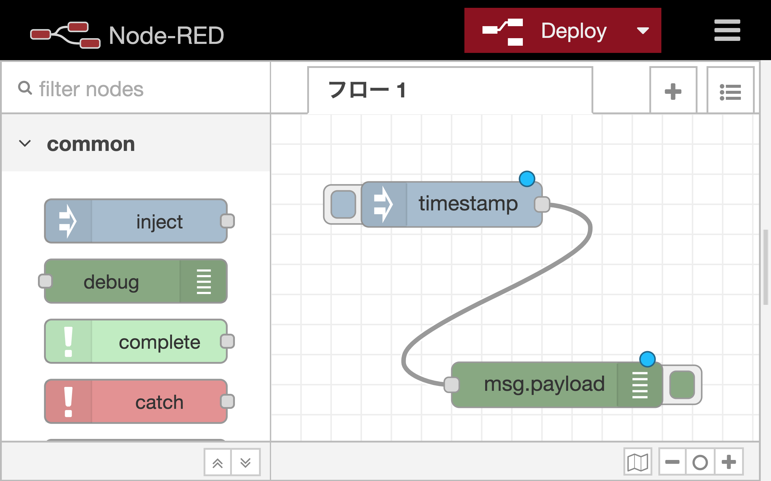

Suggestion: Limited access to flow editor
To prohibit access from unknown users to the flow editor
in desktop mode, the random path (or port number) is needed.
Node-RED
x
URL which contains a random path to avoid accesses from other users
Flow developer
Access the flow editor via http://localhost:1880/<random string>
Mobile
app
Normal access
Admin API
REST API
Runtime
Prohibited
Other users

Slide 6

Suggestion: Enabling browser access to flow editor
When users want to use the old version of Node.js
but they use the latest browser, the windowless mode may be ideal.
Use can use the latest Chrome
Electron releases
Flow developer
x
# | Electron | Chromium in the electron | Node.js in the electron
1 | v3.0.0 | v66 | v10
2 | v4.0.0 | v69 | v10
3 | v5.0.0 | v73 | v12
4 | v6.0.0 | v76 | v12
5 | v7.0.0 | v78 | v12
6 | v8.0.0 | v80 | v12
7 | v9.0.0 | v83 | v12
No window
Chrome v83
Mobile
app
Normal access
Normal
access
If the node requires
the old Node.js,
the browser engine
also becomes old.
Runtime
Admin API
REST API
https://www.electronjs.org/docs/tutorial/electron-timelines
Node.js v10

Slide 7
Requirement: Logging
To record errors, the standalone Node-RED saves the information
to log files at the appropriate location in each OS.
Node-RED
x
The distributor can
investigate the reasons
why problems occurred.
Flow developer
Logs
Provide log
Log file
Distributor

Slide 8
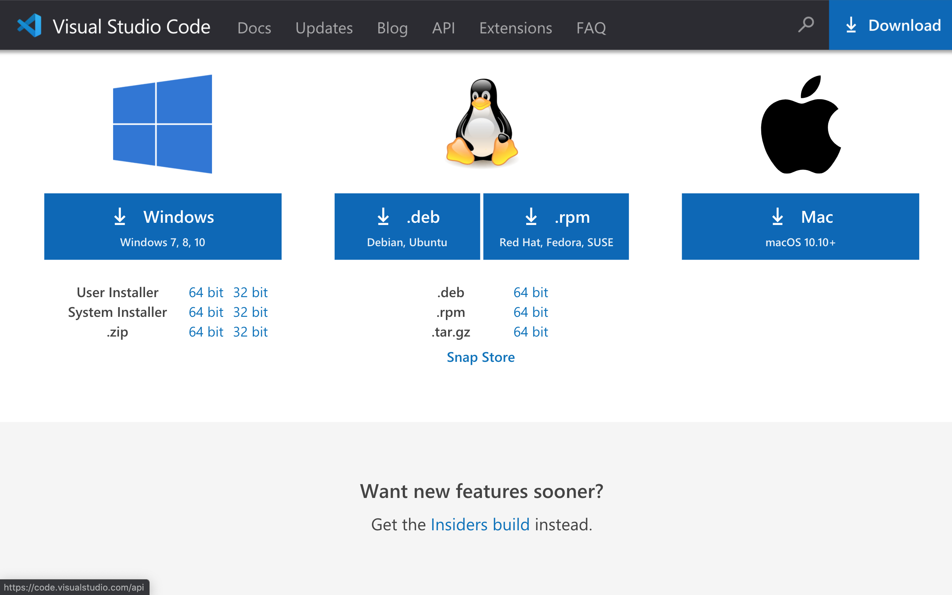
Requirement: Supported OS
# | Question
1 | The supported OS and formats are enough?
Supported OS and formats
[F.Y.I.] Supported OS and formats in VS Code
# | OS | format
1 | Windows | Installer
2 |  | Portable exe
3 | macOS | dmg installer
4 | Raspbian (only for ARMv7 CPU) | AppImage
5 | Ubuntu | deb file
6 | RHEL | rpm file
https://code.visualstudio.com/#alt-downloads

Slide 9
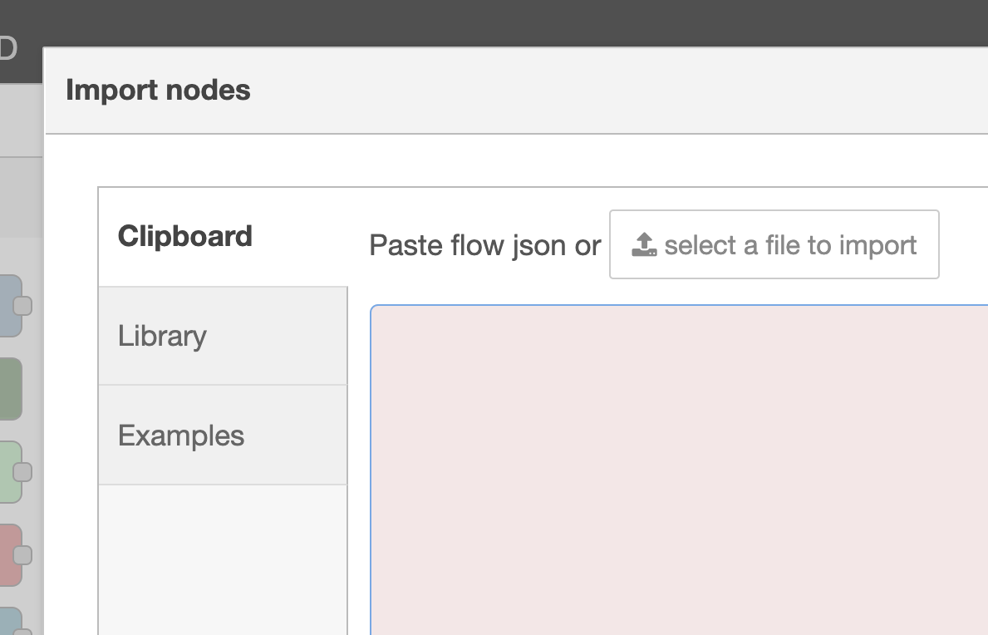
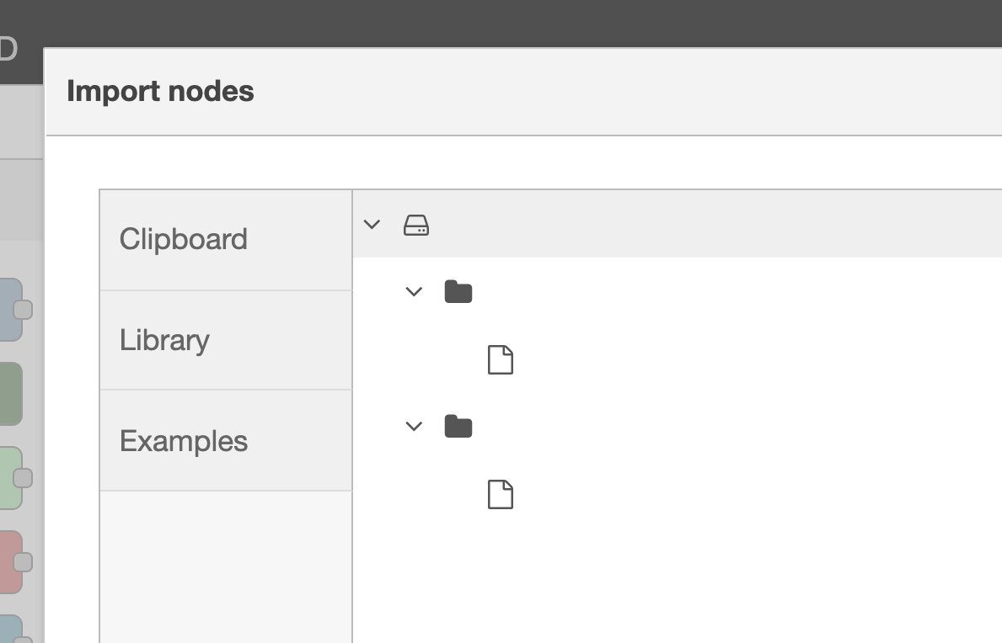
Suggestion: Integration with file system (1/2)
The file explorer is suitable for the following dialogs in the desktop application.
Import/export nodes dialog
Library dialog
Project feature
Users can see files
on the flow editor.
C:¥
dir1
flow1.json
dir2
flow2.json
Move the functionality to tab
in desktop application mode
Explorer
File explorer in flow editor

Slide 10
Suggestion: Integration with file system (2/2)
File association
After opening flow JSON file in explorer, the standalone Node-RED starts to edit the flow.
When clicking the deploy button, the Node-RED saves the flow.
When closing the window without saving the flow, the notification will be showed to save the flow or cancel closing.
Node-RED
x
Node-RED
x
flow.json
flow.json
Open
Save
Node-RED
x
Exit?
Save&OK
Cancel

Slide 11
Next step
# | Question
1 | Can I start to write the design note about the standalone Node-RED?

