Slide 1
Exportable SUBFLOW
Hiroyasu Nishiyama

Slide 2
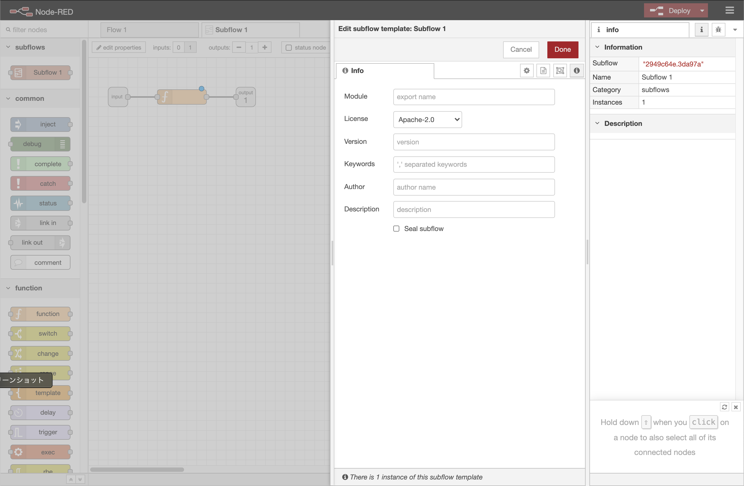


Exportable SUBFLOW
Currently following two implementation exists for Exportable SUBFLOW:
JSON-based import/export feature (HITACHI)
tgz-based import/export feature (IBM)
We do not care about either implementation. But, if (2) is adopted, SUBFLOW export feature including meta-data setting interface is required.
Required feature:
UI for metadata definition
UI for SUBFLOW export (SUBFLOW extraction, npm pack, and download)
Some implementation may reuse #1.
JSON
export
SUBFLOW+ metadata
currently no
implementation
tgz(npm)
import
SUBFLOW +
metadata

