Slide 1
Contribution of New Nodes
Kazuhito Yokoi,
Hiroyasu Nishiyama

Slide 2
Candidate Nodes
We would like to contribute following Node-RED nodes under node-red-nodes/node-red-ui-nodes created for out internal projects that seems to be commonly useful.
 | Name | Description
1 | ui_3d | UI widget node for displaying 3D objects using Three.js
2 | ui_iframe | UI widget node for displaying external Web page inline using iframe
3 | ui_speech_recog | UI widget node for speech to text recognition (STT) using Web speech API
4 | bitfield | Node for bit-field manipulation and byte order conversion

Slide 3
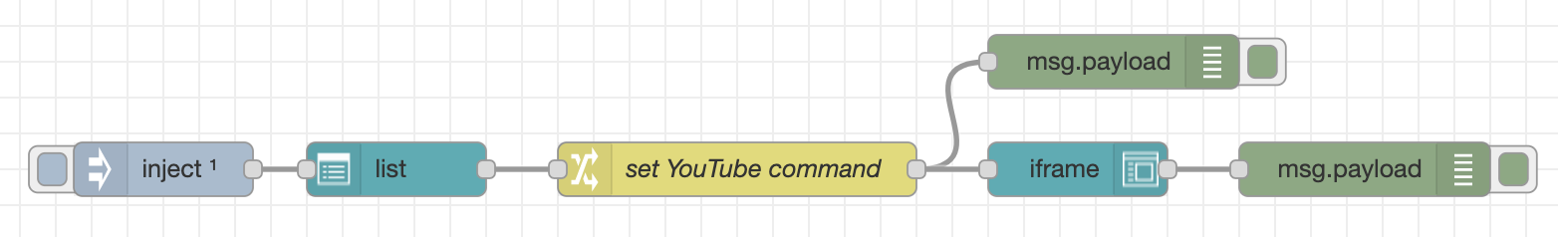
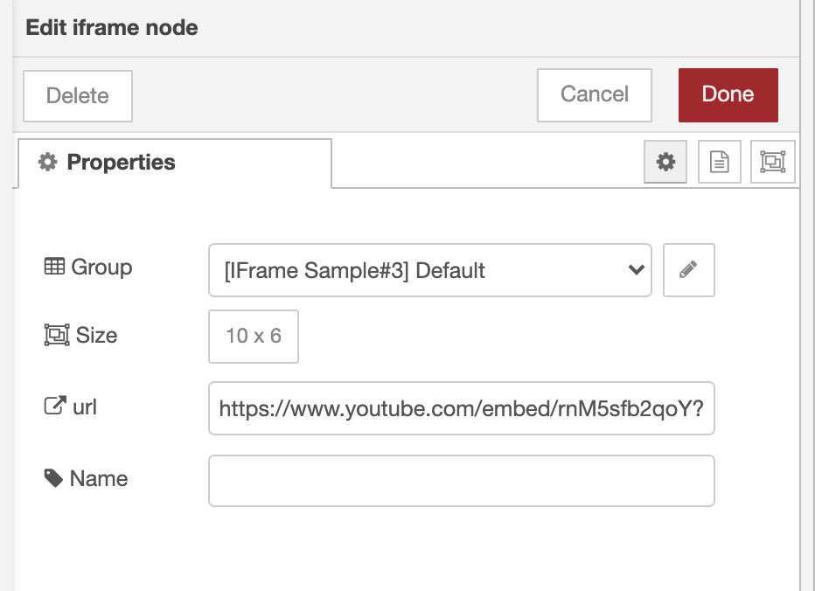
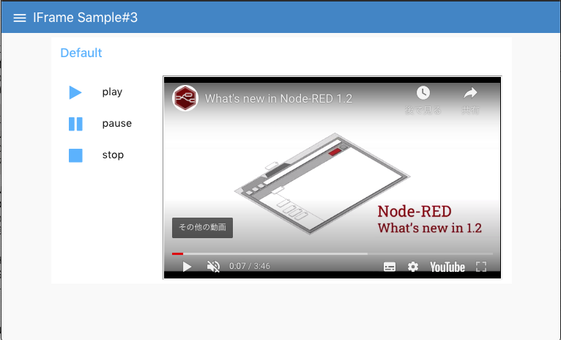
Node: ui_iframe
ui_iframe node allows embedding an external Web page on Node-RED dashboard
It also provides message passing mechanism to/from the embedded Web page using Web Messaging API
target URL
embed by iframe
Control using Web Messaging API
Node-RED Dashboard
YouTube Video

Slide 4
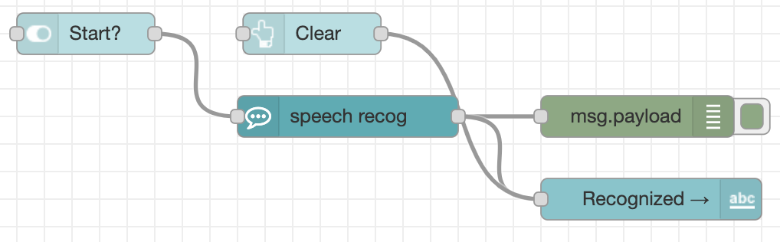
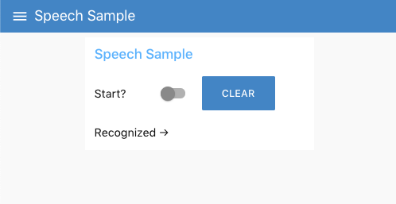

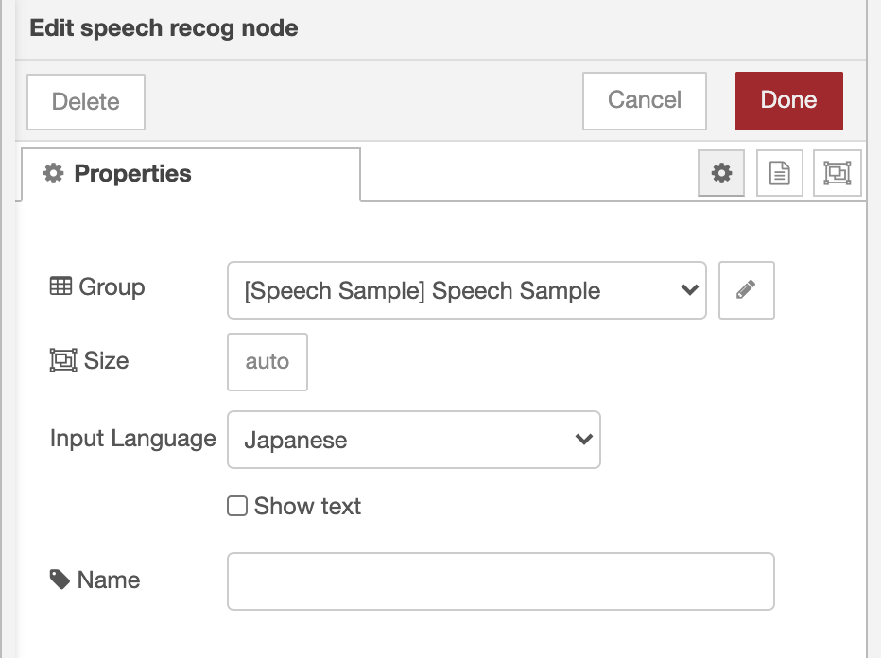
Node: ui_speech_recog
ui_speech_recog node allows speech to text recognition (STT) on Node-RED dashboard.
It uses Web speech API and audio input device connected to browser.
Node-RED Dashboard
Input Language

Slide 5
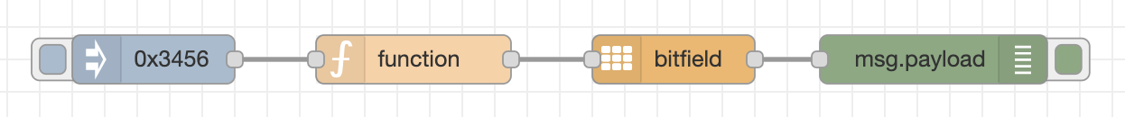
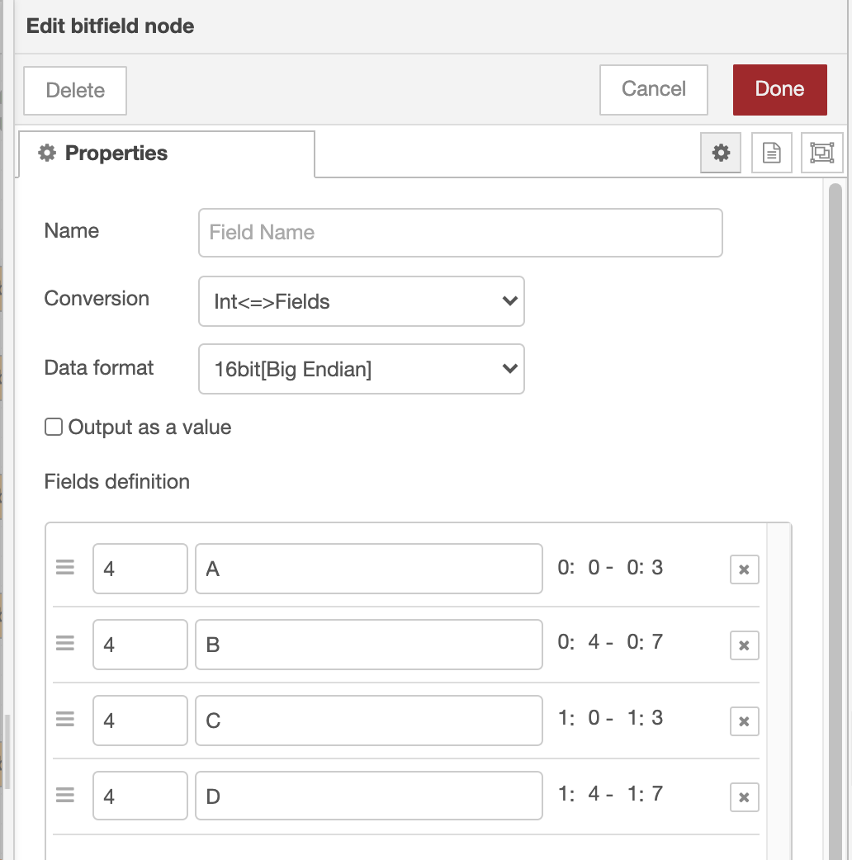
Node: bitfield
bitfield node allows bit-field manipulation and byte order conversion between integer value, integer array, an object containing field values.
Input: 0x3456
Output: an object
{
A: 3, B: 4, C: 5, D: 6
}
Type of Conversion
Fields definition

Slide 6
Demo
DEMO

