Slide 1
Flow Development Guideline

Slide 2
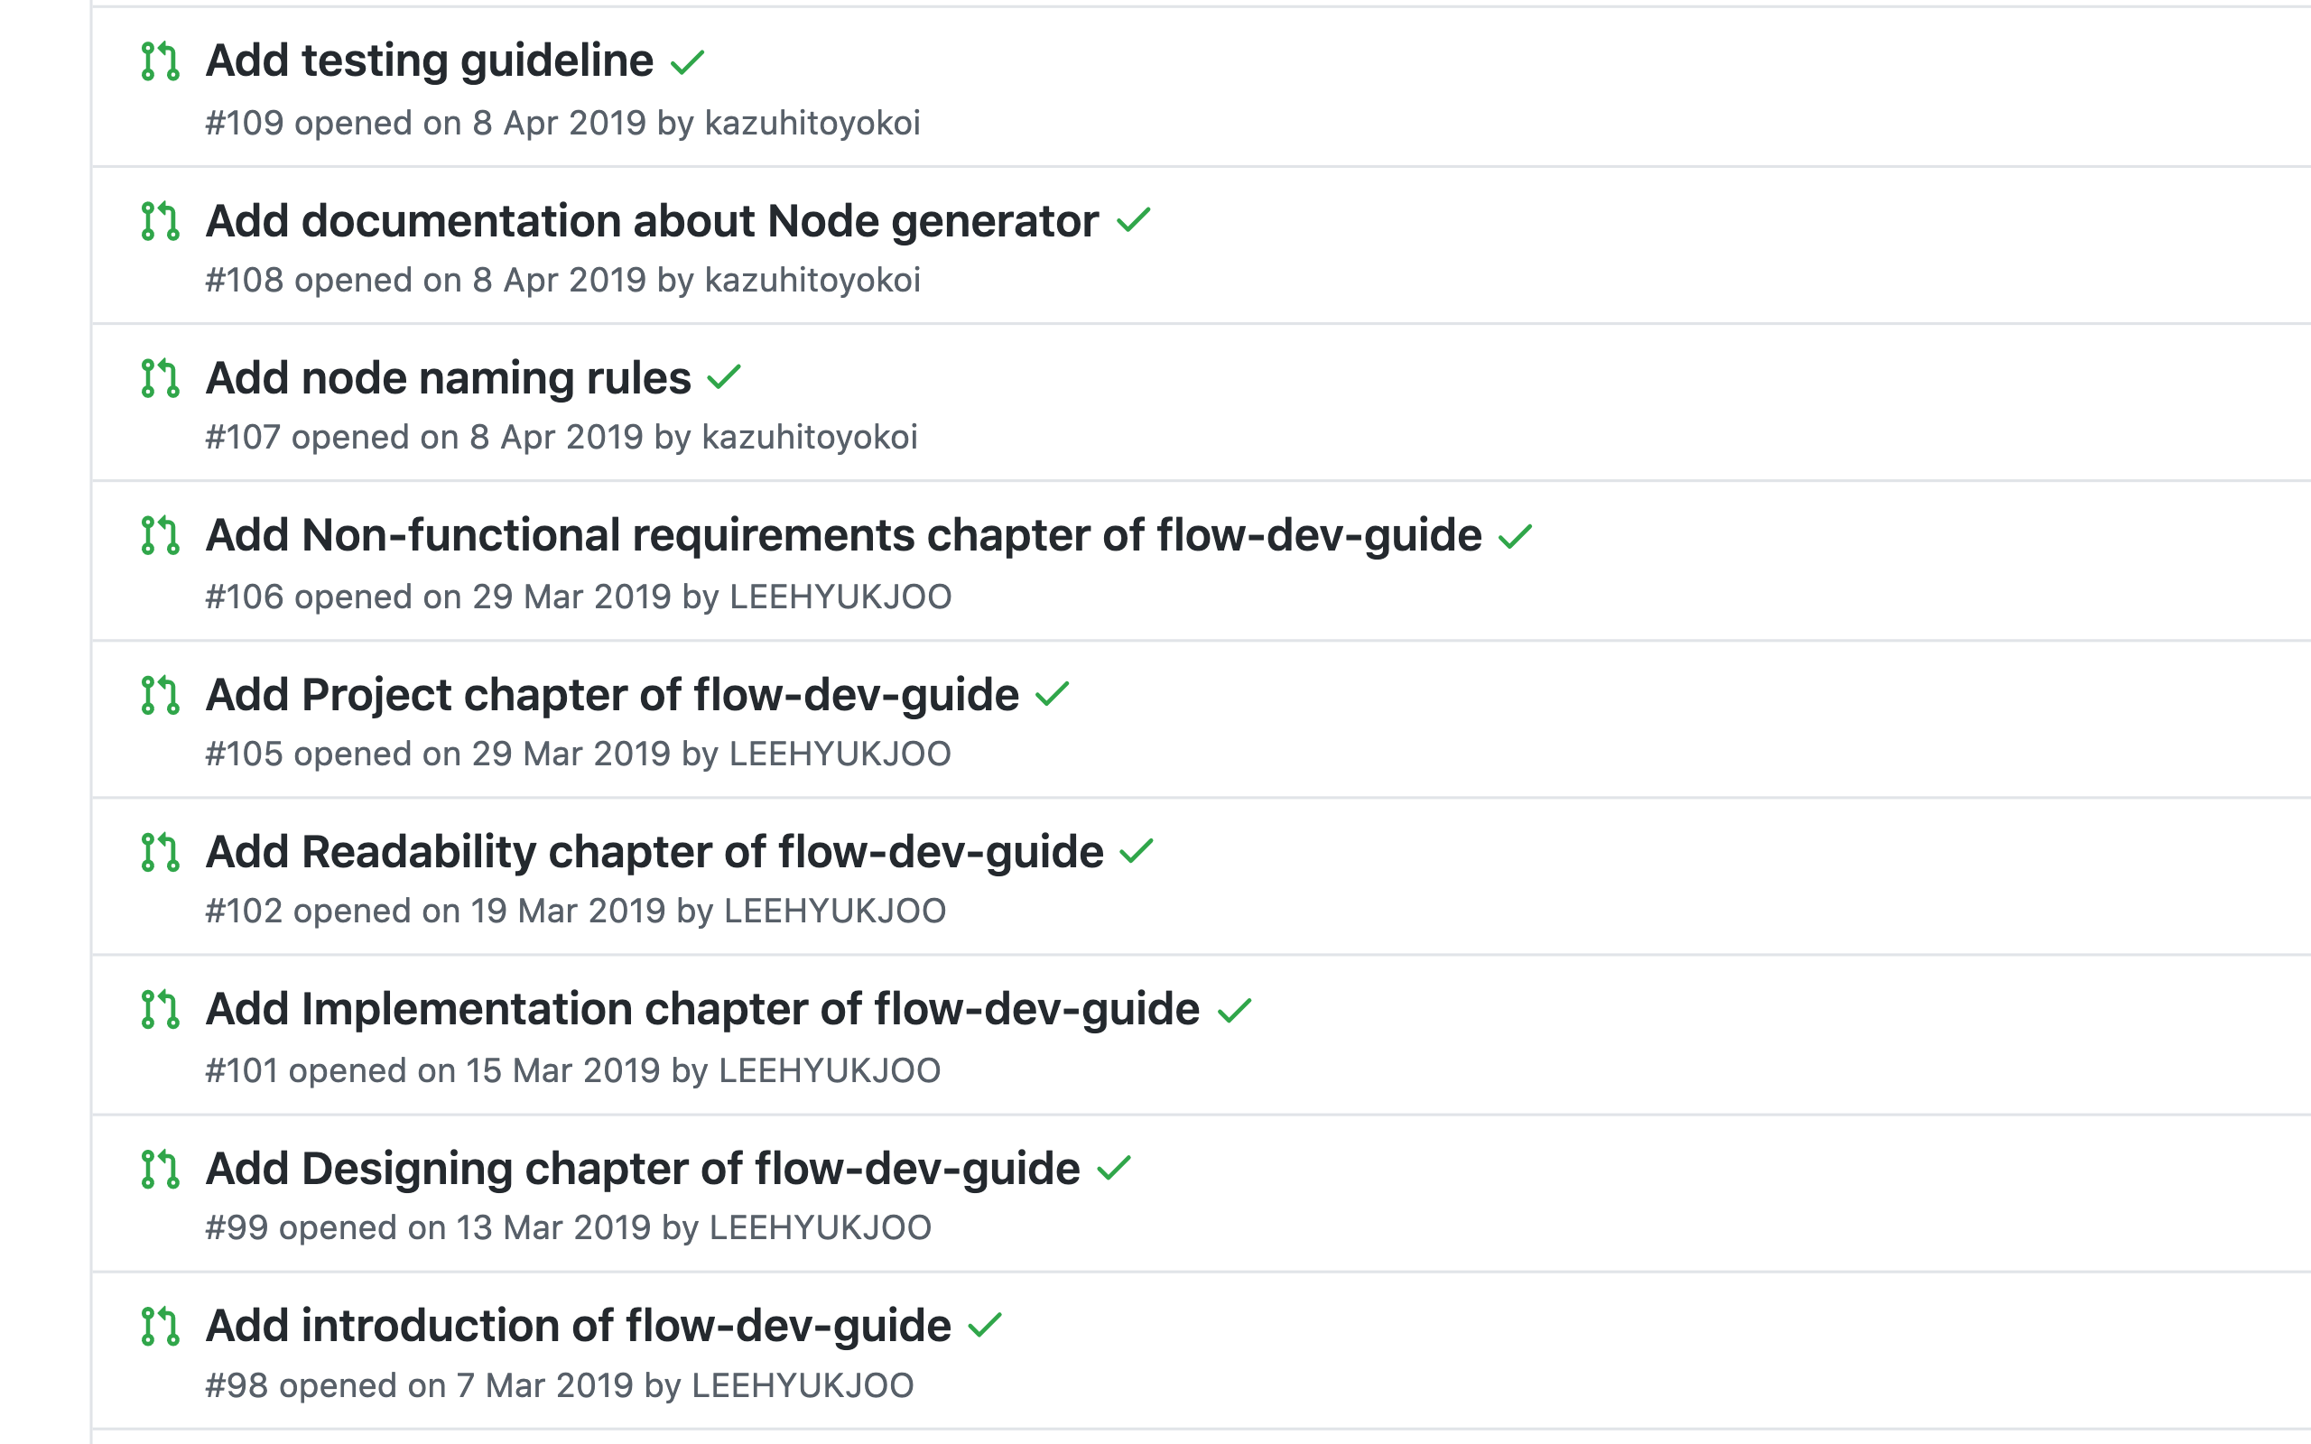
Flow Development Guideline
There’re 6 pull request related to flow development guideline currently.
https://github.com/node-red/node-red.github.io/pulls

Slide 3
Flow Development Guideline
[Yokoi’s opinion]
#105 and #106 need discussion to adopt as the official document.
#98, #99, #101, #102 are ready to merge or have discussions.
To merge them as step-by-step, I would like to divide one pull request to multiple pull requests by sections.
# | Pull requests | The number of lines | Discussions needed
98 | Add introduction of flow-dev-guide | +32 -4 | none
99 | Add Designing chapter of flow-dev-guide | +157 -25 | none
101 | Add Implementation chapter of flow-dev-guide | +159 -9 | none
102 | Add Readability chapter of flow-dev-guide | +282 -13 | none
105 | Add Project chapter of flow-dev-guide | +119 -5 | Method of team development
106 | Add Non-functional requirements chapter of flow-dev-guide | +84 -11 | Precautions due to single thread

Slide 4
Flow Development Guideline
[Tentative schedule]
By end of July: Yokoi will re-check the contents and divide the pull requests
By end of August: Review by Nick-san and Dave-san and merge of the acceptable contents
By end of September: Yokoi will add Japanese translations to nodered.jp website
# | Question
1 | Is the following schedule acceptable?

Slide 5
Standalone Node-RED

Slide 6
Scope of standalone Node-RED
Installer
- Installer setups Node-RED application to a user environment.
- Easy update using installer including nodes.
IDE
- The following behaviors are the same as the normal Node-RED.
- Flow deployment to local runtime
- Flow import and export via clipboard or file upload/download
- Project features
- JSON file association
- The standalone Node-RED opens the flow file using the JSON file association.
- The standalone Node-RED saves the flow to the opened file when deploying it or exiting the application.
Logging
- Flow developers can check the log on the event log window.
- For investigating error log by other users, the standalone Node-RED outputs the logs to files withe log rotate style.

Slide 7
Standalone Node-RED
# | Question
1 | Is the scope document OK?
2 | Can I start to develop the simplest implementation?

